Slide 1
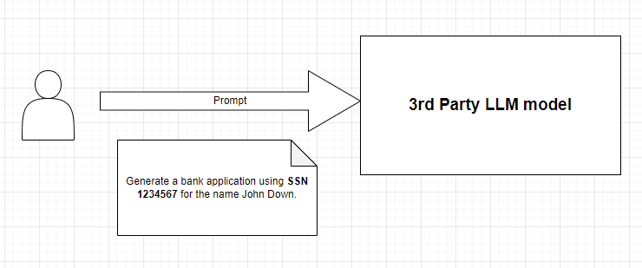
Confidential Prompt
Problem

Slide 2
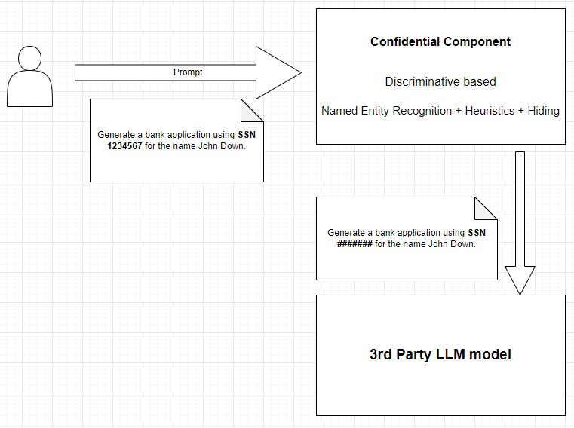
Confidential Prompt

Slide 3
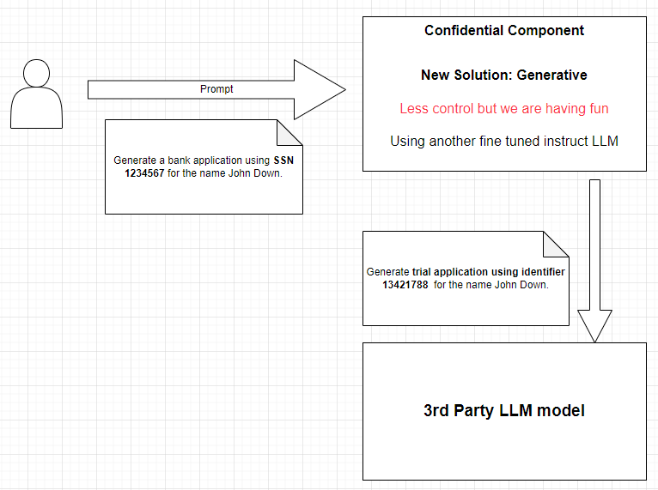
Confidential Prompt

Slide 4
Confidential Prompt
Building blocks:
Huggingface pretrained LLMs
A prompt dataset
Parameter Efficient fine tuning (PEFT)
Proximal Policy Optimization (PPO)
Mihai's limited knowledge&understanding
Lonely 1070TI GPU – 8GB ram
  mainly used for gaming

Slide 5
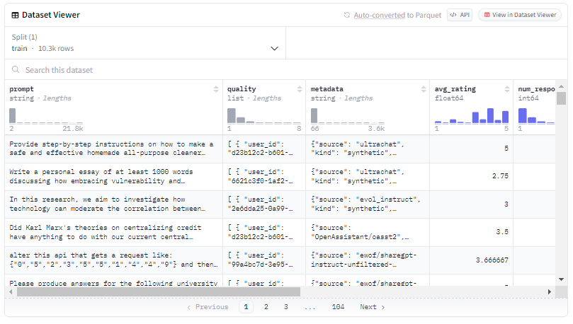
Confidential Prompt
Prompt dataset
https://huggingface.co/datasets/DIBT/10k_prompts_ranked

Slide 6
Confidential Prompt
Steps
1) Choose a pretrained trainable LLM
2) Fine tune the model for a specific prompt output
3) Improve prompt output with PPO
4) Deploy it

Slide 7
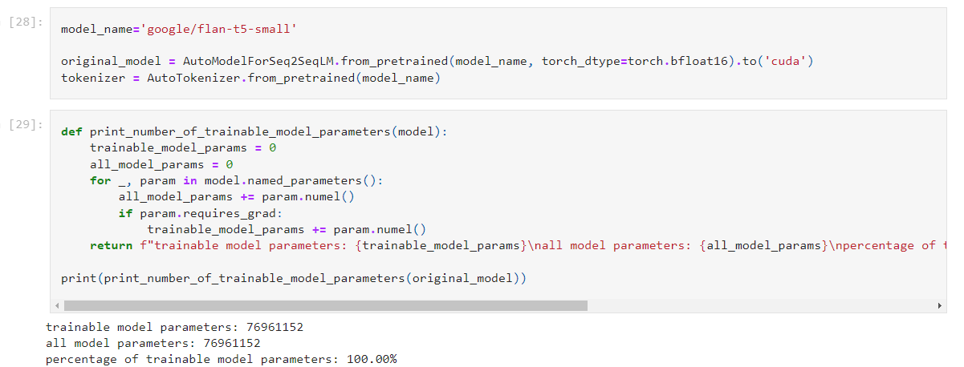
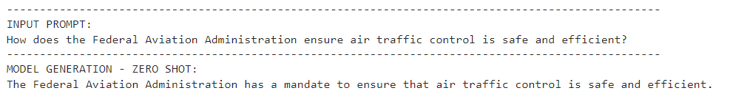
Confidential Prompt
https://huggingface.co/docs/transformers/model_doc/flan-t5

Slide 8
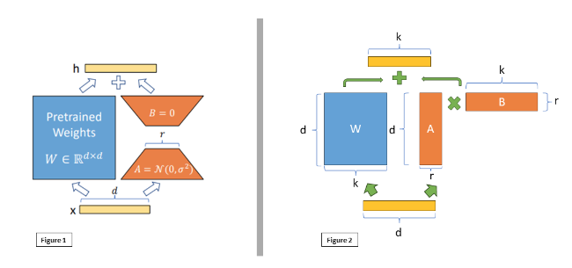
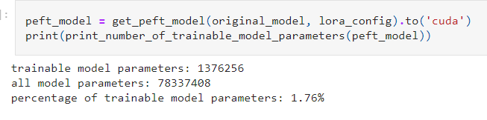
Confidential Prompt
Fine tuning – LoRA Low Rank Adaptation

Slide 9
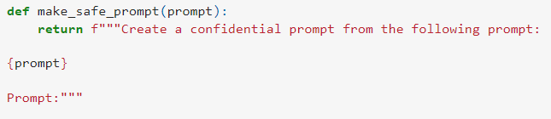
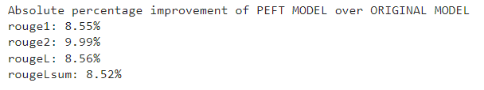
Confidential Prompt
Fine tuning – LoRA Low Rank Adaptation
Fine tuning with input
and output the prompt
Model learns to be more an autoencoder

Slide 10
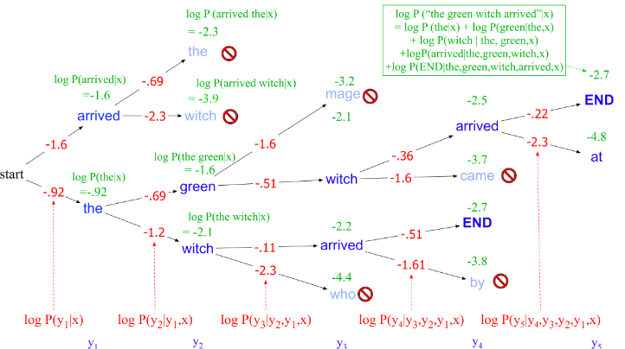
Confidential Prompt
PPO – Proximal Policy Optimization
Beam Search Inference

Slide 11
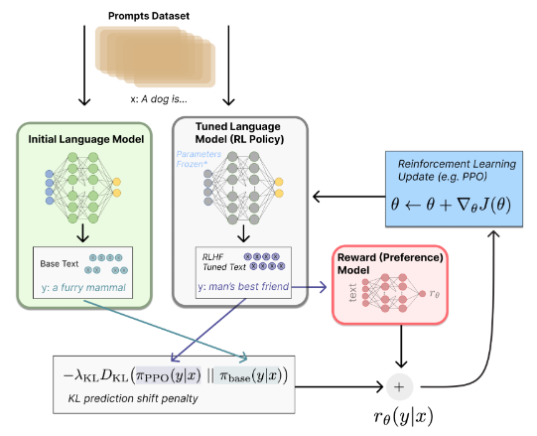
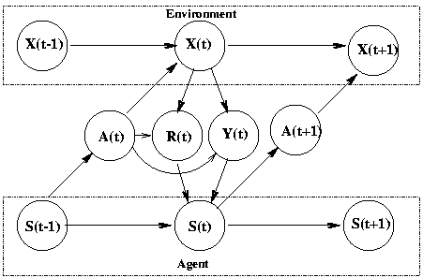
Confidential Prompt
PPO – Proximal Policy Optimization
Reinforced Learning Inference
PPO model learns a new policy to predict tokens
that bests suits a reward model.

Slide 12
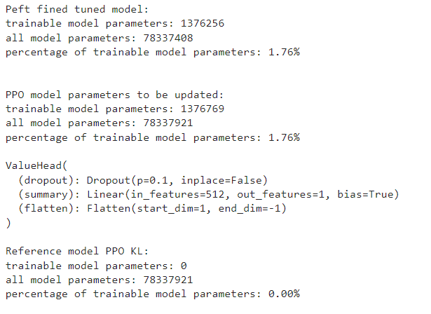
Confidential Prompt
PPO – Proximal Policy Optimization
3 things are needed
Original peft model
PPO model
Reward model

Slide 13
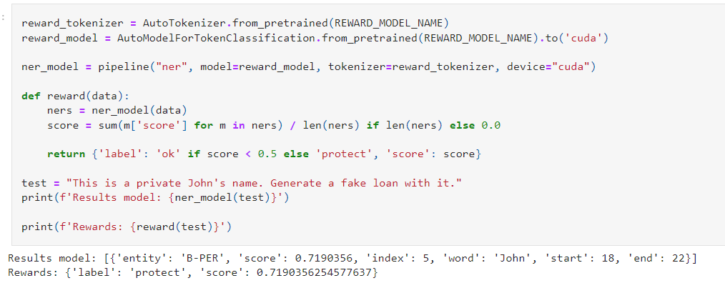
Confidential Prompt
PPO – Proximal Policy Optimization
https://huggingface.co/dslim/distilbert-NER

Slide 14
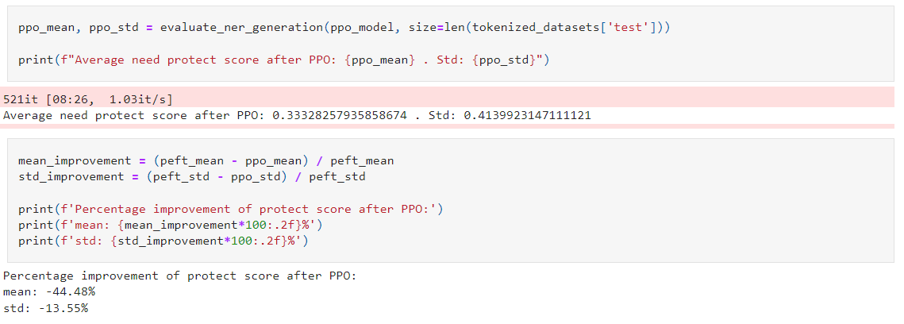
Confidential Prompt
PPO – Proximal Policy Optimization
Results on 1000 prompts
Something went wrong....PPO generates NE with higher confidence as redurned by Reward
But definetly is a change....Trained for 4 hours

Slide 15
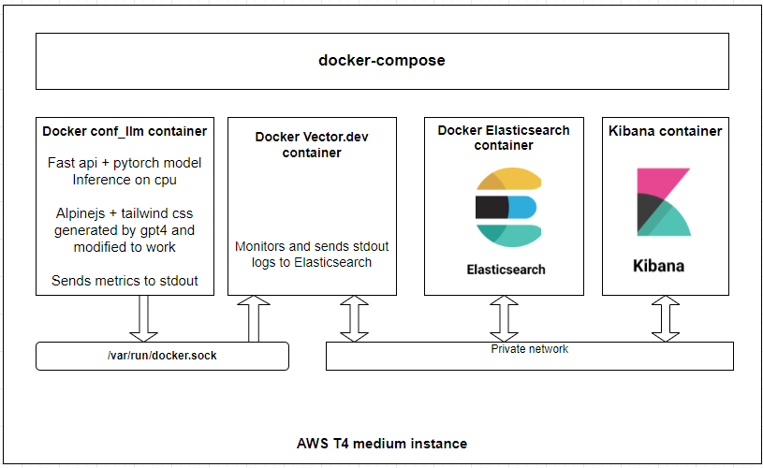
Confidential Prompt

Slide 16
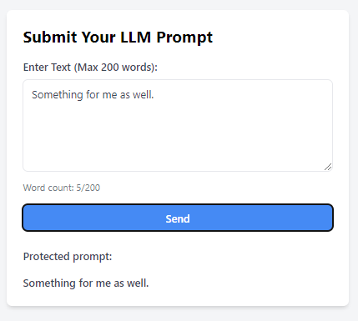
Confidential Prompt
https://www.2glyph.com/confidential/llm/

Slide 17
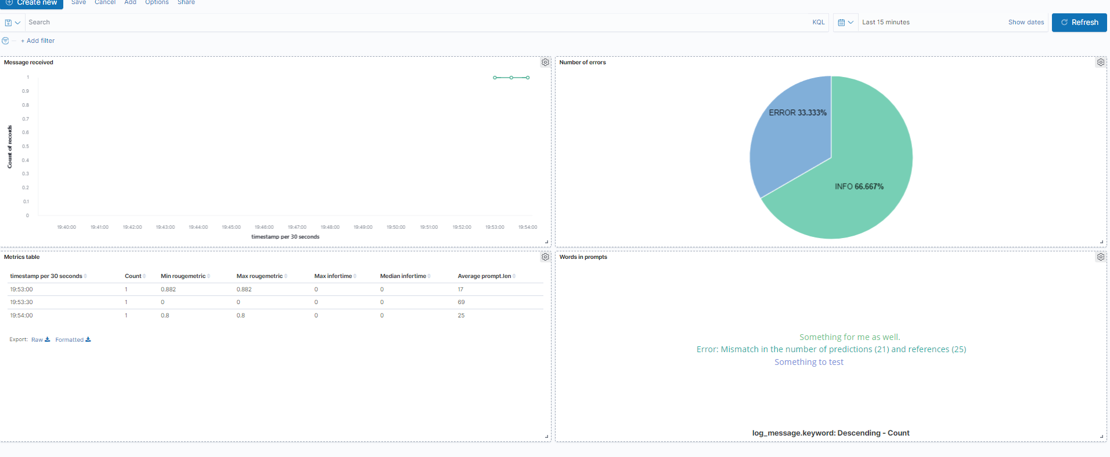
Confidential Prompt
https://www.2glyph.com/confidential/stats/

Slide 18
Confidential Prompt
Code: https://github.com/glypher/LLMPromptNE
DEMO
&&
QA

