Slide 1
Repository Schema ( example Glycan )
glyco ontology + glytoucan ontology
Accession Number
string
Derivatized mass
glytoucan:has_primary_id
glytoucan:has_derivatized_mass
Glytoucan URL
Saccharide
Resource entry
glycan:has_resource_entry
glycan:has_component
Component
glycan:has_motif
glycan:has_glycosequence
glycan:has_image
Glycan Motif
Glycosequence
Structure Image URL
Image
Notes:
Accession Number Glytoucan URL has_primary_id is_subsumed_by is_linkage_isomer is_substructure is_superstructure glyco ontology + glytoucan ontology
native and derivatized structures (permethylated/ peracetylated)

Slide 2
Repository Schema ( example Glycan )
glyco ontology + glytoucan ontology
Accession Number
string
Derivatized mass
glytoucan:has_primary_id
glytoucan:has_derivatized_mass
Glytoucan URL
Saccharide
Resource entry
glycan:has_resource_entry
glycan:has_component
Component
glycan:has_motif
glycan:has_glycosequence
Glycan Motif
Glycosequence
Notes:
Accession Number Glytoucan URL has_primary_id is_subsumed_by is_linkage_isomer is_substructure is_superstructure glyco ontology + glytoucan ontology
native and derivatized structures (permethylated/ peracetylated)

Slide 3
Repository Schema ( example Glycan )
glyco ontology + glytoucan ontology
double
Derivatized mass
glytoucan:has_mass
Literal
Contributor
foaf : name
Person
glytoucan:has_derivatization_type
Derivatization type
( individual )
glytoucan:contributor
Glytoucan URL
literal
Resource entry
glytoucan:date_registered
glycan:in_glycan_database
WURCS
GlycoCT
Glycan Database
( individual )
Glycosequence
string
glycan:has_sequence
glycan:in_carbohydrate_format
Carbohydrate format : WURCS, GlycoCT
integer
Component
glycan:has_cardinality
Structure Image URL
string
glycan:has_monosaccharide
Image
dc: : format
MonosaccharideDB URL
Monosaccharide
glycan:has_symbol_format
Symbol Format
(CFG, CFG grey scale, Oxford, Oxford color scale, CFG and Oxford, IUPAC)
Notes:
Accession Number Glytoucan URL has_primary_id is_subsumed_by is_linkage_isomer is_substructure is_superstructure glyco ontology + glytoucan ontology
native and derivatized structures (permethylated/ peracetylated)

Slide 4
Repository Schema ( example Glycan )
glyco ontology + glytoucan ontology
double
Derivatized mass
glytoucan:has_mass
string
Contributor
foaf : name
Person
glytoucan:has_derivatization_type
Derivatization type
( individual )
glytoucan:contributor
Glytoucan URL
dateTimeStamp
Resource entry
glytoucan:date_registered
glycan:in_glycan_database
GlycoCT
Glycan Database
( individual )
Glycosequence
string
glycan:has_sequence
glycan:in_carbohydrate_format
Carbohydrate format : WURCS, GlycoCT
integer
Component
glycan:has_cardinality
Structure Image URL
string
glycan:has_monosaccharide
Image
dc: : format
MonosaccharideDB URL
Monosaccharide
glycan:has_symbol_format
Symbol Format
(CFG, Oxford, etc.)
Notes:
Accession Number Glytoucan URL has_primary_id is_subsumed_by is_linkage_isomer is_substructure is_superstructure glyco ontology + glytoucan ontology
native and derivatized structures (permethylated/ peracetylated)

Slide 5
Repository Schema ( example Glycan )
glyco ontology + glytoucan ontology
Accession Number
literal
Derivatized mass
is_subsumed_by
has_primary_id
has_derivatized_mass
Glytoucan URL
is_linkage_isomer
Saccharide
Resource entry
has_resource_entry
has_component
Component
hus_superstructure
has_substructure
has_motif
has_glycosequence
has_image
Structure Image URL
rdfs:SubClassOf
Image
Glycosequence
Glycan Motif
Notes:
Accession Number Glytoucan URL has_primary_id is_subsumed_by is_linkage_isomer is_substructure is_superstructure glyco ontology + glytoucan ontology
native and derivatized structures (permethylated/ peracetylated)

Slide 6
Repository Schema ( example Glycan )
glyco ontology + glytoucan ontology
Derivatization type
( individual )
Literal
has_derivatization_type
foaf : name
Derivatized mass
Contributor
foaf: Person
has_mass
double
contributor
Glytoucan URL
date_registered
Resource entry
literal
GlycoCT
string
In_glycan_database
Glycan Database
( individual )
has_sequence
Glycosequence
In_carbohydrate_format
Carbohydrate format : GlycoCT
integer
Component
cardinality
Structure Image URL
has_monosaccharide
Image
dc: : format
string
MonosaccharideDB URL
Monosaccharide
has_symbol_format
Symbol Format
(symbol_format_cfg, uoxf, iupac)
Notes:
Accession Number Glytoucan URL has_primary_id is_subsumed_by is_linkage_isomer is_substructure is_superstructure glyco ontology + glytoucan ontology
native and derivatized structures (permethylated/ peracetylated)

Slide 7
Repository Schema ( example Glycan )
Literal
glyco ontology + glytoucan ontology
Derivatization type
( individual )
Contributor
foaf : name
double
foaf: Person
has_derivatization_type
Accession Number
has_mass
contributor
literal
literal
Derivatized mass
is_subsumed_by
date_registered
has_primary_id
Glytoucan URL
Glycan Database
( individual )
has_derivatized_mass
Resource entry
In_glycan_database
is_linkage_isomer
Saccharide
has_resource_entry
has_component
integer
Component
cardinality
hus_superstructure
has_glycosequence
has_monosaccharide
has_substructure
has_motif
MonosaccharideDB URL
Monosaccharide
rdfs:SubClassOf
has_image
Structure Image URL
Glycosequence
Image
Glycan Motif
dc: : format
In_carbohydrate_format
has_sequence
has_symbol_format
string
Carbohydrate format : GlycoCT
GlycoCT
Symbol Format
(symbol_format_cfg, uoxf, iupac)
string
Notes:
Accession Number Glytoucan URL has_primary_id is_subsumed_by is_linkage_isomer is_substructure is_superstructure glyco ontology + glytoucan ontology
native and derivatized structures (permethylated/ peracetylated)

Slide 8
Repository Schema ( example Motif )
Glycan Motif
rdfs:SubClassOf
Saccharide
glyco ontology + glytoucan ontology
Saccharide
has_motif
Structure Image URL
Glycan Motif
Glycosequence
Image
has_image
has_glycosequence
has_resource_entry
foaf : name
In_carbohydrate_format
Glytoucan URL
has_symbol_format
dc: : format
Resource entry
has_sequence
Symbol Format
string
Literal
Carbohydrate format : GlycoCT
GlycoCT
string
In_glycan_database
Glycan Database
( individual )
Notes:
Accession Number Glytoucan URL has_primary_id is_subsumed_by is_linkage_isomer is_substructure is_superstructure glyco ontology + glytoucan ontology
native and derivatized structures (permethylated/ peracetylated)

Slide 9
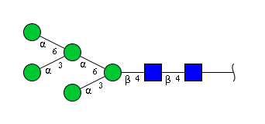
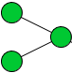
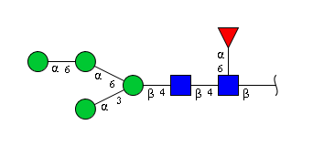

Saccharide
Saccharide
Is_subsumed_by
Saccharide
Saccharide
Is_linkage_isomer

Slide 10
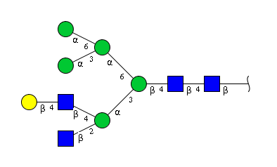
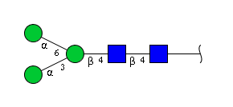
Saccharide
Saccharide
has_superstructure
Saccharide
Saccharide
has_substructure
Notes:
is_substructure Saccharide is_superstructure

Slide 11
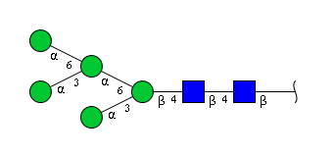
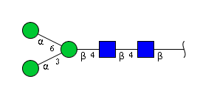


G55220VL
has_motif
G63838JW
has_motif
G22768VO
has_motif
is_linkage_isomer
G43547MI
has_motif
G68004TY
Notes:
has_motif is_linkage_isomer
G63838JW
G22768VO
G68004TY
G55220VL
G43547MI

Slide 12
Repository Schema ( example 1 )
Saccharide
has_motif
has_glycosequence
Glycan Motif
Glycosequence
has_image
Image
has_glycosequence
dc: : format
In_carbohydrate_format
has_sequence
string
foaf : name
string
has_symbol_format
literal
Carbohydrate format : GlycoCT
Symbol Format
Notes:
Accession Number Glytoucan URL has_primary_id is_subsumed_by is_linkage_isomer is_substructure is_superstructure
native and derivatized structures (permethylated/ peracetylated)

Slide 13
Repository Schema ( example 1 )
Literal
foaf : name
Derivatization type
( individual )
foaf: Person
double
has_derivatization_type
Accession Number
has_mass
contributor
literal
literal
Derivatized mass
date_registered
is_subsumed_by
has_primary_id
Glytoucan URL
Glycan Database
( individual )
Resource entry
has_derivatized_mass
In_glycan_database
has_resource_entry
integer
is_linkage_isomer
Saccharide
Component
has_component
cardinality
has_monosaccharide
is_superstructure
has_glycosequence
Monosaccharide
Image
is_substructure
has_motif
Glycosequence
has_image
dc: : format
string
has_glycosequence
has_sequence
has_symbol_format
Glycan Motif
In_carbohydrate_format
string
Symbol Format
foaf : name
Carbohydrate format : GlycoCT
literal
Notes:
Accession Number Glytoucan URL has_primary_id is_subsumed_by is_linkage_isomer is_substructure is_superstructure
native and derivatized structures (permethylated/ peracetylated)

Slide 14
Registered Compound
This class is like a referenced compound class.
Including mass, date entered, contributor
If this glyco ontology revised:
has_image
Domain Saccharide
Range Image
has_motif
Domain Saccharie
Range Glycan Motif
has_image
Domain Referenced Compound or Registered Compound
Range Image
has_motif
Domain Referenced Compound or Registered Compound
Range Glycan Motif

Slide 15
integer
Repository Schema ( example 2 )
has_component
Component
cardinality
Saccharide
has_monosaccharide
has_registered
Monosaccharide
Registered Compound
has_image
has_motif
Glycan Motif
Image
format
has_mass
string
contributor
date_registered
literal
name
integer
Has_symbol_format
literal
literal
Symbol Format
A Registered Compound include glycan motif and image.

