Slide 1
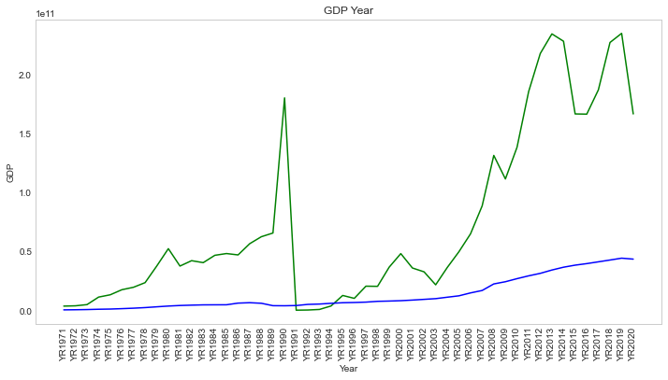
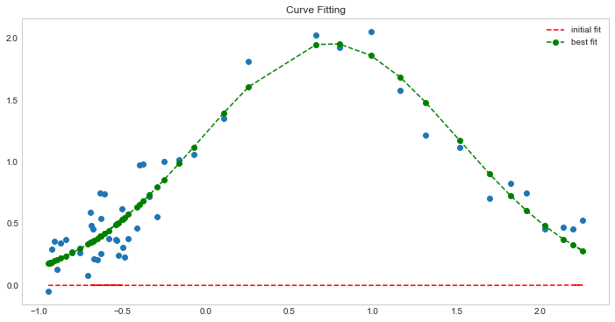
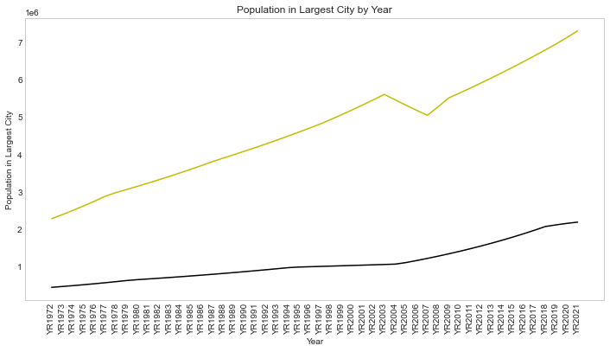
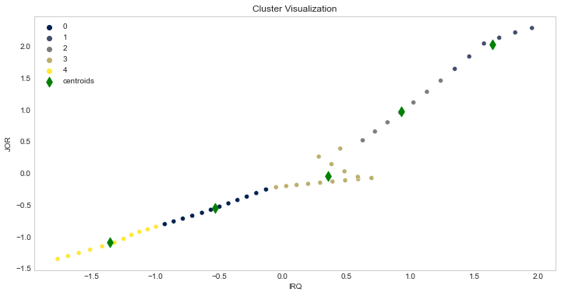
GDP & Country Population
Aim & Focus
The aim has been taken to analyze the population of the largest city of a countries and the GDP of the nation. In this poster the outcome of the analyses will be presented with the description to create a clear picture of the analysis.
Background
World Bank is the superior in the provision of data regarding climate change and demography of countries across the world. In this analysis, the demography data has been taken for Jordon and Iraq for the analysis of the Population in Largest City and GPD of the country. The data has been collected by selecting the indicators and two data has been created. For the purpose of clustering, the data regarding Population in Largest City has been used and for the prediction, GDP data has been used.
The analysis is showing the fact that the GDP of Iraq has been increased from 1971 to 2020. However, the drop has been observed for Iraq in the year 1991 but after that, the values have been increased. On the other hand, the GDP for Jordon ahs been increased from 1991.
The curve fitting model has been applied to the GDP data and it can be seen that the curve has been properly fitted with the data and predicted better result compared to the initial fit.
The initial Analysis om the data regarding population of the largest city, it can be see that the value is increasing by year for Iraq but the increase of the population is less for Jordon.
The result of clustering is showing the fact that 5 clusters have been observed concerning the population and top-2 clusters are attained by Iraq.
Data Link: https://data.worldbank.org/topic/climate-change

