Slide 1
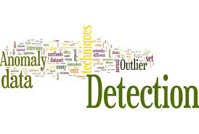
Graph based Anomaly detection and description
A project by Gaurav Mahadik and Mandar Phapale

Slide 2
What is Anomaly Detection?
In data mining, anomaly detection is the identification of rare items, events or observations which raise suspicions by differing significantly from the majority of the data.
Typically the anomalous items will translate to some kind of problem such as bank fraud, a structural defect, medical problems or errors in a text.
Anomalies are also referred to as outliers, novelties, noise, deviations and exceptions.

Slide 3
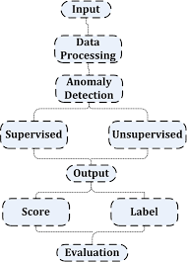
This survey aims to provide a general, comprehensive, and structured overview of the state-of-the-art methods for anomaly detection in data represented as graphs.
As a key contribution, we give a general framework for the algorithms categorized under various settings: unsupervised vs. (semi-)supervised approaches, for static vs. dynamic graphs, for attributed vs. plain graphs.

Slide 4
Why Graphs?
We highlight four main reasons that make graph-based approaches to anomaly detection vital and necessary:
Inter-dependent nature of the data
Powerful representation
Relational nature of problem domains
Robust machinery

Slide 5
ANOMALY DETECTION CHALLENGES: 1. Data-specific challenges : The challenges with respect to data are those of working with big data; namely volume, velocity, and variety of massive, streaming, and complex datasets. The same challenges generalize to graph data as well.

Slide 6
2. Problem-specific challenges:
The data often comes without any class labels, that is, the ground truth of which data instances are anomalous and non-anomalous does not exist. Importantly, the task of manual labeling is quite challenging given the size of the data.

Slide 7
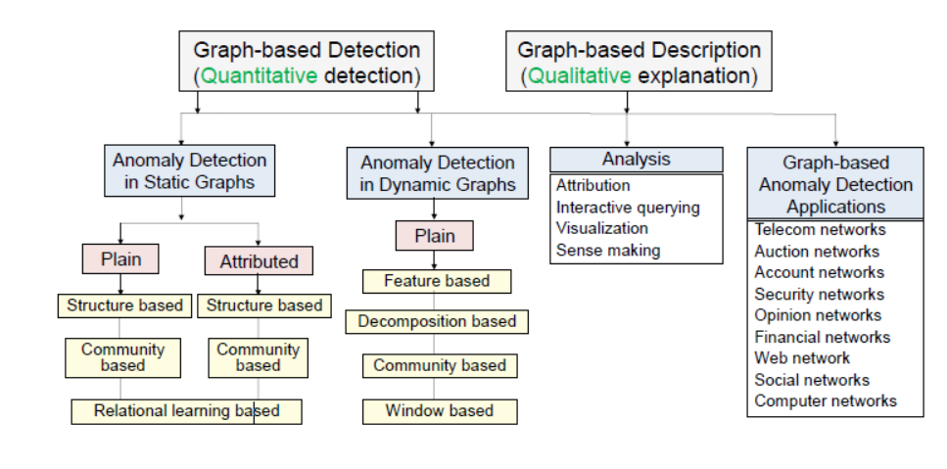
Anomaly Detection Methods

Slide 8
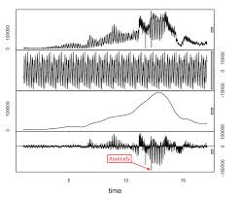
Graph Based Detection (Quantitative detection)
1. Anomaly Detection in Static Graphs :
Given the snapshot of a (plain or attributed) graph database, we have to find the nodes and/or edges and/or substructures that are “few and different” or deviate significantly from the patterns observed in the graph.

Slide 9
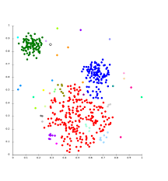
2. Anomaly Detection in Dynamic Graphs:
The novelty of each proposed algorithm lies in the “graph summary” it constructs, the distance/similarity function it uses, as well as the way it defines and chooses the threshold to flag an instance as anomaly.

Slide 10
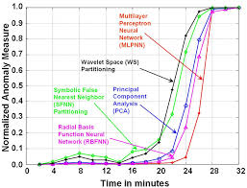
Graph-based Description (Qualitative explanation)
1. Graph Based Analysis :
Some processes would have interaction between different players. Flow analysis of such graphs might show anomalies. On some other use cases such as insurance, stock markets, corporate payment fraud etc., similarities between player’s transactions might suggest anomalous behavior

Slide 11
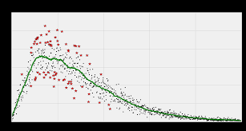
2. Graph-based Anomaly Detection Applications:
These graph-based applications provide powerful machinery on top of previously used signature-based methods, where few simple measures such as extensive late night activity and long call durations have been taken as indicators for fraudulent behavior.

Slide 12
Learnings and Conclusion:
In this post, we discussed anomaly detection, how it is different from machine learning, and then discussed different anomaly detection techniques.
We categorized anomalies and discussed some of the techniques for detecting them.
Our aim, however, is not to claim the superiority of graph-based methods overother detection techniques. On the other hand, our goal is to highlight the advantages of graphs, and provide a comprehensive list of available algorithms and tools that exploit graphs to build anomaly detection solutions

Slide 13
Questions ??

Slide 14
Thank you..!!!

