Slide 1
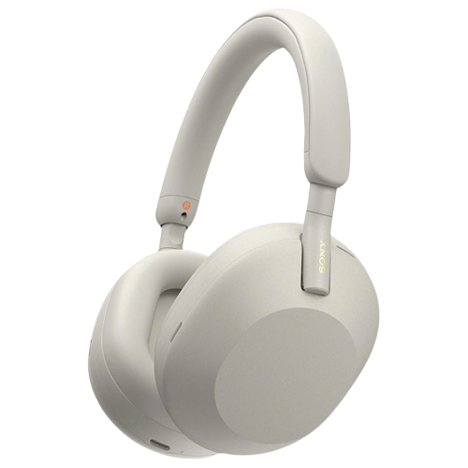
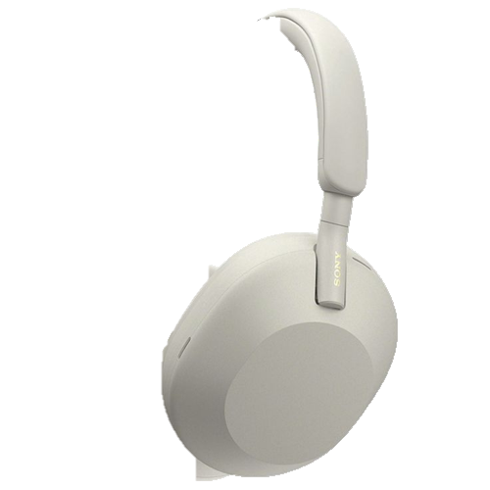
10.000
COMMON PASSWORD
DATASTRUCTURE AND ALGORITHM
ThS.Trần Quang Khải

Slide 2
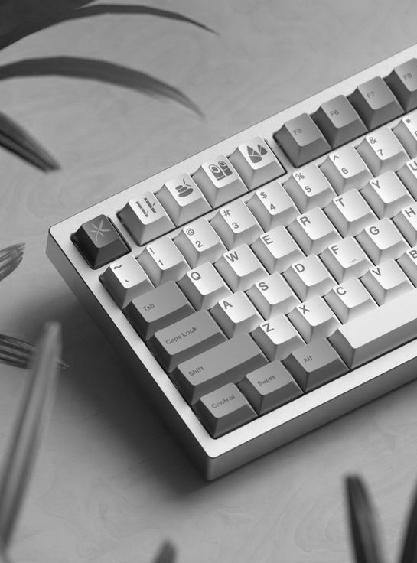
OUR
CONTENTS.
Overview of the project.
Dataset description.
Algorithm implemented.
Visualization.
Conclusion.

Slide 3
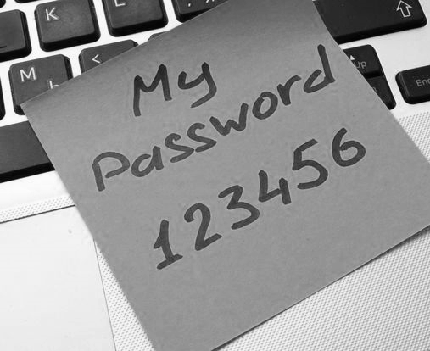
“
Overview of the project.
If your password is on this list, you need a new password.
Hacker can use or generate files like this.
Enhancing password security.
FIRST
CONCEPT.

Slide 4

“
Dataset description.
The dataset was procured by SecList.
Fields: length, num-chars, num-digits, num-lower, num-upper, num-vowels, num-special.
Second
Concept.
10000 most common password ranging from 3 – 16 characters.

Slide 5

THIRD
CONCEPT.
“
Algorithm implemented.
Binary Search Tree.
File operations.
Password management.
Sorting.

Slide 6
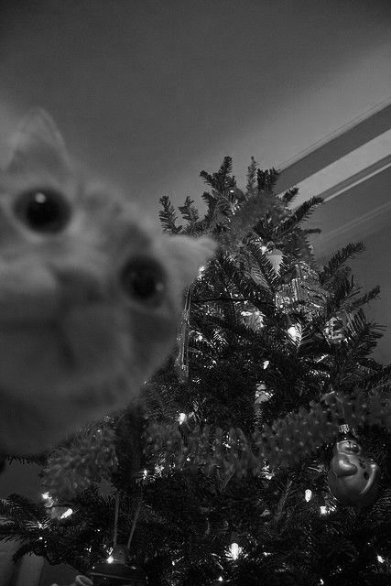
BINARY
AND
SEARCH TREE
FILE OPERATIONS.
BINARY
Structure: Node, Root, Right/ Left Child, Leaf.
File operations refer to actions perfomed on files.
TREE
File creation, opening, reading, writing, closing, deletion.

Slide 7

PASSWORD
MANAGEMENT
Insertion, Deletion, Traversal, Searching.
Binary trees allow quick lookup, insertion, and deletion operations.

Slide 8
SORTING
Password List
02
Quick Sort (Descending).
01
03
Convert tree to array list.
Selection Sort (Ascending).

Slide 9
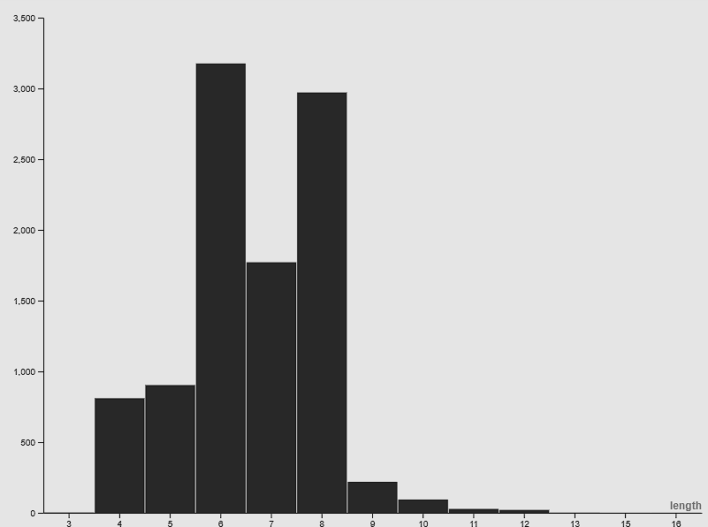
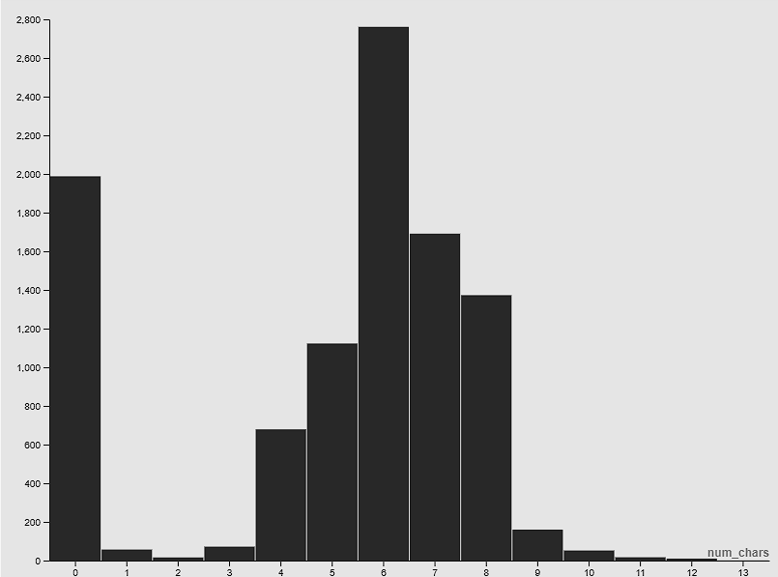
Fourth
Concept.
“
Visualization.
Graph by length.

Slide 10
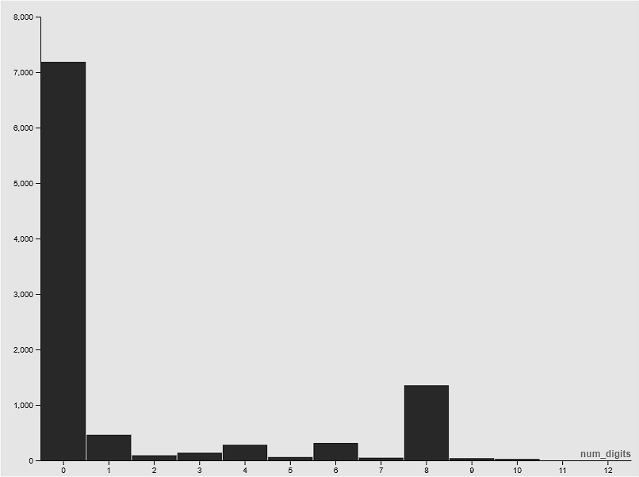
Fourth
Concept.
“
Visualization.
Graph by num-chars.

Slide 11

Fourth
Concept.
“
Visualization.
Graph by num-digits.

Slide 12
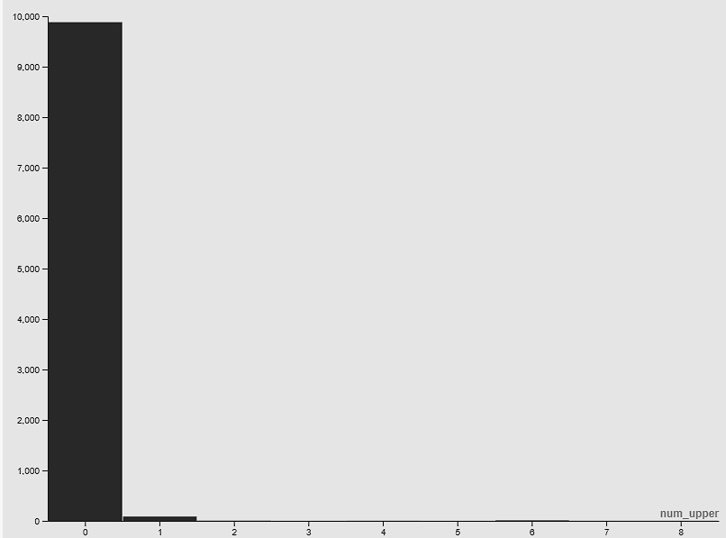
Fourth
Concept.
“
Visualization.
Graph by num-lower.

Slide 13
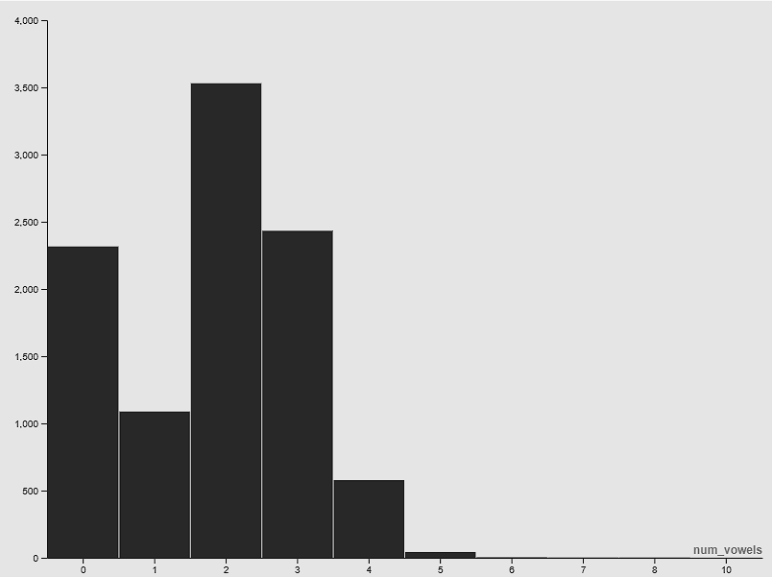
Fourth
Concept.
“
Visualization.
Graph by num-upper.

Slide 14
Fourth
Concept.
“
Visualization.
Graph by num-vowels.

Slide 15


Project summary
Using binary tree, array list, file operations, quick sort and selection sort.
FIFTH CONCEPT.
Achieved results
Conclusion.
Binary trees allow quick lookup, insertion, and deletion operations.
Data is always sorted by binary search tree rules, making it useful for search.

Slide 16
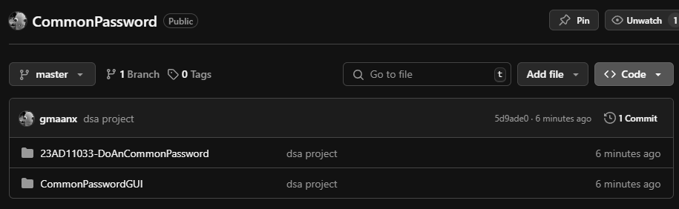
VERSION CONTROL SYSTEM.
https://github.com/gmaanx/CommonPassword

Slide 17
Thanks.

Slide 18
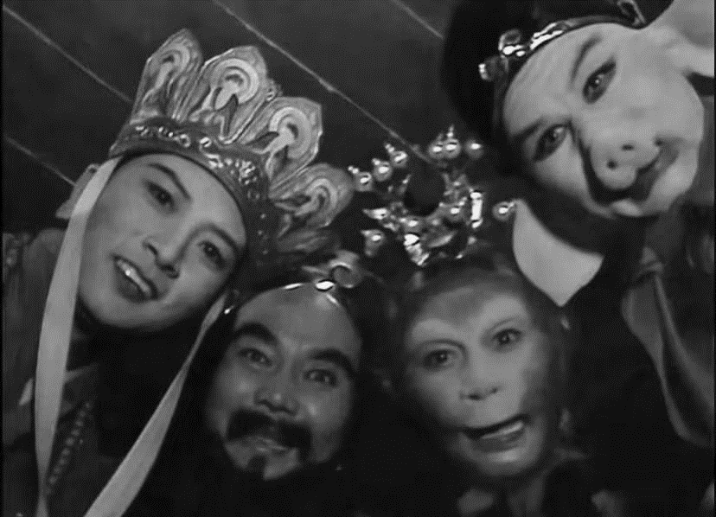
OUR
MEMBER.
GIA MẪN - PINTEREST - CHATGPT - KAGGLE

