Slide 1
Teaching a robot to love play Mine Sweeper
Ryan Baldini

Slide 2
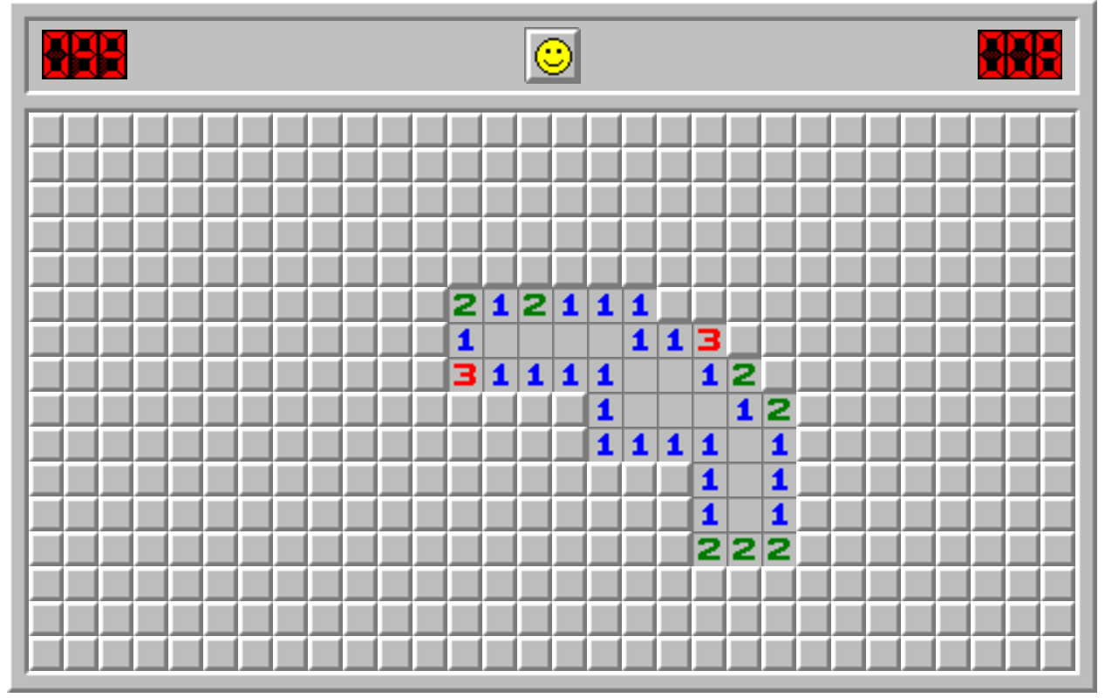
Mine Sweeper
Notes:
Explain rules of game

Slide 3
Goal
1. Train neural net by playing
“reinforcement learning”
2. Try to code little game-specific logic into it
3. Get it to be good

Slide 4
1. Make and train neural net
Input: “game board” array
Pre-processed; more on that soon
Output: a number for each cell giving the probability of a mine (16x30 = 480 #s)
During play, model selects cell with lowest probability

Slide 5
Model input
Input is 11 x 16 x 30 “cube” array:
One 16x30 binary for “already revealed”
Needs to know which cells to “read”
One 16x30 binary for “cell is on game board”
Always 1, so model knows when it’s “on the board.” More on that soon.
Nine 16x30 binaries for each revealed number
i.e. layers “showing a 1”, “showing a 2” …
Went with categorical approach under the logic that, e.g., a 1 isn’t just half 2; it has very strong meaning

Slide 6
Inner workings of model
Model does multiple convolutional layers
Currently
Five 3x3 convolutional layers, each with 64 kernels and relu activation
And one 1x1 convolution with 1 kernel and sigmoid activation
154,177 total parameters
Final output is altered to ensure cells already revealed have probability 0

Slide 7
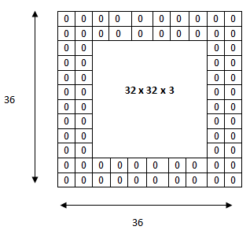
Why include “on-board” input?
Convolutions run a dot product on the area around the cell. For cells near the edge, we “zero pad” the original input.
Adding a layer of ones
lets the model know
when it is “near the
edge”
30 x 16 x 11

Slide 8
Why convolutions?
Decision for a cell…
Depends mostly on local information
Doesn’t really depend on location in the grid
Convolution looks for patterns over some local range to output a result
Convolution output is independent of location

Slide 9
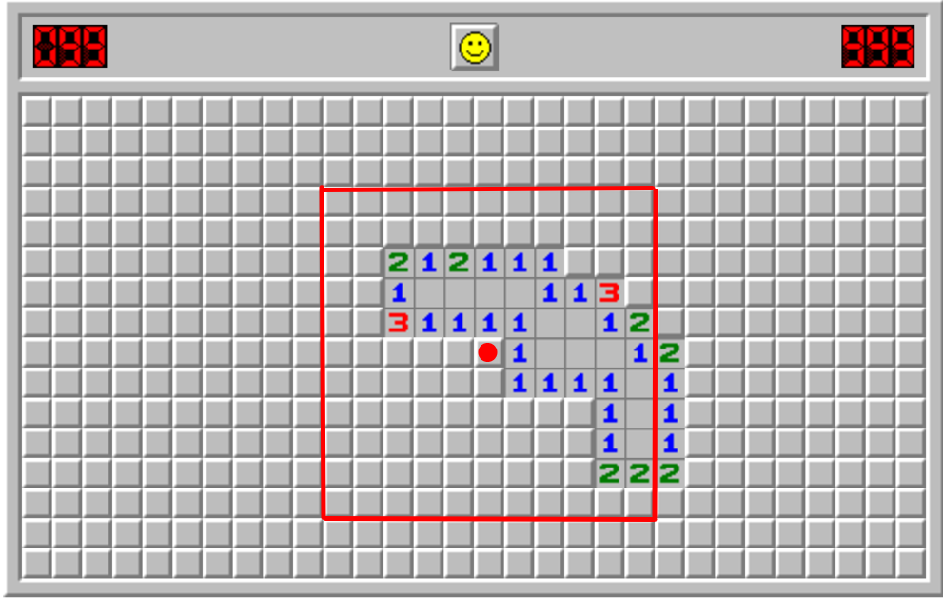
How big is local neighborhood?
Five 3x3 convolutional layers implies 11x11 neighborhood

Slide 10
How to train
Have model play game
When cell is revealed, that is data
If there was a mine, correct probability = 1.0
Else, correct probability = 0.0
Many such decisions provide a batch of inputs and correct answers
Use gradient descent to update parameters to minimize log loss

Slide 11
2. Game-specific logic?
How general is it?
Some game-specific decisions:
Input is pre-processed to yield information I know to be useful
Convolutions achieve location-independence
Final multiplication ensures already-revealed cells have probability 0; doesn’t have to learn this
The ideal: let the input be an untouched screenshot of game!

Slide 12
3. Make it good
Best model currently winning ~42% of Expert games
A hard-coded Mine-Sweeper-specific model (found online) gets ~50%
Includes end-game strategies that use the model’s guess of how many mines are remaining
How to improve?
Include input on how many cells are available?
More layers? Kernels?
RNN?

Slide 13
Lesson: Training Inefficiency
Once the model gets “good”, most predictions are correct with high (~100%) confidence
These samples have a small effect on gradient
So most samples yield little information; learning slows down
Thought: only sample the last n moves from a game?
Could cause model to “forget” early- and mid-game behavior?

