Slide 1

ONLINE BOOK RECOMMENDATION USING COLLABORATIVE FILTERING
A PROJECT REPORT
SUBMITTED BY
G. Mahesh (192212296)
L.Nishanth Reddy(192212168)
UNDER THE GUIDANCE OF
DR. R. DHANALAKSHMI
IN PARTIAL FULFILMENT FOR THE COMPLETION OF COURSE
CSA0279 – C PROGRAMMING FOR BEGINNERS

Slide 2

Project: ONLINE BOOK RECOMMENDATION USING COLLABORATIVE FILTERING
PROBLEM STATEMENT:With the vast number of books available in the market and the increasing reliance on digital platforms for reading, users often face challenges in discovering titles that align with their interests and preferences. Traditional recommendation systems may rely solely on basic categorizations or popularity rankings, which can lead to a lack of personalized suggestions that truly resonate with individual readers. This can result in users feeling overwhelmed and less likely to engage with the platform.
TASKS:
User Registration and Profile Management
Book Database Integration
Implement Collaborative Filtering Algorithm
Recommendation Engine
Rating and Review System
User Interface (UI) Development
Analytics Dashboard for Admins
Database Management
Security and Authentication
Integration with External APIs
Testing and Debugging
Deployment and Hosting
Future Enhancements
OUTCOME: The outcome of this project is to develop an Online Book Recommendation System Using Collaborative Filtering that analyzes user behavior and preferences to provide personalized book suggestions. By leveraging collaborative filtering techniques, the system will analyze user interactions, such as ratings, reviews, and reading history, to identify patterns and recommend books that similar users have enjoyed. This approach aims to enhance the user experience by making book discovery more relevant and enjoyable.

Slide 3
AIM:
Personalized Book Recommendations: To develop a recommendation system that analyzes user behavior, preferences, and interactions to provide personalized book suggestions using collaborative filtering techniques.
Enhancing User Experience: To create a user-friendly platform that enables users to discover books relevant to their interests, fostering better engagement through a rating and review system.
Data-Driven Insights: To utilize collaborative filtering algorithms to identify patterns in user behavior, improving the accuracy and relevance of book recommendations over time.
Integration and Scalability: To integrate with external book databases and support scalable, real-time recommendations, ensuring a wide variety of books are accessible to users.

Slide 4
ABSTRACT
This project aims to develop an online book recommendation system that leverages collaborative filtering techniques to offer personalized book suggestions based on user preferences and behavior.
The system analyzes user interactions, including ratings, reviews, and reading history, to identify patterns and recommend books that similar users have enjoyed, enhancing the user experience.
It features a user-friendly interface, allowing users to browse recommendations, read reviews, and rate books, while also providing an analytics dashboard for administrators to monitor system performance.
Integration with external book databases ensures access to a wide range of book titles, making the system scalable and adaptable to a growing user base.

Slide 5
INTRODUCTION
With the vast number of books available online, users often struggle to find titles that match their personal interests. Traditional recommendation systems, relying on basic categorizations or popularity, may not offer personalized suggestions.
The proposed system uses collaborative filtering to analyze user preferences, ratings, and reviews, enabling it to generate more accurate and tailored book recommendations based on the behaviors of similar users.
By offering a user-friendly interface, users can easily explore recommended books, view detailed descriptions, and provide feedback through ratings and reviews.
The system integrates with external book databases, ensuring a wide variety of books and metadata, and provides analytics tools for administrators to track user engagement and optimize recommendations
The system aims to enhance user engagement by continuously refining recommendations based on user feedback and interactions, ensuring that the suggestions stay relevant and dynamic over time.
By utilizing collaborative filtering techniques, the system not only improves book discovery for users but also helps foster a more interactive community through reviews, ratings, and shared preferences, making book recommendations a more social and collaborative experience.

Slide 6
TECHNOLOGY
Backend:
Python (Flask/Django) for building the server-side logic and handling collaborative filtering.
Machine Learning Libraries like scikit-learn, Surprise, or TensorFlow for implementing collaborative filtering algorithms.
Database: Use MySQL, PostgreSQL, or MongoDB to store user profiles, ratings, and book metadata.
Frontend:
HTML/CSS/JavaScript for building the frontend interface.
Frameworks like React.js or Vue.js for dynamic rendering and interactive UI.
Use Bootstrap or TailwindCSS for responsive design.
APIs and External Data Integration:
Google Books API or Open Library API for accessing books' metadata.
Use OAuth for user authentication via social media (Google/Facebook).
Recommendation Algorithms:
Collaborative Filtering (User-based or Item-based) using k-NN, Matrix Factorization (SVD), or Deep Learning models if the data size is large.
Deployment:
Cloud Hosting (AWS, Heroku) for deployment.
Docker for containerization and ensuring consistency across environments.

Slide 7
CODE IMPLEMENTATION
Data Structures for Users and Books:
User and Book structures are defined to store essential information.
User structure holds a user ID, name, and an array of ratings for each book.
Book structure contains a book ID, title, author, and an array of ratings from different users.
Rating Books:
The rate_books function allows users to rate books. The program asks the user for their ID, the book ID, and a rating (1–5).
The rating is then stored in both the user's ratings array and the corresponding book's ratings array.
Collaborative Filtering for Recommendations:
The recommend_books function implements a basic collaborative filtering approach, recommending books based on the average rating from all users who have rated a particular book.
If a book has an average rating of 3 or higher, it is recommended to the user.
Displaying Books:
The display_books function shows all books in the system, including their ratings from all users.
It prints each book's details (title, author, and ratings) for the users to view and interact with.
Admin Dashboard for Analytics:
The admin_dashboard function provides an overview of the system’s engagement.
It calculates how many ratings have been given by users and how many books have been rated.
It also provides a summary of how many ratings each book has received, helping to analyze book popularity.
Simulated Fetching of Book Metadata:
The fetch_book_metadata function simulates retrieving book metadata (e.g., title and author) from an external source.
It loops through all the books and prints their information, mimicking the process of fetching data from an external API or database.

Slide 8
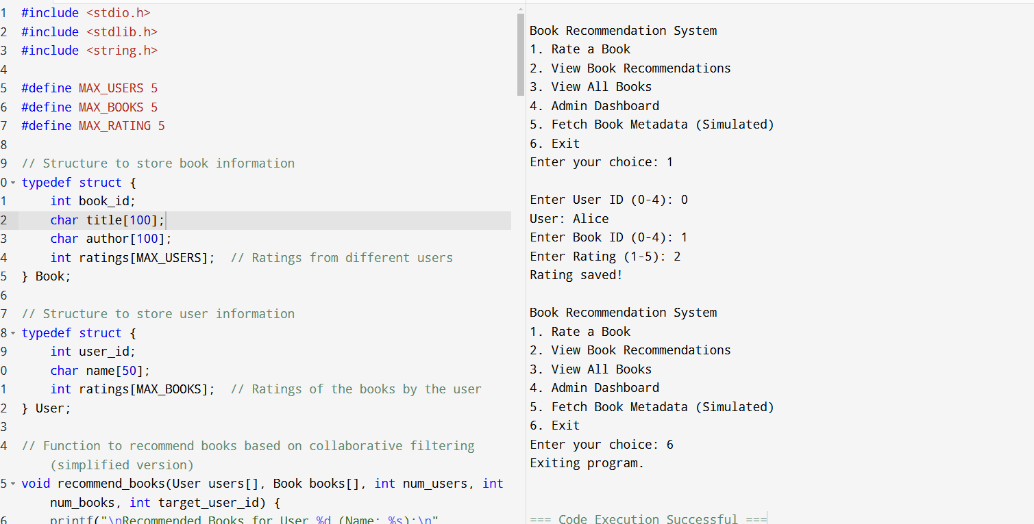
RESULTS

Slide 9
Engineering Standards
1.BASIC PROGRAMMING STANDARDS
ISO/IEC 9899 - C Language Standards
i.ISO/IEC 9899:1990 (C90)
Original standard, also known as ANSI C.
Standardized the C language with improvements over K&R C.
ii.ISO/IEC 9899:1999 (C99)
Introduced new data types (long long int, _Bool).
Added inline functions.
Supported variable-length arrays.
Added new standard library functions.
Improved type checking.
iii.ISO/IEC 9899:2018 (C17)
Bug-fix release with no major new features.
Improved clarity and fixed defects in C11.
iv.ISO/IEC 9899:202x (C2x)
Upcoming standard (under development as of 2024).
Expected to introduce further improvements and updates.
2.Software Engineering Standards
i.ISO/IEC 12207 (SDLC)
Provides a structured framework for the software development lifecycle.
ii.IEEE 829 (Testing Documentation)
Standardizes documentation for thorough and traceable software testing.
iii.ISO/IEC 25010 (Software Quality)
Defines quality attributes like functionality, performance, and maintainability.
Usability & QA Guidelines: Ensures efficient performance, ease of maintenance, and user-centric design.

Slide 10
FUTURE SCOPE
Hybrid Recommendation Systems: Future versions of the system can combine collaborative filtering with content-based filtering techniques. This hybrid approach can improve recommendation accuracy by considering both user behavior and the content features of books, such as genre, author, and keywords.
Deep Learning Integration: Implementing neural networks and advanced models like Neural Collaborative Filtering (NCF) can enhance the ability to detect complex user-item patterns, providing more nuanced and precise recommendations.
Real-Time Updates and Streaming Data: The system can evolve to offer real-time recommendations based on user activities, such as when a user rates a book or reads a new one. Streaming data integration would allow the system to adjust suggestions dynamically as new user data becomes available.
Social Media and User Communities: Integration with social media platforms (e.g., Facebook, Twitter) can allow users to share books, see what friends are reading, and receive suggestions based on their social circle's preferences.
Cross-Platform Integration: The system can extend beyond books to recommend related media, such as audiobooks, movies, and podcasts. Moreover, integrating mobile apps and offline access will enhance user experience.

Slide 11
CONCLUSION
The Online Book Recommendation System Using Collaborative Filtering provides an innovative approach to enhancing the book discovery process by delivering personalized recommendations based on user interactions, such as ratings, reviews, and reading history. By leveraging collaborative filtering techniques, the system identifies patterns in user behavior to suggest books that align with individual preferences, improving the user experience and reducing the overwhelming choice that many users face.
With features like user profile management, a rating and review system, and integration with external book databases, the platform ensures access to a broad range of books, enriching the discovery process. The analytics dashboard provides valuable insights for administrators, allowing for continuous improvement in the system's performance and user engagement.
The future scope of the project includes integrating hybrid recommendation techniques, deep learning models, and real-time recommendation capabilities to make the system even more dynamic and accurate. Additionally, expanding the system to support cross-platform recommendations, multilingual content, and emotion-aware features will further enhance its reach and usability.
Overall, the system not only aims to offer personalized book suggestions but also encourages community interaction through user feedback and shared preferences, making book discovery more enjoyable and socially engaging. The development of this system holds great potential for improving how users explore and engage with books.

Slide 12


