Slide 1
Flight Booking System
Group 1
January 4,2022

Slide 2
Coverage
Overview of the project
Requirement & GUIs
High Level Design
Individual contribution
Challenges faced & how it addressed
Experience gained

Slide 3
Overview
Develop a Flight Booking System using .NET framework
Project functionalities
Record Flight
Book Ticket
Cancel Ticket
UI : Winforms
Users concerned:
Admin
Passengers

Slide 4
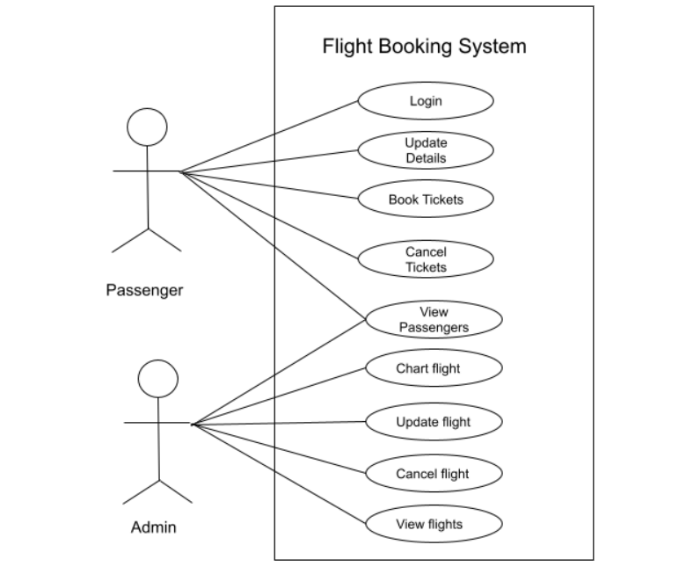
High Level Design
1.Use Case

Slide 5
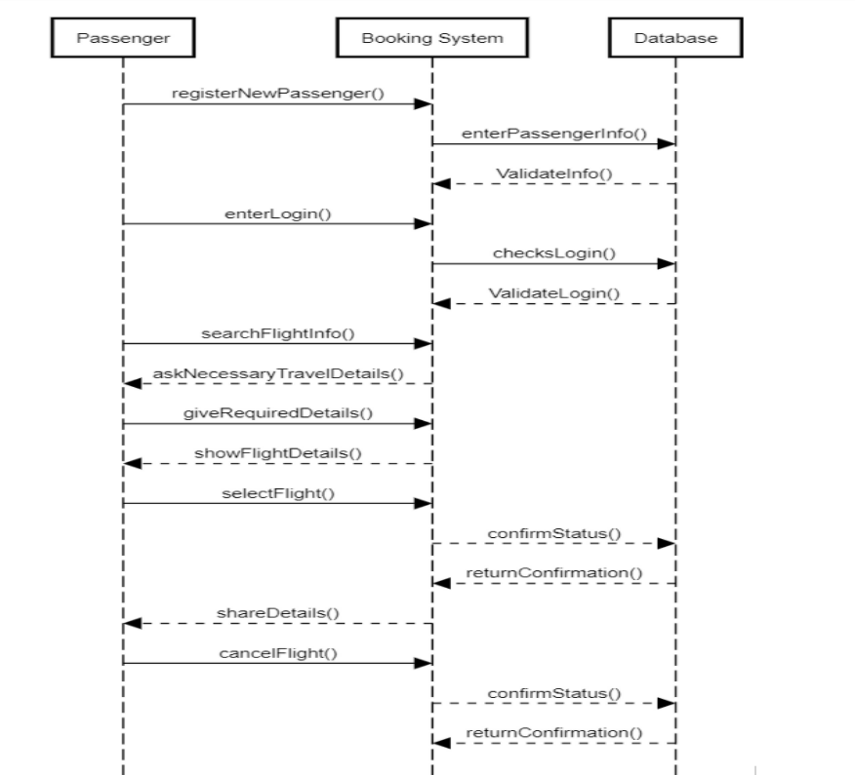
High level design
2. Sequence Diagram

Slide 6
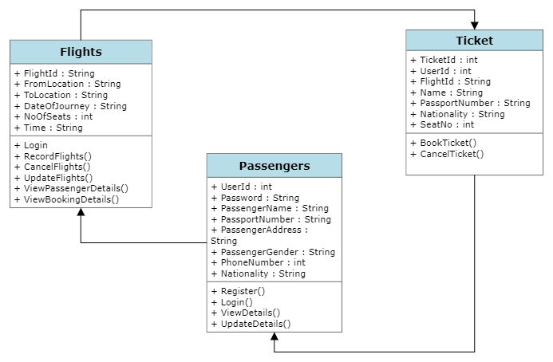
High level design
3. UML Diagram

Slide 7
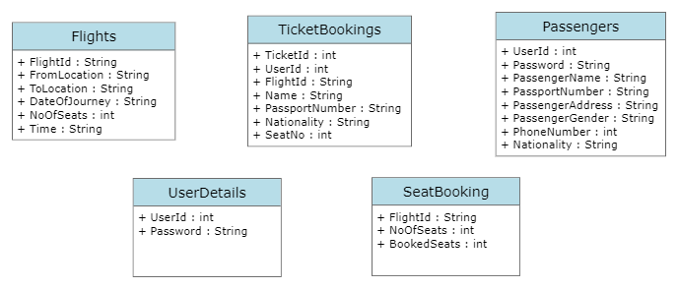
High Level Design
4.Table Design

Slide 8
High level design
Class :Flights
Functionality | Description
Chart or Record flights | The system allows the admin to add or chart flights.
Update recorded flights | The system allows the admin to update flights details.
View recorded flights | The system allows the admin to view all the flight details
Delete or Cancel flights | The system allows the admin to delete or cancel flights
View passenger details | The system allows the admin to view all the passenger details
View booking details | The system allows the admin to view all the booking details

Slide 9
High Level Design
Class: Passenger
Functionality | Description
Registration | New Passengers can register and login
Login | Existing Passengers can login
Update details | The system allows the passenger to update their details
View details | The system allows the passenger to view their details
Book Ticket | The system allows the passenger to book tickets
View scheduled flights | The system allows the passenger to view scheduled flights to book tickets
Cancel Tickets | The system allows the passenger to cancel their tickets

Slide 10
High Level Design
Class TicketBooking
Functionality | Description
Check Flights | Passenger can check the available flights
Book Seats | Passenger can book the available seats
Cancel Booking | Passenger can cancel the booked seats

Slide 11
High level design
Functionality Table
Test Module | Test Scenario | Test Case | Expected Result | Actual result | Pass/Fail
Admin Login | Verify Login | Validate Username and Password | Admin Successfully Logged in | Admin Successfully Logged in | Pass
View Flight | Check Availability | View Available Flights | View Flight Data | View Flight Data | Pass
Passenger Login | Verify Login | Validate Username and Password | Passenger Successfully Logged in | Passenger Successfully Logged in | Pass
Search Flight | Check Info | Check Available flights | Flights Available | Flights Available | Pass
Book Flight | Check Availability | View Available Flights | Seats Available | Seats Available | Pass
Ticket | Book Ticket | Book ticket based on seat available | Successful Ticket Booking | Successful Ticket Booking | Pass
Cancel Ticket | Cancel Ticket | Cancel tickets | Successful Ticket Canceling | Successful Ticket Canceling | Pass

Slide 12
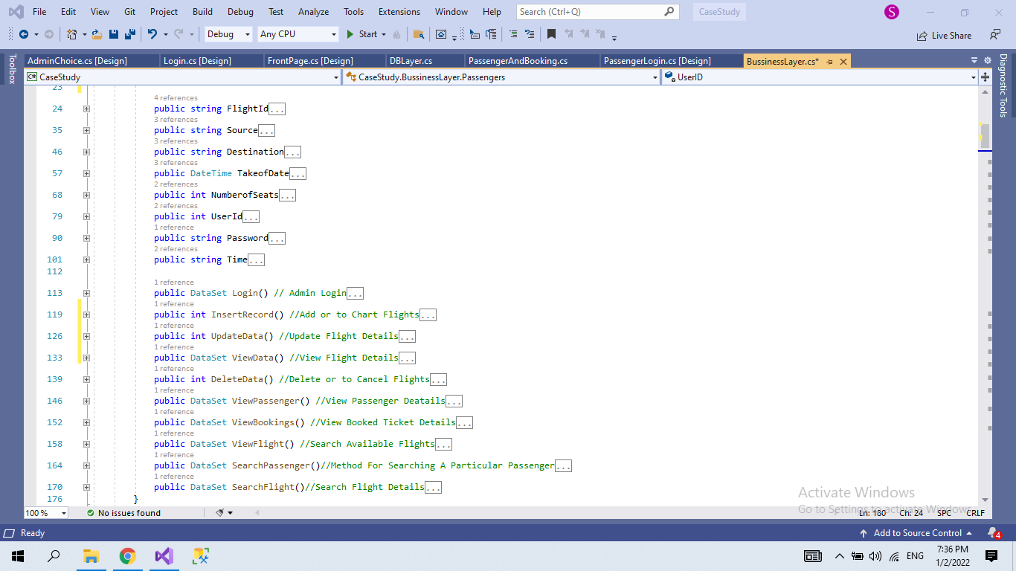
Sample Code Snippets

Slide 13
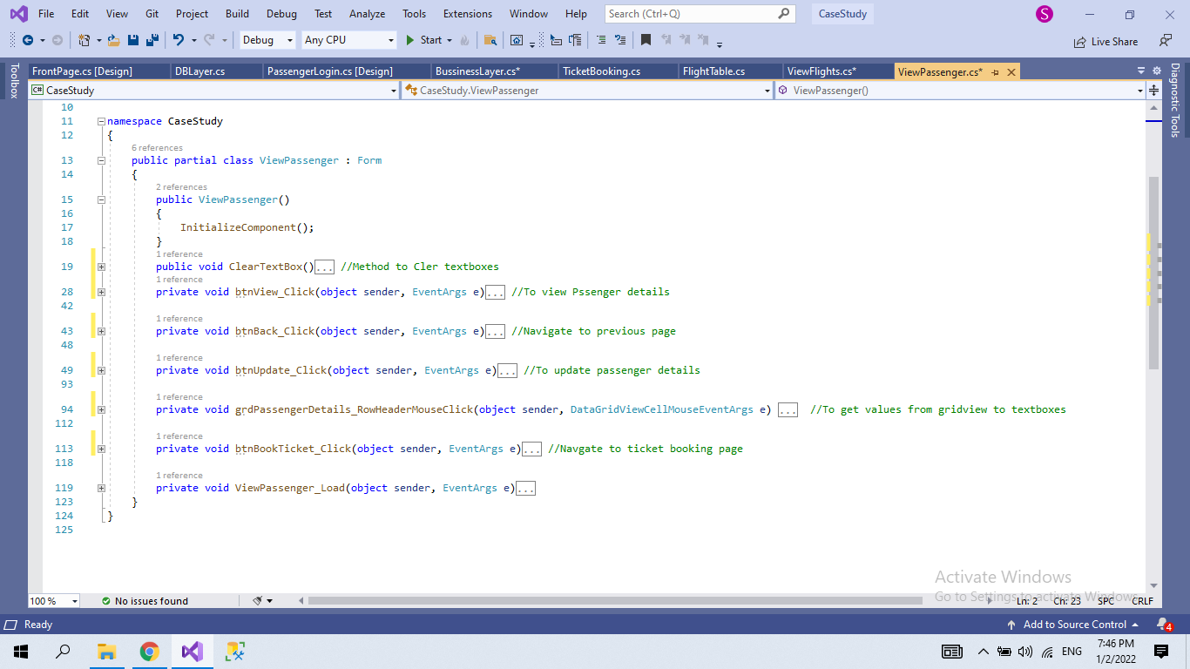
Sample Code Snippets

Slide 14
Requirement & GUIs
Visual Studio : Code and Build Software
Sql Databases
System Specifications :
OS :Windows 10
Processor : Intel i5
Ram : 8 GB

Slide 15
Individual contribution
Samyuktha Ganesh
User Interface
SRS
Design Document
Flight Module
Database
Anju Rajeev
User Interface
SRS
Design Document
Passenger
Database

Slide 16
Individual contribution
Aiswarya A
User Interface
SRS
Design Document
Ticket Booking
Database

Slide 17
Challenges faced & how it addressed
Developing Control Flow
DataBase Management : Key constraints
Finalizing Seat Reservation

Slide 18
Experience gained
Database management
UI designing
Handling problems using Three Tier Architecture
Team coordination
Time management
Problem solving
Proper usage of programming conventions

Slide 19
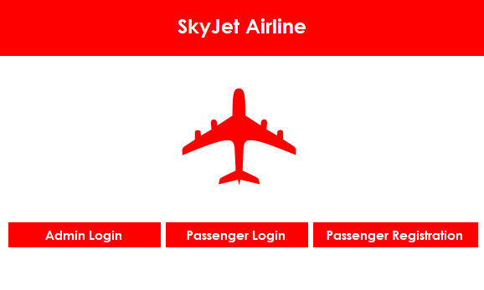
Demo

Slide 20
Thank You

