Slide 1
CRIME RECORD MANAGEMENT
Group 6
March 26,2022

Slide 2
Coverage
Overview of the project
Requirement & GUIs
High Level Design
Individual contribution
Challenges faced & how it addressed
Experience gained

Slide 3
Overview
Develop Crime Record Management Application using .NET framework
Project functionalities
Case Registration
Fir
Charge Sheet
Investigation Status
Users concerned:
Admin
User
Writer
Officer

Slide 4
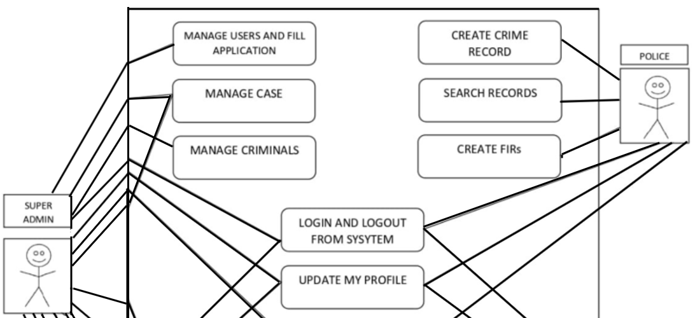
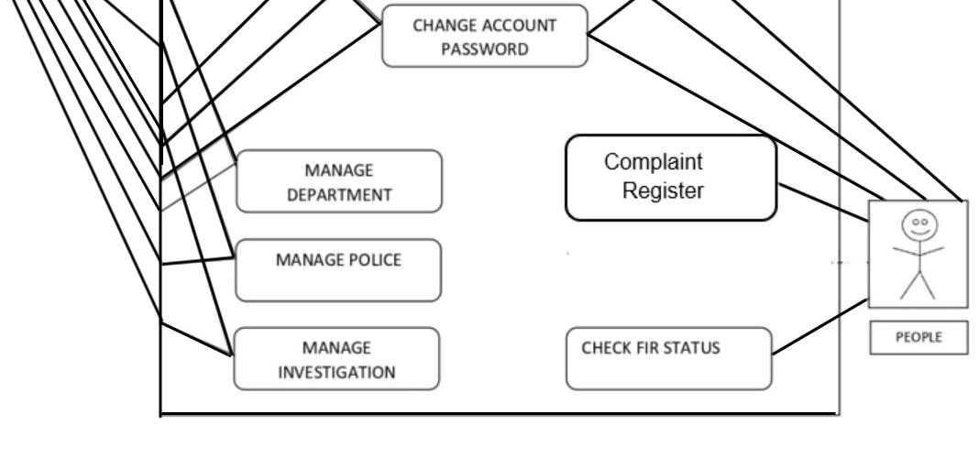
High Level Design
1.Use Case

Slide 5
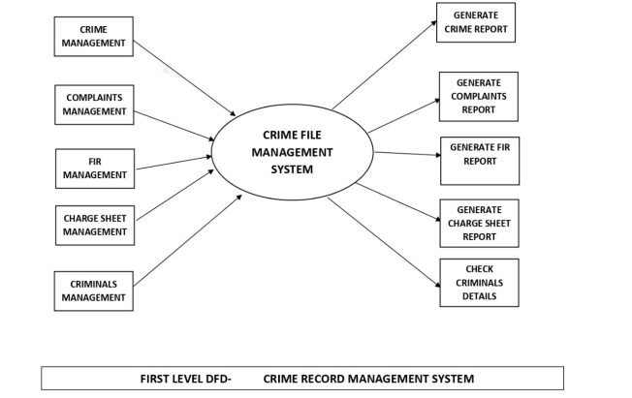
First level DFD

Slide 6
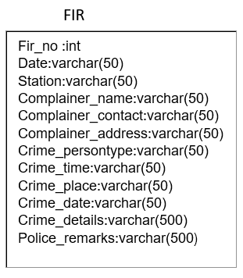
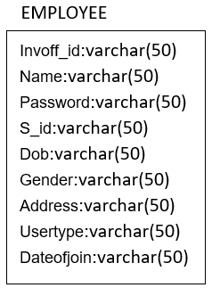
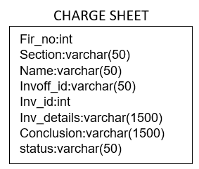
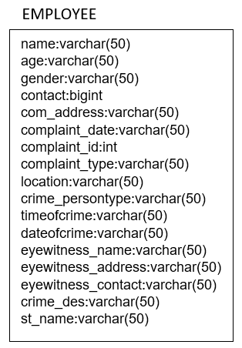
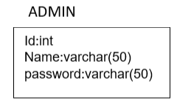
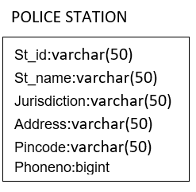
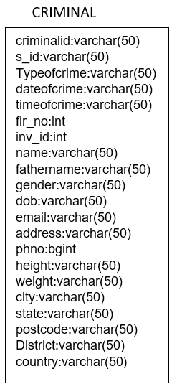
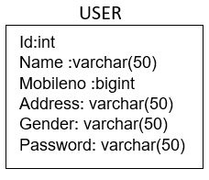
High Level Design
4.Table Design
Notes:
amala

Slide 7
High level design
Class :Admin
Functionality | Description
Add | The system allows the admin to add users and employee.
Delete | The system allows the admin to delete users and employee
Update | The system allows the admin to update details of users and employee.
View | The system allows the admin to view users and status of case.
Class: User
Functionality | Description
Register complaint | The system allows the users to register complaints.
View | The system allows the users to view the status of their complaints.

Slide 8
High level design
Class Complaints
Functionality | Description
Add | The system allows the user and the employees to add complaints
Delete | The system allows the employees to delete complaints
Update | The system allows the employees to update complaints
View | The system allows the user and the employees to view complaints
Class: Fir
Functionality | Description
View | The system allows the employees to view fir.
Register | The system allows the employees to register fir.

Slide 9
High level design
Class:Criminals
Functionality | Description
Add | The system allows the employees to add criminal details.
Delete | The system allows the employees to delete criminal details.
Update | The system allows the employees to update criminal details.
View | The system allows the employees to view criminal details.
Class: Charge Sheet
Functionality | Description
Assign | The system allows the employees to assign the investigation officer.
View | The system allows the employees to view the charge sheet.
Delete | The system allows the employees to delete charge sheet.

Slide 10
High level design
Functionality Table
Test Module | Test Scenario | Test Case | Expected Result | Actual Result | Pass/Fail
Admin | Verify login. If necessary, verify registration,view, delete and edit. | Validate username and password | Admin successfully logged in and made the necessary changes | Admin successfully logged in and made the necessary changes | pass
User | Verify login. If necessary, verify registration,view, delete and edit | Validate username and password | Admin successfully logged in and made the necessary changes | Admin successfully logged in and made the necessary changes | pass
Employee | Verify login. If necessary, verify registration,view, delete and edit | Validate username and password | Admin successfully logged in and made the necessary changes | Admin successfully logged in and made the necessary changes | pass
Complaint | Register and view | Button Click | Registered or Viewed successfully | Registered or Viewed successfully | pass
Fir | Register and view | Button Click | Registered or Viewed successfully | Registered or Viewed successfully | pass
Chargesheet | Register ,View ,Update | Button Click | Registered or Viewed or edited successfully | Registered or Viewed successfully | pass
Notes:
abby

Slide 11
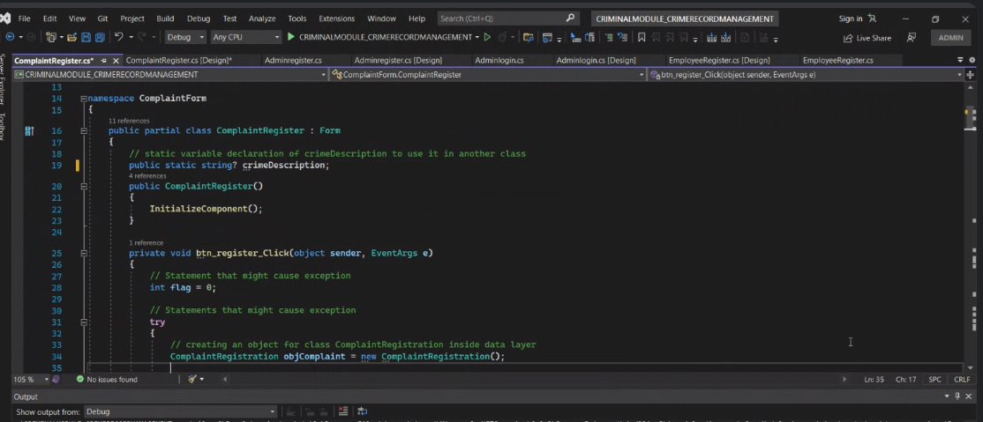
Sample Code Snippets

Slide 12
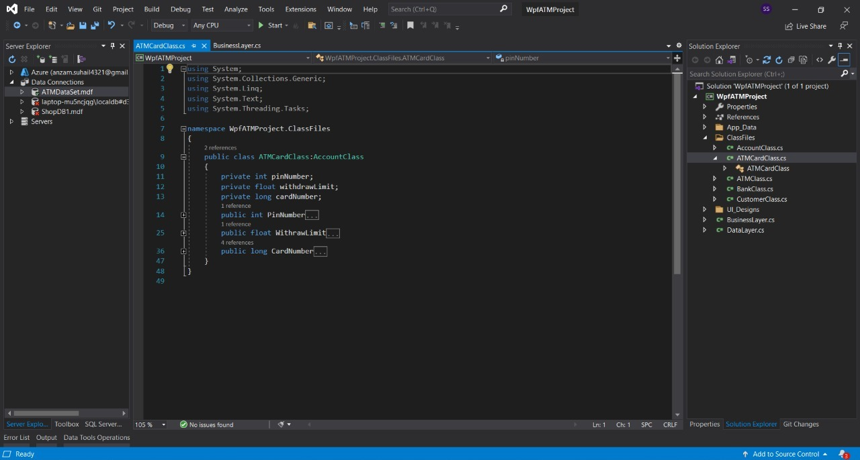
Sample Code Snippets
Notes:
sumayya

Slide 13
Requirement & GUIs
Visual Studio : Code and Build Software
Sql Databases
System Specifications :
OS :Windows 11
Processor : Intel i5
Ram : 8 GB

Slide 14
Individual contribution
Abdul Hakkim S
Charge Sheet Module
Criminal Module
Cynthia Ann Binny
Fir Module
PPT
Lekshmy P
Complaint Module
SRS
R Ravi Shankar
Admin Module
User Module
Notes:
abby

Slide 15
Challenges faced & how it addressed
Finalizing Design Functionalities : Splitting into modules
Developing Control Flow
DataBase Management : Key constraints
Function call conflicts

Slide 16
Experience gained
Database management
UI designing
Handling problems using Three Tier Architecture
Team coordination
Time management
Problem solving
Proper usage of programming conventions

Slide 17
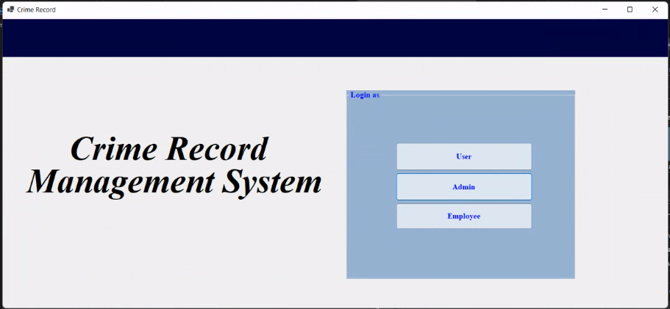
Demo

Slide 18
Thank You

