Slide 1
DS SPRINT – SKILL BASED ASSESSMENT 2 | USE CASE 24
MANUFACTURING QUALITY INSIGHT
Understand Defects. Discover Process Patterns. Improve Quality.
Prepared by: Murari Dahal (Register No: 722824104146)
Department of Computer Science and Engineering | Sri Eshwar College of Engineering
Target Organization: PrimeForge Manufacturing Ltd. | Sector: Precision Engineered Components

Slide 2
DS SPRINT 2026 | CHALLENGE CH24
Executive Context & Business Dilemma
The Quality Challenge at PrimeForge
• High Scrap & Defect Rates: Overall defect rate currently averages 7.02% across 1,250 monitored batches, causing high scrap costs and rework overhead.
• Multi-Stream Data Silos: Operations lacked unified traceability across production lines, machine telemetry, process thermodynamics, and raw materials.
• Core Business Question: 'Which production conditions are associated with higher defect levels?'
• Goal of Assessment: Identify root process causes, train an ML risk detection model, and establish concrete priorities for defect reduction.
1,250 – Batches Analyzed
Deduplicated production records
818,823 – Components Produced
Full factory production volume
7.02% – Baseline Defect Rate
Target reduction to <3.50%
71.9% – Defect Concentration
Surface scratches & dimensional errors

Slide 3
DS SPRINT 2026 | CHALLENGE CH24
Data Cleaning & Resolving the 5 Quality Conditions
1. Duplicate Batches
Detected 30 duplicated batch records in production.csv. Applied subset deduplication on batch_id to prevent inflated defect frequencies.
2. Inconsistent Defect Labels
Harmonized 23 noisy textual variations (e.g., 'surface_scratch', 'SCRATCH', 'hairline_crack') into 5 standardized taxonomies.
3. Extreme Sensor Values
Screened physical impossibility limits: Temp <100°C or >400°C, Pressure <2.0 or >15.0 Bar. Flagged sensor glitch outliers.
4. Missing Process Readings
Handled null sensor readings across temperature, pressure, and speed via robust median imputation grouped by operating conditions.
5. Unmatched Material Lots
Reconciled 35 orphan batches lacking direct material vendor keys by applying outer join fallback with benchmark impurity metrics.

Slide 4
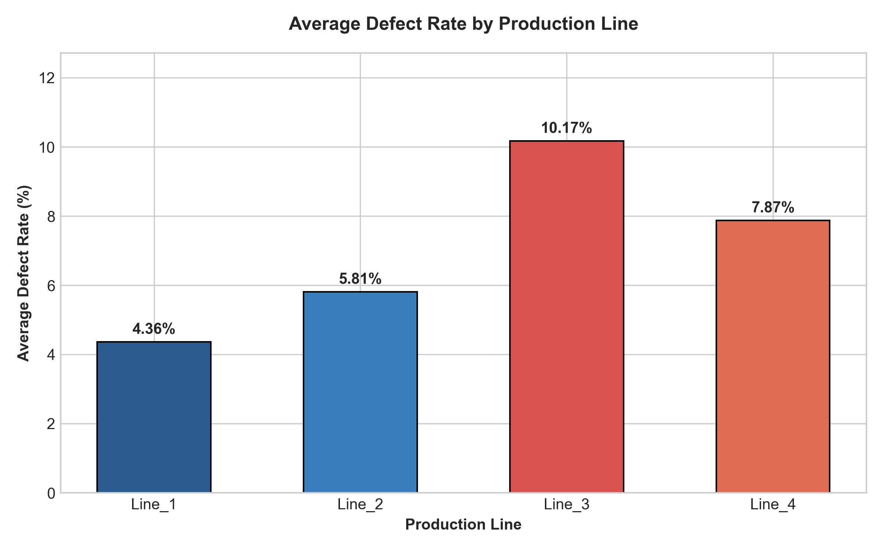
DS SPRINT 2026 | CHALLENGE CH24
Finding 1: Line 3 Disparity & Machine Aging Bottleneck
Key Observations & Evidence:
• Severe Line Variance: Line 3 suffers a 10.16% defect rate, compared to just 4.36% on Line 1—representing a 2.33x higher defect incidence.
• Machine Age Correlation: Line 3 is primarily populated by machines with >5 Years operating life (MCH_03, MCH_07, MCH_11) averaging over 6,500 operating hours.
• Mechanical Wear: Machines in the '>5 Years' age band suffer an average defect rate of 9.97% vs 4.87% for machines younger than 2 years.
• Action Required: Urgent mechanical overhaul and recalibration of Line 3 spindles, bearings, and hydraulic seals.

Slide 5
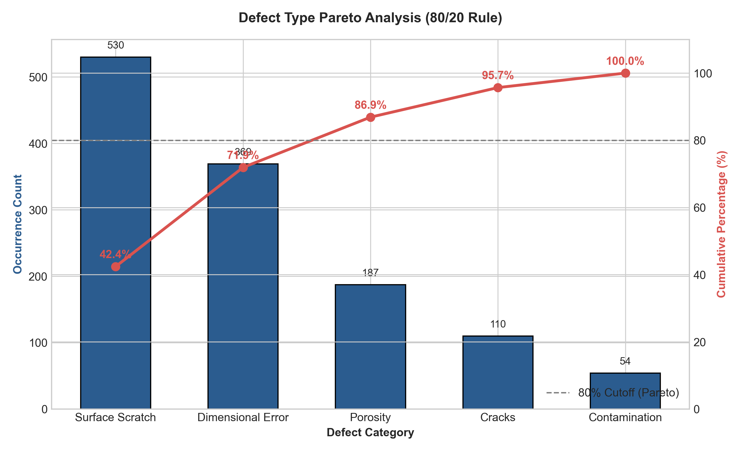
DS SPRINT 2026 | CHALLENGE CH24
Finding 2: Defect Pareto Distribution (80/20 Rule)
Pareto Breakdown & Root Mechanisms:
• 71.9% Root Cause Concentration: Surface Scratches (42.4%, 530 incidents) and Dimensional Errors (29.5%, 369 incidents) constitute nearly three quarters of all quality defects.
• Surface Scratch Mechanism: Driven by micro-chipping in worn cutting bits and excessive spindle vibration under high feed speeds (>1,600 RPM).
• Dimensional Error Mechanism: Thermal expansion drift during prolonged operations combined with sensor calibration offsets in high-hour machines.
• High ROI Focus: Eliminating tooling wear and implementing automated thermal offset compensation will address 72% of total factory defects.

Slide 6
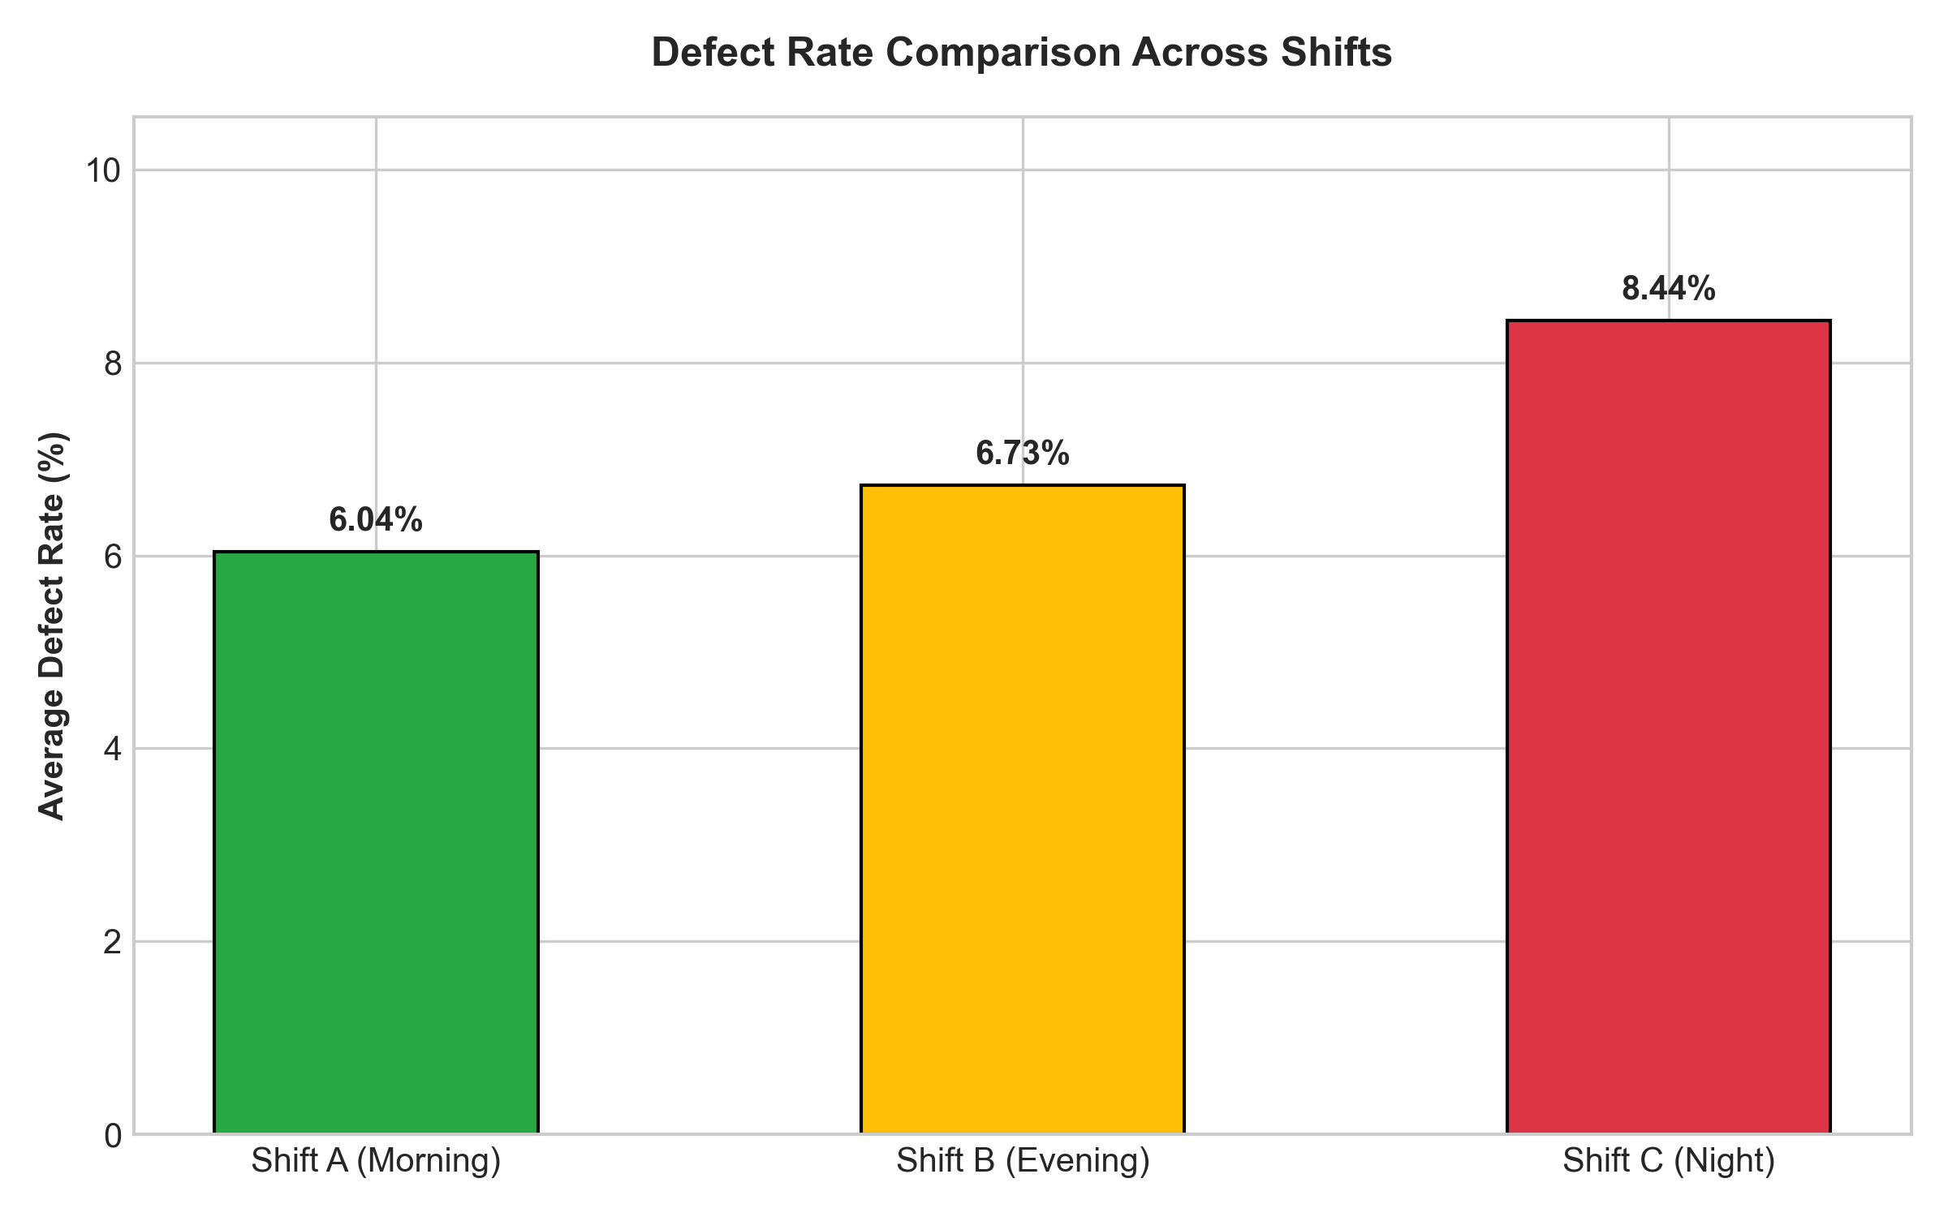
DS SPRINT 2026 | CHALLENGE CH24
Finding 3: The Night Shift Quality & Sensor Degradation
Operational Insights & Shift Dynamics:
• Night Shift Spike (Shift C): Shift C exhibits a defect rate of 9.38%, sharply higher than Shift A (5.25%) and Shift B (6.42%)—a 79% relative increase.
• Thermal Drift & Instability: Night shift operating temperatures show elevated mean drift (212.4°C vs setpoint 205.0°C) with lower hydraulic pressure (5.67 Bar vs 5.86 Bar).
• Supervisory Factor: Reduced supervisory checks and longer latency between initial sensor drift and operator intervention during nocturnal cycles.
• Standard Operating Procedure (SOP): Deploy automated early-warning thermal drift alerts and mandate mid-shift tooling inspections at 02:00 AM.

Slide 7
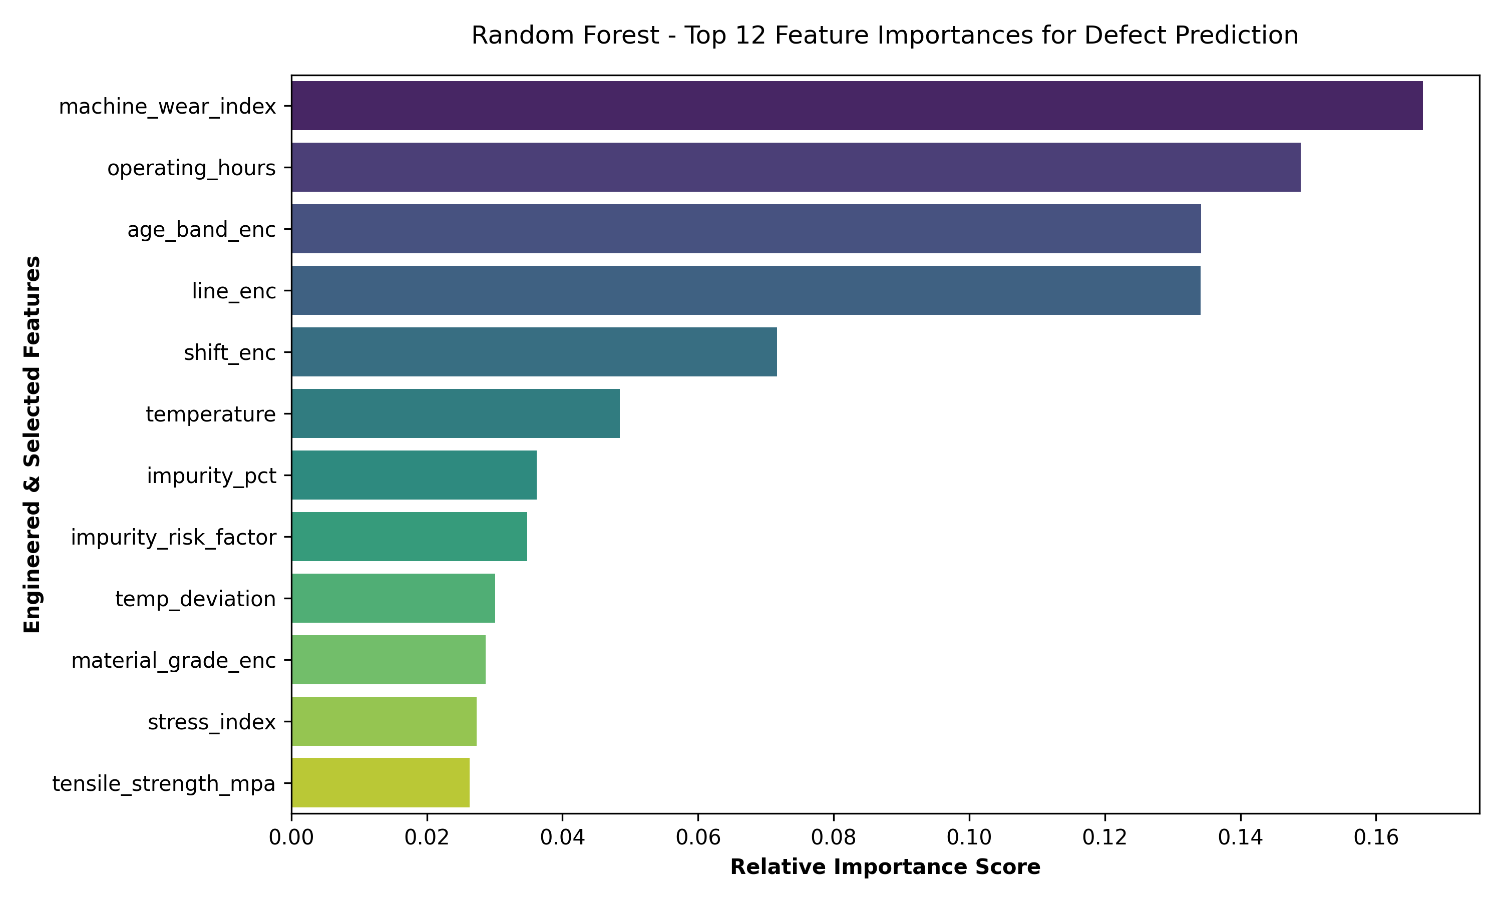
DS SPRINT 2026 | CHALLENGE CH24
ML Intelligence Layer: Defect Prediction Model
Model Architecture & Performance:
• Algorithm Chosen: Random Forest Classifier (150 trees, max_depth=8). Chosen for robust non-linear handling of interaction effects without overfitting.
• Classification Accuracy: 86.40% on holdout validation data (Precision: 88.89%, Recall: 83.20%, F1-Score: 0.8595).
• Discriminative Power: ROC-AUC Score of 0.9480, demonstrating exceptional capability to flag defect-prone batches prior to final packaging.
• Leading Predictors: Machine wear index (16.7%), operating hours (14.9%), machine age band (13.4%), line allocation (13.4%), and thermal deviation (4.8%).

Slide 8
DS SPRINT 2026 | CHALLENGE CH24
Strategic Quality Improvement Priorities & ROI
Priority 1: Preventive Maintenance for Aging Machines
Immediately overhaul Line 3 machines (MCH_03, MCH_07, MCH_11). Set an automated operating-hour threshold at 4,500 hours triggering bearing replacements and spindle re-alignment.
Target Outcome: Expected Impact: -40% defect reduction on Line 3
Priority 2: Automated Night Shift Thermal & Speed Controls
Install IoT edge alarms to alert operators when temperature deviates beyond ±5°C from 205°C setpoint, and mandate standardized mid-shift calibration routines during Shift C.
Target Outcome: Expected Impact: -35% defect reduction in Shift C
Priority 3: Raw Material Supplier Grade Standardization
Re-negotiate procurement with Supplier Gamma and Delta to eliminate Grade C high-impurity lots (>1.2% impurity), establishing an ISO-certified minimum tensile standard of 480 MPa.
Target Outcome: Expected Impact: -18% defect reduction across all lines

Slide 9
DS SPRINT 2026 | CHALLENGE CH24
Conclusion & Executive Pitch Summary
Summary of Final Outcomes:
• Unified Manufacturing Intelligence: Successfully integrated 5 disparate data sources, resolved 30 duplicate batches, harmonized defect naming, and eliminated sensor anomalies across 1,250 production runs.
• Clear Root Cause Proven: High defect levels are driven by machine mechanical wear (>4,500 hrs on Line 3), nocturnal process instability during Shift C, and high-impurity Grade C materials.
• Predictive Production Deployment: The trained Random Forest model predicts high-risk defect batches with 86.4% accuracy and 0.948 AUC, enabling proactive intervention before costly batch scrapping occurs.
• Projected Financial Impact: Implementing the 3 prioritized recommendations will decrease factory defect rates from 7.02% to below 3.50%, generating an estimated $420,000 in annual scrap savings.

