Slide 1
How Can a Wellness Technology Company Play It Smart?
Last updated: November 2nd, 2021

Slide 2
Table of Contents
Statement of Task
Summary of Analysis
Recommendations
Resources

Slide 3
Statement of Task
Analyze smart device usage data in order to gain insight into how consumers use non-bellabeat smart devices.

Slide 4
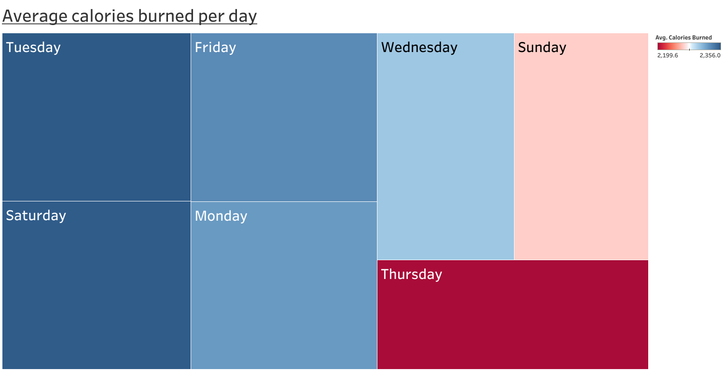
Summary of Analysis

Slide 5
Summary of Analysis
Days where most calories on average were being burned were Tuesday and Saturday.
Days where the least amount of calories on average were being burned were Thursday and Sunday.

Slide 6
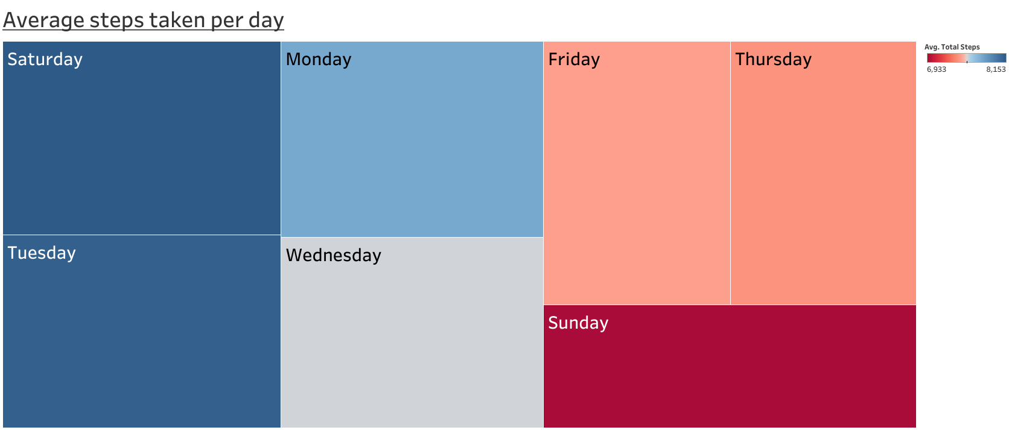
Summary of Analysis

Slide 7
Summary of Analysis
Days where most steps on average were taken were Saturday and Tuesday.
Days where least steps on average were taken were sunday and Thursday.

Slide 8
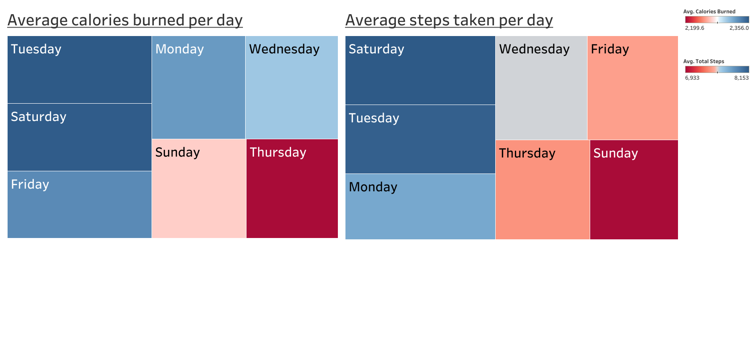
Summary of Analysis
The most active days during the week are: Tuesday and Saturday.
The least active days during the week are: Sunday and Thursday.

Slide 9
Recommendations
We should focus on getting better data first.
Time frame was only a month.
Many users did not fully submit all the data required on a daily basis.
With the data that I do have, I recommend the following:
Using the Bellabeat app we should drive the users to being more active on Sundays. During the work week there are too many unknowns and too little time to always find time to exercise. Saturdays already accomplish this and users have a larger window to be active during the weekend.

Slide 10
Questions?

Slide 11
Resources
Data: Public data was pulled from here.
In-depth write up on cleaning and analysis process here.

