Slide 1
Comparing Casual and Annual Members
Last Updated: October 13th, 2021

Slide 2
Table of Contents
Statement of Task
Summary of Analysis
Recommendations
Resources

Slide 3
Statement of Task
Identify how annual and casual riders use bikes differently in order to design marketing strategies aimed at converting casual riders into annual members.

Slide 4
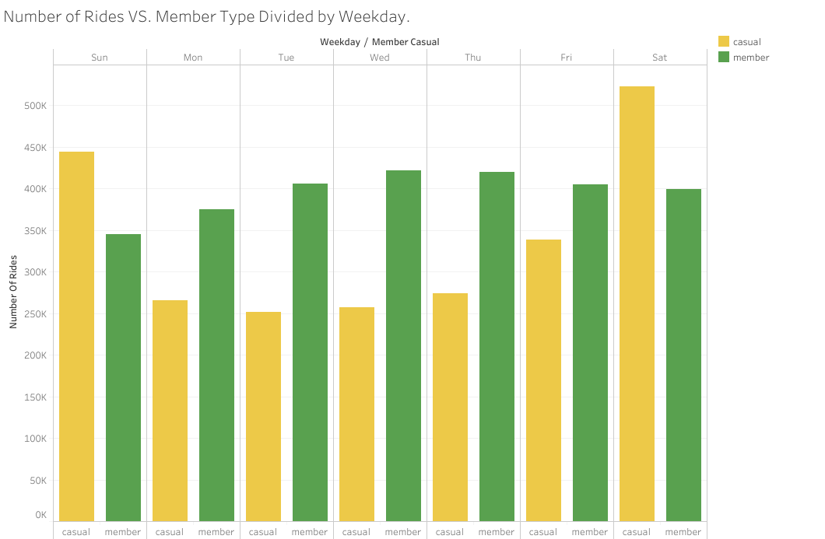
Summary of Analysis

Slide 5
Summary of Analysis
Annual members use is higher during the work week(Monday – Friday)
Casual members tend to use bikes more during the weekends.

Slide 6
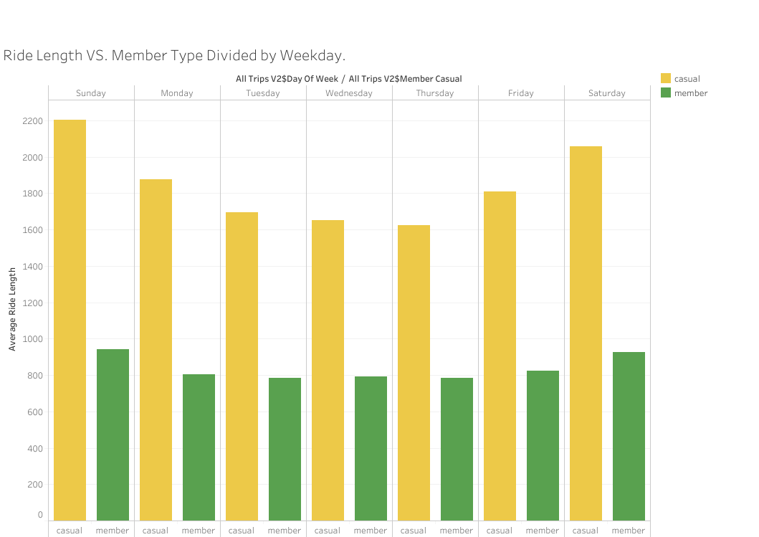
Summary of Analysis

Slide 7
Summary of Analysis
On average annual members ride for less than 20 min.
On average casual members ride for over 20 min.
Annual members bike use coincides with commuting to and from work.
Majority of casual members bike use coincides with recreational use.

Slide 8
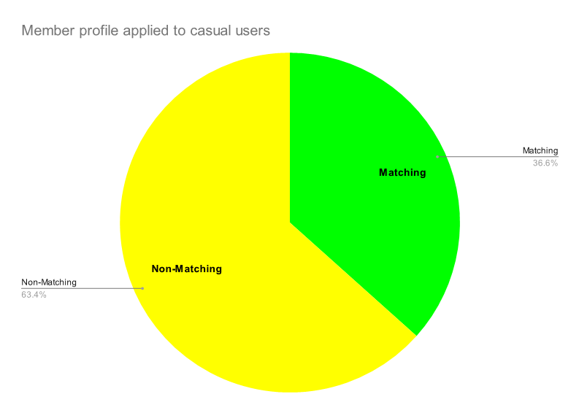
Summary of Analysis

Slide 9
Summary of Analysis
Annual member behavior was compiled into a member profile.
Profile consisted of:
  Travel time is less than 20 minutes
  Trip is during work week (Monday through Friday)
Annual member profile was applied to casual members to determine how many trips could be a better fit for marketing to target.
36.6% of casual trips matched the profile of an annual member.

Slide 10
My Recommendations
I recommend the marketing strategy focus on the group of casual users who have similar riding patterns as annual members:
Target casual users who ride during the work week(Monday – Friday)
Target casual members whose ride length is less than 20 minutes.
Marketing should focus advertising being shown during morning and evening commutes to better target casual members fitting the annual member profile.

Slide 11
Questions?

Slide 12
Resources
Data: sourced directly from company website
Detailed write up of data cleaning and analyzing process here

