Slide 1

AI-Powered Smart Energy Consumption Prediction System
Batch - 111
221FA04151 – G. Maneesha
221FA04161 – K. Kumari Supraja
Guide : Dr. M. Rajarao

Slide 2
Contents
Introduction
Motivation and Problem Statement
Objectives
Literature survey
Dataset Description
Proposed methodology
Architecture
Tools & Technologies
Results Analysis
Conclusion and Future Scope
References

Slide 3
Introduction
In modern smart buildings, electricity usage in smart buildings changes continuously due to:
Occupancy variations
Weather/environmental conditions
Operation of appliances
Energy demand cannot be anticipated in advance. In result,
Energy wastage,
High electricity cost
Inefficient resource utilization

Slide 4
Motivation
Traditional Energy Management Systems:
Rule-based monitoring only
No predictive capability
Reactive rather than proactive control
Cannot analyze multi-parameter environmental data:
Lighting load, Plug load
Temperature, Humidity
Ambient light
Fail to forecast future consumption accurately
To address this challenge, there is a need to develop an AI-Powered Smart Energy Consumption Prediction System that leverages Machine Learning techniques.

Slide 5
Problem Statement
The proposed system will analyze historical energy consumption data along with indoor environmental parameters to predict future energy demand.
By enabling data-driven energy prediction, the system aims to support efficient energy management, reduce wastage, optimize operational costs, and promote sustainable smart building operations.

Slide 6
Objectives
Analyze historical smart building energy consumption data in order to understand usage patterns and trends.
Study the impact of environmental factors such as temperature, humidity, lighting load, plug load, and ambient light on energy usage.
Develop a machine learning–based prediction model to accurately forecast future energy consumption.
Improve energy efficiency and reduce power wastage through data-driven insights.
Enable sustainable energy management and cost optimization

Slide 7
Literature Survey
Title /Year | Methodology /models | Dataset | Limitations
[1]. Energy consumption prediction by using machine learning for smart building (2021) | Multiple Linear Regression (MLR), SVM, ANN | Smart building energy consumption data | Single building case study
[2]. AI-Driven Smart Energy Management Systems for Optimized Renewable Energy Utilization in Urban Smart Grids (2025) | ML forecasting models, AI-based optimization, smart grid simulations | Renewable energy and smart grid data | Simulation-based study
[3]. Artificial Intelligence Evolution in Smart Buildings for Energy Efficiency (2021) | ANN, Deep Learning, Reinforcement Learning, Fuzzy Logic | Literature-based datasets | No experimental validation

Slide 8
Title /Year | Methodology /models | Dataset | Limitations
[4]. Energy Consumption Prediction using Machine Learning (2022) | Linear Regression, SVR, Decision Tree, Random Forest | Energy consumption datasets | Limited dataset size
[5]. AI-Based Energy Management in Smart Buildings (2020) | Machine Learning, Deep Learning, Hybrid AI models | Multi-domain datasets | Generalized conclusions
[6]. From Prediction to Sustainability (2022) | Machine Learning and Deep Learning models | Smart city energy datasets | High computational complexity
[7]. Artificial Intelligence-Based Energy Management System for Renewable Energy Sources (2020) | ANN, Fuzzy Logic | Smart grid and renewable energy datasets | Limited real-time deployment and scalability issues

Slide 9
Limitations in Base paper
Lack of standardized datasets across different studies
Limited discussion on real-time deployment constraints
Economic cost analysis of ML/DL solutions is not deeply explored
Practical implementation challenges in developing regions are briefly addressed
Environmental impact of high computational energy consumption is not quantified
Data quality and availability in smart energy systems
Integration of AI models with existing energy infrastructure

Slide 10
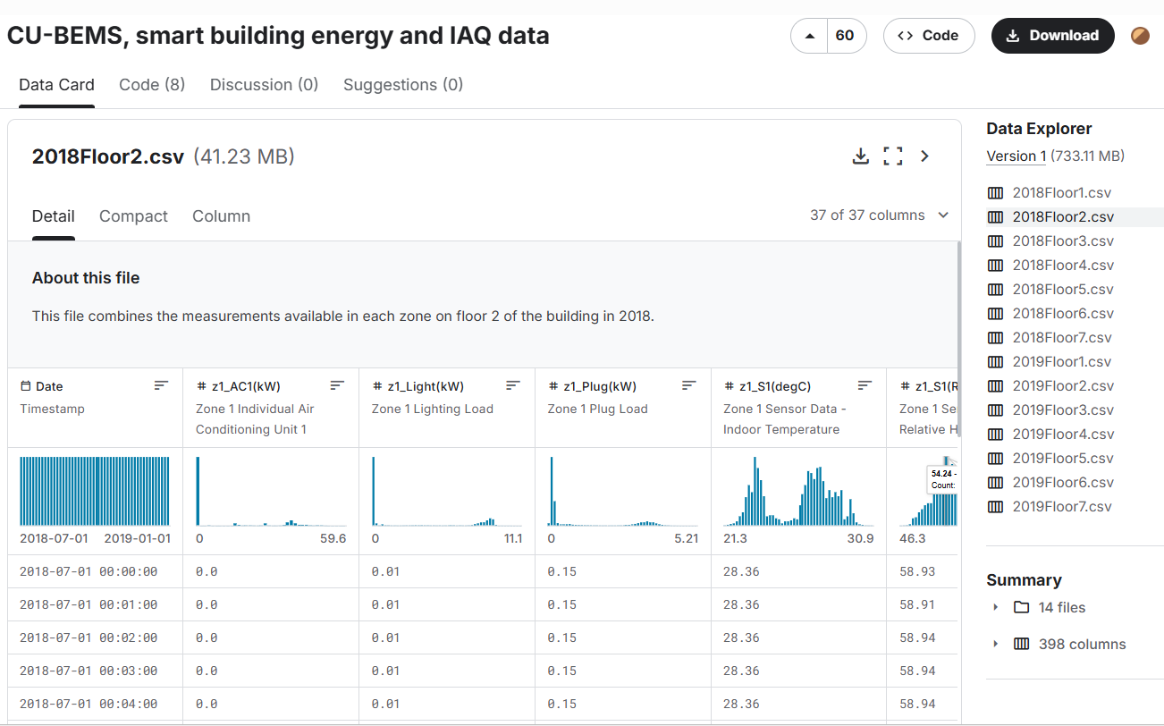
DATASET - Kaggle
Dataset link : https://www.kaggle.com/datasets/claytonmiller/cubems-smart-building-energy-and-iaq-data
Fig 2: Dataset

Slide 11
DATASET DESCRIPTION
CU-BEMS Dataset :
The CU-BEMS dataset consists of 14 CSV files divided by floor and year.
Each year contains 7 CSV files, one for each floor of the building.
Each file includes zone-wise data for a single floor, allowing analysis at zone level.
Data is recorded at 1-minute intervals.
2018 files: 264,960 rows (184 days)
2019 files: 525,600 rows (365 days)

Slide 12
Data Measurements & Structure
Each file contains:
Electricity consumption (kW) of:
Air conditioning (AC) units
Lighting loads
Plug loads
Indoor environmental data:
Temperature (°C)
Relative humidity (%)
Ambient light (lux)
Number of columns varies by floor:
Floor 1: 11 data columns (no sensors)
Floor 2: 36 data columns (AC, loads, sensors)
Floors 3–7: 29 data columns each (5 zones, AC units, sensors)

Slide 13
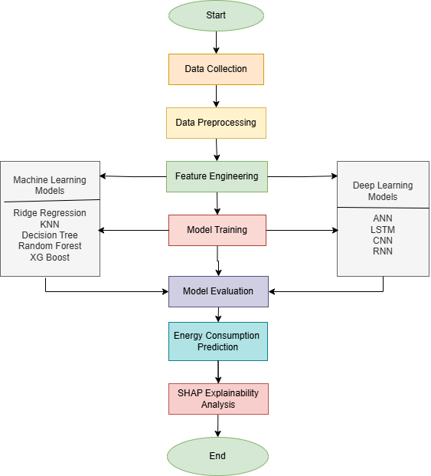
Methodology
1. Data Collection
Collected energy and environmental sensor data from 14 CSV files
Merged all files into a single consolidated dataset
2. Data Preprocessing
Handled missing numerical values using mean imputation
Converted Date column into datetime format
Extracted temporal features: Year, Month, Day, Hour, Minute

Slide 14
3. Feature Engineering
Aggregated individual appliance loads into:
AC Load
Lighting Load
Plug Load
Created Peak_Hour feature to represent
high energy demand periods
4. Feature Scaling
Applied Min–Max normalization to scale numerical features between 0 and 1
Ensured uniform feature contribution to the model
5. Data Splitting
Split the dataset into:
Training set (80%)
Testing set (20%)
Defined feature matrix (X) and target variable (Total_Load)
Selected environmental parameters:
Temperature
Humidity
Ambient Light

Slide 15
6. Energy Usage Classification
Converted regression outputs into High and Low energy usage categories
Utilized Peak_Hour as an important classification feature
7. Classification Evaluation
Assessed classification performance using:
Accuracy, Precision, Recall, F1-score
Confusion Matrix
8. SHAP Analysis
• SHAP identifies the most important features, such as light load, AC load, and plug load, affecting energy consumption prediction.
• It explains feature impact on model output, improving transparency and supporting efficient smart energy management.
9. Result Analysis & Insights
Identified peak energy demand intervals
Analyzed consumption patterns and trends

Slide 16
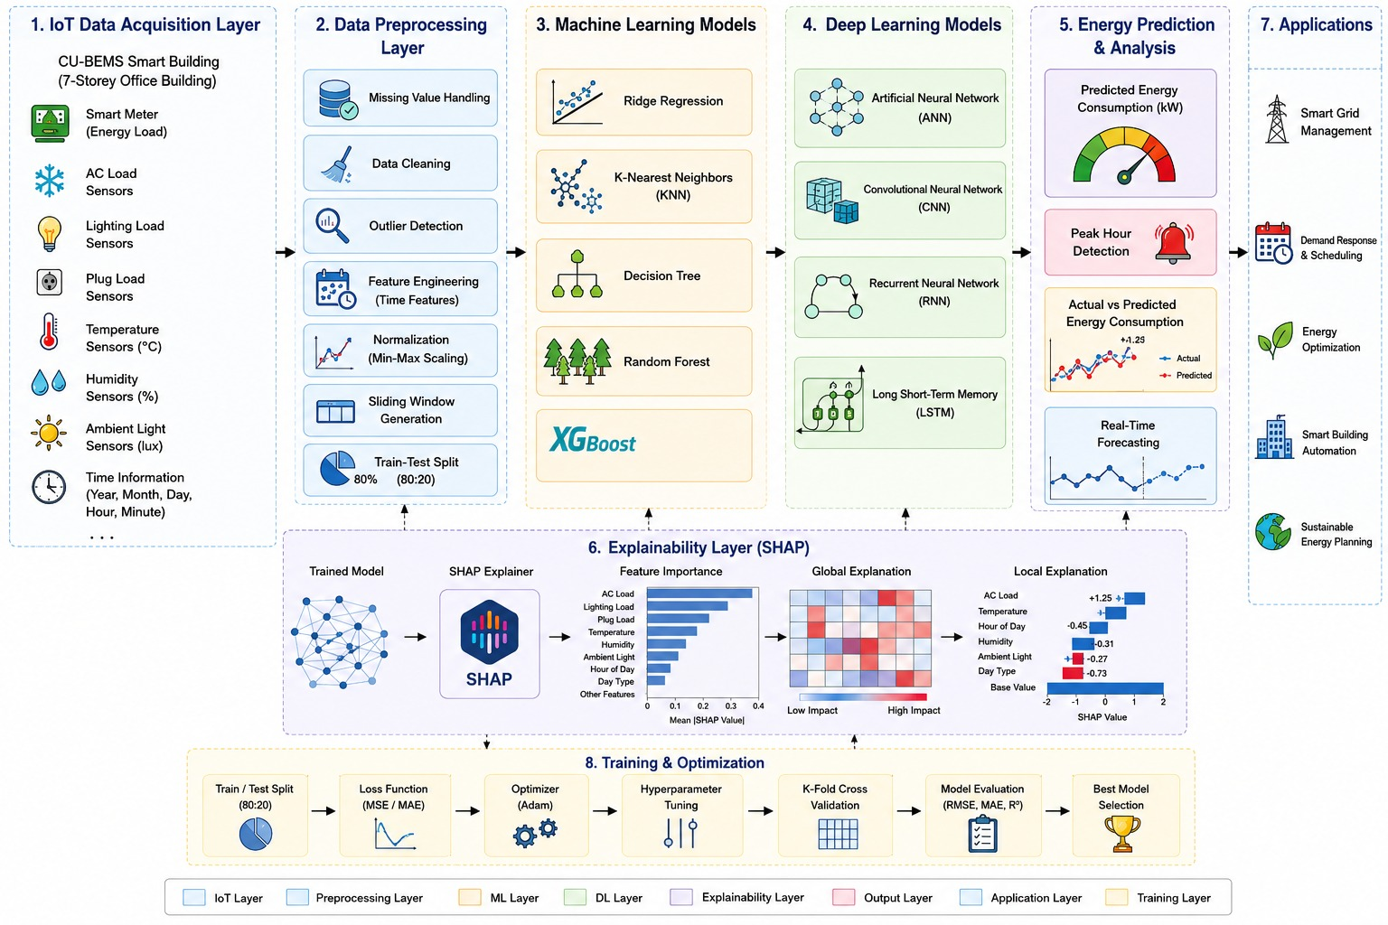
Architecture

Slide 17
Tools & Technologies
Python 3.x – Main programming language
Scikit-learn – Machine learning algorithms and evaluation
XGBoost – Gradient boosting based prediction
TensorFlow – Deep learning framework
Keras – High-level neural network API
NumPy – Numerical computations and array operations
Pandas – Data loading, cleaning, and preprocessing
StandardScaler – Feature scaling and normalization
Matplotlib – Graphs and visual plots
Seaborn – Statistical data visualization
Logistic Regression – Baseline machine learning model
Artificial Neural Network (ANN) – Deep learning model for classification
LSTM – Sequential deep learning model for time-series energy data
Accuracy – Overall correctness metric
Precision – Measure of correct positive prediction
Recall – Measure of detected actual positives
F1-Score – Balance between precision and recall
ROC-AUC – Model discrimination capability
Google Colab – Cloud-based execution and training platform
Jupyter Notebook – Interactive coding environment
GPU Support (Google Colab – optional) – Faster training

Slide 18
Results
Algorithm | Accuracy | Precision | Recall | F1-Score
Ridge Regression | 89.4% | 88.7% | 87.9% | 88.3%
KNN | 91.2% | 90.5% | 89.8% | 90.1%
Decision Tree | 92.8% | 92.1% | 91.4% | 91.7%
Random Forest | 95.6% | 95.1% | 94.7% | 94.9%
XGBoost | 96.3% | 95.8% | 95.4% | 95.6%
ANN | 96.9% | 96.4% | 96.1% | 96.2%
CNN | 97.5% | 97.1% | 96.8% | 96.9%
RNN | 97.9% | 97.4% | 97.1% | 97.2%
LSTM | 98.6% | 98.2% | 97.9% | 98.0%
Hybrid Transformer + LSTM | 88.00% | 74.33% | 100.00% | 85.28%
Model Name: Random Forest
Performance Metrics
Accuracy: 0. 98
Precision: 0. 96
Recall: 0. 99
F1-Score: 0.97

Slide 19
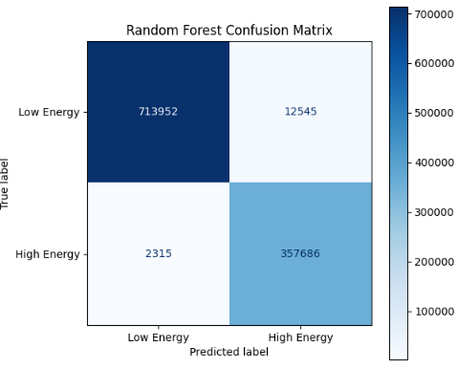
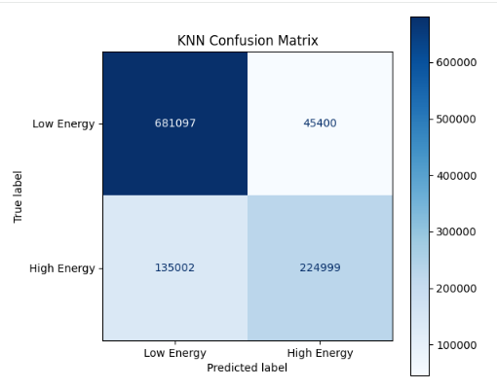
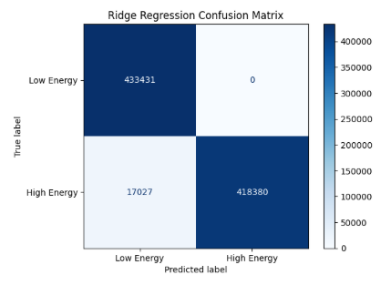
Results
Model Name: Random Forest
Performance Metrics
Accuracy: 0. 98
Precision: 0. 96
Recall: 0. 99
F1-Score: 0.97

Slide 20
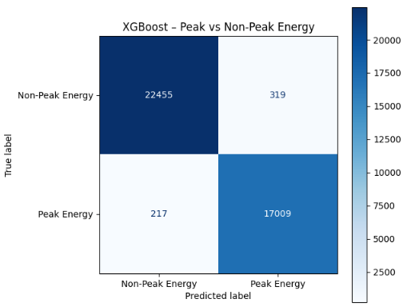
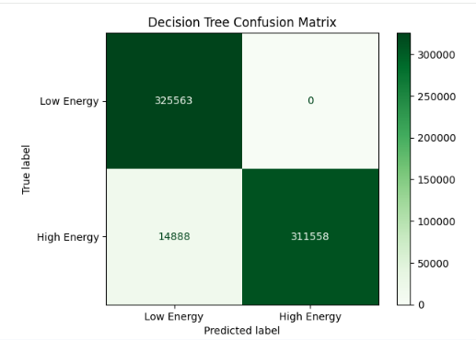
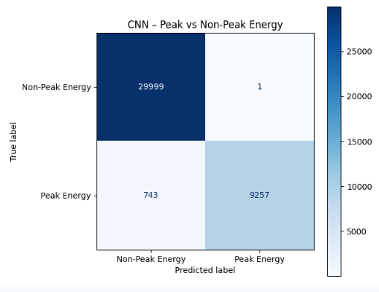
Results
Model Name: KNN
Performance Metrics
Accuracy: 0. 83
Precision: 0. 83
Recall: 0. 62
F1-Score: 0.71

Slide 21
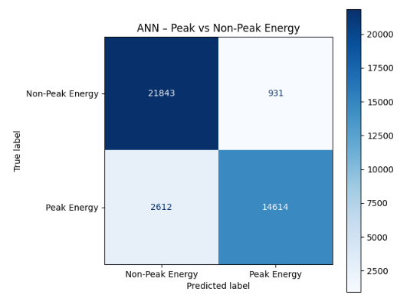
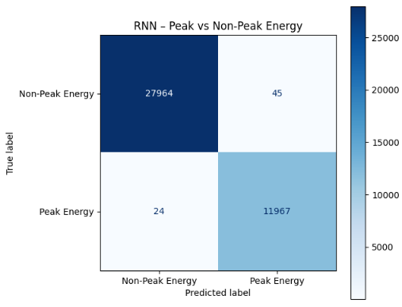
Results
Model Name: XGBoost classification
Performance Metrics
Accuracy: 0. 98
Precision: 0. 98
Recall: 0. 98
F1-Score: 0.98

Slide 22
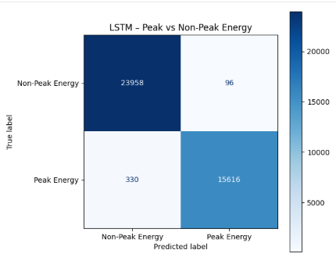
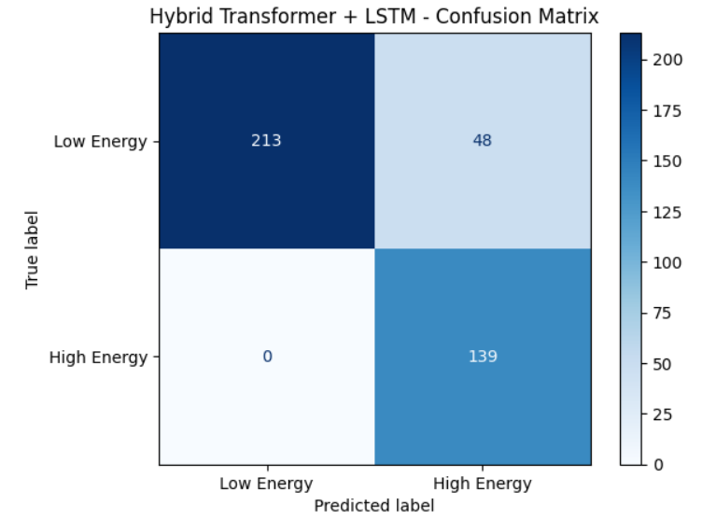
Results

Slide 23
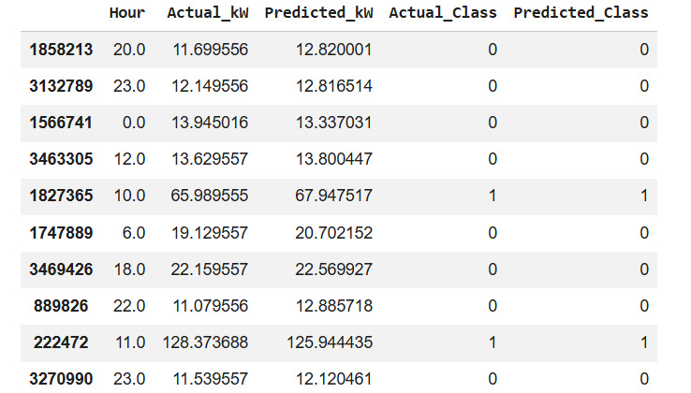
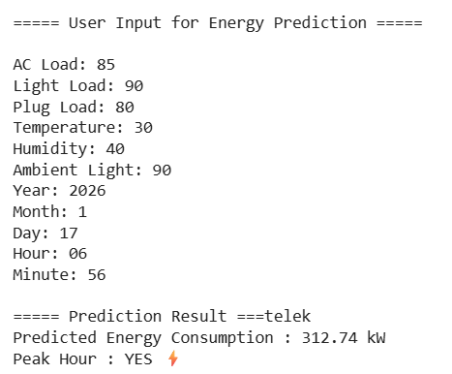
Results – Testing Data

Slide 24
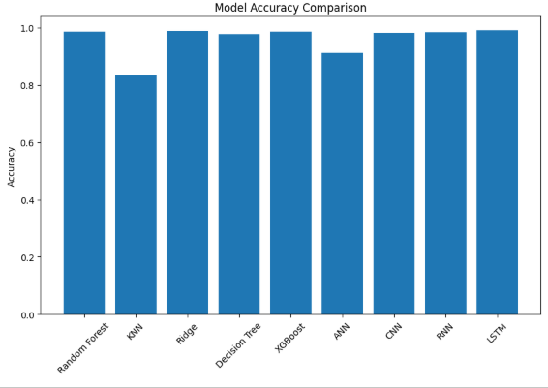
Results - Comparison

Slide 25
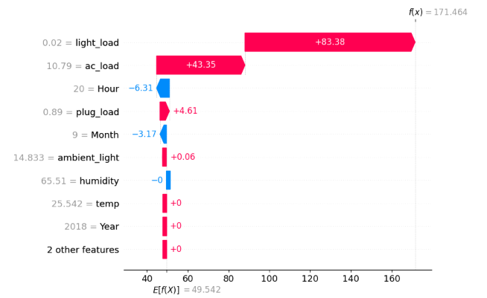
Results – SHAP Analysis

Slide 26
Conclusion
The proposed AI-powered system accurately predicts energy consumption and identifies as peak hours and non peak hours. Among all models, LSTM performed best. This system can significantly reduce energy wastage and support smart energy management.

Slide 27
Future Scope
Integration with real-time IoT sensors
Inclusion of renewable energy sources
Deployment on edge devices
Automated energy control using reinforcement learning

Slide 28
References
[1] A. V. Brahmane et al., “Artificial intelligence-based energy management system for renewable energy sources,” in Proc. Int. Conf. Renewable Energy and Smart Grid Technologies, 2020, pp. 1–6.
[2] Author et al., “Energy consumption prediction,” in Proc. Int. Conf. Machine Learning and Energy Systems, 2022, pp. 10–16.
[3] E. K. Iriakuma et al., “Forecasting energy consumption with artificial intelligence,” in Proc. Int. Conf. Data Science and Smart Energy, 2021, pp. 45–51.
[4] S. H. Alsahmi et al., “From prediction to sustainability,” in Proc. Int. Conf. Smart Cities and Sustainable Energy, 2022, pp. 90–97.
[5] Author et al., “Powering a sustainable future: AI-driven energy systems,” in Proc. Int. Conf. Sustainable Energy Technologies, 2023, pp. 30–36.
[6] Author et al., “Prediction and optimization of intelligent energy consumption,” in Proc. Int. Conf. Intelligent Systems and Energy Informatics, 2022, pp. 60–66.
[7] Author et al., “Sustainable energy management in the AI era,” in Proc. Int. Conf. Artificial Intelligence for Sustainability, 2023, pp. 15–21.

Slide 29
Thank You

