Slide 1

Genre-BOT
Using Natural Language Processing in Music Marketing

Slide 2


CROSS-GENRE MARKETING
PROVIDING THE RIGHT CONTENT
TO THE RIGHT LISTENERS
Listeners have music genre affinities, either self-identified or observed from listening habits
Social media aggregation tools, such as Sprout, can provide us with a wealth of user-generated text content
Top terms from that content tell us what’s trending in each genre
We can mine those terms for marketing and music recommendation opportunities

Slide 3

Data overload
Sprout sends me 1000s of user-generated documents a day from a variety of social media sources
It’s too much for a human to analyze!
So….what do we do?

Slide 4
SUBREDDIT SAMPLING
Data imported from music subreddits such as classicalmusic and jazz via the PushShift API
Posts sampled proportionally across the lifetime of the subreddit to get complete picture
10,000 posts per subreddit used for training
Text content for each document is a cleaned version of the title + the post text
Notes:
Using Reddit as training corpus, but generalize to other text sources
Cleaning included removing URLs, HTML entities, Unicode characters, emojis, and more

Slide 5
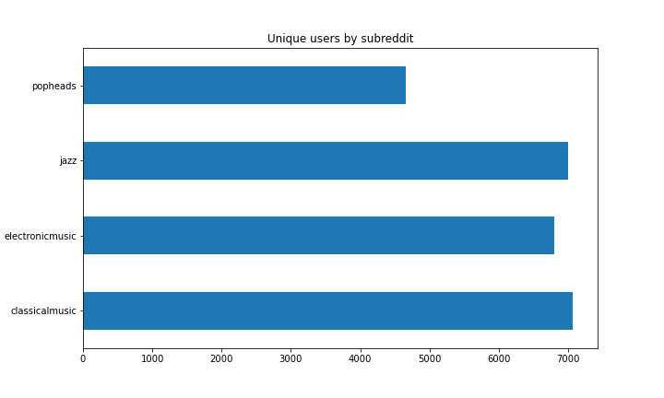
CROSS-GENRE MARKETING
PLENTY OF POSTERS
Unique post authors are mostly well-distributed per genre
Popheads looks a little suspect – fewer authors, probably over-represented writing styles

Slide 6
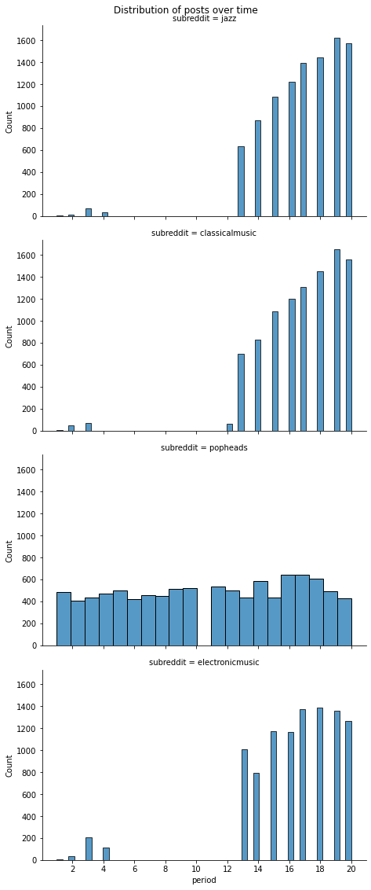

A LIFETIME OF POSTS
Jazz, classicalmusic and electronicmusic all look very similar, including the gap in the middle
Popheads sticks out here too
So we probably won’t use popheads to train

Slide 7
CROSS-GENRE MARKETING
MYRIAD OF MODELS
15 models trained on classicalmusic and jazz subreddits
All but 2 achieved our minimum desired accuracy of 80%
Stemming/lemmatization
Count vs TFIDF vectorization
Logistic regression, K-nearest neighbors, decision trees + tree ensembles, boosted models, stacked models
Collected train accuracy, test accuracy, precision, recall, F1, and time required to fit
Notes:
GridSearchCV over RandomizedSearchCV

Slide 8
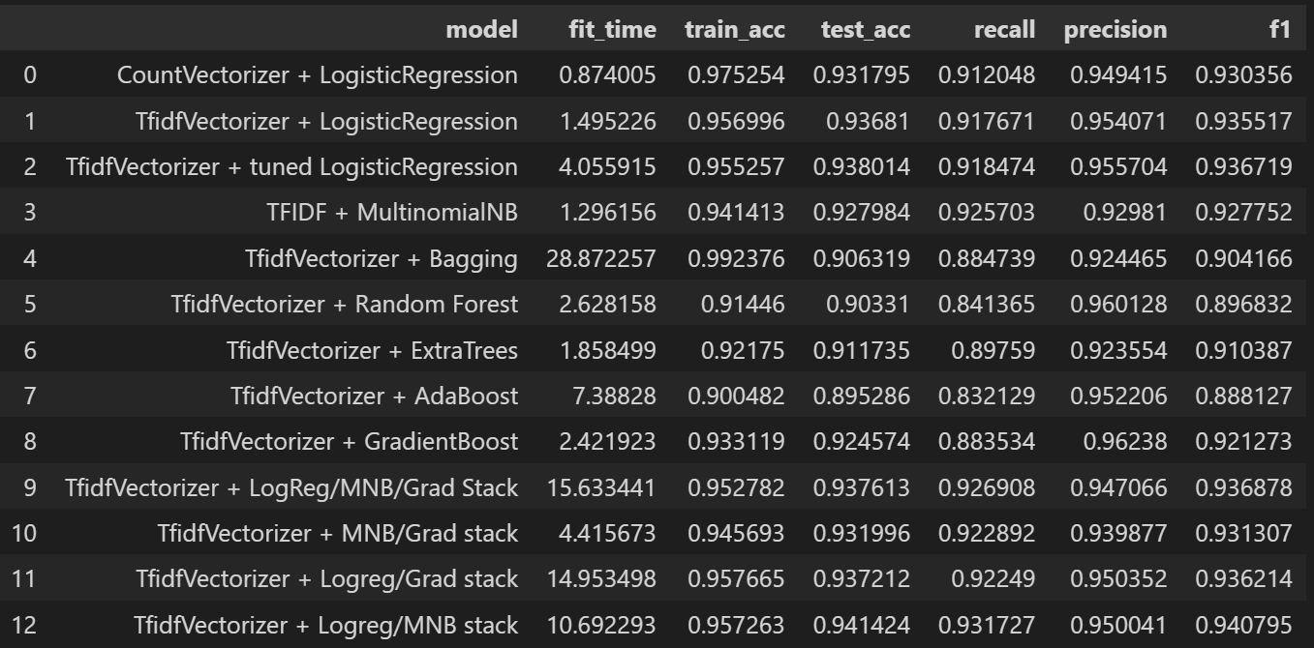
CROSS-GENRE MARKETING
MYRIAD OF MODELS
Notes:
Fit_time doesn’t refer to GridSearch – it refers to the time required to fit the final selected model on the training data

Slide 9
PICKING A WINNER
We mainly care about test accuracy, overfitting delta from train to test, and time required to fit
Weighted sum of these 3 scaled factors – 4:2:1 ratio
Overall scores calculated, and the winner is…

Slide 10
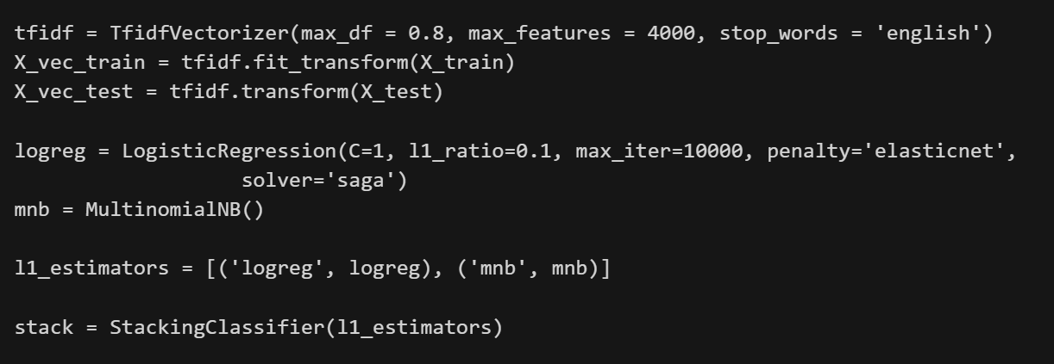
CROSS-GENRE MARKETING
THE VERY LAST ONE
TFIDF + STACK OF LOGISTIC REGRESSION + MULTINOMIAL NAÏVE BAYES

Slide 11
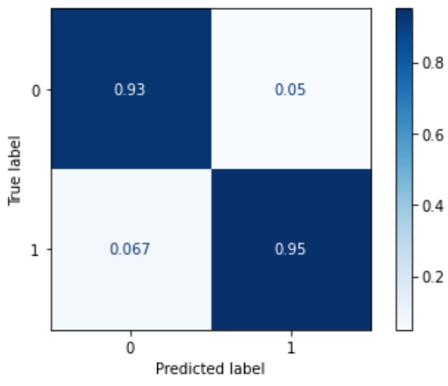
CROSS-GENRE MARKETING
HOW’D WE DO?
Train accuracy of 95.7%
Test accuracy of 94.1%
Recall of 93.2%
Precision of 95.0%
F1 score of 94.1%
Final fit time of 10.1 seconds
True = jazz

Slide 12
CROSS-GENRE MARKETING
HOW’D WE DO?
Misclassified 122 classical posts as jazz
Steps to take to become a singer
soundtrack transcribing to notes or synthesia help
Sambo Godly Talk
Misclassified 170 jazz posts as classical
The Clash Walk Evil Talk The Clash Walk Evil Talk
Looking for upbeat peppy music like the Ren Stimpy theme song
Pain

Slide 13
CROSS-GENRE MARKETING
TOP 10s
CLASSICAL BIGRAMS
classical music 600
don know 84
piano concerto 81
sheet music 55
th century 51
feel like 51
does know 50
ve heard 49
thanks advance 46
classical pieces 45
JAZZ BIGRAMS
miles davis 136
don know 92
big band 90
jazz music 75
does know 69
new jazz 67
john coltrane 60
jazz albums 58
charlie parker 55
feel like 54
CLASSICAL WORDS
music 1824
classical 1108
like 803
piece 676
pieces 639
piano 552
know 545
just 510
ve 426
help 355
JAZZ WORDS
jazz 2753
like 936
music 719
know 637
just 620
ve 515
really 437
looking 420
play 372
new 363
Notes:
Bigrams!!!

Slide 14
WHAT’s NEXT?
Stopwords are our friends and we need to make more
Experiments in clustering and PCA…outlook is murky, supervised seems the way to go
Multi-class problem – there are more than 2 genres in the world…outlook is promising!
Notes:
Clustering – poor silhouette scores
PCA – no improvement at 500 components, more components becomes unworkable
Multi-class – tried 4 experiment, scores dropped slightly but not bad

Slide 15

Thank You
gabrielmangiante@gmail.com

