Slide 1

Presentation By
Manindar G

Slide 2
Introduction:
Big Chain DB is a scalable block chain database created with the characteristics of block chain such as
Decentralization
Immutability
built-in support for creation and transfer of assets.
Bitcoin showed that its possible to create a trustable immutable record of transactions without relaying on a central trusted third party.
Later, many people decided to use the concept behind the bitcoin to store trustable records of any kind.

Slide 3
Issues with Bitcoin Network:
Can not scale
Performance can’t change with number of nodes
Bitcoin
Network
High Latency
Notes:
Unfortunately bitcoin network has several issues as mentioned above.
1) Bitcoin network itself can't scale to handle all the records.
To solve this scaling problem there are many ideas and prototypes, but Big Chain DB took a different approach to solve this scaling problem i.e., it used the proved scalable big-data database and then added the block chain characteristics into it.
2) The current bit coin system records less then 10 transactions per second, which will not change even if we increase the number of nodes. Which means ****Write throughput doesn't scale with node count****.
3) Bitcoin network takes tens of minutes to hours to finalize the bitcoin transaction. Which means it will not scale to handle if there are millions of requests per seconds.

Slide 4
Modern NoSQL databases:
NoSQL
Fast
Eventual Consistent
Available
Reliable
Scalable
Distributed
Low latency
Fault tolerant

Slide 5
Big Data DB to solve Bitcoin issues:
Scalability
All NoSQL databases are highly scalable
Can scale horizontal and vertical
Performance
Latency
All NoSQL DBs can handle millions of requests per second
Performance will increase with respect to node count
We can achieve near real-time responses with NoSQL DBs
With NoSQL DB we can achieve low latency

Slide 6
Can NoSQL DB solve the Bitcoin Network Issue.?
Scalable
High Performance
Low Latency
NoSQL
NoSQL Databases are having vast features, which can solve the current Bitcoin network issues.
But there are no available NoSQL Databases with in built block chain characteristics.

Slide 7
Concept of Big Chain DB:
Block-chain characteristics
NoSQL Features
Big Chain DB
Big chain DB designed with two-layer consensus.
Higher layer
Big chain DB
Lower layer
MongoDB
Handles transaction ordering and crash faults.
Federation handles double spends and malicious attacks.

Slide 8
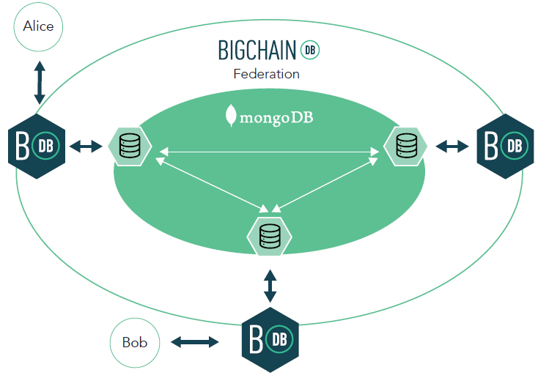
Big Chain DB Architecture:
Notes:
The current BigChain DB architechture is having 2 levels, the outer level is the BigChain DB and each BigChain DB will connect to 1 Mongo DB which is the lower level in architechture.
An external client can connect with any instance of BigChain DB server which will further connect with Mongo DB.
The lower level (Mongo DB) handles transaction ordering and fault tolerance with low latency and high throughput. Where as the higher level (BigChain DB) handles double spends and malicious attacks.

Slide 9
Advantages of Big Chain DB:
Immutable data storage
No central authority (Decentralized System)
Assets over network
High throughput
Low latency
High capacity
Rich permissioning
Query capability

Slide 10
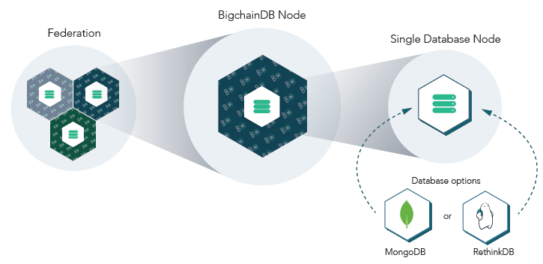
Big Chain DB Federation/Cluster:

Slide 11

How transactions work in Big Chain DB:
Node1
Node2
Node3
Propose (n)
Voting (n,v)
Commit (n,v)
Accept (n)

Slide 12
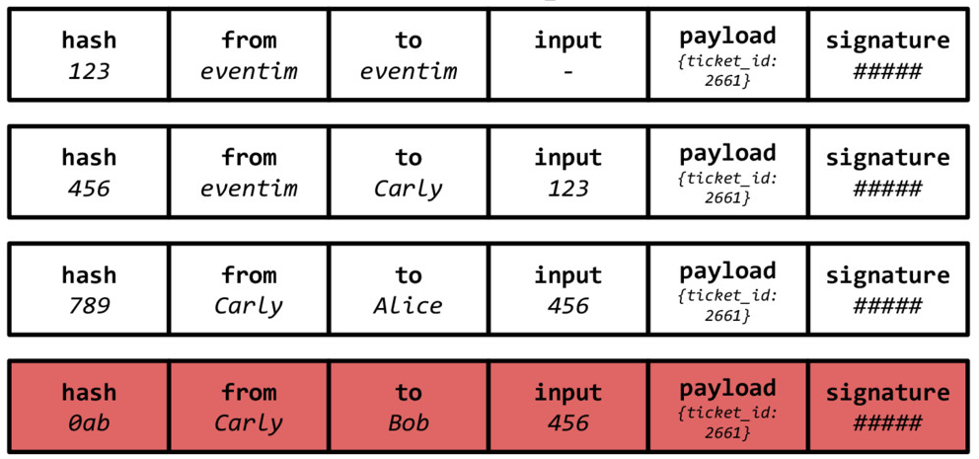
Malicious transactions detection:

Slide 13
Big Chain DB use cases
There are several use cases proposed with Big Chain DB, such as,
1) Intellectual Property
2) Identity
3) Supply Chain
4) Government, etc.
We can use the Big Chain DB in almost all the use cases of block chain.

Slide 14
Let’s Look at Use case of
Big Chain DB
with
EHR System

Slide 15
What is EHR?
Patient’s EHR Record
Organization-1
Organization-2
Organization-3
An Electronic Health Record is the electronic record of patient’s health information stored in a digital format. These records can be shared across different health care settings.
EHRs may include a range of data, including demographics, medical history, medication and allergies, immunization status, laboratory test results, radiology information, vital signs, personal statistics like age and weight, and etc.

Slide 16
Challenges with EHR:
Patient’s Health record is inherently sensitive in nature. How to protect the information in a secure way?
Sharing the access to EHR data when it is stored in public sharing network?
Protection from malicious updates to EHR data?
What if the EHR data is corrupted or lost?
What if any third party authority edit the EHR data?

Slide 17
Big Chain DB is the best solution for all the challenges of EHR:
Security
EHR data is secured with cryptographic encryptions
No centralized authority can view/ update the records
Access control
Rich permissioning Support to avoid malicious access
Rich query language support for quicker data access
Storage
Data is immutable
Stored in a fault tolerant way
Stored in a de-centralized distributed environment
Performance
Low latency
High throughput
Can scale easily
High capacity
Reliable
Eventual consistent

Slide 18
Conclusion:
With all the above information Big Chain DB can easily fit into any kind of architecture. The data in Big Chain DB is secured with cryptographic hashing techniques.
The underlying system is designed in such a way that no central third party authority can read or update the information even the data is shared in a public network.
It has a rich permissioning and query language support to access quickly and securely.
Moreover, it can scale as per the need and the performance will also scale with respect to node count increment.
It is internally using MongoDB, which is proven that it can handle millions of requests per second without failing, so there will be very low latency.

Slide 19
Thank you
Presentation By
Manindar G
Notes:
The current BigChain DB architechture is having 2 levels, the outer level is the BigChain DB and each BigChain DB will connect to 1 Mongo DB which is the lower level in architechture.
An external client can connect with any instance of BigChain DB server which will further connect with Mongo DB.
The lower level (Mongo DB) handles transaction ordering and fault tolerance with low latency and high throughput. Where as the higher level (BigChain DB) handles double spends and malicious attacks.

