Slide 1
PRODUCT MARKETING · GTM STRATEGY CASE STUDY
From Product-Centric Marketing
to Value-Led Lending Solutions
Supporting portfolio positioning, SEO, content strategy, campaign intelligence, and sales enablement
Case study context: Moody’s Lending Technology Portfolio (Lending Suite)
Illustrative case study prepared for portfolio review — quantitative outcomes shown only where documented.
FROM PRODUCT-CENTRIC MARKETING TO VALUE-LED LENDING SOLUTIONS
1 / 23

Slide 2
BUSINESS CONTEXT
Building a Unified Lending Portfolio
INTEGRATED LENDING PORTFOLIO
MOODY’S DATA
ADVANTAGE
INDIVIDUALLY MARKETED
Lending Suite: a unified portfolio spanning Origination and Monitoring
CreditLens — and other lending solutions — marketed and sold as separate products
Orbis firmographic data, credit risk analytics, and proprietary Moody’s datasets packaged into one suite for differentiation and scale.
Repositioned around customer workflows rather than individual products
WHY NOW
Competitors are shifting to integrated, AI-driven lending platforms; banks and lenders want end-to-end coverage — borrower engagement through compliance — rather than piecemeal tools.
1
2
3
4
5
Portfolio clarity
Customer relevance
Scalable GTM structure
Consistent messaging
Support for new capabilities
A single, coherent lending story instead of fragmented products
Positioning organized around lending workflows, not feature lists
A framework that absorbs new modules without re-architecting messaging
One value narrative across web, sales, and campaign assets
Room to introduce AI modules and asset-class offerings coherently
BUSINESS CONTEXT
2 / 23
Notes:
Business context: Prior to the transformation, CreditLens and other lending solutions were positioned and sold individually. The organization consolidated these into Lending Suite, an integrated lending technology portfolio built around two packages: Origination and Monitoring. The shift was driven by real market pressure — competitors moving to integrated, AI-driven lending platforms, and banks wanting end-to-end coverage rather than piecemeal tools — and by Moody's own data advantage: Orbis firmographic data, credit risk analytics, and other proprietary datasets that could be packaged into one differentiated suite. This slide frames the strategic opportunity the transformation created — portfolio clarity, customer relevance, a scalable GTM structure, consistent messaging, and a foundation that could support new AI-enabled modules and asset-class offerings as the portfolio expanded. I supported the positioning work that underpinned this shift by helping connect product capabilities across the portfolio to customer needs.

Slide 3
THE MARKETING CHALLENGE
Six Forces Shaping the GTM Problem
GTM
COMPLEXITY
1
Portfolio complexity
2
Customer understanding
3
Feature-to-value translation
across multiple products and packages
varying by role, workflow, and region
moving beyond technical capability lists
4
Multiple buyer personas
5
Regional market needs
6
Sales & marketing alignment
credit, risk, ops, and relationship roles
US, EMEA, and APAC differences
shared context and consistent messaging
THE MARKETING CHALLENGE
3 / 23
Notes:
The marketing challenge centered on six intersecting forces: growing portfolio complexity as more products and packages were added; the need to understand customers across different roles and workflows; the work of translating technical features into customer value; multiple buyer personas spanning credit, risk, operations, and relationship roles; regional differences across US, EMEA, and APAC markets; and the ongoing need to keep sales and marketing aligned on a shared, consistent story. Addressing these together — rather than one product at a time — was the core problem the repositioning work had to solve.

Slide 4
PORTFOLIO EVOLUTION
Lending Suite Architecture
Reflects Moody’s published Lending Suite architecture.
MOODY’S LENDING SUITE
BORROWER ENGAGEMENT
ORIGINATION
MONITORING
Screening
Borrower
Onboarding
Structuring &
Pricing
Spreading &
Scoring
Underwriting &
Decisioning
Fulfillment &
Booking
Portfolio
Insights
Covenants
Early
Warning
MOODY’S DATA, INTEGRATED THROUGHOUT
Credit risk analysis · Physical & transition risk · Counterparty & industry data · Firmographic data · Behavioral & economic data · Financial crime & sanctions data
AI-ENABLED MODULES
Automated Spreading
Automated Credit Memo
Automated Covenants
ASSET-CLASS OFFERINGS
Commercial Real Estate (CRE)
Agriculture
Small Business
Targeted experiences for Commercial & Industrial, Commercial Real Estate, Agriculture, and Small Business portfolios.
PORTFOLIO EVOLUTION
4 / 23
Notes:
The Lending Suite architecture runs Borrower Engagement, Origination, and Monitoring as three connected stages under one platform. Borrower Engagement covers Screening and Borrower Onboarding. Origination covers Structuring & Pricing, Spreading & Scoring, Underwriting & Decisioning, and Fulfillment & Booking. Monitoring covers Portfolio Insights, Covenants, and Early Warning. Moody's own data — credit risk analysis, counterparty and firmographic data, behavioral and economic data, and financial crime and sanctions data — is integrated throughout every stage, which is Moody's core differentiator. AI-enabled modules (Automated Spreading, Automated Credit Memo, Automated Covenants) and asset-class offerings (CRE, Agriculture, Small Business) extend this same architecture rather than sitting apart from it. This is the structure I worked from when connecting product capabilities across the portfolio to customer needs.

Slide 5
PHASED PORTFOLIO EXPANSION
A Portfolio Built in Stages
PHASE 1 · 2023
PHASE 2 · 2024
PHASE 3 · 2025
Origination &
Monitoring
AI-Enabled
Modules
Asset-Class
Offerings
CreditLens rebranded to Lending Suite; Origination and Monitoring packages established
Automated Spreading, Credit Memo, and Covenants introduced
CRE, Agriculture, and Small Business offerings launched
Each phase broadened portfolio depth — from core lending workflows, to AI-assisted execution, to asset-class specialization — without fragmenting the customer story.
PHASED PORTFOLIO EXPANSION
5 / 23
Notes:
The portfolio was launched and expanded in phases. Phase 1 (2023) rebranded CreditLens to Lending Suite and established the foundational Origination and Monitoring packages. Phase 2 (2024) introduced the AI-enabled modules — Automated Spreading, Automated Credit Memo, and Automated Covenants. Phase 3 (2025) extended the portfolio with asset-class-specific offerings for Commercial Real Estate, Agriculture, and Small Business lending.

Slide 6
MY ROLE
Connecting Strategy to Execution
STRATEGY
EXECUTION
Portfolio & Product Understanding
Content Development
Collaborated with product teams to understand lending solutions
Webpages, brochures, video scripts, “how it works” infographics, demo GIFs, campaign assets
SEO
Customer & Buyer Research
Keyword research and audience language informing content
Researched ICPs, buyer personas, and regional needs
Campaign Intelligence
Briefs, ad copy, performance monitoring, and optimization support
Value Proposition & Messaging
Website Analytics
Shifted communication from features to customer value
Attribution analysis and heatmaps supporting page optimization
Sales Enablement
Sales plays, battle cards, newsletters, and Salesforce reporting
MY ROLE
6 / 23
Notes:
My contribution spanned both strategy and execution. On the strategy side, I worked with product teams to understand the lending solutions in the portfolio, researched target audiences and buyer personas, and helped shift messaging from product features toward customer value. On the execution side, I supported content development across webpages, brochures, and sales materials; used SEO research to inform content and messaging; supported campaign planning and ad copy; worked with website analytics to inform optimization; and contributed to sales enablement materials. The through-line was connecting strategic positioning decisions to the day-to-day content and campaign work that brought them to life.

Slide 7
CUSTOMER & BUYER UNDERSTANDING
Persona-to-Workflow Framework
Illustrative framework — generalized lending roles, not confirmed company-specific personas.
Lending Role
Core Problem
Primary Workflow Need
Regional Consideration
Credit / Underwriting
Manual spreading and inconsistent risk assessment
Faster, more consistent decisioning
Varies by lending regulation and data availability
Loan Operations
Fragmented handoffs across origination stages
Streamlined loan operations workflow
Process maturity differs by market
Relationship / Origination
Slow borrower engagement and onboarding
Faster borrower engagement cycle
Local borrower expectations differ by region
Portfolio / Monitoring
Limited visibility into covenant and portfolio risk
Ongoing monitoring and early risk signals
Reporting requirements vary by jurisdiction
CUSTOMER & BUYER UNDERSTANDING
7 / 23
Notes:
Understanding buyers meant looking at lending roles, ideal customer profile characteristics, and workflow needs together — not just job titles. This slide illustrates the kind of persona-to-workflow framework used to connect a role's core problem to the workflow need our messaging had to address, with regional considerations layered in. This is shown as an illustrative framework rather than confirmed, company-specific persona documentation, reflecting the type of thinking applied rather than internal research outputs.

Slide 8
MESSAGING TRANSFORMATION
From Features to Customer Value
BEFORE — PRODUCT-CENTRIC (CREDITLENS)
AFTER — VALUE-LED (LENDING SUITE)
“OCR for PDF statements, Orbis database integration, and automated tax return reading.”
“Reduce origination time and eliminate manual errors.”
Describes what the product does
Leads with the customer and their outcome
Centers on a single named product
Portfolio-level framing, not a single product
Requires prior product knowledge to see value
Understandable without prior product knowledge
Real example drawn from CreditLens and Lending Suite marketing materials.
MESSAGING TRANSFORMATION
8 / 23
Notes:
This slide shows the actual shift in messaging approach: moving from statements about what CreditLens does technically — OCR for PDF statements, Orbis database integration, automated tax return reading — to a statement about what the customer achieves with Lending Suite: reduced origination time and fewer manual errors. In practice, this meant reworking webpage, brochure, and campaign messaging to lead with the customer's problem and outcome, with the product capability supporting rather than leading the narrative.

Slide 9
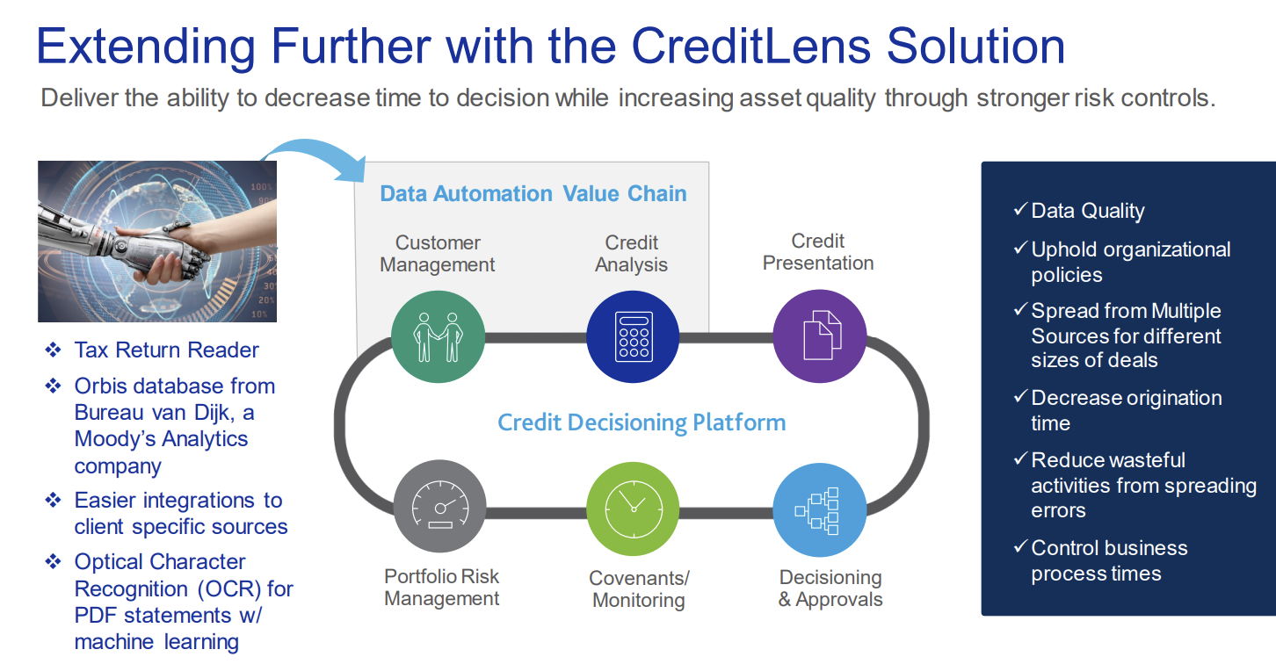
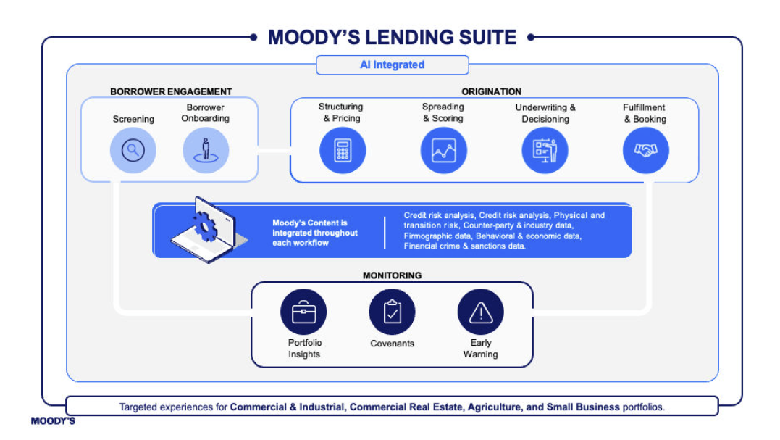
MESSAGING TRANSFORMATION
Messaging in Practice — Original Materials
Original diagrams from CreditLens and Lending Suite marketing materials, used with permission.
OLD — CREDITLENS (PRODUCT-CENTRIC)
NEW — LENDING SUITE (VALUE-LED)
Feature-led: OCR, Orbis integration, tax return reading.
Workflow-led: Borrower Engagement → Origination → Monitoring, Moody’s data throughout.
MESSAGING IN PRACTICE
9 / 23
Notes:
These are the original diagrams used in CreditLens and Lending Suite marketing materials, included here with permission. The CreditLens diagram is organized around technical capabilities — OCR, Orbis database integration, tax return reading — wrapped around a generic 'credit decisioning platform' idea. The Lending Suite diagram is organized around the customer's actual workflow — Borrower Engagement, Origination, Monitoring — with Moody's data shown running underneath every stage rather than listed as a feature. This is the same shift described on the previous slide, shown here in the real, as-shipped marketing materials rather than an illustrative example.

Slide 10
SUPPORTING EVIDENCE
Solution Webpages, Brochures & Video
Brochures are downloadable from each product’s landing page — shown here as one linked destination per product.
Product
Landing Page + Brochure
Video / Additional Evidence
Loan Origination (Overview)
moodys.com/solutions/lending/loan-origination
Video
Borrower Engagement
moodys.com/.../borrower-engagement
—
Spreading & Scoring
moodys.com/.../spreading-scoring
—
Automated Spreading
moodys.com/.../spreading-scoring (Automated Spreading)
Demo video (internal asset)
Underwriting & Decisioning
moodys.com/.../underwriting-decisioning
—
Automated Credit Memo
moodys.com/.../underwriting-decisioning (Credit Memo)
Video
Loan Operations
moodys.com/.../loan-operations
—
Loan Monitoring (Overview)
moodys.com/solutions/lending/loan-monitoring
—
Automated Covenants
moodys.com/.../loan-monitoring (Automated Covenants)
Case study
Commercial Real Estate (CRE)
moodys.com/.../commercial-real-estate
—
Small Business
moodys.com/.../small-business
Demo video (internal asset)
Agriculture
moodys.com/.../agriculture
—
SUPPORTING EVIDENCE
10 / 23
Notes:
This table links directly to the live solution webpages for each Lending Suite product; brochures are downloadable from those same landing pages, so one link serves both. Automated Spreading, Automated Credit Memo, and Automated Covenants also had dedicated demo videos or case studies — Automated Credit Memo and the general Loan Origination overview each have a public video, Automated Spreading and Small Business each have an internal product demo video, and Automated Covenants is backed by a published Momentum Metropolitan case study. CRE, Small Business, and Agriculture each have their own solution webpage and brochure, linked here directly.

Slide 11
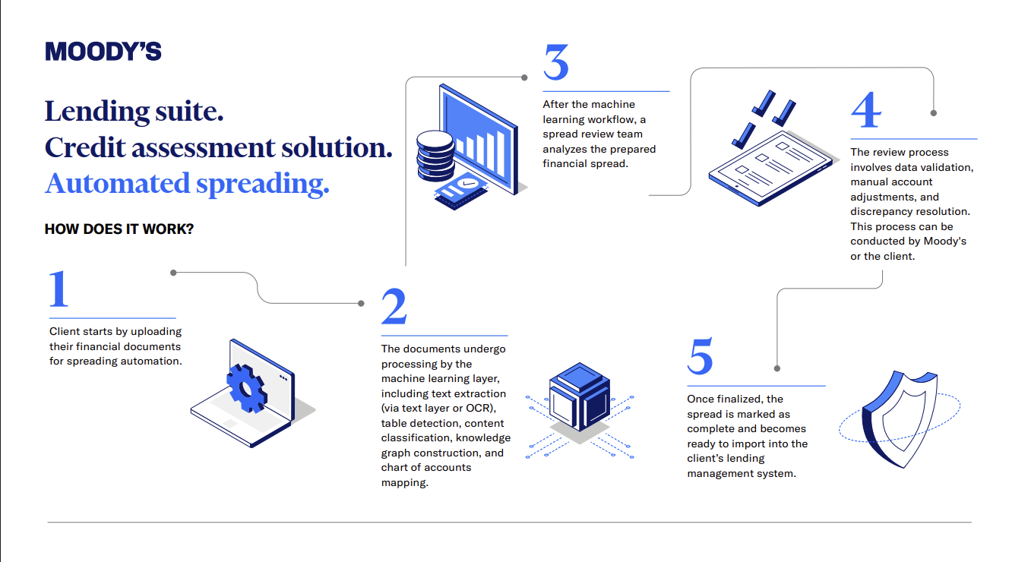
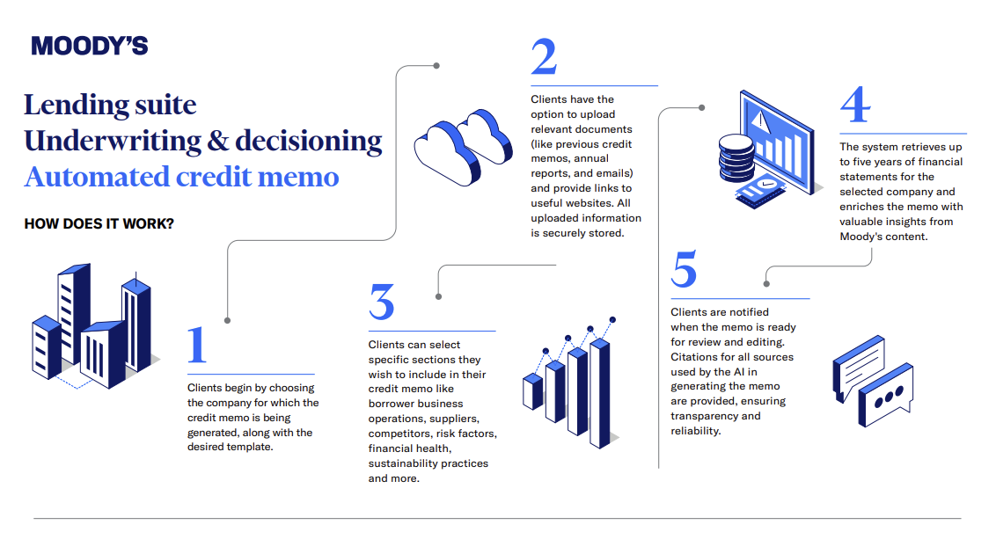
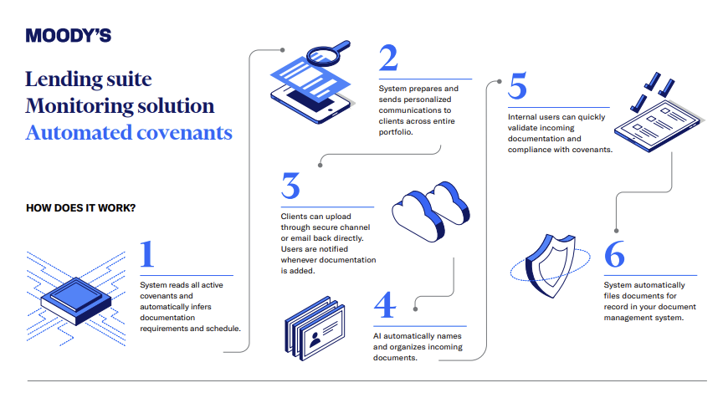
SUPPORTING EVIDENCE
“How It Works” — Original Infographics
Original product infographics, used with permission.
AUTOMATED SPREADING
AUTOMATED CREDIT MEMO
AUTOMATED COVENANTS
5-step walkthrough: document upload → ML processing → spread review team → validation & adjustments → ready to import.
5-step walkthrough: select company → upload supporting documents → choose memo sections → enrich with Moody’s data → cited, reviewable memo.
6-step walkthrough: read active covenants → notify clients → secure document upload → auto-file & organize → internal validation → compliance testing.
“HOW IT WORKS” INFOGRAPHICS
11 / 23
Notes:
These are the original 'how it works' infographics produced for three AI-enabled modules: Automated Spreading, Automated Credit Memo, and Automated Covenants, included here with permission. Each breaks the module's automation down into a simple numbered sequence — from document upload through machine-learning processing to a completed, reviewable output — which is the format used consistently across the AI module line to make the underlying automation legible to a non-technical buyer.

Slide 12
VALUE PROPOSITION FRAMEWORK
Four Pillars of Customer Value
Efficiency & Speed
Risk & Compliance
Automated workflows cut origination time
Integrated Moody’s data ensures high-quality credit risk analysis
AI modules reduce manual spreading and memo creation
Automated covenants and monitoring uphold organizational policies
Flexibility & Scale
Customer Experience
Modular packages (Origination, Monitoring) allow phased adoption
Borrower engagement tools streamline onboarding
Industry-specific tailoring (CRE, Agriculture, SMB) meets diverse client needs
End-to-end visibility improves trust and transparency
Automated Credit Memo: manual drafting › automated generation › faster, more consistent memos › more underwriter time for judgment
APPLIED
VALUE PROPOSITION FRAMEWORK
12 / 23
Notes:
The value proposition framework used to structure messaging rests on four pillars: Efficiency & Speed, Risk & Compliance, Flexibility & Scale, and Customer Experience, each grounded in specific product capabilities — automated workflows and AI modules for speed, Moody's integrated data and automated covenants for risk and compliance, modular packages and industry tailoring for flexibility, and borrower engagement tools for experience. The applied example at the bottom shows how this plays out for Automated Credit Memo: manual drafting becomes automated generation, producing faster, more consistent memos and freeing up underwriter time for judgment and portfolio quality.

Slide 13
SEO-LED CONTENT STRATEGY
A Continuous Research-to-Content Loop
1
2
SEO RESEARCH INFORMED
Keyword & Search
Intent Research
Audience Language
Analysis
Audience language used in messaging
Search intent behind lending topics
SEO-INFORMED
CONTENT
6
3
Keyword-informed webpage structure
Review &
Refine
Content & Messaging
Development
Campaign copy aligned to real search terms
Ongoing content refinement based on findings
5
4
Publish &
Distribute
Webpage & Campaign
Copy
2025: this process contributed to a $3.1M SQL for Loan Origination, sourced directly through the website.
SEO-LED CONTENT STRATEGY
13 / 23
Notes:
SEO research was used as an ongoing input into content and messaging, not a one-off exercise. The loop moved from keyword and search-intent research, to analysis of the language audiences actually use, into content and messaging development, then into webpage and campaign copy, publication, and review and refinement based on what was learned. This slide describes the process I contributed to using keyword research, search volume, and audience language; it does not claim specific ranking or organic traffic improvements, since those results were not independently documented for this project.

Slide 14
REGIONAL MARKETING INTELLIGENCE
Campaign Observations Across Markets
Shown as campaign-level observations, not universal market conclusions.
US
EMEA
APAC
United States
Europe, Middle East & Africa
Asia-Pacific
Loan Origination campaigns showed strong relevance
Portfolio messaging extended to EMEA audiences
Automated Spreading showed relevance in APAC
Agriculture lending engagement observed in Australia
Cross-regional segment observation: Automated Credit Memo showed relevance for small-business-related needs, independent of a single region.
REGIONAL MARKETING INTELLIGENCE
14 / 23
Notes:
Campaigns were developed for US, EMEA, and APAC audiences, and some patterns of relevance emerged across markets and segments. Observed examples included Loan Origination campaigns performing relevantly in the US, Automated Spreading showing relevance in APAC, Agriculture lending engagement in Australia, and Automated Credit Memo showing relevance for small-business-related needs across regions. These are presented as campaign-level observations rather than universal market conclusions.

Slide 15
CAMPAIGN STRATEGY
From Brief to Optimization
Campaign
Brief
›
Audience
›
Value
Proposition
›
Ad
Copy
›
Performance
Monitoring
›
Optimization
Decisions
LED & DEVELOPED
NOT DIRECTLY EXECUTED
Campaign briefs documenting products, goals, and value propositions
Day-to-day media buying and ad platform operation
Ad copy for Google and LinkedIn campaigns
Role focused on strategy, briefs, copy, and analysis — supporting, not operating, platform execution.
Performance monitoring and optimization recommendations
CAMPAIGN STRATEGY
15 / 23
Notes:
Campaign work followed a clear path from brief to optimization: campaign briefs documented products, target audience, and value proposition; this fed into ad copy for Google and LinkedIn campaigns; and campaign performance was monitored to support optimization decisions. It's important to note the scope of my role accurately — I created briefs, developed ad copy, and monitored and supported optimization decisions, but I did not directly operate or manage the ad platforms; day-to-day media execution sat with other parts of the marketing organization.

Slide 16
CAMPAIGN STRATEGY — WORKED EXAMPLE
LinkedIn: AI-Powered Credit Memo
TARGET AUDIENCE
TOTAL IMPRESSIONS
JOB
10K–20K
Banking decision-makers — credit risk, underwriting & lending operations leadership at financial organizations
COMPANY
Banks — large, medium, and small financial institutions
IMPRESSIONS BY COUNTRY
LOCATIONS — 18 MARKETS
United States
49%
United States
United Kingdom
Canada
United Kingdom
21%
Canada
16%
Singapore
Hong Kong SAR
Germany
Singapore
4%
Netherlands
Sweden
Norway
Denmark
Hong Kong SAR
3%
Finland
France
Luxembourg
Belgium
Finland
1%
Austria
Italy
Spain
Japan
+ 12 more markets at ≤1% each: Netherlands, Germany, Sweden, Norway, Denmark, France, Luxembourg, Belgium, Austria, Italy, Spain, Japan
A/B TESTED · 1 QUARTER:
Caption length · Creative style · Ad format (single image vs. message) · CTA wording
CAMPAIGN EXAMPLE — LINKEDIN
16 / 23
Notes:
This is a worked campaign example for the Automated Credit Memo LinkedIn campaign. Targeting combined two dimensions: job (banking decision-makers — credit risk, underwriting, and lending operations leadership) and company (banks of all sizes — large, medium, and small financial institutions), across 18 markets spanning North America, Europe, and Asia-Pacific. The campaign delivered 10K–20K impressions, concentrated in the US (49%), UK (21%), and Canada (16%), with the remaining markets each contributing a smaller share. The campaign ran for one quarter with structured A/B testing across caption length, creative style, ad format (single-image vs. message ads), and CTA wording to identify what resonated with this audience.

Slide 17
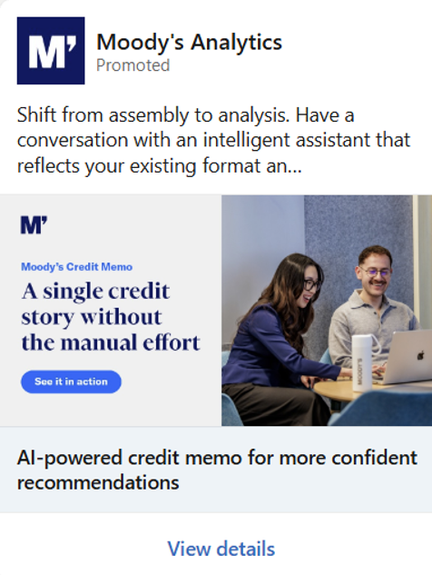
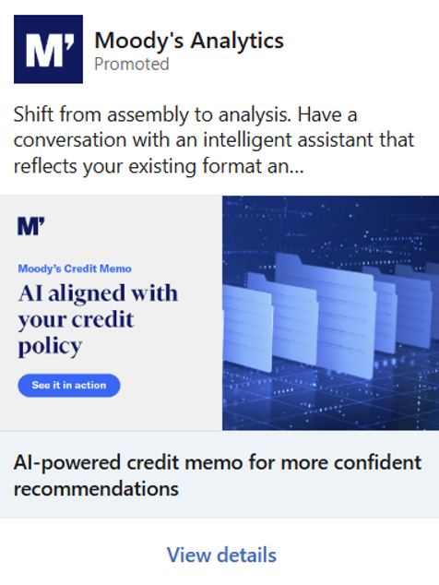
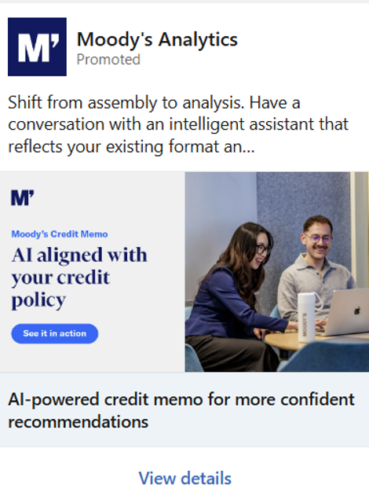
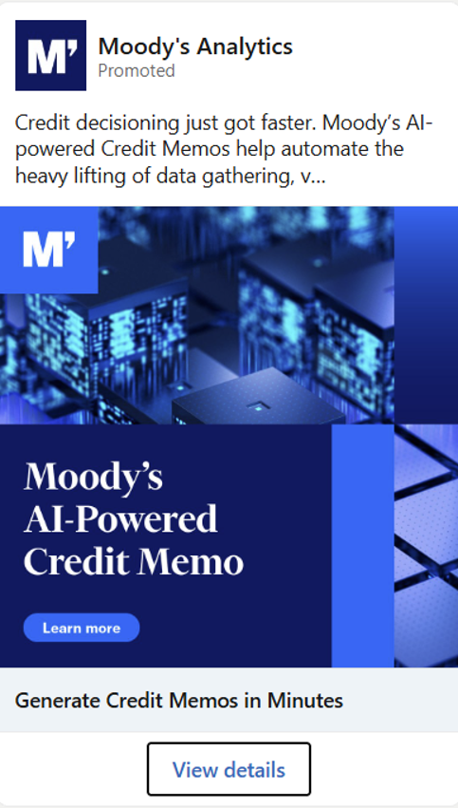
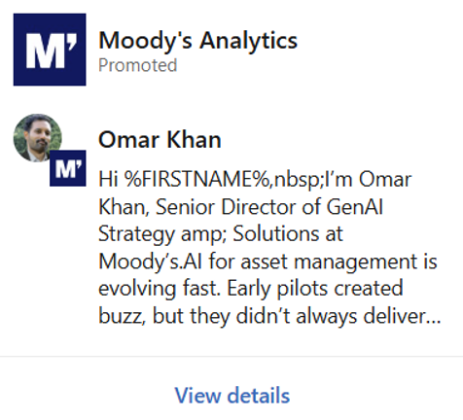
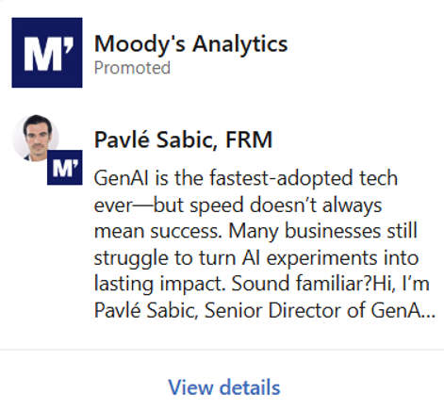
CAMPAIGN STRATEGY — WORKED EXAMPLE
Ad Creative — A/B Test Variants
Actual LinkedIn ad creative from the Automated Credit Memo campaign, used with permission.
Variant A — Team photo · “A single credit story…” · CTA: See it in action
Variant B — Abstract visual · “AI aligned with your credit policy” · CTA: See it in action
Variant C — Team photo + Variant B headline (creative swap test)
Variant D — “Generate Credit Memos in Minutes” · CTA: Learn more
Message ad — Omar Khan, Sr. Director, GenAI Strategy & Solutions
Message ad — Pavlé Sabic, FRM, Sr. Director, GenAI Strategy & Solutions
CAMPAIGN EXAMPLE — CREATIVE VARIANTS
17 / 23
Notes:
These are the actual ad creative variants tested in the Automated Credit Memo LinkedIn campaign, included here with permission. Variants A through C isolated creative and headline choices within the same single-image ad format — a team photo versus an abstract data visual, and a shorter outcome-led headline versus a policy-alignment headline. Variant D tested a different visual treatment and CTA (“Learn more” instead of “See it in action”) paired with a more direct headline. The final two are message ads from named spokespeople — Omar Khan and Pavlé Sabic — testing a completely different ad format (conversational, first-person) against the single-image ads above.

Slide 18
WEBSITE ANALYTICS
Behaviour-Informed Optimization
Traffic & Visits
Clicks
1
2
INSIGHT → ACTION
INSIGHT
Heatmap analysis identified drop-off points mid-page
Form Submissions
Avg. Time on Page
3
4
ACTION
Informed page restructuring recommendations
INSIGHT
Bounce Rate
Engagement Behaviour
Attribution analysis linked engagement to specific content types
5
6
ACTION
Prioritized higher-performing content formats
Heatmaps
Attribution Analysis
INSIGHT
7
8
Bounce rate patterns flagged weaker landing experiences
ACTION
Supported targeted messaging and layout refinements
Illustrative insight-to-action pattern — no specific metric values are shown or implied.
WEBSITE ANALYTICS
18 / 23
Notes:
Website analytics work involved traffic, visits, clicks, form submissions, average time on page, bounce rate, and broader engagement behaviour, supplemented by heatmap and attribution analysis to understand where users engaged or dropped off. The Insight-to-Action panel illustrates the kind of process used to turn behavioural data into optimization recommendations; specific figures are intentionally omitted since no documented metrics were provided for this project, consistent with not inventing results.

Slide 19
SALES ENABLEMENT
Marketing ↔ Sales Alignment
MARKETING PROVIDES
SALES CONTEXT RETURNED
Sales plays aligned to portfolio positioning
Salesforce reports and lead lists
Weekly sales newsletters on marketing activity
Field context on prospect engagement
⇄
HighSpot campaign pages
Feedback on messaging and positioning resonance
Feature grids and battle cards
Competitive analysis
Purpose: help sales teams understand relevant marketing activity and act on prospect engagement in real time.
SALES ENABLEMENT
19 / 23
Notes:
Sales enablement work was built as a two-way exchange rather than a one-directional handoff. Marketing provided sales plays, weekly sales newsletters, HighSpot campaign pages, feature grids, battle cards, and competitive analysis. In return, Salesforce reports, lead lists, and field context on prospect engagement helped shape ongoing marketing activity. The goal throughout was marketing and sales alignment — making sure sales teams understood relevant marketing activity and had the context needed to act on it.

Slide 20
INTEGRATED GTM WORKFLOW
One Continuous, Iterative Cycle
1
Market & Audience
Research
9
2
Feedback &
Iteration
Portfolio
Positioning
8
CONTINUOUS
GTM LOOP
3
Sales
Enablement
Value
Proposition
7
4
Optimize
Insights
SEO & Content
Strategy
6
5
Performance
Analysis
Campaign
Planning
INTEGRATED GTM WORKFLOW
20 / 23
Notes:
The overall GTM workflow I contributed to ran as a continuous, iterative loop rather than a linear one-time project: market and audience research fed portfolio positioning and value proposition work, which informed SEO and content strategy and campaign planning; performance analysis and optimization insights closed the loop back into sales enablement and further research and iteration. This integrated view is the frame that connects the individual pieces of work shown throughout this deck into a single, repeatable GTM system.

Slide 21
3 YEARS OF PERFORMANCE MARKETING
Budget Stewardship & Revenue Impact
$22.8M
$7.6M
$3.1M
$1.59M
Total marketing budget managed
Average yearly budget
SQL influenced (2025)
Revenue influenced
LinkedIn + Google Ads, across 3 years
$4.5M LinkedIn · $3.1M Google Ads
Loan Origination — sourced via SEO-optimized webpage
Via Google & LinkedIn ad campaigns
2025 FLAGSHIP WIN
A customer came in directly from our website and said the Loan Origination webpage gave them the relevant information they needed to move forward — resulting in a $3.1M SQL (sales-qualified lead) traced directly to SEO-led website optimization.
Recognized and celebrated internally as a flagship example of SEO and website optimization translating directly into pipeline value.
BUDGET STEWARDSHIP & REVENUE IMPACT
21 / 23
Notes:
Across three years, I managed a combined $22.8M in LinkedIn and Google Ads budget, averaging $7.6M per year ($4.5M on LinkedIn, $3.1M on Google Ads). Beyond budget stewardship, this work translated into measurable revenue impact: $1.59M in revenue influenced through Google and LinkedIn ad campaigns, and a standout 2025 result — a $3.1M sales-qualified lead for Loan Origination that came in directly through the website, with the customer explicitly citing the relevance of the Loan Origination webpage content. This was recognized and celebrated internally as a flagship example of SEO and website optimization work translating directly into pipeline value, connecting the SEO and content strategy work shown earlier in this deck to a concrete, documented business outcome.

Slide 22
CONTRIBUTION & OUTCOMES
What I Delivered, and Why It Mattered
A. WHAT I DELIVERED
B. STRATEGIC CONTRIBUTION
Developed customer-focused messaging and value proposition frameworks
Helped connect product capabilities to customer problems and value
Created content for webpages, brochures, and sales materials
Supported portfolio-wide positioning consistency across channels
Supported campaign briefs and developed Google & LinkedIn ad copy
Contributed to closer marketing and sales alignment
Analyzed website behaviour and attribution to inform optimization
Helped bring SEO and audience insight into content decisions
Created sales enablement assets: battle cards, feature grids, newsletters
Supported data-informed optimization across web and campaigns
Moody’s published case study: “Bank SinoPac reports shorter loan turnaround times following adoption of Moody’s Lending Suite Origination.”
CASE STUDY
CONTRIBUTION & OUTCOMES
22 / 23
Notes:
This slide separates concrete deliverables from strategic contribution. What I delivered includes messaging frameworks, content across webpages, brochures and sales materials, campaign briefs and ad copy, analytics-informed recommendations, and sales enablement assets. The strategic contribution reflects the broader value of that work: connecting product capabilities to customer value, supporting consistent portfolio positioning, contributing to marketing and sales alignment, and helping bring SEO and audience insight into content decisions. Language throughout is intentionally evidence-based — supported, developed, contributed to — rather than claiming revenue, conversion, ranking, or pipeline outcomes that are not documented. The one external, documented data point included here is Moody's own published case study on Bank SinoPac reporting shorter loan turnaround times after adopting Lending Suite Origination — real, citable third-party evidence rather than an internal claim.

Slide 23
CLOSING
Connecting Product Capabilities
With Customer Value
Portfolio Marketing
Value Proposition Development
SEO
Content Strategy
Campaign Intelligence
Marketing Analytics
Sales Enablement
GTM Alignment
A product marketing approach grounded in customer understanding, structured positioning, and cross-functional alignment — turning complex lending technology into clear, value-led communication.
CONNECTING PRODUCT CAPABILITIES WITH CUSTOMER VALUE
23 / 23
Notes:
This closing slide brings together the full capability set demonstrated across the deck: portfolio marketing, value proposition development, SEO, content strategy, campaign intelligence, marketing analytics, sales enablement, and GTM alignment. The closing statement reinforces the central theme of the case study — an approach grounded in customer understanding and structured positioning that turns complex lending technology into clear, value-led communication across the buyer and sales journey.

