Slide 1
#HackTheHat Sustainability Hackathon with Red Hat
Project submission
Team name - Datawise Project name - project RALI

Slide 2
Vision and value proposition
Predicting Regional Asthma likelihood index from air quality perimeters which will beneficial towards reducing future asthma patients and preparing required medical sources.

Slide 3
The problem
Climate change is an environmental issue and a serious threat to our public health.
Human activities, such as the burning of fossil fuels like coal and oil, increase the amount of carbon dioxide that is emitted into the Earth’s atmosphere, thus changing the Earth’s natural atmospheric greenhouse.
According to the Center for Disease Control (CDC), this air pollution will affect by climate change.
Climate change is a huge threat to respiratory health by directly causing or aggravating pre-existing respiratory diseases and increasing exposure to risk factors for respiratory diseases.
World Health Organization (March 2014), estimated that 8 million people die every year due to the harmful effects of air pollution.

Slide 4
The solution
Awareness in people for the pollution in their area and probability of causing asthma.
Manufacturing and availability of medicines curing asthma or other respiratory deceases will increase. In order to avoid air pollution we need to reduce harmful emissions and promote the use of renewable energies. In solution we will provide the impact of air pollution on human body. Our model provide the future prediction of asthma due to air pollution. Using this future prediction people, government, doctors , healthcare companies will take preventive actions.

Slide 5
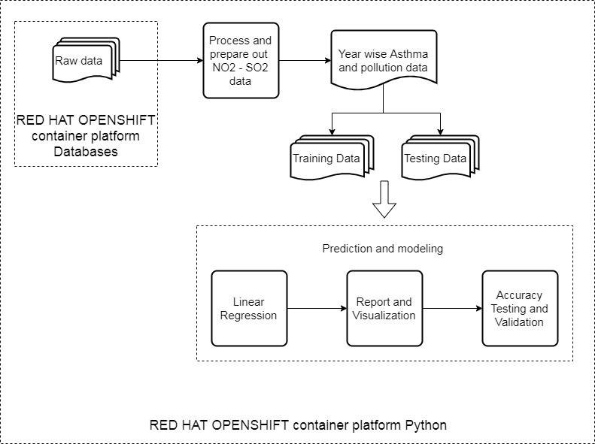
Technical design

Slide 6
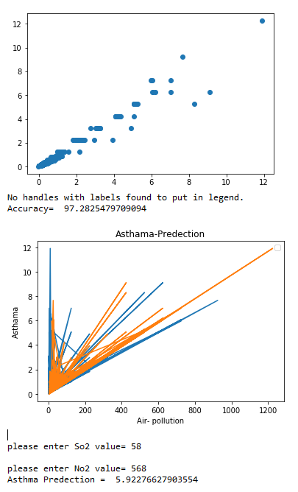
Accuracy and Asthma Prediction

Slide 7
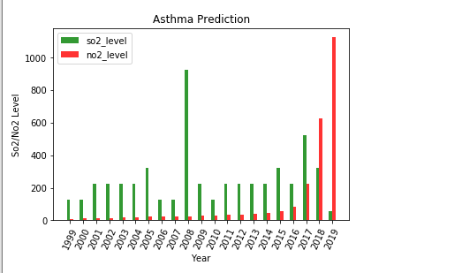
Year-Wise So2/No2 Level

Slide 8
Sustainability 30% weighting
Air pollution affects our health more than we think. From our model we will provide the complete air pollution impact on asthama so we will highlight region those highly impacted or in future they will more impact. people will aware and take necessary action to minimise air pollution. In addition to this model in future we will target other diseases predictions and solutions.

Slide 9
Red Hat’s tech adoption 20% weighting
We are using “RED HAT openshift container platform” provided by AMOS.
We have used python and databases provided by openshift container platform.
Its been really easy and convenient to deploy our solution using above red hat technologies.

Slide 10
Feasibility 30% weighting
We are targeting the healthcare clients from our solution. From this model we provide them the future prediction about asthma patients. So they can focus on particular area from marketing perspective, As well they can increase the device/medicine manufacturing. Further in future using this model we can predict air pollution impact on other diseases as well.

Slide 11
Disruptiveness 15% weighting
In current scenario around 8 million people die due to air pollution. From our solution we will provide correct prediction about asthma and other respiratory diseases. So from healthcare companies as well patients in advance will let know about the future challenges. Our target is to minimise the asthma percentage and impact on other body parts due to asthma

Slide 12
Technical innovation 10% weighting
From technical perspective we are using Linear regression a Machine Learning Algorithm, Our idea will useful for organizations, governments, research institutes. In advance our model will provide Asthma predictions plus provide survey's to medical companies and doctors about future challenges in respiratory diseases. We are using open source technologies for implementation, it’s cost efficient, portable and easy to use.

Slide 13
Social acceptability 5% weighting
We received feedback from doctors and their patients. Doctors feedback is really helpful to focus more on the respiratory diseases.

Slide 14
URLs
This presentation is attached to the Wiki section on AtosOne Git –
Datawise.HackTheHat.Wiki
URL of project on AtosOne Git - https://git.atosone.com/kiran.karandikar/datawise
URL of application on the AMOS platform – AMOS application platform link not been provided.

Slide 15
Team Datawise overview
Email | Hackathon Role | Job Role | Team Lead | Location
Sameer Rastogi | Hustler | Business Analyst | Yes | Pune
Niket Paygude | Hacker | System’s Architect | No | Pune
Kiran Karandikar | Hacker | Data Engineer | No | Pune
GManoj Reddy | Hacker | Data Engineer | No | Pune
Shivani Raut | Hipster | Visualization (Graphic Designer) | No | Pune

Slide 16
#HackTheHat 2019
For more information please contact: Hackathon@Syntelinc.com

