Slide 1
Nutrition
By Dastan E. M.

Slide 2
introduction
Nutrition is the process by which living organisms obtain nutrients assimilate and use them in their own bodies

Slide 3
Types of Nutrition
There are two main types of nutrition. These are:
Autotrophic nutrition
Heterotrophic nutrition

Slide 4
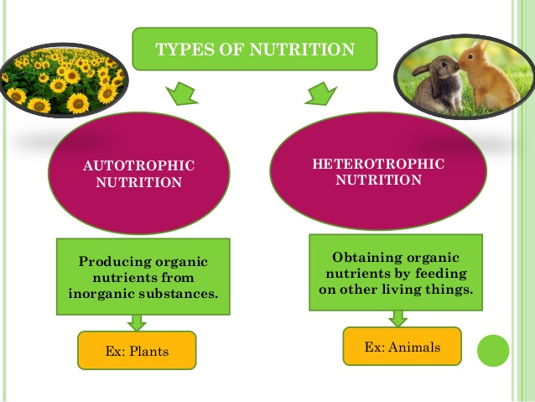
Types of Nutrition

Slide 5
Autotrophic nutrition
Autotrophic nutrition is the type of nutrition in which organisms manufacture their own food from simple inorganic substances like carbon dioxide and water using light or chemical energy.
E.g. Green plants and some bacteria.
The organism which manufacture its own food is referred to as autotroph
It involves chemosynthesis and photosynthesis

Slide 6
Chemosynthesis and Photosynthesis
Chemosynthesis is the form of autotrophic nutrition in which organisms make their own food using carbon dioxide and water in the presence of energy obtained from chemicals like sulphur. E.g. some bacteria
Photosynthesis is the form of autotrophic nutrition in which organisms make their own food using carbon dioxide and water in the presence sunlight energy absorbed by chlorophylls. E.g. green plants.

Slide 7
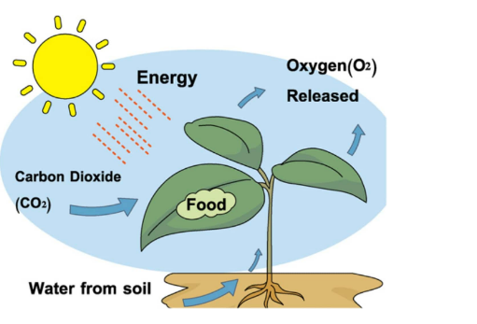
Chemosynthesis and Photosynthesis

Slide 8
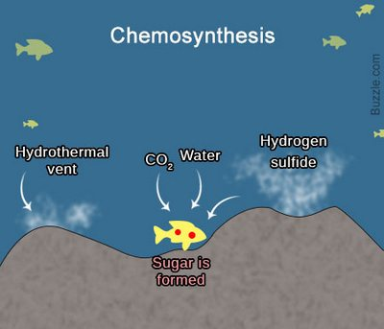
Chemosynthesis and Photosynthesis

Slide 9
Heterotrophic nutrition
Heterotrophic nutrition is the type of nutrition in which organisms take readymade nutrients such as carbohydrates, lipids and proteins by feeding from other organisms.
The organism which depends on other organisms as their source of food are referred to as heterotrophs

Slide 10
Forms of heterotrophic nutrition
Holozoic nutrition
Saprotrophic nutrition
Symbiotic nutrition

Slide 11
Holozoic nutrition
Holozoic nutrition is a form of heterotrophic nutrition which involves ingestion, digestion, absorption, assimilation and egestion of food substances. It is further divided into:
Carnivorous nutrition in which the organisms are eating flesh only. E.g. lions. The organisms which use carnivorous nutrition are called carnivores
Omnivorous nutrition in which the organisms are eating both flesh and plant sources of food. E.g. man and pigs. The organisms which are using omnivorous nutrition are called omnivores
Herbivorous nutrition in which the organisms are eating from plant sources only. E.g. cows and goats. Organisms that are using herbivorous nutrition are referred to as herbivores

Slide 12
Saprotrophic nutrition
Saprotrophic nutrition is a form of heterotrophic nutrition in which the organism feed on dead decaying organic matter. E.g. fungi. The organisms that are using saprophytic nutrition are referred to as saprotrophs
Symbiotic nutrition is a form of heterotrophic nutrition in which two or more organisms of different species form a close nutritional relationship. There are several forms of symbiotic nutrition

Slide 13
Forms of symbiotic nutrition
Parasitism: This is a feeding relationship between two organisms of different species in which one organism benefits while harming the other one. E.g. Salmonella typhi, roundworms, tapeworms and fleas on humans. Organisms that feed lives and feed on other organisms and harm them are referred to as parasites. The parasites may be either endoparasites or ectoparasites. The organism that is harmed by the parasite is called a host.

Slide 14
Forms of symbiotic nutrition
Commensalism: This is a feeding relationship between two organisms of different species in which one organism benefit from the relationship while the other is neither harmed nor benefiting from the relationship. E.g. Epiphytes like climber plants on higher plants, moss plants and ferns.

Slide 15
Forms of symbiotic nutrition
Mutualism: This is a feeding relationship between two organisms of different species in which both organisms benefit from the relationship and neither is harmed. E.g. cellulose digesting bacteria in the intestines of ruminant animals like cows, lichens found on the barks of trees (composed of fungi and algae)

Slide 16
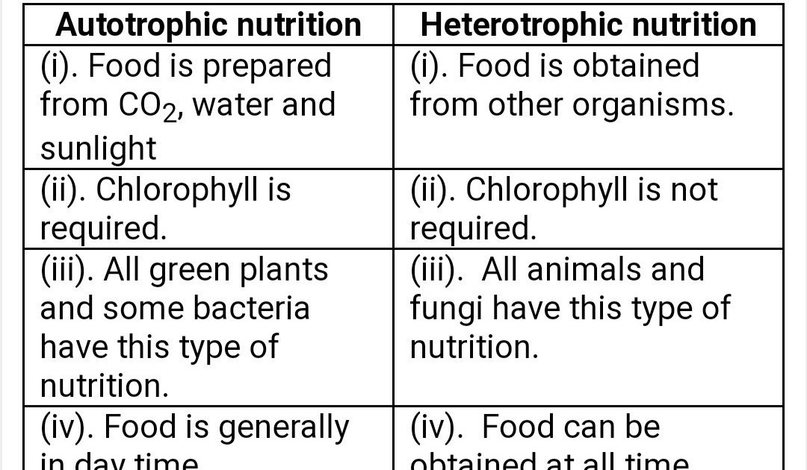
Autotrophic Vs Heterotrophic Nutrition

Slide 17
Note:
Endoparasites have the following adaptations for their survival:
They have cuticle as an outer layer which is tough and cannot be digested by the enzymes secreted by host
They have hooks for attachment (holding) to the walls of the host
They have Suckers for sucking nutrients from their hosts.
They have flattened bodies to increase surface area for absorption of nutrients by diffusion and osmosis
They have thin skin for easy passage of nutrients
They do not have alimentary canal as they absorb readily digested nutrients

Slide 18
Importance of Nutrition
Nutrients are required for the growth and development of living organisms
Nutrients are required by the body of an organism for repair of the worn out and damaged tissues.
Nutrients are required by the body for protection against diseases and infections
Nutrients are required for maintenance of constant body temperature in warm blooded animals
Nutrients are needed by organisms for electrical transmission of nerve impulses

Slide 19
Note:
Nutrients are substances found in the food that are needed by the body of an organism for growth, repair and protection of the body.
Diet refers to sum/total food substances taken by organisms in a given meal
Balanced diet refers to the right amount of food substances taken in the correct proportions
Food is any substance that contains nutrients that can be used by living organisms for maintenance of life processes.

Slide 20
NUTRIENTS
These are substances found in the food that are needed by the body of an organism for growth, repair and protection of the body.

Slide 21
Types of nutrients
Carbohydrates
Proteins
Lipids (fats and oils)
Vitamins
Mineral salts
Roughages
Water

Slide 22
Note:
Quantity of food required by an individual organism depends on the following factors:
Age. That is, old or young
Sex. That is, male or female
Activity. That is, the kind of work one is doing
Body health status. That is, sick or normal

Slide 23
Note:
The food taken does not yield all the food value because some values of food can be lost:
During cooking or preparation
Due to incomplete digestion
Due to incomplete absorption

Slide 24
Note:
It is important to cook food in order to:
Kill harmful germs
Make the food more palatable
Soften the food for easy digestion

Slide 25
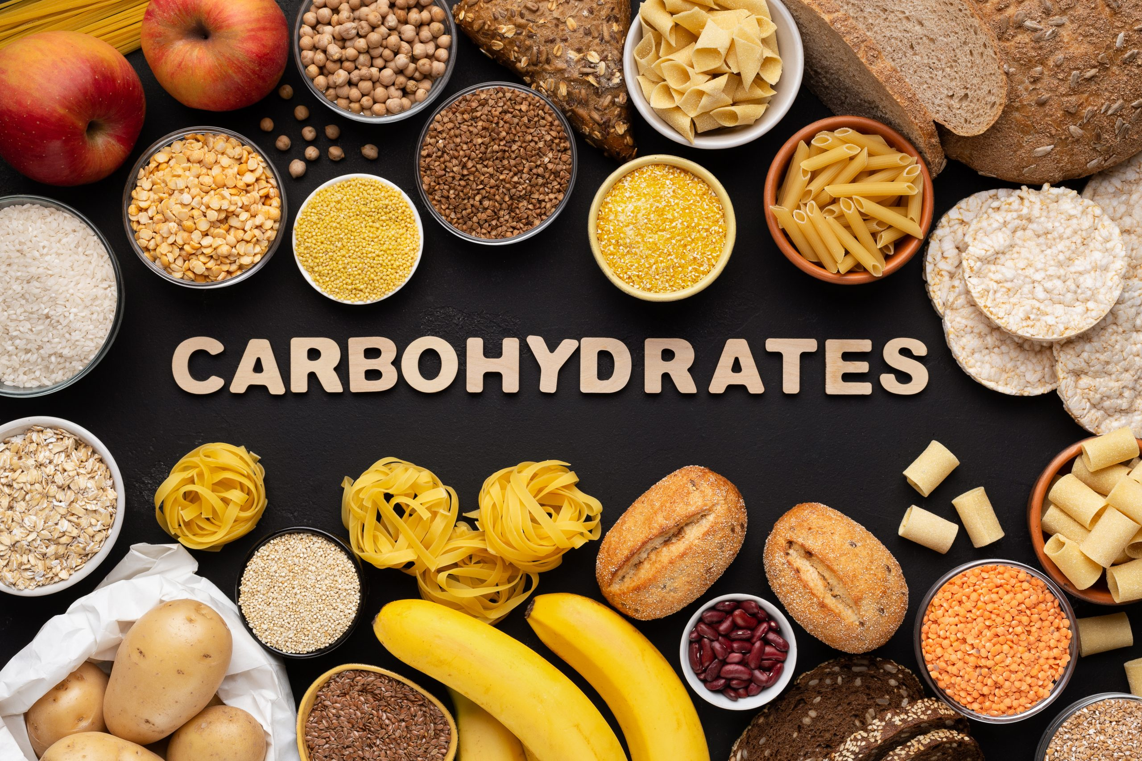
Carbohydrates

Slide 26
Carbohydrates
These are organic substances that contain Carbon, Hydrogen and Oxygen in the ratio of 1:2:1. That is CH₂O
Their main function is to provide energy in the body
They can be classified into three main groups. That is:
Monosaccharides
Disaccharides
Polysaccharides

Slide 27
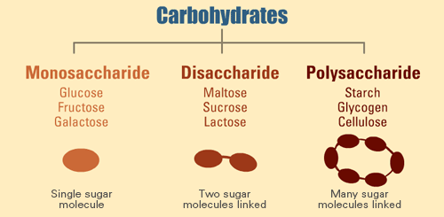
Carbohydrates

Slide 28
Monosaccharide
These are the simplest form of carbohydrates with a general chemical formula of C₆H₁₂O₆
They are also known as simple sugars or reducing sugars
They are the end products of digestion in the alimentary canal

Slide 29
Characteristics of Monosaccharides
They are colorless
They are soluble in water
They taste sweet
They can diffuse through semi-permeable membrane
Converts copper (II) sulphate to copper (I) oxide. That is, reduction, and therefore the name Reducing sugar
Examples: glucose, fructose and galactose
Sources: onions, citrus fruits, sugar beets,

Slide 30
Disaccharide
They are formed when two molecules of monosaccharides combine accompanied by loss of a water molecule. That is condensation reaction
They are also known as complex sugars or non-reducing sugars.

Slide 31
Characteristics of Disaccharides
They are colorless
They are very soluble in water
They taste very sweet
They diffuse slowly to semi-permeable membrane
Except for sucrose, they can convert copper (II) sulphate into copper (I) oxide
They can be broken down to monosaccharide by hydrolysis using dilute hydrochloric acid
Examples: Sucrose (formed by combining glucose and fructose), Lactose (formed by combining glucose and galactose) and Maltose (formed by combining two glucose molecules)
Sources: Sucrose -sugar cane, Lactose –milk, Maltose –Malt.

Slide 32
Polysaccharide
They are formed when many monosaccharide molecules are combined together in a dehydration reaction.
That is, several units of monosaccharides are linked together to form polysaccharides

Slide 33
Characteristics of Polysaccharides
They are insoluble in water
Forms a gel when boiled and cooled
They give blue-black color with iodine solution and hence the basis for test of starch
They are tasteless
Examples: starch, glycogen, pectin, chitin and cellulose
Sources:
Starch and Cellulose from Irish potato, cassava, yams, rice and maize grains
Glycogen from liver of mammals

Slide 34
Note:
Condensation is the process of bringing two molecules together, chemically with the release of water molecule.
Hydrolysis is the process of breaking down complex/large molecules chemically by addition of water.

Slide 35
Condensation and Hydrolysis

Slide 36
Importance of Carbohydrates
Provides energy
Provides structural substances
Provide storage structures

Slide 37
Food Tests for Carbohydrates

Slide 38
Test for Reducing Sugars
Reagent to be used is Benedict’s Solution.
Procedures:
Put 2cm³ of food sample solution in a test tube.
Add 2cm³ of Benedict’s solution into the food sample solution in (i) above.
Boil the mixture in (ii) above for about 3 minutes and allow it to cool.

Slide 39
Test for Reducing Sugars
Observations:
A series of color change from blue to green to yellow and finally brick red or orange precipitates will be observed.
Inference:
Reducing sugar was present.

Slide 40
Test for Non-reducing Sugars
Reagents to be used are:
Dilute Hydrochloric acid,
Dilute Sodium Hydroxide and
Benedict’s solution

Slide 41
Test for Non-reducing Sugars
Procedures:
Put 2cm³ of food sample solution into a test tube.
Add 1cm³ of dilute Hydrochloric acid into the solution in (i) above.
Boil the mixture in (ii) above for about three minutes and allow it to cool.
Add 2cm³ of dilute Sodium hydroxide solution into the mixture in (iii) above.
Add 2cm³ of Benedict’s solution into the mixture obtained in (iv) above.
Boil the mixture obtained in (v) above for about 3 minutes and allow it to cool.

Slide 42
Test for Non-reducing Sugars
Observations:
A series of color change from blue to green to yellow and finally brick red or orange precipitates will be observed.
Inference:
Non-reducing sugar was present

Slide 43
Test for Starch
Reagent used is Iodine solution (brown in color)
Procedures:
Put 2cm³ of cooked starch solution in a test tube.
Add three (03)drops of Iodine solution into the food sample solution in (i) above

Slide 44
Test for Starch
Observations:
Blue-black (deep blue) coloration will be observed.
Inference:
Starch was present

Slide 45
Proteins
These are large organic compounds composed of small units called amino acids.
Their elemental composition is carbon, hydrogen, oxygen, nitrogen and sometimes sulphur and phosphorus

Slide 46
Properties of Proteins
They are insoluble in water
Coagulates/clumps on heating
They react with Million’s reagent to form a red color, hence, the basis for the Millon’s reagent test. No longer used due to its toxicity.
Reacts with Sodium hydroxide (caustic soda) and copper II sulphate solution to produce purple color which intensifies on heating. This is the basis for BIURET TEST for proteins

Slide 47
Note:
Amino Acids are the building blocks/units of proteins.
Types of Amino Acids
There are two main types of amino acids. These are:
Essential amino acids
Non-essential amino acids

Slide 48
Amino Acids
Essential Amino Acids are those amino acids that cannot be synthesized (formed) in the body. Hence they have to be obtained directly from foods.
Non-essential Amino Acids are those amino acids that can be synthesized in our bodies

Slide 49
CLASSIFICATION OF PROTEINS
First class proteins
Second class proteins
First Class Proteins are proteins that contains all essential amino acids. E.g. animal proteins (milk, eggs, meat) and soy beans.
Second Class Proteins are proteins that lack one or more essential amino acids. E.g. plant proteins like beans, peas, etc

Slide 50
Functions of Proteins
For body growth and repair
Formation of antibodies which provide the body with immunity against diseases and infections
Formation of haemoglobin formed in red blood cells which help in transportation of oxygen gas in the body
Formation of hormones
Formation of enzymes which speed up biochemical reaction in the body
Alternative source of energy. Protein can provide the body with energy if there is shortage of carbohydrates and lipids

Slide 51
Natural sources of Proteins:
Animal proteins (milk, eggs, meat)
Plant proteins like beans, peas, etc

Slide 52
Food Test for Proteins (Biuret Test)
Reagents to be used are:
Dilute sodium hydroxide solution (colorless)
1% copper II sulphate solution (Blue in color)

Slide 53
Food Test for Proteins (Biuret Test)
Procedures:
Add 2cm³ of food sample solution in a test tube
Add 2cm³ dilute sodium hydroxide solution into the food sample solution in (i) above
Add 2cm³ of 1% copper II sulphate solution into the mixture obtained in (ii) above, drop wise.
Shake the mixture gently and allow it to settle
Observe the color change

Slide 54
Food Test for Proteins (Biuret Test)
Observation:
A purple (violet) color will be observed
Inference:
Protein is present
Note:
Food sample solution can be an egg albumen (egg-white), milk, groundnuts, etc.

Slide 55
FATS AND OILS (LIPIDS)
Fats and oils are collectively called lipids
Fats and oils contain carbon and hydrogen in high proportions and low proportion of oxygen.
Fats are often stored in living tissues such as seeds of certain plants and adipose tissues of animals.
Lipids are energy supplying foods and are important food reserves

Slide 56
Natural sources of Lipids
Plant sources like avocado, groundnuts, peanuts, coconuts, etc.
Animal sources like meat.

Slide 57
Properties of Fats and Oils
They are insoluble in water but soluble in organic solvents (e.g. ether)
They are composed of fatty acids and glycerol (end products of digestion of fats and oils
Protect internal organs such as heart and kidneys if deposited around them
When shaken vigorously with water they form an emulsion
When rubbed on a piece of paper, the paper becomes translucent. When the paper is dipped in ether, the translucency disappear because the oil dissolves in ether
They form a reddish ring with Sudan III solution on top of the solution in a test tube. This is the basis for food test for lipids

Slide 58
Uses of Fats and Oils
They provide the body with energy
Being bad conductors of heat, they also insulate the body of animals from cold

Slide 59
Assignment:
Distinguish between fats and oils.

Slide 60
Test for Lipids
Reagent to be used is Sudan III solution
Procedures:
Add 2cm³ of food sample solution into a test tube.
Add 3 drops of Sudan III solution into the test tube in (i) above.
Shake the mixture gently and allow it to settle.

Slide 61
Test for Lipids
Observations:
A reddish ring is observed on top of the mixture in a test tube
Inference:
Lipid is present

Slide 62
SUMMARY OF FOOD TEST REPORTING
TEST FOR | PROCEDURES | OBSERVATIONS | INFERENCE
STARCH | To 2cm³ of food sample solution Z in test tube, 3 drops of Iodine solution were added | A blue-black coloration was observed | Starch was present
 |  | The mixture retained the brown color of Iodine solution | Starch was absent
PROTEIN | To 2cm³ of the food sample solution Z in a test tube, 2cm³ of dilute Sodium Hydroxide solution were added followed by 2cm³ of 1%copper II sulphate solution drop wise | The purple coloration was observed | Protein was present
 |  | The mixture retained the blue color of 1% copper II sulphate solution | Protein was absent

Slide 63
SUMMARY OF FOOD TEST REPORTING
LIPIDS | To 2cm³ of food sample solution Z in a test tube, 3 drops of Sudan III solution were added. Then the mixture was shaken and allowed to settle for one minute | A layer of red color of Sudan III solution was formed at the top of the solution | Lipid was present
 |  | A mixture retained the red color of Sudan III solution | Lipid was absent
REDUCING SUGAR | To 2cm³ of food sample solution Z in a test tube, 2cm³ of Benedict’s solution was added, then the mixture in a test tube was boiled for 3 minutes | The color changed from blue to green to yellow and finally brick red precipitate was formed | Reducing sugar was present
 |  | The mixture retained the blue color of Benedict’s solution | Reducing sugar was absent

Slide 64
SUMMARY OF FOOD TEST REPORTING
NON-REDUCING SUGAR | To 2cm³ of food sample solution Z in a test tube, 1cm³ of Dilute hydrochloric acid was added and boiled for two minute and cooled. Then, 2cm³ of dilute sodium hydroxide solution was added to neutralize the mixture, followed by 2cm³ of Benedict’s solution, then the mixture in the test tube was boiled for 3 minutes | The color changed from blue to green to yellow and finally brick red precipitate was formed | Non-reducing sugar was present
 |  | The mixture retained the blue color of Benedict’s solution | Non-reducing sugar was absent

Slide 65
VITAMINS
These are organic substances present in small quantities in the food that we take.
They are essential for normal body functioning
They act as catalysts in several chemical processes in the body.
They are identified by letters A, B, C, D, E and K.

Slide 66
Note:
Vitamin B complex is composed of a group of water-soluble substances which are not chemically related but are grouped together because they occur in the same plant and animal foods.
Generally vitamin B is essential for normal growth. They include B₁, B₂, B₃, B₆ and B₁₂.

Slide 67
Classification of vitamins:
Based on their solubility in water and fat, vitamins are classified into:
Water soluble vitamins. E.g. Vitamin B complex (B1, B2, B3, B6 and B12) and vitamin C
Fat soluble vitamins. E.g. Vitamins A, D, E and K

Slide 68
Differences between Water-soluble and Fat-soluble vitamins
Water-soluble vitamins | Fat-soluble vitamins
Can be dissolved in water | They can be dissolved in fat
They can easily be destroyed by cooking | They are not lost during cooking

Slide 69
Data Table for Vitamins
VITAMIN | NATURAL SOURCE | FUNCTIONS | DEFFIENCY DISEASE
A (Retinol) | Green vegetables and fruits (e.g. spinach), carrots, butter, liver, fish, eggs and tomatoes | Normal growth in children Eyesight in dim light Protection of mucous membrane lining and the cornea of the eye | Night blindness Retarded growth in children Infection of the throat and the skin Dry skin, cornea of the eye and the moist membrane of the respiratory surfaces

Slide 70
Data Table for Vitamins
B₁ (Thiamine) | Yeast, milk, egg, beans, peas, unpolished cereals and groundnuts | Respiration, normal growth and proper functioning of the nervous system | Beriberi with symptoms like: Loss of appetite Weakness of the limbs Lack of nervous sensation and mental disturbance
B₂ (Riboflavin) | Fresh green vegetables, yeast, milk, soy beans, liver and meat | Respiration, normal growth and general body function | Pellagra with the following symptoms: Cracked skin Sore in the tongue Retarded growth in children

Slide 71
Data Table for Vitamins
B12 (Cyanocobalamine) | Liver, egg, milk, meat and fish | Formation of normal blood cells Protein synthesis | Formation of abnormally large blood cells which lead to a type of anemia called pernicious.
C (Ascorbic Acid) | Citrus fruits, fresh green vegetables, liver and black currant | Keeps the skin healthy Development of healthy blood vessels Maintaining food appetite | Scurvy with the following symptoms: Bleeding gums Poor healing of wounds Painful joints Weak blood vessels

Slide 72
Data Table for Vitamins
D (Calciferol) | Egg-yolk, milk, cod liver oil, mushroom, animal fat and can be made by skin when exposed to sunlight | Absorption of Calcium and phosphorus for building bones and teeth. | Malformation of bones which results in bowed up, a condition known as RICKETS in children. Swollen joints in adults
E (Tocopherol) | Green vegetables, seed’s embryo and egg yolk | Normal functioning of the reproductive organs | Slow clotting of blood or prolonged bleeding in case of injury
K | Fresh green vegetables, tomato, soy beans, and yeast | For blood clotting | Slow clotting of blood or prolonged bleeding in case of injury

Slide 73
MINERAL SALTS
Minerals are inorganic elements which are required in small amounts for normal body metabolism and health. Essentially they are needed for growth, repair and protection against diseases.

Slide 74
Data Table for Mineral Salts
Mineral Salt | Sources | Functions | Deficiency Symptoms
Calcium | Milk and milky products (e.g. cheese and yoghurt), sardines, eggs and green vegetables | Builds strong bones and teeth, promotes muscle and nerve functioning, help in blood clotting | Rickets due to weak bones, easy bleeding, poor nerve conduction
Phosphorus | Meat, milk, fish, eggs and nuts | Build bones and teeth | Impaired nerve activity, poor bones and teeth formation

Slide 75
Data Table for Mineral Salts
Potassium | Peanuts, banana, green beans and meat | Maintain regular fluid balance, nerve and muscle functioning | Poor muscle contraction and nerve impulse transmission
Iron | Liver, lean meat, kidney, beans and green vegetables | Formation of hemoglobin (red pigment in red blood cells) | Anemia
Iodine | Iodized table salt and sea foods | Production of thyroxin hormone which regulate growth and general metabolic activities | Goiter. (enlargement of thyroid gland located at the front part of the neck)

Slide 76
Data Table for Mineral Salts
Zinc | Oysters, shrimps, crab, meat and yeast extract | Activate enzymes, facilitate wounds healing, health immune system | Poor immune response, skin problem,
Sodium | Table salt and sea foods | Nerve and muscle activity | Muscle cramps
Chloride | Table salt and sea foods | Maintenance of water and ionic balance, formation of hydrochloric acid in the stomach | Poor digestion of proteins
Sulphur | Meat, milk and eggs | Formation of amino acids | Poor protein synthesis

Slide 77
Data Table for Mineral Salts
Manganese | Kidney, liver, tea, coffee nuts, and fruits | Formation of bones and activation of enzymes | Poor formation of teeth and bones, failure of muscles to contract, nausea, dizziness and hearing loss
Magnesium | Spinach, pumpkin seeds, sesame seeds and black beans | Relaxation of nerves and muscles, strengthening of bones | Muscle weakness, irregular heart beat and weak bones
Copper | Meat, fish and liver | Synthesis of bones and hemoglobin and activation of enzymes | Bleeding under the skin, easy rupturing of blood vessels, bone and joint problems and anemia

Slide 78
WATER
Water is important for the normal functioning of the body. About 75% of the total body weight. It is an important part of the protoplasm and when the cell dries it dies.
Water is necessary for various chemical processes which takes place in the body such as hydrolysis, condensation, respiration, absorption, transportation of hormones and food, excretion of waste products and manufacturing of different secretions.
Water is taken into the body through drinking and through the food that an individual eats.

Slide 79
Functions of water:
Maintains the shape of cells and organs
Helps in cooling process through evaporation of sweat.
Acts as a lubricant by reducing friction between surfaces that rub against one anther
Major constituent of body fluid such as blood tear and saliva

Slide 80
Functions of water:
The breaking down of food during digestion requires water
It forms a large portion of cytoplasm where most of the chemical reaction takes place in the body
It dilutes waste products and poisonous substances in the body
It is the medium through which materials are transported in the body

Slide 81
Note:
Lack of adequate amount of water leads to thirst, dehydration, constipation.
Losing more than 10% of water in the body can lead to death

Slide 82
ROUGHAGE
Roughage is a dietary fiber that is obtained from the indigestible parts of plant tissues.
They do not have any nutritional value as it is not digested and absorbed in the body.
Functions of roughages
It help in the passage of food through the gut by aiding contraction of the gut muscles

Slide 83
ROUGHAGE
Sources of Dietary fiber
They include whole grain cereals like maize, millet, wheat, rice, sorghum, fruits, beans, cabbages, spinach, cassava and potatoes
Lack of dietary fiber in the meals leads to constipation.

Slide 84
BALANCED DIET
A balanced diet refers to the food that contain all types of food nutrients in the right proportion.
Our diet should be low in fats, sugars and salts but high in proteins, vitamins and roughages as well as large amount of water.

Slide 85
Importance of Balanced diet
Balanced diet is important to the body for proper growth, repair, maintenance, protection and energy provision to the body of an organism.
If the diet taken daily contains more or less than what is specified in the balanced diet, an individual may develop a condition known as malnutrition.

Slide 86
MALNUTRITION
Malnutrition is a poor health condition caused by overfeeding or underfeeding.
Underfeeding means eating too little amount than what is required by the body.
Overfeeding means eating too much amount of food than what is required by the body

Slide 87
Causes of Malnutrition
Laziness. Some of the parents are too lazy in such a way that they fail to supply enough food to their family.
Drought. The climatic condition of an area can affect the availability of food to the family
Taboos (Traditional believes). In some tribes there are taboos which may lead to malnutrition. E.g. expectant/pregnant mothers are prohibited to eat eggs as it is believed that the new born baby will be hairless.

Slide 88
Causes of Malnutrition
Poverty. Poverty means low income. In such families children will not get enough and balanced diet due to lack of enough income.
Ignorance/lack of education. The parents may have enough food but due to ignorance, they may fail to mix different food available to get a balanced diet.
War. People may fail to participate in their daily activities due to war. As a result, poor production will occur which may lead to poor supply of food to the family members
Population explosion
Early weaning of children

Slide 89
Note:
Nutritional Deficiency Diseases are disorders or diseases which occur in the body as a result of getting little amount of food than what is required by the body. E.g. kwashiorkor, marasmus, goiter, etc.

Slide 90
Types of Malnutrition in Humans
Marasmus
Kwashiorkor
Vitamin Deficiency Diseases

Slide 91
Types of Malnutrition in Humans
Obesity
Starvation
Mineral deficiency diseases
Goiter (Iodine deficiency)

Slide 92
Vitamin Deficiency Diseases
Night blindness (Vitamin A deficiency)
Beriberi (Vitamin B1 deficiency)
Pellagra (Vitamin B2 deficiency)
Pernicious Anemia (Vitamin B12 deficiency)
Scurvy (Vitamin C deficiency)
Rickets (Vitamin D deficiency)

Slide 93
Question
With an example in each case, distinguish between malnutrition and nutritional deficiency disease

Slide 94
Kwashiorkor
This is deficiency disease caused by lack of protein in the body. It is more common in children between the age of 1 and 5 years old, especially after weaning

Slide 95
Symptoms of kwashiorkor
Retarded growth
Swelling of limbs (oedema)
Loss of appetite
Anemia
Color of hair changes from black to brown

Slide 96
Symptoms of kwashiorkor
General body weakness
Extremely thin arms and legs
Swollen abdomen
Dry skin that cracks easily

Slide 97
Note:
Because the body becomes weak, it is very easy for such children to be attacked by other diseases such as measles and tuberculosis

Slide 98
Treatment and prevention of kwashiorkor
Feeding children with a properly balanced diet with enough amount of protein
Care must be taken to children after weaning because kwashiorkor occurs mostly during this period
To educate mothers on the causes, symptoms and the effect of kwashiorkor
Avoid taboos and poverty

Slide 99
Marasmus
This is a nutritional deficiency disease that is caused by lack of enough nutrients from almost all types of food.
It is most common in children between 0 and 1 year old.
This happens especially when a child depends solely on milk as the only source of food such that the child does not get enough nutrients

Slide 100
Symptoms of Marasmus
Thinness and poor muscle development (loss of weight)
Stunted growth
Tendency of eating too much food when it is available
Tendency of crying a lot and being unhappy
Wrinkled skin

Slide 101
Treatment of Marasmus
Getting adequate amounts of food that contains all the nutrients in the right proportions as the child grows

Slide 102
Starvation
This is a condition which occurs if a person does not get enough food to eat. Prolonged periods of undernourishment makes the body use up all its food (deposited fat) and finally the body becomes thin.
Prolonged starvation can definitely lead to death

Slide 103
Rickets
This is a nutritional deficiency disease caused by lack of vitamin D and calcium in the body. It is most common in children
Lack of vitamin D slows down the rate of absorption of calcium and phosphorus

Slide 104
Symptoms of Rickets
Softened and easy to break bones
Fractures and deformity of bones
The long bones of the legs fail to support the weight of body

Slide 105
Obesity
This is overweight due to taking a lot of carbohydrates and lipids than what the body requires

Slide 106
Symptoms of Obesity
Increase of body weight
High blood pressure
Diabetes
Stroke

Slide 107
Symptoms of Obesity
Respiratory problems
Arthritis
Certain types of cancer

Slide 108
Prevention of Obesity
Eating proper balanced diet
Engaging in regular physical exercises
Avoid eating too much of the lipids

Slide 109
Anorexia Nervosa
This is also called slimmer’s disease or self-starvation syndrome.
It occurs when a person intentionally refuses to eat enough food leading to severe loss of body mass
This results due to extreme fear of being fat. Sufferers often see themselves as being fat even if they are not.

Slide 110
Signs and Symptoms of Anorexia Nervosa
Muscle wasting (including weakening of heart muscles)
Excessive loss of body mass
Extreme fear of being fat

Slide 111
NUTRITIONAL REQUIREMENTS FOR DIFFERENT GROUPS OF PEOPLE
Expectant and lactating mothers
Expectant and lactating mothers should take a balanced diet as they require nutrients for the growing foetus or baby.
More protein is necessary to build the growth and development of foetus
More calcium and phosphorus is needed for the development of baby’s bones
The mother-to-be require iron in her diet for her blood supply needs
Expectant and lactating mothers need to drink plenty of water as it is the major constituent of breast milk

Slide 112
NUTRITIONAL REQUIREMENTS FOR DIFFERENT GROUPS OF PEOPLE
Young Children
They need balanced diet with high proportion of proteins as children need to grow.
They also need with high nutritional value of vitamins for protection against infections and diseases.
Children also require more energy-giving foods because they are more active than adults

Slide 113
NUTRITIONAL REQUIREMENTS FOR DIFFERENT GROUPS OF PEOPLE
Elderly people
Elderly people require less energy-giving foods because they are less active.
They require adequate amount of vitamins and minerals to maintain their health
They should eat food rich in roughages to reduce constipation
They should get enough calcium for their strong bones as old age comes with loss of calcium from bones
Zinc is necessary to them for healthy immune system.
Iron is necessary to them for prevention of anemia at old age

Slide 114
NUTRITIONAL REQUIREMENTS FOR DIFFERENT GROUPS OF PEOPLE
Manual Workers
These are laborers who do hand manual works. They need to take a lot of energy-giving foods

Slide 115
NUTRITIONAL REQUIREMENTS FOR DIFFERENT GROUPS OF PEOPLE
The Sick
They need food with high nutritional value of proteins and vitamins. This will also apply to people with HIV/AIDS
Food with high nutritional value of proteins, mineral salts and vitamins will strengthen their immune system which will fight against diseases and infections.
Excess caffeine, sugar, fried foods, spicy foods and alcohol should be avoided because they are harmful to a body whose immune system is already weak.

Slide 116
NUTRITIONAL REQUIREMENTS FOR DIFFERENT GROUPS OF PEOPLE
Sedentary Workers
These are people who work for a long time seated. E.g. secretaries, tailors, etc.
They require low quantity of energy-giving foods
They should reduce food rich in lipids
Physical exercise is necessary to them

Slide 117
HUMAN DIGESTIVE SYSTEM (The Human Alimentary Canal)
In humans, the alimentary canal has two openings, the mouth at the anterior end and the anus at the posterior end.
Between the mouth and the anus there are the following structures:
Pharynx; the throat, found at the back of the mouth. It is the cavity behind the mouth connected to the ears by the Eustachian tube.

Slide 118
HUMAN DIGESTIVE SYSTEM (The Human Alimentary Canal)
Oesophagus; part of the alimentary canal between the pharynx and the stomach, passing the food downward by peristalsis.
Stomach; sac-like structure on the anterior region of the gut. It has two openings, the cardiac sphincter and the pyloric sphincter.
Duodenum; the first part of the small intestine just after the stomach. In humans, it is about 30cm long.
Ileum; the second part of the small intestine, before large intestine
Caecum; is the first portion of the large bowel, situated in the lower right quadrant of the abdomen

Slide 119
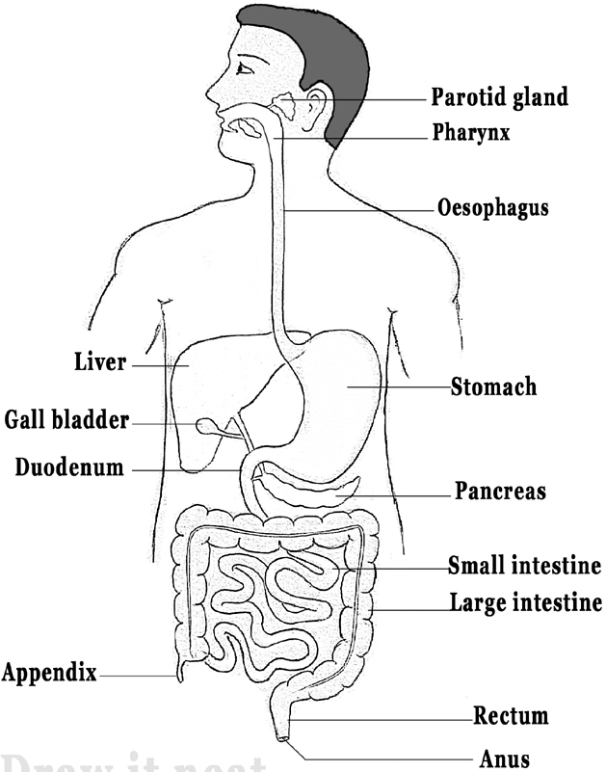
HUMAN DIGESTIVE SYSTEM (The Human Alimentary Canal)
Mouth
Salivary /Parotid gland
Tongue
Epiglottis
Cardiac Sphincter
Small intestine
Bile Duct
Pyloric Sphincter
Ileum
Pancreatic duct
Colon
Large Intestine

Slide 120
HUMAN DIGESTIVE SYSTEM (The Human Alimentary Canal)
Appendix; is a finger-like, blind-ended tube connected to the cecum
Colon; first part of the large intestine concerned with preparation of feces and absorption of water
Rectum; terminal part of the large intestine. It opens to the outside by the anus.
Other structures associated with the alimentary canal are salivary glands, liver, gall bladder and pancreas

Slide 121
DIGESTION
Digestion is the process by which large food substances are broken down into smaller, soluble particles which can easily be absorbed and used by the body.
In animals, digestion takes place in special tube called alimentary canal

Slide 122
Types of Digestion
Mechanical Digestion
Chemical Digestion

Slide 123
Types of Digestion
Mechanical digestion is the process of physical break down of large food particles to smaller particles that can easily be swallowed. It is done by the teeth.
Chemical digestion is the process of chemical break down of large food molecules by the use of enzymes into smaller molecules that can be easily absorbed and utilized by the body. It takes place in the alimentary canal

Slide 124
Importance of Digestion
It enables food to be absorbed and used by the body
It enables enzymes to act upon food easily
It enables the food to pass easily through the alimentary canal

Slide 125
Important Terms to be used
Ingestion; is the act of taking food in to the alimentary canal through the mouth
Absorption; is the process by which soluble end products of digestion diffuse into the blood stream
Assimilation; is the process by which simple absorbed food molecules are used in the body cells for metabolism
Egestion; is the process by which indigested food particles are removed from the body through anus.
Enzymes; are biological catalysts that speed up the rate of chemical reactions in the body of an organism

Slide 126
Properties of enzymes
They are protein in nature
They are denatured at high temperatures and deactivated at low temperatures
They work best at their optimum temperatures. E.g. 37⁰C in humans.
Enzymes work best at a Particular pH. E.g. acidic/alkaline conditions.
Enzymes are specific. That is, each catalyze one kind of chemical reaction
They are not chemically affected by the chemical reaction they catalyze

Slide 127
Digestion Process in Human
The process of digestion starts in the mouth and ends in the ileum of the small intestine

Slide 128
Digestion in the Mouth
In the mouth, the food is mechanically broken down by a process called chewing using the teeth

Slide 129
Chewing is necessary because
It breaks down large pieces of food into small pieces for easy swallowing
It mixes food with saliva for easy swallowing
It makes it easy for the digestive enzymes contained in saliva to penetrate the food

Slide 130
Digestion in the mouth
In the mouth there is secretion of saliva produced from salivary glands. Components of saliva are:
Mucus; for lubricating the food to make it easy to chew and swallow
Water; for moistening the food and providing a medium for enzyme activity on the food
Sodium and Calcium salts; for providing alkaline medium suitable for the enzymes to work properly
Salivary amylase; the enzyme that digests starch into maltose in the mouth. It is also known as ptyalin

Slide 131
That is:

Slide 132
The Role of Saliva in the Mouth
It digest particles of starch which remains between the teeth after swallowing into maltose
It moistens the mouth, tongue and lips. This enables a person to talk
It dissolves chemicals taken into the mouth. This enables the chemicals reach the taste buds of the tongue where their tastes are detected

Slide 133
Note
The tongue turns the food when it is being chewed. It helps to roll the food into a bolus ready for swallowing down the oesophagus
Epiglottis is a flap of cartilage which closes the trachea (windpipe) to prevent the food from entering it due to swallowing process.
The Oesophagus is a muscular tube that conveys food bolus form the mouth into the stomach

Slide 134
Note
Peristalsis is the contraction of the muscle of the alimentary canal that propels the food particles down the alimentary canal. It helps to convey food (bolus) into the stomach
Cardiac Sphincter is a valve between oesophagus and stomach that allows the food (bolus) into the stomach from the oesophagus

Slide 135
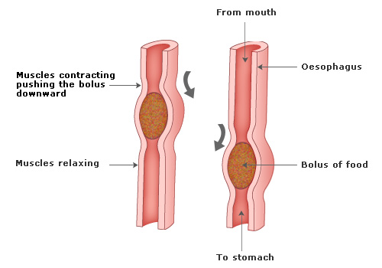
Swallowing Process
After the food has been chewed, it is rolled by the tongue into small balls called bolus (plural = boli). In this form, the food is ready to be swallowed
The food is pushed into the pharynx by the muscular tongue.
The epiglottis closes the opening of the trachea to prevent the food from entering the trachea

Slide 136
Note:
Since the trachea closes during swallowing, breathing and swallowing cannot occur at the same time.

Slide 137
Swallowing Process
The bolus is then pushed down through the oesophagus.
The oesophagus is a muscular tube connecting the pharynx with the upper part of the stomach.
The food is moved down the oesophagus by a series of wave-like muscular contractions of the walls of the oesophagus. These series of contractions are called peristalsis.

Slide 138
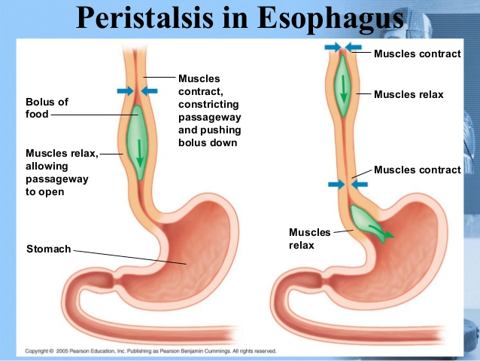
Swallowing Process
At the junction between the oesophagus and the stomach there is a ring of muscles called cardiac sphincter. These muscles relax and open to allow food to enter the stomach. Once the food is in the stomach, cardiac sphincter contract to close the entrance

Slide 139
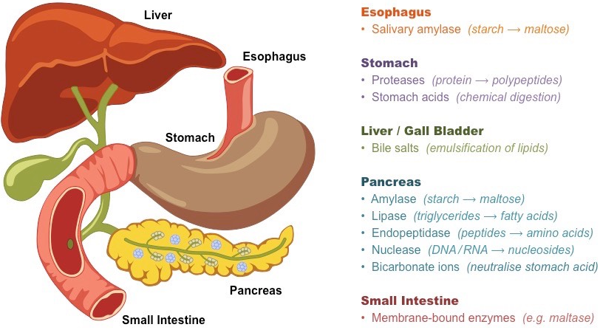
Digestion in the Stomach
Bile duct
Gall bladder
Pancreatic duct

Slide 140
Digestion in the Stomach
The stomach is a thick-walled muscular sac on the left side of the body just beneath the ribs and the diaphragm.
The walls of stomach has glands called gastric glands which secretes a digestive juice called gastric juice.

Slide 141
Digestion in the Stomach
Gastric juice is composed of the following:
Dilute hydrochloric acid
Protein digesting enzymes (Renin and pepsin)
Mucus
Water

Slide 142
Functions of Dilute Hydrochloric Acid
Kills bacteria and germs which may have entered with food
To provide an acidic medium for proper functioning of digestive enzymes (pepsin and rennin)
To Activate (convert) pepsinogen into pepsin enzyme
To stop the action of salivary amylase which cannot work in acidic medium
Breaks down, physically, large bolus (food substances) by making the food mass far apart.

Slide 143
Functions of Pepsin
To break down protein into peptide. It is produced in inactive form (pepsinogen) in order to prevent it from digesting the walls of the stomach. That is:

Slide 144
Function of Rennin
It coagulates (solidifies) soluble milk protein (casein) into insoluble form (caseinogen, composed of milk protein and calcium salts) which is acted upon by pepsin. This enzyme is mostly useful in young mammals during suckling (breastfeeding) period. That is:

Slide 145
Functions of Mucus
Lines the stomach wall and protects it from corrosion by hydrochloric acid and digestive enzymes.
It also lubricates the food to make it move smoothly along the alimentary canal

Slide 146
Functions of Water
Provides medium for enzymes activities

Slide 147
Note
When the process of digestion in the stomach is over, the semi-solid food substance mixed with gastric juice (now known as Chyme) is released into the duodenum through the pyloric sphincter.
That is, pyloric sphincter relaxes bit by bit to allow the chyme to move to the duodenum.
No absorption of food takes place in the mouth except for some materials like water, alcohol and some drugs such as aspirin which are absorbed in the stomach

Slide 148
Digestion in the Duodenum
The duodenum is associated with liver, pancreas and gall bladder as accessory organs. Entrance of the food into the duodenum stimulates the pancreas to secrete pancreatic juice and the liver to secrete bile. Bile is then stored in the gall bladder

Slide 149
Note
Bile is yellowish green in color.
Pancreatic juice is released from pancreas to the duodenum through pancreatic duct while bile is released from gall bladder into the duodenum through bile duct

Slide 150
Composition of Bile
Water (about 90%)
Salts (about 7%)
Yellowish-green pigments (about 2.5%)

Slide 151
Functions of Bile
Helps to break down (physically) fat droplets (emulsification of fats) which enables the enzymes lipase to act on fats effectively.
Bile salts (Sodium hydrogen carbonate) reacts with fat soluble vitamins (A, D, E and K) to make them water soluble, ready for absorption in the ileum.
Sodium bicarbonate salts, being alkaline, they neutralizes the hydrochloric acid in the chyme and make it (chyme) alkaline in the duodenum. This alkaline medium provides a suitable environment required by enzymes in the pancreatic juice to act on the food
Gives color to the chyme which differs from the color of the food taken in and color of feces

Slide 152
Composition of Pancreatic Juice
Pancreatic amylase
Pancreatic lipase
Trypsin
Sodium hydrogen carbonate

Slide 153
The role(s) of Components of Pancreatic Juice in Digestion

Slide 154
The role(s) of Components of Pancreatic Juice in Digestion

Slide 155
Note
When the digestion process in the duodenum is completed, the resulting mixture of food is moved by peristaltic movement into the ileum

Slide 156
Digestion in the Ileum
The ileum is last part of the small intestine connecting duodenum and the large intestine. It is about six meters long in humans.
The internal walls of the ileum (intestinal walls) secretes a juice known as intestinal juice

Slide 157
Composition of Intestinal Juices
Erepsin enzyme
Maltase enzyme
Sucrase enzyme
Lactase enzyme
Lipase enzyme

Slide 158
Functions of the Digestive Enzymes of the Intestinal Juice

Slide 159
Functions of the Digestive Enzymes of the Intestinal Juice

Slide 160
Functions of the Digestive Enzymes of the Intestinal Juice

Slide 161
Note:
Glucose, galactose and fructose are the end products of digestion of carbohydrates.
Fatty acids and glycerol are the end products of digestion of lipids
Amino acids are the end products of digestion of protein.
The end products of digestion are soluble molecules which are soluble in water, and therefore, absorbable

Slide 162
Summary of Digestion Process in Humans
Part of Alimentary Canal | pH condition | Source of digestive juice | Name of digestive juice | Enzymes produced | Food substance digested | End product of digestion
Mouth | Slightly alkaline | Salivary gland | saliva | Salivary amylase (ptyalin) | Starch | Maltose
Stomach | Acidic | Gastric glands | Gastric juice | Rennin | Soluble milk protein (casein) | Insoluble milk protein (caseinogen)
 |  |  |  | Pepsin | Protein | Peptides

Slide 163
Summary of Digestion Process in Humans
Duodenum | Alkaline | Pancreas | Pancreatic juice | Trypsin | Protein | Peptides
 |  |  |  | Pancreatic amylase | Starch | Maltose
 |  |  |  | Pancreatic lipase | Lipids | Fatty acids and glycerol
Ileum | Alkaline | Intestinal glands | Intestinal juices | Erepsin | Peptides | Amino acids
 |  |  |  | Maltase | maltose | glucose
 |  |  |  | Sucrase | Sucrose | Glucose and fructose
 |  |  |  | Lactase | Lactose | Glucose and galactose
 |  |  |  | Lipase | Lipids | Fatty acids and glycerol

Slide 164
Absorption of End Products of Digestion in the Ileum
All the end products of digestion are absorbed into the blood stream in the ileum

Slide 165
Adaptations of Ileum to Absorptive Function
It is long. The time taken for food to pass through it is therefore long and hence ensures maximum absorption of the end products of digestion.
Its internal surface is covered by finger-like projections called Villi (Villus in singular form). These increase surface area for maximum absorption.
The inner lining of its walls are made up of a single layer of cells. This decreases the distance through which the food passes (by diffusion) into the blood stream, thus, increasing the rate of absorption of food

Slide 166
Adaptations of Ileum to Absorptive Function
Each villus is provided with a dense network of blood capillaries which increase the rate of absorption because the absorbed food is immediately transported away from the site of absorption.
Presence of lymphatic vessel called lacteal inside the villus, which facilitates absorption of fatty acids and glycerol (end products of lipids.
The internal lining is folded to form ridges. This slows down the speed of food along the ileum to ensure that complete absorption of the end products of digestion takes place

Slide 167
Adaptations of Ileum to Absorptive Function
It is coiled in order to slow down the speed of food along the ileum to ensure that complete absorption of the end products of digestion takes place.
The surface of the villus is covered by microvilli which increases surface area for maximum absorption of end products of digestion

Slide 168
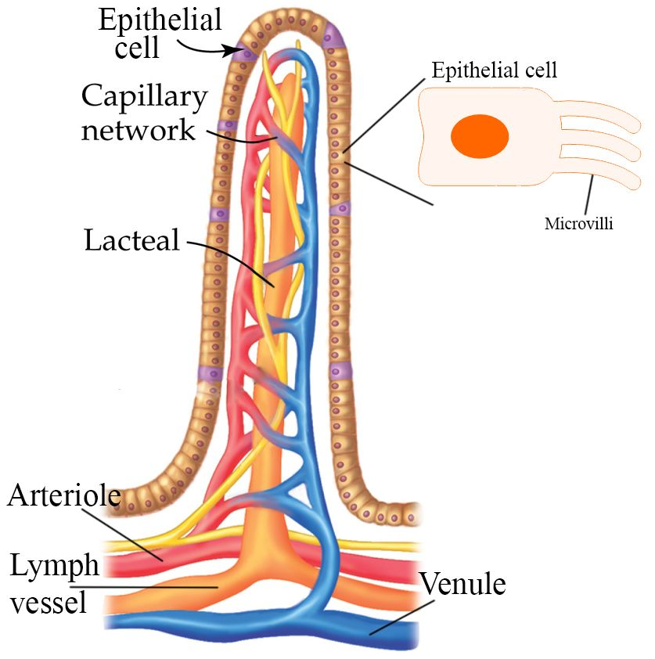
Longitudinal Section of Villus

Slide 169
Cross Section of the ileum
Fibrous layer
Muscular layer
Villus
Lumen/Cavity

Slide 170
Note
All the blood capillaries from the ileum are joined together to form a large blood vessel called hepatic portal vein leading to the liver.
This enables the liver to detoxify any harmful material that might have been absorbed with the end products of digestion before it affects other sensitive organs of the body.
Fatty acids and glycerol are absorbed into the lacteals. Lacteals join together into the lymphatic system

Slide 171
Note
Amino acids, glucose, fructose and galactose are absorbed directly into the blood stream and carried away by hepatic portal vein to the liver.
Fatty acids and glycerol recombine into fats/oils within the epithelial cells lining the internal surface of the ileum.
The fats are absorbed by lacteal and carried away from the small intestine through lymphatic system

Slide 172
Colon
The undigested food material is passed into the colon by peristalsis. There are no digestive enzymes in the large intestine (colon).
It has two main functions

Slide 173
Functions of colon
Absorption of water
Transportation of undigested waste materials to the rectum by peristalsis.

Slide 174
Note
Waste materials in the large intestine are called faeces (stool) and contains:
Undigested food materials
Some substances like bile and intestinal juices/fluids
Large quantities of bacteria

Slide 175
Note
Colon is called large intestine because:
It is thicker in diameter than the small intestine (ileum and duodenum)
It has thicker walls than the small intestine

Slide 176
Note
If peristalsis in the large intestine takes place quickly much water will remain in the faeces, hence one develops diarrhea.
If too much water is removed from the faeces, they become hard, thus developing constipation

Slide 177
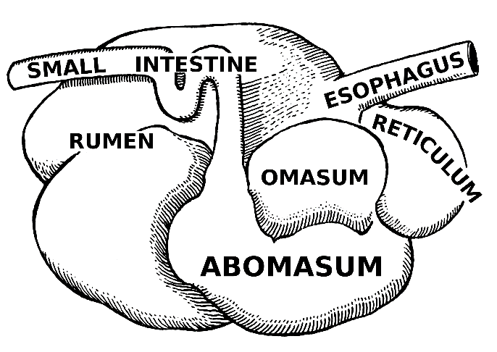
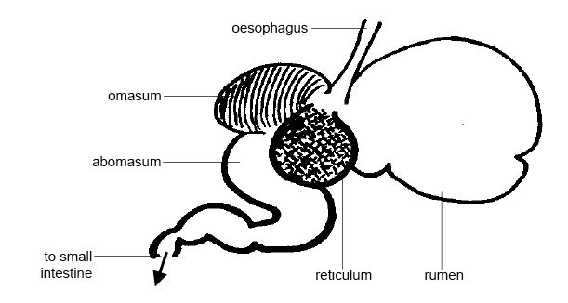
THE DIGESTIVE SYSTEM OF RUMINANT ANIMALS
Diagrams of the Four Chambers of Ruminant’s Stomach

Slide 178
THE DIGESTIVE SYSTEM OF RUMINANT ANIMALS
Ruminant animals are animals that have rumens.
Rumen is an extension portion of the oesophagus where food is temporarily stored, then brought back into the mouth (regurgitated) periodically for further chewing.
Returning the food back to the mouth for further chewing is called chewing the cud
Examples of ruminants include cows, goats, sheep, elephants and giraffes

Slide 179
THE DIGESTIVE SYSTEM OF RUMINANT ANIMALS
The stomach of ruminants has four chambers. These are:
Rumen
Reticulum
Omasum
Abomasum

Slide 180
THE DIGESTIVE SYSTEM OF RUMINANT ANIMALS
Abomasum is the true stomach which secretes gastric juices containing enzymes.
Rumen is also referred to as the first chamber of the ruminant’s stomach.
After the food is partly chewed and swallowed it goes to the rumen. There are bacteria which secretes an enzyme called cellulase which digests cellulose

Slide 181
THE DIGESTIVE SYSTEM OF RUMINANT ANIMALS
When ruminant animals are resting, they regurgitate the partly chewed food from the rumen to the mouth for proper chewing. This process is called rumination or chewing the cud.
After the food is properly chewed, it is swallowed again and it goes straight to the reticulum and then proceeds to the omasum and the abomasum.
Abomasum, being the true stomach, secretes gastric juices which carries out normal digestion as in humans

Slide 182
Note
Ruminant digestive tract is also referred to as poly-gastric digestive tract while non-ruminant digestive tract is referred to as mono-gastric digestive tract

Slide 183
Differences between Ruminant and Non-ruminant Digestive systems
Ruminant (Poly-gastric) | Non-ruminant (Mono-gastric)
Complex digestive tract | Simple digestive tract
Manufacture vitamin B complex through rumen micro-flora | Cannot manufacture vitamin B complex as it does not have rumen
Utilizes low quality protein and non-protein nitrogen | Cannot utilize non-protein nitrogen

Slide 184
Differences between Ruminant and Non-ruminant Digestive systems
Digests large quantities of roughages | Does not digest roughage (except horses)
Prominent microbial digestion | Enzymatic digestion only
Long digestive system | Short digestive system than ruminant
pH range between 4-7 in the stomach | pH range between 3.2-4 in the stomach
Stomach composed of four chambers | The stomach composed of only one chamber

Slide 185
DISORDERS AND DISEASES OF THE HUMAN DIGESTIVE SYSTEM
These include diseases and disorders that affect the teeth, the oesophagus, the stomach, the small intestine and the large intestine. Examples: dental caries, heartburn, ulcers, constipation and flatulence

Slide 186
Dental Caries
It is commonly referred to as tooth decay.
It occurs when the bacteria destroy the outer part of the tooth.
There are always bacteria present in the mouth. Bacteria combined with saliva and food remains collectively are referred to as plaque

Slide 187
Dental Caries
The bacteria in the plaque convert the remains of food (especially sugar and starch) into acids.
The acid dissolves the enamel of the tooth, forming a cavity. If the cavity is left untreated, it reaches the pulp cavity and nerve endings inside the tooth causing a painful infection

Slide 188
Signs and symptoms of dental caries
Tooth ache
Hole on the tooth
Swelling of the gum

Slide 189
Control measures against Dental Caries
Brush the teeth frequently and regularly in order to remove plaque
Minimize the intake of sugary foods
Visit the dentists regularly for dental check-ups

Slide 190
Treatment
The damaged tooth/teeth can be filled or covered with an artificial crown.
The damaged tooth/teeth can be removed/pulled out

Slide 191
Heartburn
This is a burning sensation which occurs in the oesophagus part of the digestive tract.
It is caused by excess acid in the stomach which leaks to the oesophagus causing discomfort or a burning feeling. This may be due to excessive intake of greasy foods and consumption of alcohol

Slide 192
Signs and Symptoms of Heartburn
A burning feeling in the chest
A sour taste in the mouth
Excessive belching
Difficulty swallowing

Slide 193
Treatment of Heartburn
It is normally treated by taking anti-acids like ashes

Slide 194
Note:
If the conditions persists you need to consult a doctor. Do not keep on using anti-acids or medicines without doctor’s advice

Slide 195
Stomach Ulcers
Ulcers are chronic sores or wounds in the stomach or small intestine

Slide 196
Causes of Ulcers
Presence of too much acid in the stomach
Too much drinking of alcohol
Erosion of the mucus coating the stomach, thus exposing it to the action of digestive enzymes and acids
Emotional stress and staying for long hours without eating

Slide 197
Signs and Symptoms of Ulcers
Burning pain in the stomach
Nausea and vomiting
Tiredness and weakness
Blood vomit or stool with blood

Slide 198
Treatment of Stomach Ulcers
They can be treated and controlled by using medications that prevent action of bacteria on the stomach lining.
Avoid smoking, alcoholism, smoking, caffeinated drinks and acidic foods
Eat food regularly
Use anti-acids like magnesium (milk of magnesium), etc.
Avoid anger, tension and nervousness as these may worsen the condition

Slide 199
Constipation
This is a dry and hard faeces which leads to difficulty bowel movement

Slide 200
Causes of Constipation
Inadequate amount of fiber in the diet
Inadequate intake of liquids
Lack of exercises
Ignoring the urge to go for a long call

Slide 201
Causes of Constipation
Life style changes such as pregnancy and old age
Abuse of laxatives. These are drugs which loosen the bowel by softening the stool and increase the amount of water in the colon. If used for a long time, these drugs interfere with the colon’s natural ability to contract during peristalsis

Slide 202
Signs/symptoms of Constipation
Lack of bowel movements for three or more days
Hard stools that are difficult or painful to pass
The urge to go for a long call even after you have just gone

Slide 203
Prevention and Control of Constipation
Eat enough fiber
Drink plenty of liquids every day
Exercise frequently
Go for a long call when you feel the urge to
Seek medical help if constipation is persistent

Slide 204
Cancer
Cancer is a disease which affects the digestive tract include
There are two main types of cancer that affect the digestive system. These are:
Cancer of oesophagus
Cancer of the colon

Slide 205
Causative agents of cancer
Mutation of genes
Cancer inducing foods we eat. They affect the colon when they come in contact over a long direction of time

Slide 206
Treatment
It has not been up to date easy to treat or prevent cancer. The following methods are applied in treating it.
Chemotherapy – During treatment to supplement surgery
Radiation – Bombardment using radioactive particles to eliminate the cancerous cells
Surgery – Removal of all cancerous cells

Slide 207
Note:
The outlined treatment are not 100% perfects, they will affect other cells or induce other cells to become cancerous

Slide 208
Control
Taking the fiber food in the food to come into contact with the cells leaving the colon wall

