Slide 1
Recommenders
Part 7

Slide 2
Overview
Recommenders suggest items based on:
User similarity
Item similarity
History
Ratings

Slide 3
Collaborative Filtering
 | Item1 | Item2 | Item3 | Item4 | Item5
User1 | 4.0 |  | 5.0 | 3.0
User2 |  | 2.0 |  |  | 1.0
User3 | 5.0 |  | 1.0 | 3.0
User4 |  | 3.0 | 3.0 | 4.0
Concept of utility matrix (aka UIR matrix)
Recommendations based on similarity of users’ ratings of items, not similarity of items or users.

Slide 4
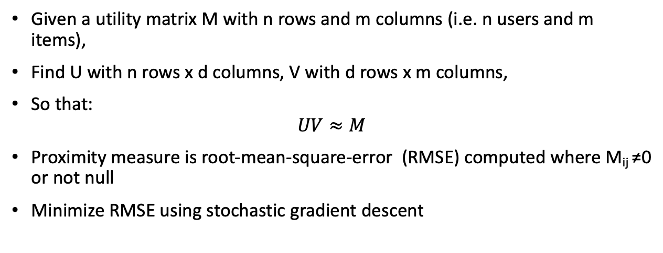
Matrix Decomposition
Given a utility matrix M with n rows and m columns (i.e. n users and m items),
Find U with n rows x d columns, V with d rows x m columns,
So that:
$$UV≈M$$
Proximity measure is root-mean-square-error (RMSE) computed where M_{ij} ≠0 or not null
Minimize RMSE using stochastic gradient descent

Slide 5
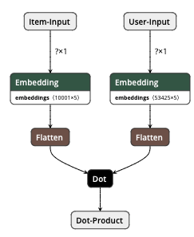
Matrix Decomposition with Neural Networks

Slide 6
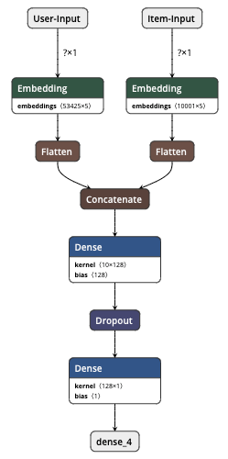
Deep Neural Network Recommender

Slide 7
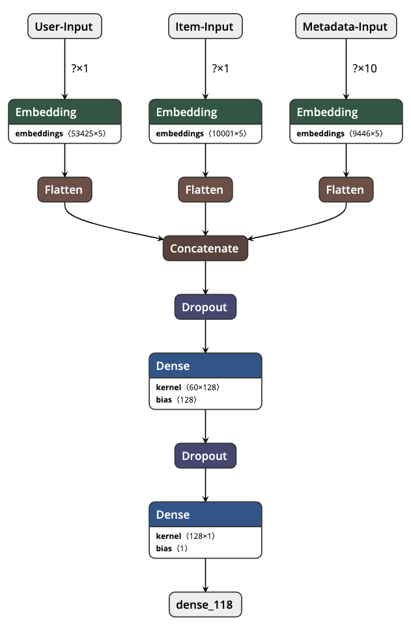
Hybrid Recommenders
Consider metadata to solve cold start problem

Slide 8
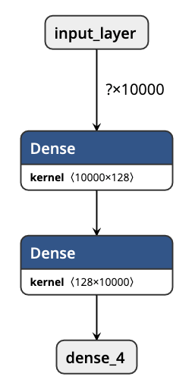
Autoencoders
Learn User/Item mapping from utility matrix M
Large, sparse M
Only non-zero elements relevant
Train on those only

Slide 9

Evaluation Metrics
Precision@k – out of the top k items recommended, how many did the user like?
$p@k=\frac{top_k(rating>t)}{k}$
Recall@k - the proportion of all items that the user likes and that was recommended
$r@k=\frac{top_k(rating>t)}{all_items(u, rating>t) }$
Normalized Discounted Cumulative Gain (NDCG) - how well the predicted items for a user are ranked based on relevance

Slide 10
Advantages of Neural Networks
More flexible than matrix decomposition
Easier to include metadata to help with cold start problem
Can featurize visual or text data and include in recommendation

