Slide 1

AI & DevOps Workshop
June 24, 2019

Slide 2
Agenda
Time | Topic | Presenter
8:30 – 9:00 | Breakfast & Registration
9:00 – 9:10 | Welcome | Hyun
9:10 – 10:00 | Session: Overview of AML Pipelines | Giovanni
10:00 – 11:00 | Session: Intro to Lifecycle Management with Azure DevOps/YAML | Prashant
11:00 – 12:00 | Session: YAML and AML Pipeline Integration | Sanjeev & Kate
12:00 – 1:00 | Lunch
1:00 – 3:30 | Lab: Implement Build, Retrain, Deployment Pipelines | Kate
3:30 – 4:00 | Wrap-up
Notes:
At the end of the lab today you will have a working sample implemented in your own subscription that you can use for a reference for your own projects.

Slide 3
Session: Overview of Azure ML Services and Pipelines
Notes:
At the end of the lab today you will have a working sample implemented in your own subscription that you can use for a reference for your own projects.

Slide 4
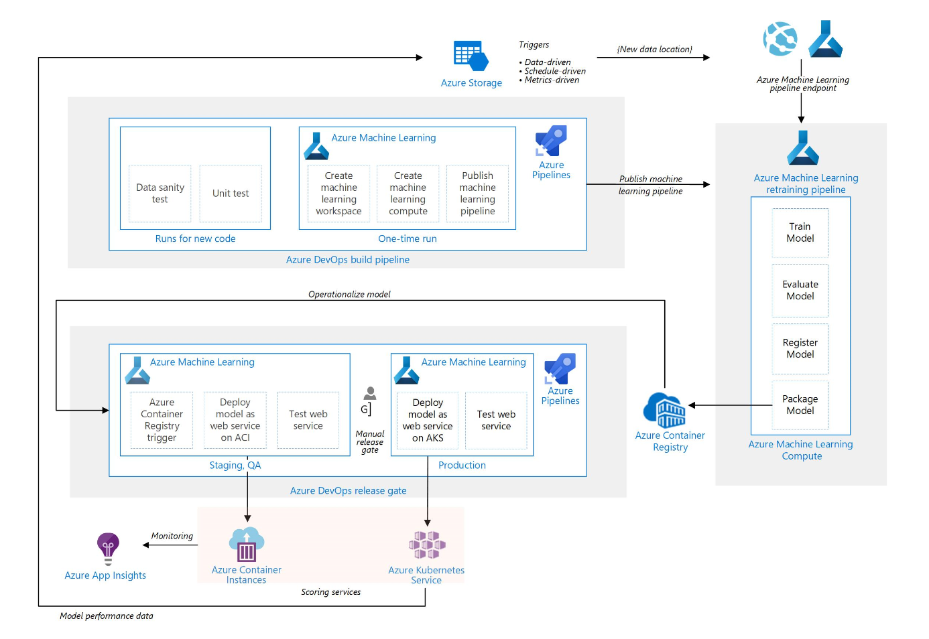
MLOps Reference Architecture
Notes:
This is the reference architecture of how MLOps for simply python model looks like. Here we leverage both Azure DevOps pipelines and Azure Machine learning pipelines.
The two green boxes are Azure DevOps pipeline, one is build (continuous Integration) and release (continuous deployment).
The build pipeline is mostly responsible for managing the code and creating infrastructure where as release pipeline is deploys the machine learning model as web service in QA and Prod env.
The orange pipeline is a AML pipeline which responsible for training model n packaging model as image.
So the typical flow starts with Data scientists updating their model training/scoring scripts and pushing it to git or create a Pull request. This will trigger the DevOps Build pipeline. It will run unit tests, pylint test, data sanity test. Next is it will run the infra as code to create AML workspace and AML compute if not already existing. Then it create AML training pipeline, validate it and publish it exposing its rest endpoints.
The AML pipeline can be triggered based on schedule, new data in blob or directly calling its endpoints. Once triggered, it will train the model on AML Compute cluster, evaluate whether new model is better than one in production and if yes, register it to promote it as new production model. It then package this new model along with its python dependencies to create scoring image and pushes it to Azure Container Registry
Here a new image being pushed to ACR is a trigger for Azure DevOps release pipeline. First step in CD pipeline is to deploy this model image in a QA environment, where its deployed as a model webservice on ACI and tested. Once this is successful, the stakeholders will get email to do manual approval, so they do final validation and once they approve, the model image is deployed as webservice on a scalable AKS cluster and some tests are performed.
This model webservice on AKS servers the scoring request and collects the data, which is then feed back to the model training, completing the feedback loop.
These pipelines are responsible for managing the code, doing version control, performing unit test, and continuous deployment is for taking your code and deploying it on AKS as a web service. The other pipeline is the azure ML pipeline which is used for training and evaluating the models,
How the flow would work: create or update the training or scoring scripts and push it to git. They create a pull request in git and the pull request triggers azure devops build or continuous integration pipeline and perform different types of tests -data, unit tests, and once it is completed it will create infrastructure which is azure ML workspace, ML compute to train the model, and take that training code and publish it as an azure ML pipeline. Once the pipeline is published it can be triggered based on schedule or new data coming to blob storage, and it performs steps like training of the model, evaluation of the model (does the new model perform better than the model in production?). If yes, then it will register and promote it for production which means to package the model with its dependencies and create a container image and push it to ACR.
The ACR we have in the lab is used as a trigger for the deployment pipeline. It will take the model image and deploy it as a container instance web service for testing purposes. And once this works, a human can manually review everything and release it to deploy on AKS in production. Once the model is deployed in AKS we can collect the model performance data and provide it back to blob storage and re-use it for retraining.

Slide 5
What is Azure Machine Learning service?
Set of Azure Cloud Services
Python SDK
That enables you to:
Prepare Data
Build Models
Train Models
Manage Models
Track Experiments
Deploy Models

Slide 6
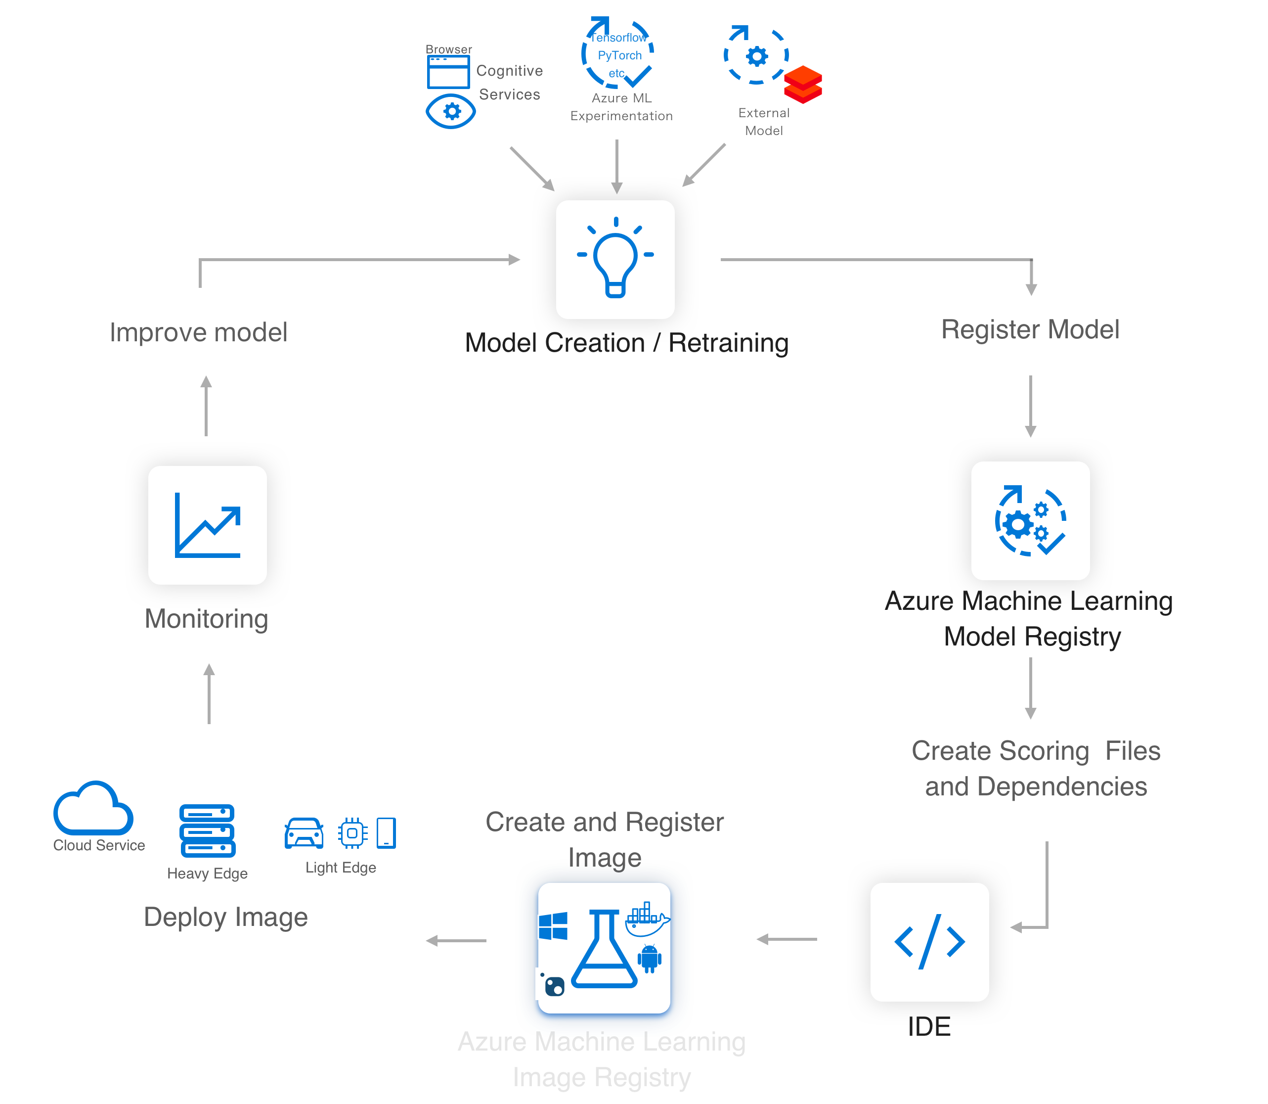

Azure ML service
Lets you easily implement this AI/ML Lifecycle
Workflow Steps
Develop machine learning training scripts in Python.
Create and configure a compute target.
Submit the scripts to the configured compute target to run in that environment. During training, the compute target stores run records to a datastore. There the records are saved to an experiment.
Query the experiment for logged metrics from the current and past runs. If the metrics do not indicate a desired outcome, loop back to step 1 and iterate on your scripts.
Once a satisfactory run is found, register the persisted model in the model registry.
Develop a scoring script.
Create an Image and register it in the image registry.
Deploy the image as a web service in Azure.
Azure Machine Learning

Slide 7
Azure Machine Learning: Technical Details

Slide 8
Azure ML service
Key Artifacts
Workspace
Models
Images
Experiments
Deployment
Pipelines
Data Stores
Compute Target

Slide 9
Azure ML service Artifact
Workspace
The workspace is the top-level resource for the Azure Machine Learning service. It provides a centralized place to work with all the artifacts you create when using Azure Machine Learning service.
The workspace keeps a list of compute targets that can be used to train your model. It also keeps a history of the training runs, including logs, metrics, output, and a snapshot of your scripts.
Models are registered with the workspace.
You can create multiple workspaces, and each workspace can be shared by multiple people.
When you create a new workspace, it automatically creates these Azure resources:
Azure Container Registry - Registers docker containers that are used during training and when deploying a model.
Azure Storage - Used as the default datastore for the workspace.
Azure Application Insights - Stores monitoring information about your models.
Azure Key Vault - Stores secrets used by compute targets and other sensitive information needed by the workspace.

Slide 10
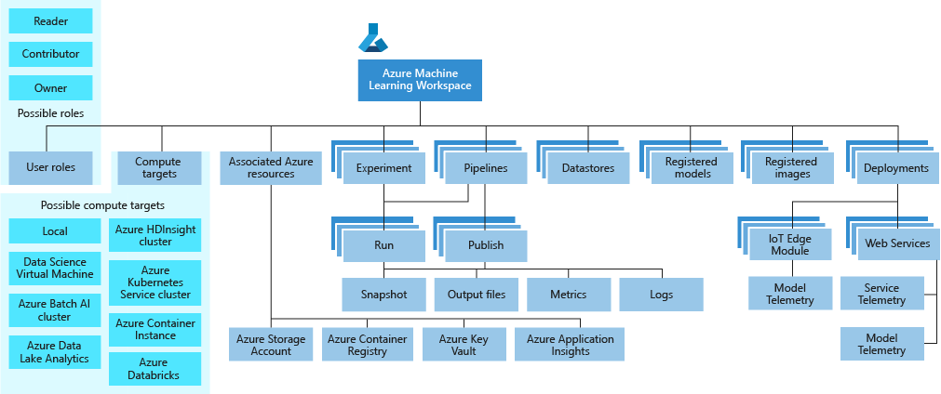
Azure ML service Workspace Taxonomy

Slide 11
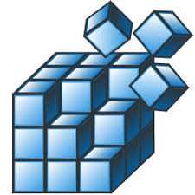
Azure ML service Artifacts
Models and Model Registry
Model
A machine learning model is an artifact that is created by your training process. You use a model to get predictions on new data.
A model is produced by a run in Azure Machine Learning.
Note: You can also use a model trained outside of Azure Machine Learning.
Azure Machine Learning service is framework agnostic — you can use any popular machine learning framework when creating a model.
A model can be registered under an Azure Machine Learning service workspace
Model Registry
Keeps track of all the models in your Azure Machine Learning service workspace.
Models are identified by name and version.
You can provide additional metadata tags when you register the model, and then use these tags when searching for models.
You cannot delete models that are being used by an image.

Slide 12
Azure ML Artifacts
Runs and Experiments
Experiment
Grouping of many runs from a given script.
Always belongs to a workspace.
Stores information about runs
Run
Produced when you submit a script to train a model. Contains:
Metadata about the run (timestamp, duration etc.)
Metrics logged by your script.
Output files autocollected by the experiment, or explicitly uploaded by you.
A snapshot of the directory that contains your scripts, prior to the run.
Run configuration
A set of instructions that defines how a script should be run in a given compute target.

Slide 13
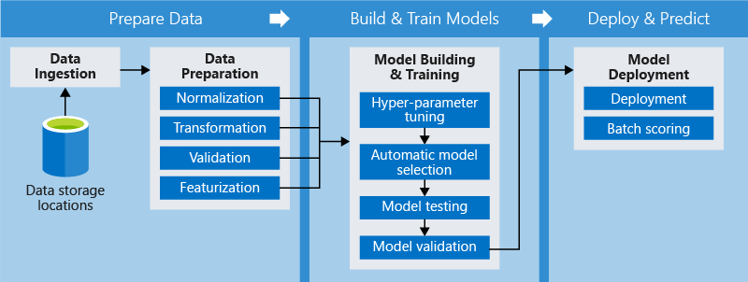
Azure ML Artifacts Pipelines
Pipelines consist of steps
Steps can be independent
Or in sequence, part of a deployment
Notes:
Using distinct steps makes it possible to rerun only the steps you need as you tweak and test your workflow.
When you rerun a pipeline, the run jumps to the steps that need to be rerun, such as an updated training script, and skips what hasn't changed.
The same holds true for unchanged scripts used for the execution of the step
You can use various toolkits and frameworks for each step in your pipeline. Azure coordinates between the various compute targets you use so that your intermediate data can be shared with the downstream compute targets easily.

Slide 14
Azure ML Pipelines
Advantages
Advantage | Description
Unattended runs | Schedule a few steps to run in parallel or in sequence in a reliable and unattended manner. Since data prep and modeling can last days or weeks, you can now focus on other tasks while your pipeline is running.
Mixed and diverse compute | Use multiple pipelines that are reliably coordinated across heterogeneous and scalable computes and storages. Individual pipeline steps can be run on different compute targets, such as HDInsight, GPU Data Science VMs, and Databricks.
Reusability | Pipelines can be templatized for specific scenarios such as retraining and batch scoring. They can be triggered from external systems via simple REST calls.
Tracking and versioning | Instead of manually tracking data and result paths as you iterate, use the pipelines SDK to explicitly name and version your data sources, inputs, and outputs as well as manage scripts and data separately for increased productivity

Slide 15
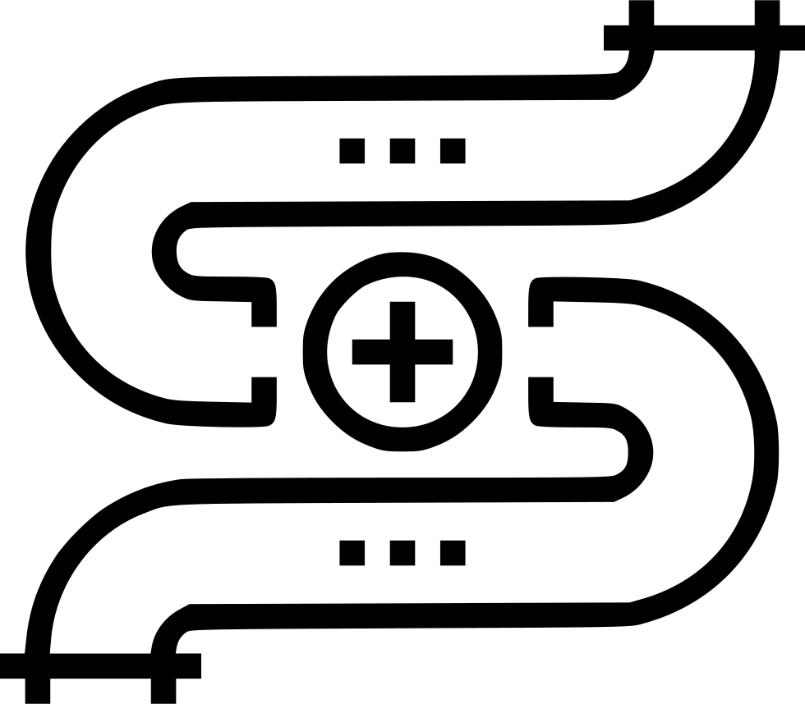
Azure ML Pipeline
Python SDK
Imperative constructs for sequencing or parallelizing the steps
Declarative data dependencies
Pre-built modules for common tasks
Extensible
Compute targets and storage resources can be managed directly from the SDK.
Pipelines can be saved as templates and deployed to a REST endpoint

Slide 16
Azure ML Artifact
Compute Target
Currently supported compute targets
Compute Target | Training | Deployment
Local Computer | ✓
A Linux VM in Azure (such as the Data Science Virtual Machine) | ✓
Azure ML Compute | ✓
Azure Databricks | ✓
Azure Data Lake Analytics | ✓
Apache Spark for HDInsight | ✓
Azure Container Instance |  | ✓
Azure Kubernetes Service |  | ✓
Azure IoT Edge |  | ✓
Field-programmable gate array (FPGA) |  | ✓
Compute Targets are the compute resources used to run training scripts or host your model when deployed as a web service.
They can be created and managed using the Azure Machine Learning SDK or CLI.
You can attach to existing resources.
You can start with local runs on your machine, and then scale up and out to other environments.

Slide 17
Azure ML
Currently Supported Compute Targets
Compute target | GPU acceleration | Hyperdrive | Automated model selection | Can be used in pipelines
Local computer | Maybe |  | ✓
Data Science Virtual Machine (DSVM) | ✓ | ✓ | ✓ | ✓
Azure ML compute | ✓ | ✓ | ✓ | ✓
Azure Databricks | ✓ |  | ✓ | ✓
Azure Data Lake Analytics |  |  |  | ✓
Azure HDInsight |  |  |  | ✓
https://docs.microsoft.com/en-us/azure/machine-learning/service/how-to-set-up-training-targets#supported-compute-targets
Notes:
Azure Databricks and Azure Data Lake Analytics can only be used in a pipeline.
You cannot attach an existing Azure Containers Instance to your workspace. Instead, you must create a new instance.
You cannot create Azure HDInsight, Azure Databricks, or Azure Data Lake Store within a workspace. Instead, you must create the resource and then attach it to your workspace.

Slide 18
Azure ML service Artifacts
Image and Registry
Image contains
A model.
A scoring script used to pass input to the model and return the output of the model.
Dependencies needed by the model or scoring script/application.
Two types of images
FPGA image: Used when deploying to a field-programmable gate array in the Azure cloud.
Docker image: Used when deploying to compute targets such as Azure Container Instances and Azure Kubernetes Service.
Image Registry
Keeps track of images created from models.
Metadata tags can be attached to images. Metadata tags are stored by the image registry and can be used in image searches

Slide 19
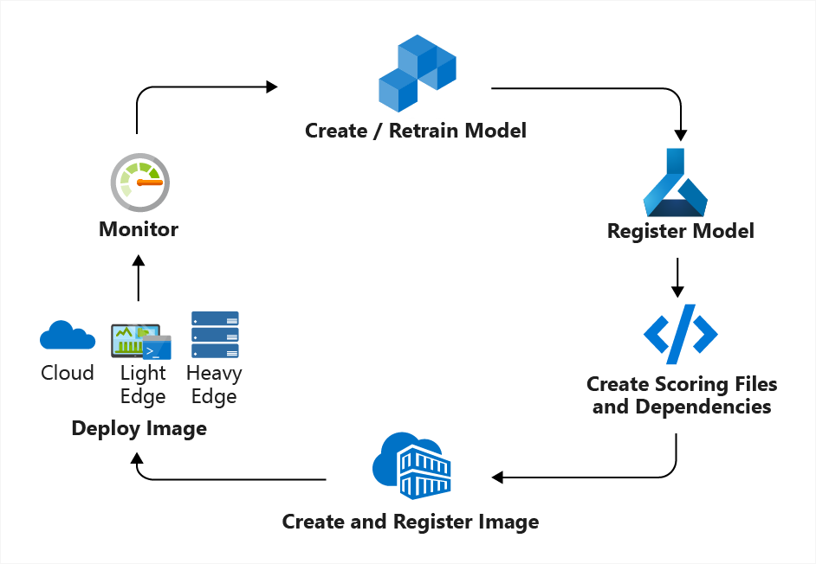
Azure ML Concept
Model Management
Model Management in Azure ML usually involves these four steps
Step 1: Register Model using the Model Registry
Step 2: Register Image using the Image Registry (the Azure Container Registry)
Step 3: Deploy the Image to cloud or to edge devices
Step 4: Monitor models—you can monitor input, output, and other relevant data from your model.

Slide 20
Azure ML Artifact
Deployment
Deployment is an instantiation of an image. Two options:
Web service
A deployed web service can run on Azure Container Instances, Azure Kubernetes Service, or field-programmable gate arrays (FPGA).
Can receive scoring requests via an exposed a load-balanced, HTTP endpoint.
Can be monitored by collecting Application Insight telemetry and/or model telemetry.
Azure can automatically scale deployments.
IoT Module
A deployed IoT Module is a Docker container that includes the model, associated script and additional dependencies.
Is deployed using Azure IoT Edge on edge devices.
Can be monitored by collecting Application Insight telemetry and/or model telemetry.
Azure IoT Edge will ensure that your module is running and monitor the device that is hosting it.

Slide 21
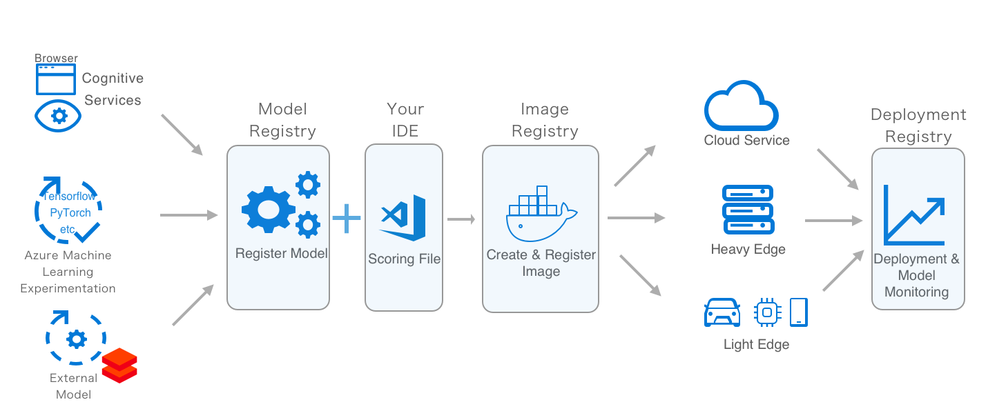
Azure ML: How to deploy models at scale

Slide 22
Azure ML Artifact
Datastore
A datastore is a storage abstraction over an Azure Storage Account.
The datastore can use either an Azure blob container or an Azure file share as the backend storage.
Each workspace has a default datastore, and you may register additional datastores.
Use the Python SDK API or Azure Machine Learning CLI to store and retrieve files from the datastore.

Slide 23
How to use the Azure Machine Learning service: E2E coding example using the SDK

Slide 24




Azure ML
Azure ML
Workspace
Steps
1. Snapshot folder and send to experiment
2. Create docker image
6. Stream stdout, logs, metrics
Experiment
Docker Image
6. Stream stdout, logs, metrics
5. Launch script
3. Deploy docker and snapshot to compute
7. Copy over outputs
Compute Target
4. Mount datastore to compute
Data Store
My Computer

Slide 25
Session: Introduction to Lifecycle Management with Azure DevOps/YAML

Slide 26
Session:YAML and AML Pipeline Integration

Slide 27
Session goals
Project architecture
Build, Re-training, Deployment pipelines
Lab Setup

Slide 28
MLOps Reference Architecture
Notes:
This is the reference architecture of how MLOps for simply python model looks like. Here we leverage both Azure DevOps pipelines and Azure Machine learning pipelines.
The two green boxes are Azure DevOps pipeline, one is build (continuous Integration) and release (continuous deployment).
The build pipeline is mostly responsible for managing the code and creating infrastructure where as release pipeline is deploys the machine learning model as web service in QA and Prod env.
The orange pipeline is a AML pipeline which responsible for training model n packaging model as image.
So the typical flow starts with Data scientists updating their model training/scoring scripts and pushing it to git or create a Pull request. This will trigger the DevOps Build pipeline. It will run unit tests, pylint test, data sanity test. Next is it will run the infra as code to create AML workspace and AML compute if not already existing. Then it create AML training pipeline, validate it and publish it exposing its rest endpoints.
The AML pipeline can be triggered based on schedule, new data in blob or directly calling its endpoints. Once triggered, it will train the model on AML Compute cluster, evaluate whether new model is better than one in production and if yes, register it to promote it as new production model. It then package this new model along with its python dependencies to create scoring image and pushes it to Azure Container Registry
Here a new image being pushed to ACR is a trigger for Azure DevOps release pipeline. First step in CD pipeline is to deploy this model image in a QA environment, where its deployed as a model webservice on ACI and tested. Once this is successful, the stakeholders will get email to do manual approval, so they do final validation and once they approve, the model image is deployed as webservice on a scalable AKS cluster and some tests are performed.
This model webservice on AKS servers the scoring request and collects the data, which is then feed back to the model training, completing the feedback loop.
These pipelines are responsible for managing the code, doing version control, performing unit test, and continuous deployment is for taking your code and deploying it on AKS as a web service. The other pipeline is the azure ML pipeline which is used for training and evaluating the models,
How the flow would work: create or update the training or scoring scripts and push it to git. They create a pull request in git and the pull request triggers azuzre devops build or continuous integration pipeline and perform different types of tests -data, unit tests, and once it is completed it will create infrastructure which is azure ML workspace, ML compute to train the model, and take that training code and publish it as an azure ML pipeline. Once the pipeline is published it can be triggered based on schedule or new data coming to blob storage, and it performs steps like training of the model, evaluation of the model (does the new model perform better than the model in production?). If yes, then it will register and promote it for production which means to package the model with its dependencies and create a container image and push it to ACR.
The ACR we have in the lab is used as a trigger for the deployment pipeline. It will take the model image and deploy it as a container instance web service for testing purposes. And once this works, a human can manually review everything and release it to deploy on AKS in production. Once the model is deployed in AKS we can collect the model performance data and provide it back to blob storage and re-use it for retraining.

Slide 29
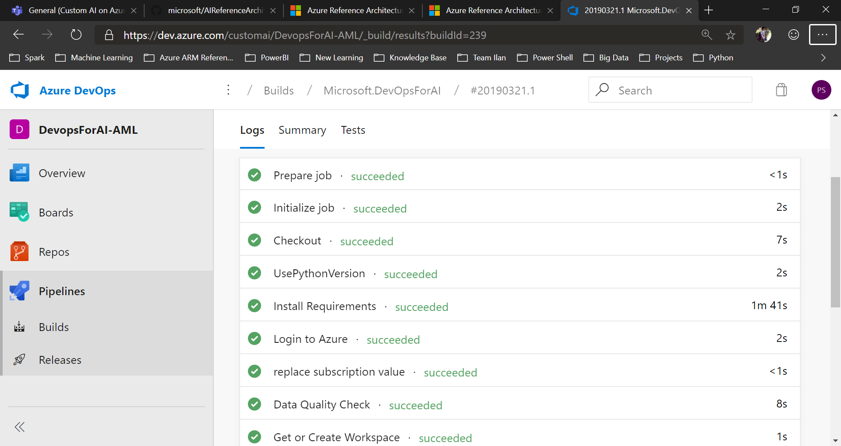
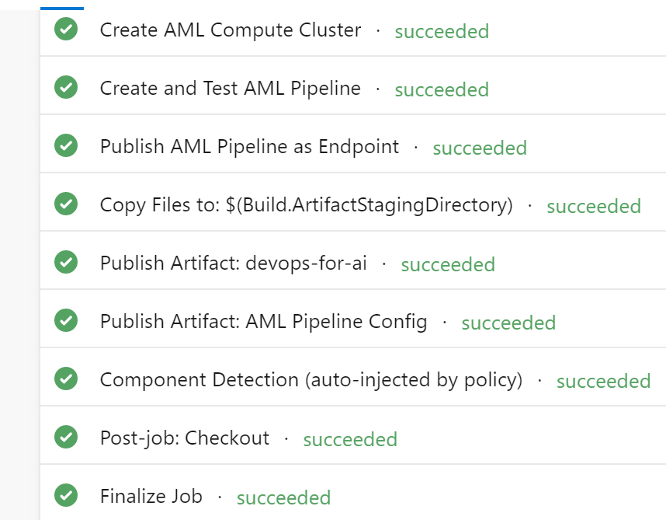
Build Pipeline
Notes:
This is how a successful build pipeline looks like. The starting steps are mostly to prepare environment to run the code. Then we have some unit tests and data sanity tests. There are some steps to create AML workspace and AML compute, validate and publish pipeline.
The script under ./aml_service are used in build pipeline. All the scripts starting with 0 are the one time run scripts. These are the scripts which need to be run only once. There is no harm of running these scripts every time in build pipeline.
00-WorkSpace.py : This is a onetime run script. It reads the workspace details from ./aml_config/config.json file and create (if workspace not available) or get (existing workspace).
01-Experiment.py : This is a onetime run script. It registers the root directory as project. It is not included as a step in build pipeline.
02-AttachTrainingVM.py : This is a onetime run script. It attaches a remote VM to the workspace. It reads the config from ./aml_config/security_config.json. It is not included as a step in build pipeline.
10-TrainOnLocal.py : This scripts triggers the run of ./training/train.py script on the local compute(Host agent in case of build pipeline). If you are training on remote vm, you do not need this script in build pipeline. All the training scripts (1x) generates an output file aml_config/run_id.json which records the run_id and run history name of the training run. run_id.json is used by 20-RegisterModel.py to get the trained model.
11-TrainOnLocalEnv.py : Its functionality is same as 10-TrainOnLocal.py, the only difference is that it creates a virtual environment on local compute and run training script on virtual env.
12-TrainOnVM.py : As we want to train the model on remote VM, this script is included as a task in build pipeline. It submits the training job on remote vm.
15.EvaluateModel.py : It gets the metrics of latest model trained and compares it with the model in production. If the production model still performs better, all below scripts are skipped.
20-RegisterModel.py : It gets the run id from training steps output json and registers the model associated with that run along with tags. This scripts outputs a model.json file which contains model name and version. This script included as build task.
30-CreateScoringImage.py : This takes the model details from last step, creates a scoring webservice docker image and publish the image to ACR. This script included as build task. It writes the image name and version to image.json file.

Slide 30
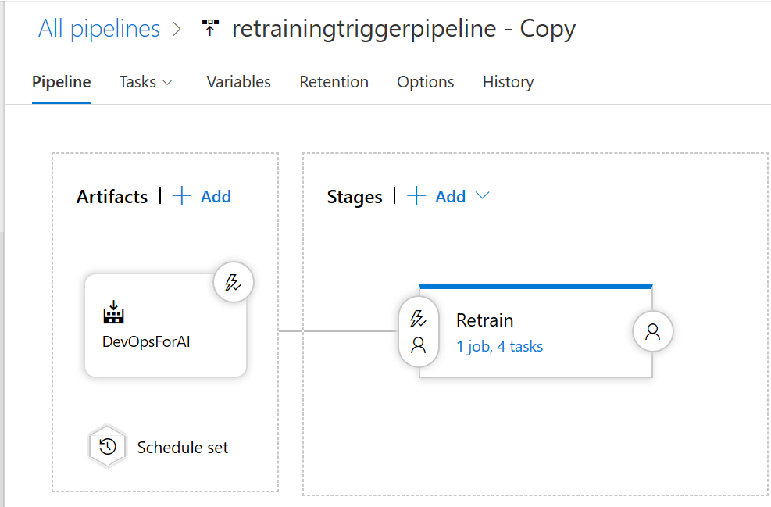
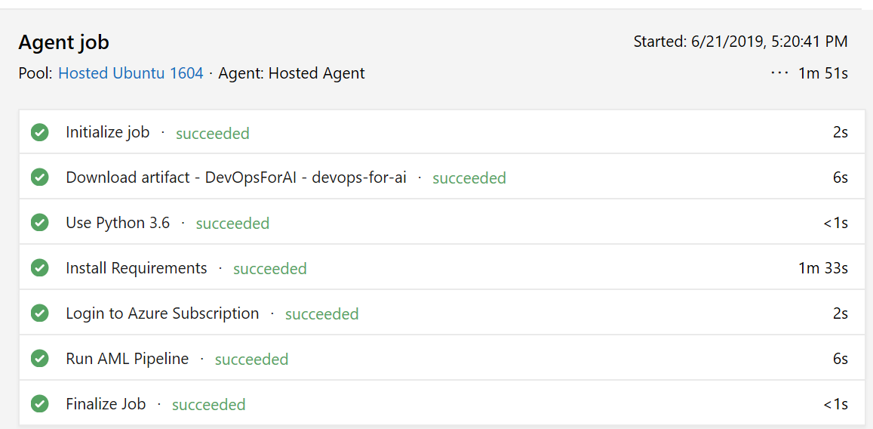
Re-training Pipeline

Slide 31
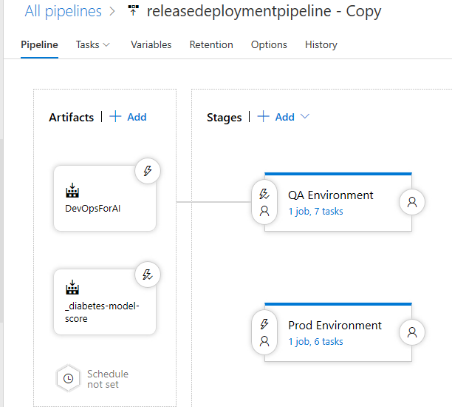
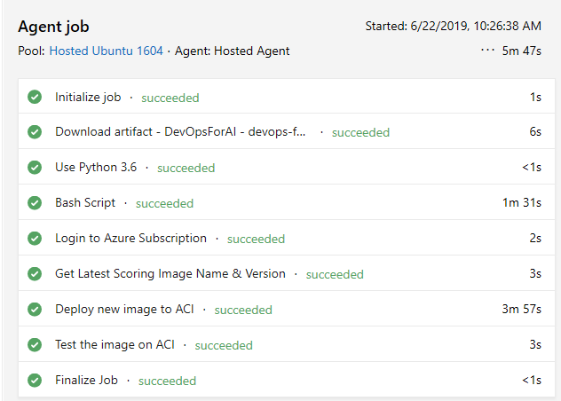
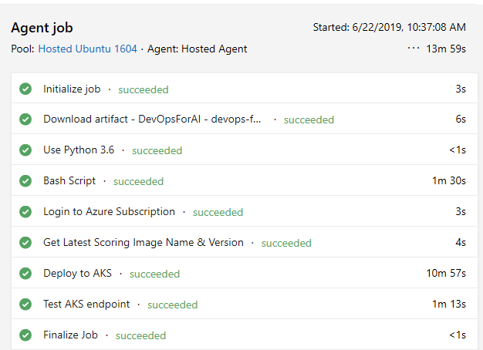
Deployment Pipeline

Slide 32

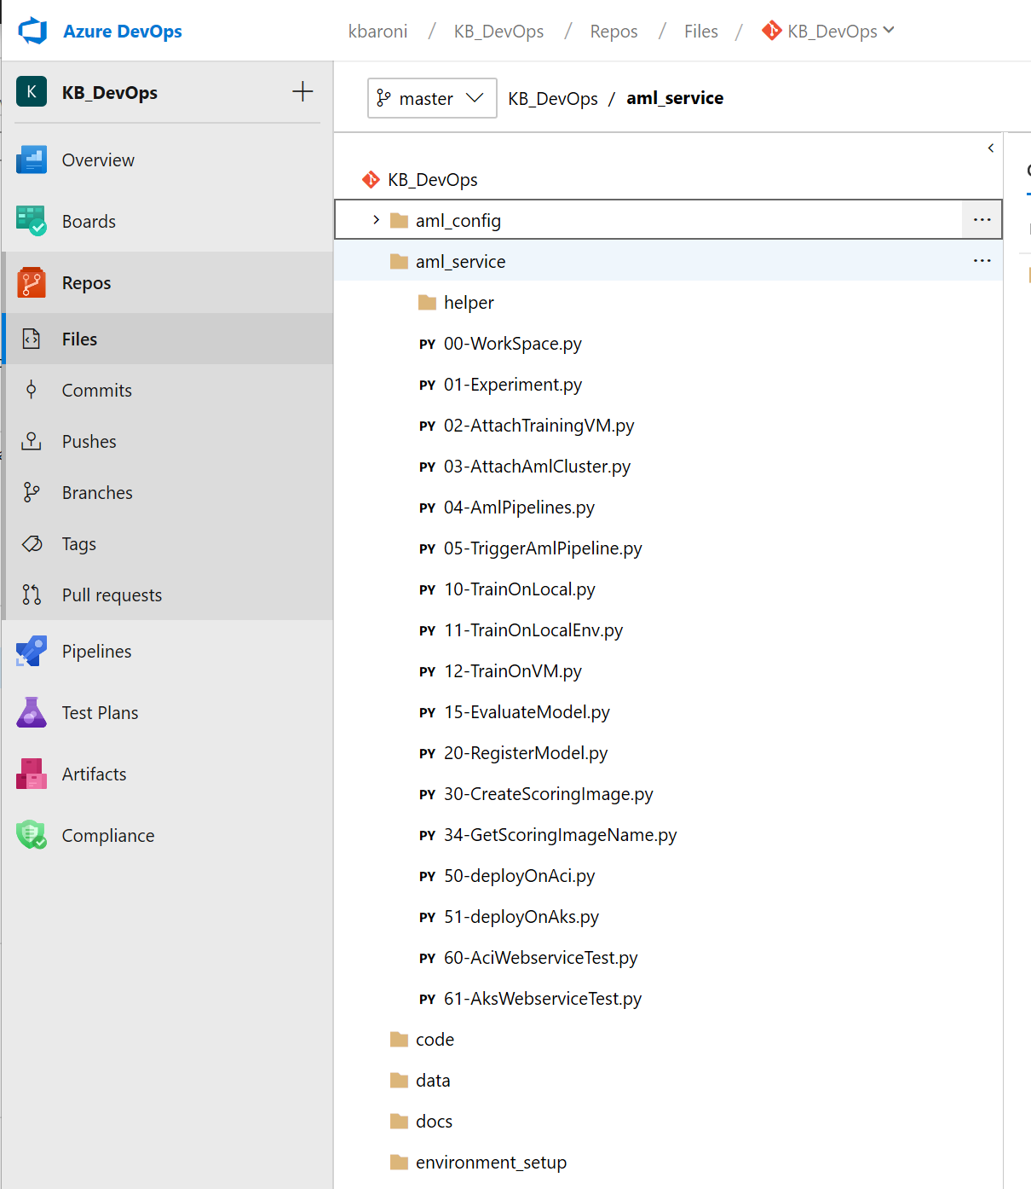
Project Code
Notes:
Config Files
All the scripts inside the ./aml_config are config files. These are the files where you need to provide details about the subscription, resource group, workspace, conda dependencies, remote vm, AKS etc.
config.json : This is a mandatory config file. Provide the subscription id, resource group name, workspace name and location where you want to create Azure ML services workspace. If you have already created the workspace, provide the existing workspace details in here.
conda_dependencies.yml : This is a mandatory file. This files contains the list of dependencies which are needed by the training/scoring script to run. This file is used to prepare environment for the local run(user managed/system managed) and docker run(local/remote).
security_config.json : This file contains the credentials to the remove vm where we want to train the model. This config is used by the script 02-AttachTrainingVM.py to attach remote vm as a compute to the workspace. Attaching remote vm to workspace is one time operation. It is recommended not to publish this file with credentials populated in it. You can put the credentials, run the 02-AttachTrainingVM.py manually and clear the credentials before pushing it to git.
aks_webservice.json : This is an optional config. If you already have an AKS attached to your workspace, then provide the details in this file. If not, you do not have to check in this file to git.

Slide 33
Lab Setup
Create new Azure DevOps project
Create Azure DevOps service connection
Setup variable group with secrets
Import repo into Azure DevOps
Notes:
Walk thru these exercises in lab doc

