Slide 1
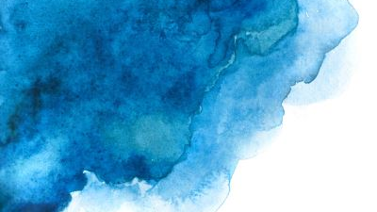
Image Segmentation

Slide 2
Definition

Slide 3
Segmentation

Slide 4
Region-based, global threshold
Original
B&W
Mean intensity as threshold
Back/foreground

Slide 5
Region-based, local threshold
Original
B&W
4 intensity level as thresholds
4 regions
Notes:
High contrast required. Analyze and equalize image beforehand, otherwise overalp of grayscale reduces accuracy significantly

Slide 6
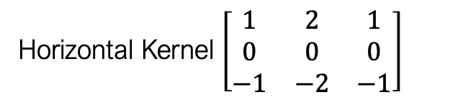
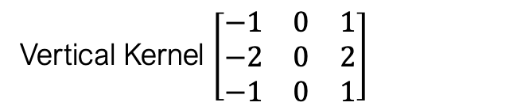
Edge detection w. convolution
Horizontal Kernel $\left[\begin{matrix}1 & 2 & 1 \\ 0 & 0 & 0 \\ −1 & −2 & −1\end{matrix}\right]$
Vertical Kernel $\left[\begin{matrix}−1 & 0 & 1 \\ −2 & 0 & 2 \\ −1 & 0 & 1\end{matrix}\right]$
Original
Notes:
Sobel filters are 2D convolution kernels. They are convolved over the image. Laplace Kernels also identify edges

Slide 7
K-Means Clusters
Notes:
Note the confusion of trees and reflection, mountains and sky
K-means is distance based, must define number of clusters a priori

Slide 8
Fast RCNN
Convolution network generates feature maps, aka RoI
RoI Pooling to fixed size
FC + softmax for classification
FC + linear regression for bounding box

Slide 9
Faster RCNN
Convolution network generates feature maps, aka RoI
RPN returns regions of different sizes
RoI Pooling to fixed size
FC + softmax for classification
FC + linear regression for bounding box

Slide 10
Mask RCNN
Add a parallel branch to Faster RCNN to predict segmentation mask
Branch is a FCN applied to each ROI
FCN predicts segmentation mask pixel-to-pixel

Slide 11
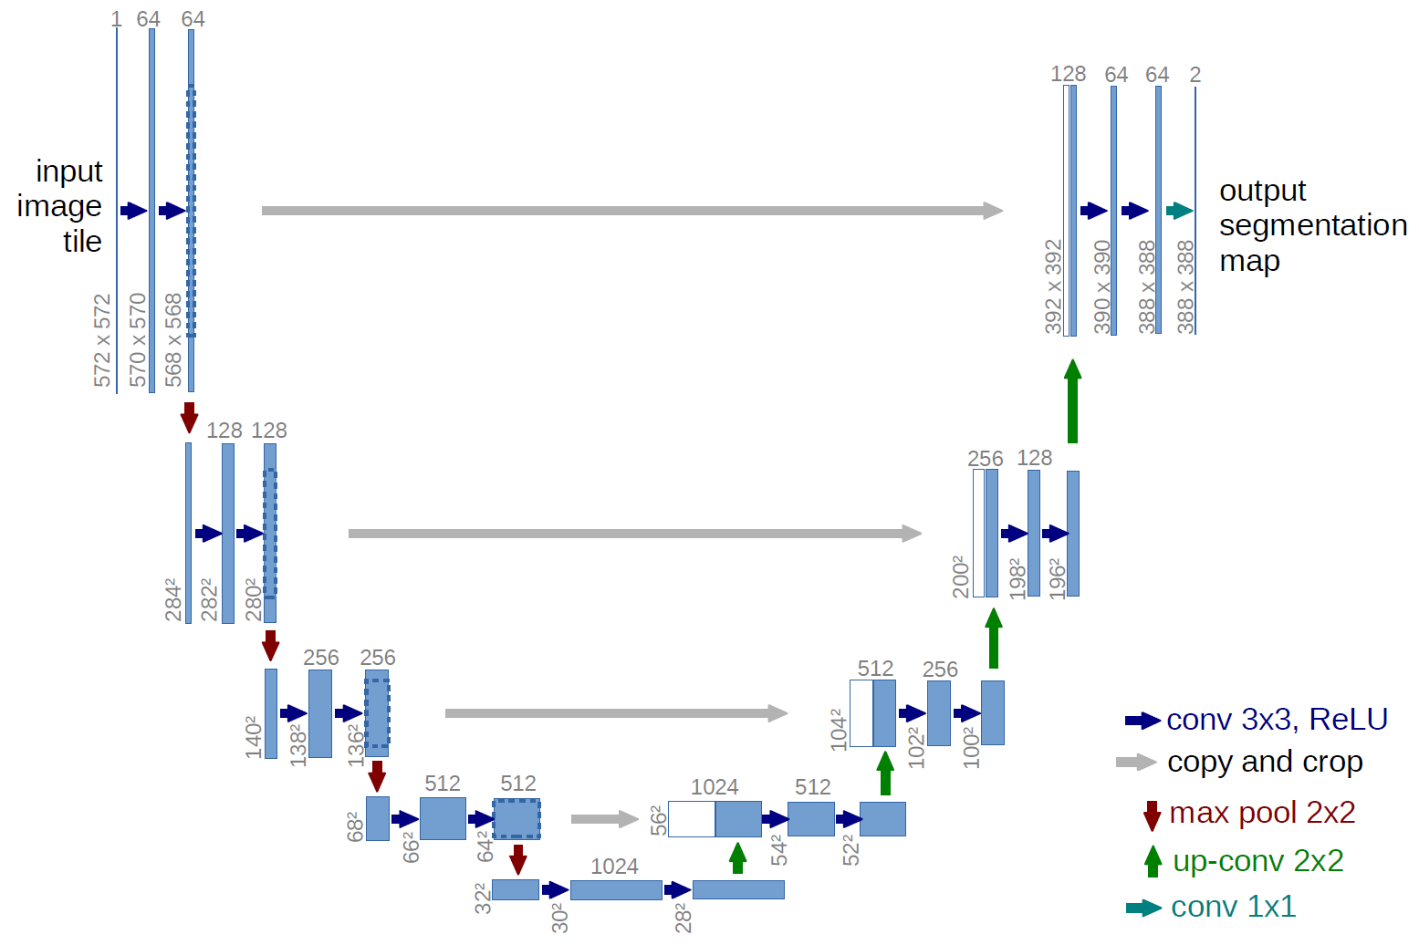
Unet
Contracting and Expanding paths
Downsample but double the channels
Upsample but halve the channels
Provide localization, i.e. pixel-by-pixel classification
Only convolutional, no FCN layer
Works with fewer data, designed for biomedical applications

Slide 12
Q&A

