Slide 1
Setup Azure ML

Slide 2
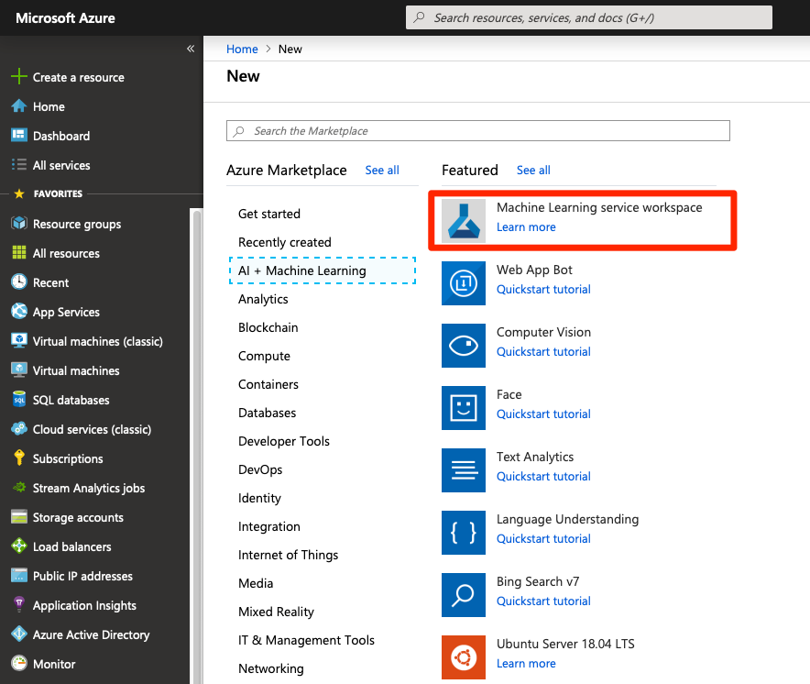
Create a workspace

Slide 3
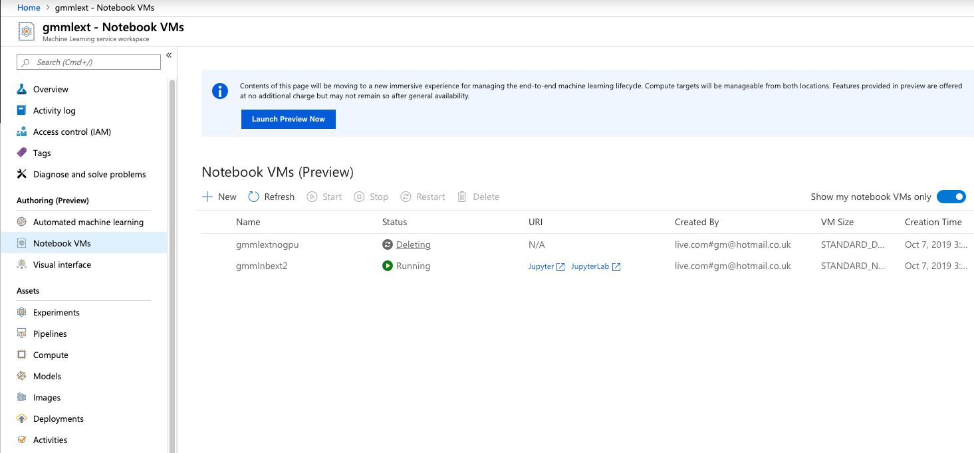
Create a Notebook VM
Select NC6 or better (1 GPU) if you have quota
Select D4v2 or better (8 CPUs) if you have not

Slide 4

Launch Jupyter
Not Jupyterlab
Then open a command prompt in jupyter

Slide 5
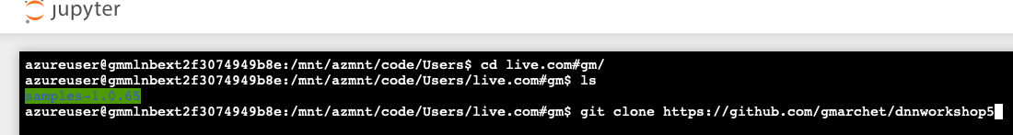
Clone the repository
cd <your user directory>
git clone https://github.com/gmarchet/dnnworkshop6

Slide 6
Install required libraries
sudo apt-get install graphviz
conda install pydot
pip install tensorflow_datasets
pip install transformers

