Slide 1

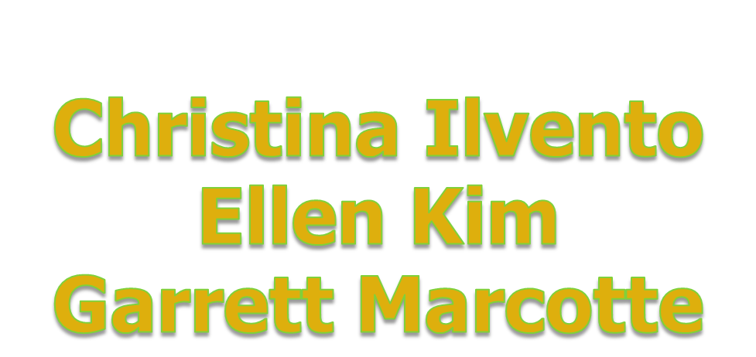

Slide 2

Paired programming
"a practice in which two programmers work side-by-side at one computer, continuously collaborating on the same design, algorithm, code, or test.”
Notes:
One partner is driving (designing and typing the code) while the other is navigating (reviewing the work, identifying bugs, and asking questions). The two partners switch roles every 30-40 minutes, and on demand, brainstorm.
Result is more efficiently producing stronger code.

Slide 3
Pairgramming
"a practice in which two programmers work side-by-side at one computer, continuously collaborating on the same design, algorithm, code, or test.”
Notes:
click

Slide 4
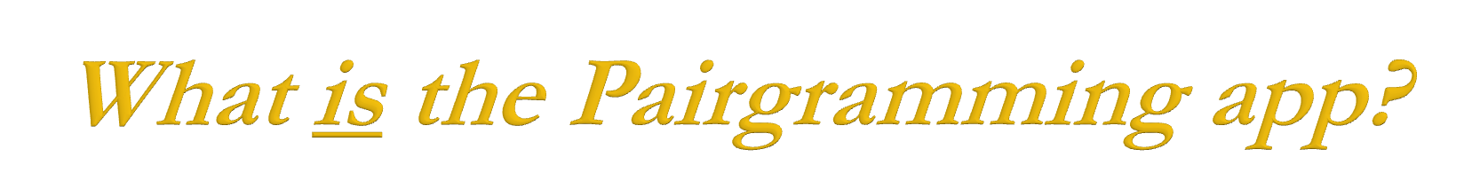
  a web-based interface for fully collaborative programming:
  1. console
  2. GUI syntax-highlighted text editor
  3. communication
  4. file management
Notes:
one coherent interface for these 4 main elements

Slide 5

  Flexibility
  Save time
  Built-in SVN
  Multiplatform
  No special installations
  Syntax highlighting GUI
  Cohesive
Notes:
First, basically everybody programs collaboratively
* Flexibility -- you don't have to be in the same place, but you can be
* Save time -- you can work with a partner during vacations, and work from friend/forbes without hunting for a free frist classroom or walking out to friend basement
* SVN control, and backups in multiple locations
* Multiplatform -- any computer with Firefox can run our app, without any special installations (like putty, dr java, etc.)
* if you don't like emacs, use our syntax highlighted GUI text editor; if you do like emacs, we'll give you emacs
* Centralized -- no more window juggling, or resizing to make everything fit on one screen

Slide 6

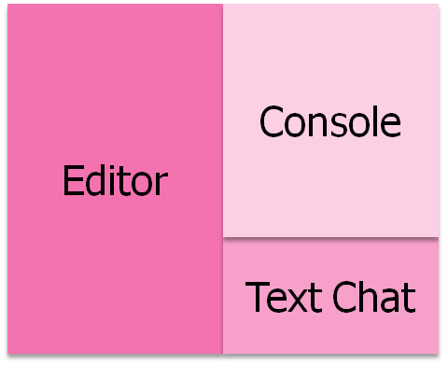
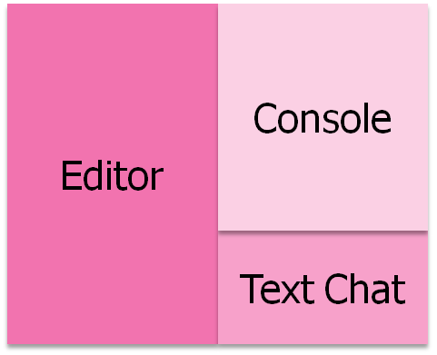
Django & Subversion Server (Apache)
Ajaxterm Server (standalone)
SSH
SSH
Driver
Passenger
Notes:
We store all files -> you don’t need to worry about permissions and where to store it, and you don’t have to deal with file transfers between users.
We handle ssh connections to your development server on your behalf, so you don’t have to worry about Putty/etc.
As you can see on the data-flow diagram, the driver has control over data flow in both directions -> to edit files and interact with the development server, whereas the passenger cannot actively make changes to the source code or interact with the development server in accordance with the paired-programming model.

Slide 7

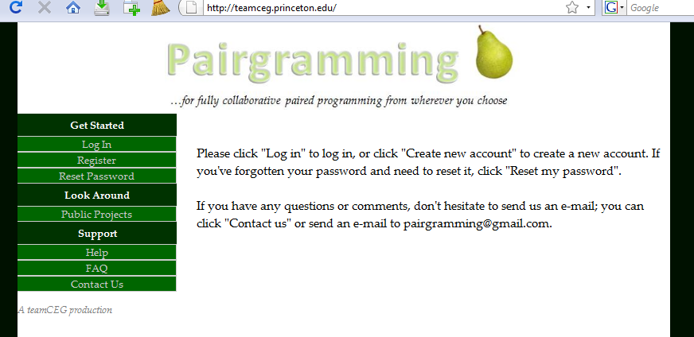
Notes:
What is django?
also open source

Slide 8
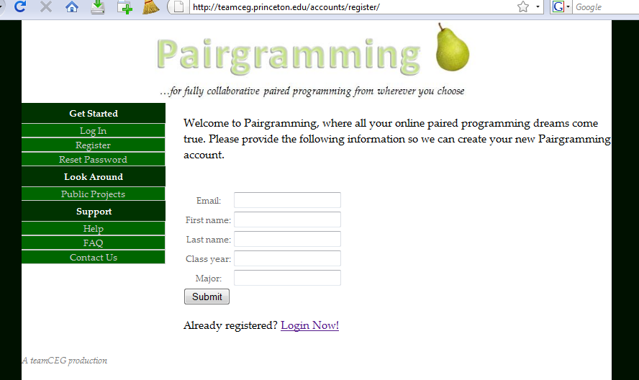
Notes:
Sign up with a valid email address.

Slide 9
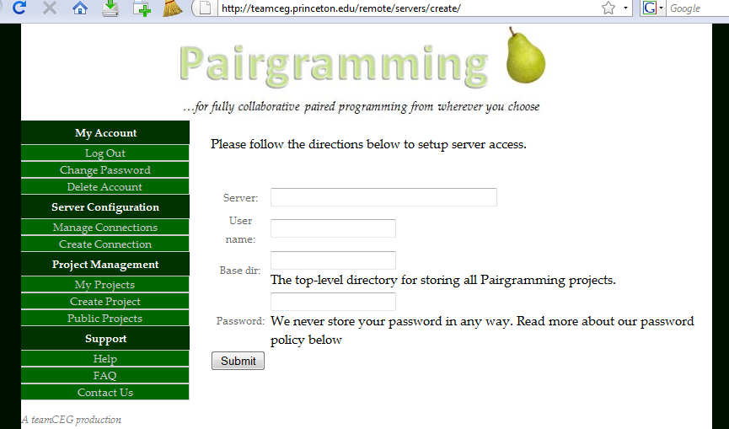
Notes:
1) Setup once and never have to give us your password again. We do not store your password.
2) Using RSA public-private key pair allows us to SSH to a development server on your behalf but does not allow us to access your webmail account, etc.

Slide 10
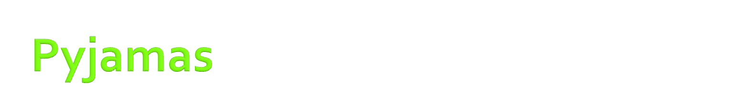
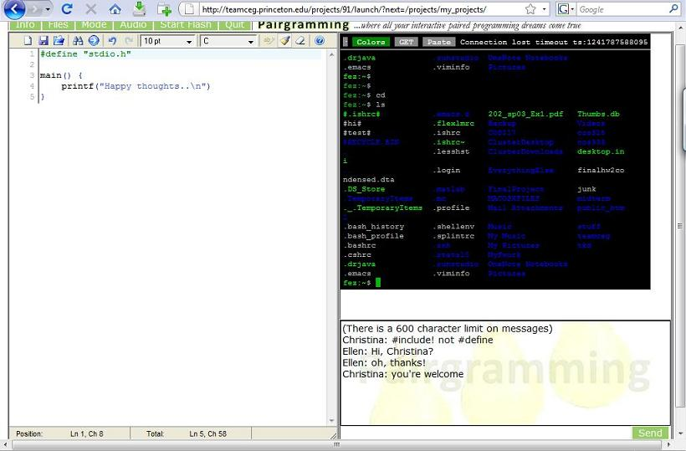
Console
Text Editor
Text Chat
Notes:
PYJAMAS: open source web toolkit in Python, compiles to GWT to Javascript
AJAXTERM: open source javascript shell/console emulator. Our major changes included piping it to two users, enabling logins with keys rather than passwords.
EDITAREA: open source javascript syntax-highlighting text area. Designed for code editing. Our major changes included allowing for the passenger-side editor.
This is the driver screen: driver can interact with the console and also edit code in the syntax-highlighting editor.
Text chat allows for 2-way communications between the two users.

Slide 11
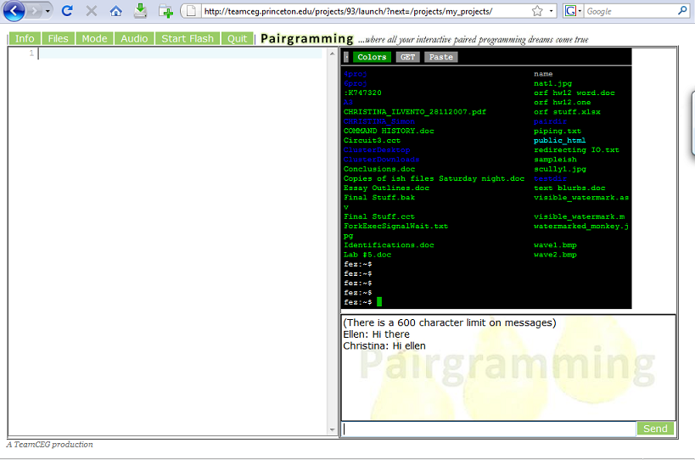
Console
Text Editor
Text Chat
Notes:
The passenger screen: The editor is not enabled – it’s actually blank here because we had just started the session and hadn’t typed anything yet,
but in essence the passenger cannot interact with the console or the editor, but can view what the driver is doing in both.
the text chat interface is identical

Slide 12



Slide 13

  Communication
  SVN
  Documentation
  Be cautious using new things
  Open source
      Editor: Editarea
      Console: Ajaxterm
Notes:
Communication – know what everyone in the group is working on at all times; communicate approval (good job, x!) and disapproval (x, we’ve noticed you’ve been working on one thing for a while now, how’s progress?)
SVN – have good commit comments
Documentation – it is invaluable. Motivation for us to have better documentation
Be cautious using new things (Pyjamas… not well documented, some function say “Don’t use this yet”)
Open source is open source for a reason sometimes – especially for smaller projects, the motivation for the original creator to maintain and document the code is usually not high, so you have to be very careful in deciding to take the plunge and commit a lot of time into fixing and adapting possibly irreparable or infeasible code.
Open source – the best and worst thing that can happen to you (saves you a lot of work, but has a lot of bugs/quirks/often not well documented at all)
the text editor we ended up switching to kind of late in the game was French so we didn’t find it in our first 5 in-depth searches online

Slide 14

  Smoother switch drivers
  Faster, smoother updates
  Improve file tree
  Protect & improve text chat
  Enhance user communication
  Bug hunting (feature enhancement)

Slide 15

Prof. Kernighan
Peng Jiang
Dr. Robert Dondero
You
Notes:
Prof. Kernighan, opportunity to pursue something really cool for class credit
Peng Jiang, high expectations every week
Dr. Robert Dondero, interested in being a client
You, for coming and supporting us and not asking any tough questions---

Slide 16


