Slide 1
Pairgramming
Christina Ilvento
Ellen Kim
Garrett Marcotte

Slide 2
Overview
Paired programming
"a practice in which two programmers work side-by-side at one computer, continuously collaborating on the same design, algorithm, code, or test.”
Notes:
One partner is driving (designing and typing the code) while the other is navigating (reviewing the work, identifying bugs, and asking questions). The two partners switch roles every 30-40 minutes, and on demand, brainstorm.
Motivation is that it's faster, less tiring, you learn more.

Slide 3
Overview
Pairgramming
"a practice in which two programmers work side-by-side at one computer, continuously collaborating on the same design, algorithm, code, or test.”
Notes:
One partner is driving (designing and typing the code) while the other is navigating (reviewing the work, identifying bugs, and asking questions). The two partners switch roles every 30-40 minutes, and on demand, brainstorm.
Motivation is that it's faster, less tiring, you learn more.

Slide 4
Why Pairgramming?
Flexibility
Save time
Built-in SVN
Multiplatform
No special installations
Syntax highlighting GUI
Security
Centralized
Notes:
* Flexibility -- you don't have to be in the same place, but you can be
* Save time -- you can work with a partner during vacations, and work from friend/forbes without hunting for a free frist classroom or walking out to friend basement
* SVN control, and backups in multiple physical locations
* Multiplatform -- any computer with Firefox can run our app, without any special installations (like putty, dr java, etc.)
* if you don't like emacs, use our syntax highlighted GUI text editor; if you do like emacs, we'll give you emacs
* Security -- we don't have your plaintext password, and if you want us out of your hats, you can delete one file
* Centralized -- no more window juggling, or resizing to make everything fit on one screen

Slide 5
Data Flow ~ Driver
Django & Subversion Server (Apache)
Ajaxterm Server (standalone)
Editor
Console
Editor
Console
SSH
SSH
Text Chat
Text Chat
Driver
Passenger

Slide 6
Data Flow ~ Passenger
Django & Subversion Server (Apache)
Ajaxterm Server (standalone)
Editor
Console
Editor
Console
SSH
SSH
Text Chat
Text Chat
Driver
Passenger

Slide 7
Data Flow
Django & Subversion Server (Apache)
Ajaxterm Server (standalone)
Editor
Console
Editor
Console
SSH
SSH
Text Chat
Text Chat
Driver
Passenger

Slide 8
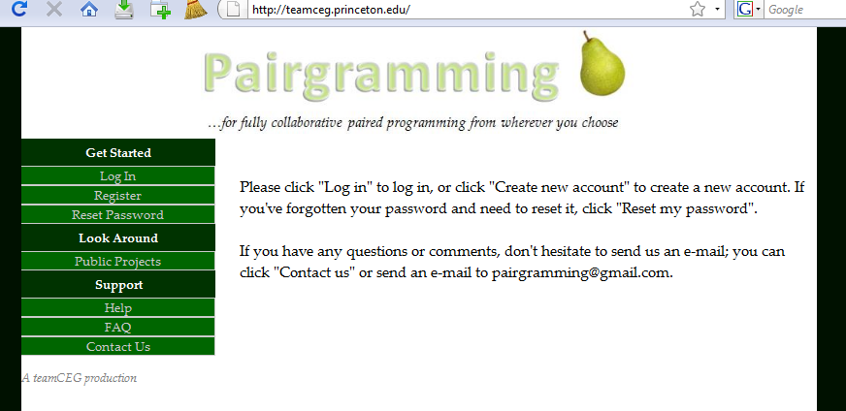
Django
Notes:
also open source

Slide 9
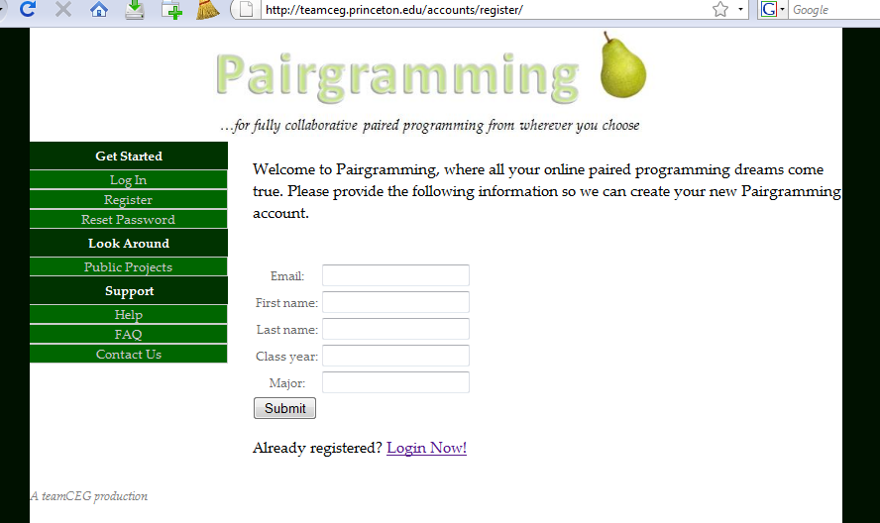
Django

Slide 10
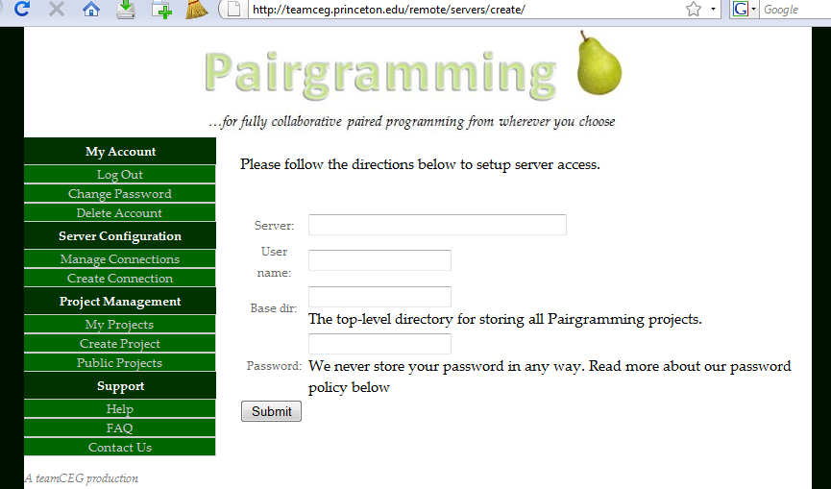
Django

Slide 11
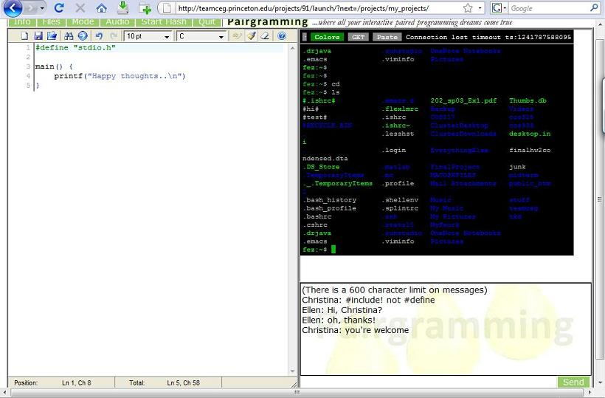
Pyjamas
Console
Text Editor
Text Chat
Notes:
open source web toolkit in Python, compiles to GWT to Javascript

Slide 12
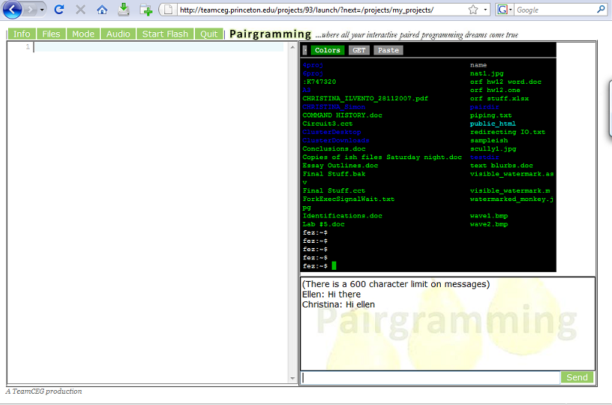
Pyjamas
Console
Text Editor
Text Chat

Slide 13
Demo

Slide 14
We've come a long way...
Documentation
Be cautious using new things
Communication
SVN
Take breaks
Open source
Editor: Editarea
Console: Ajaxterm
Notes:
Documentation – it is invaluable. Motivation for us to have better documentation
Be cautious using new things (Pyjamas… not well documented, some function say “Don’t use this yet”)
Communication – know what everyone in the group is working on at all times; communicate approval (good job, x!) and disapproval (x, we’ve noticed you’ve been working on one thing for a while now, how’s progress?)
SVN – have good commit comments
Take breaks – you will feel more refreshed and your partners will probably appreciate the grasshoppers too
Open source – the best and worst thing that can happen to you (saves you a lot of work, but has a lot of bugs/quirks/often not well documented at all)
Don’t be afraid of the French – the text editor we ended up switching to kind of late in the game was French so we didn’t find it in our first 5 in-depth searches online

Slide 15
...but we've got a long way to go
Smoother switch drivers
Faster, smoother updates
Finish file tree
Protect & improve text chat
Better integration of audio chat
Fix flash
Bug hunts…

Slide 16
Acknowledgements
Prof. Kernighan
Peng Jiang
Dr. Robert Dondero
Gyeong-Sik Choi & our study group
You
Notes:
Prof. Kernighan, opportunity to pursue something really cool for class credit
Peng Jiang, high expectations every week
Heineken, mini-kegs
Gyeong-Sik Choi, initial idea consultant / kick in the butt encourager
You, for coming and supporting us and not asking any tough questions---

Slide 17
Questions?

