Slide 1
Pairgramming
Christina Ilvento
Ellen Kim
Garrett Marcotte

Slide 2
Overview
Paired programming
"a practice in which two programmers work side-by-side at one computer, continuously collaborating on the same design, algorithm, code, or test.”
Notes:
One partner is driving (designing and typing the code) while the other is navigating (reviewing the work, identifying bugs, and asking questions). The two partners switch roles every 30-40 minutes, and on demand, brainstorm.
Motivation is that it's faster, less tiring, you learn more.

Slide 3
Overview
Pairgramming
"a practice in which two programmers work side-by-side at one computer, continuously collaborating on the same design, algorithm, code, or test.”
Notes:
One partner is driving (designing and typing the code) while the other is navigating (reviewing the work, identifying bugs, and asking questions). The two partners switch roles every 30-40 minutes, and on demand, brainstorm.
Motivation is that it's faster, less tiring, you learn more.

Slide 4
Why Pairgramming?
Flexibility
Save time
Built-in SVN
Multiplatform
No special installations
Syntax highlighting GUI
Security
Centralized
Notes:
* Flexibility -- you don't have to be in the same place, but you can be
* Save time -- you can work with a partner during vacations, and work from friend/forbes without hunting for a free frist classroom or walking out to friend basement
* SVN control, and backups in multiple physical locations
* Multiplatform -- any computer with Firefox can run our app, without any special installations (like putty, dr java, etc.)
* if you don't like emacs, use our syntax highlighted GUI text editor; if you do like emacs, we'll give you emacs
* Security -- we don't have your plaintext password, and if you want us out of your hats, you can delete one file
* Centralized -- no more window juggling, or resizing to make everything fit on one screen

Slide 5
Data Flow ~ Driver
Django & Subversion Server (Apache)
Ajaxterm Server (standalone)
Editor
Console
Editor
Console
SSH
SSH
Text Chat
Text Chat
Driver
Passenger

Slide 6
Data Flow ~ Passenger
Django & Subversion Server (Apache)
Ajaxterm Server (standalone)
Editor
Console
Editor
Console
SSH
SSH
Text Chat
Text Chat
Driver
Passenger

Slide 7
Data Flow
Django & Subversion Server (Apache)
Ajaxterm Server (standalone)
Editor
Console
Editor
Console
SSH
SSH
Text Chat
Text Chat
Driver
Passenger

Slide 8
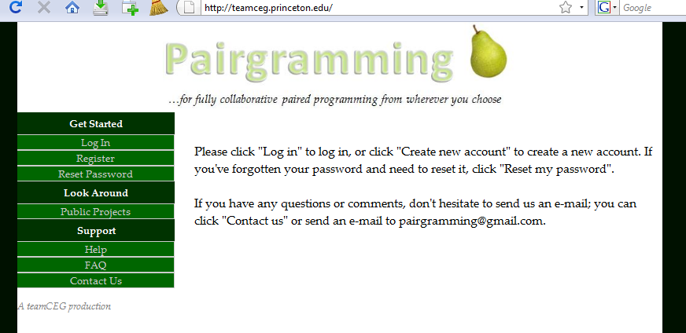
Django

Slide 9
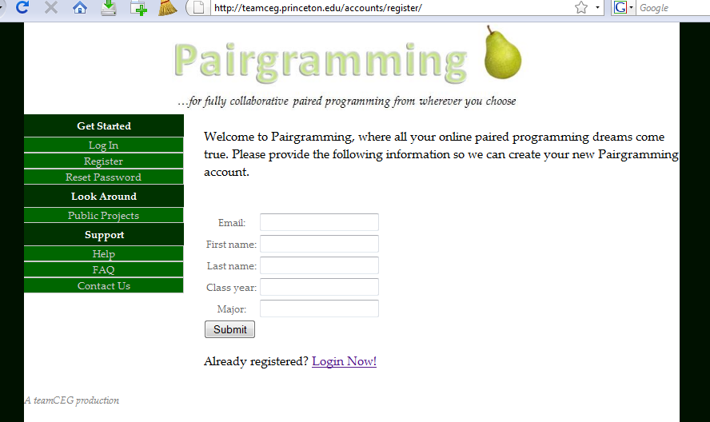
Django

Slide 10
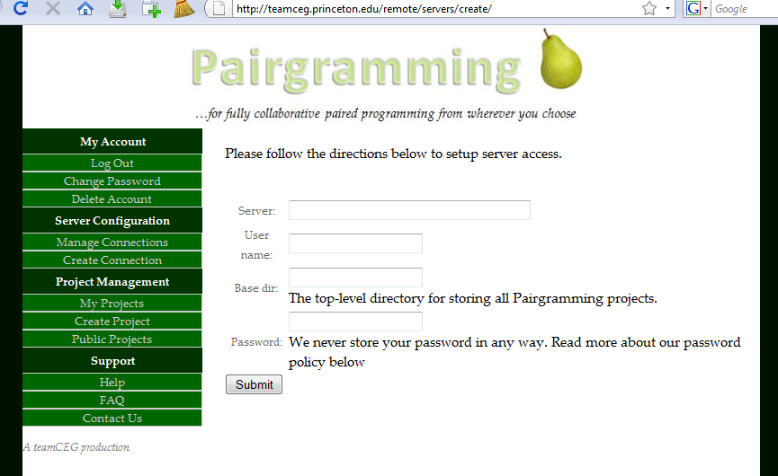
Django

Slide 11
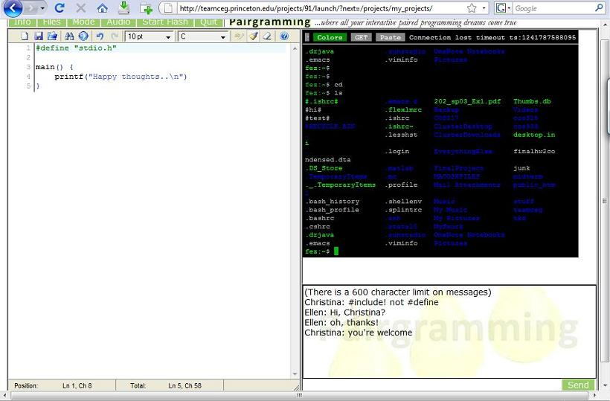
Pyjamas
Console
Text Editor
Text Chat

Slide 12
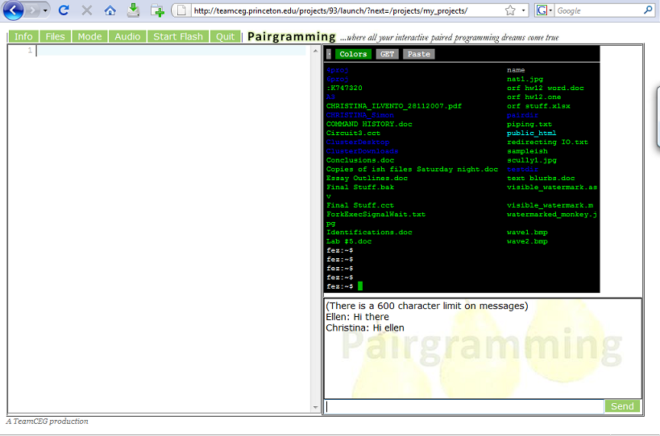
Pyjamas
Console
Text Editor
Text Chat

Slide 13
Demo
prepare a very simple demo illustrating main functionality and 1-2 nice things; do not get too detailed or include anything that might break
probably:
write a basic hello world in your fav lang, yay both computers can see
(if this is smooth enough, switch drivers)
compile and run, yay it works
use text chat a little ("hi mom!")
save and quit

Slide 14
We've come a long way...
Documentation
Be cautious using new things
Communication
SVN
Take breaks
Open source
Don’t be afraid of the French
Notes:
Documentation – it is invaluable. Motivation for us to have better documentation
Be cautious using new things (Pyjamas… not well documented, some function say “Don’t use this yet”)
Communication – know what everyone in the group is working on at all times; communicate approval (good job, x!) and disapproval (x, we’ve noticed you’ve been working on one thing for a while now, how’s progress?)
SVN – have good commit comments
Take breaks – you will feel more refreshed and your partners will probably appreciate the grasshoppers too
Open source – the best and worst thing that can happen to you (saves you a lot of work, but has a lot of bugs/quirks/often not well documented at all)
Don’t be afraid of the French – the text editor we ended up switching to kind of late in the game was French so we didn’t find it in our first 5 in-depth searches online

Slide 15
...but we've got a long way to go
things we still want to improve, expand, work on
heh heh we have no bugs… no bugs at all…

Slide 16
Acknowledgements
Prof. Kernighan
Peng Jiang
Dr. Robert Dondero
Gyeong-Sik Choi & our Frist cohorts
You!
Notes:
Prof. Kernighan, opportunity to pursue something really cool for class credit
Peng Jiang, high expectations every week
Heineken, mini-kegs
Gyeong-Sik Choi, initial idea consultant / kick in the butt encourager
You, for coming and supporting us and not asking any tough questions---

Slide 17
Questions?

