Slide 1
Pairgramming
Christina Ilvento
Ellen Kim
Garrett Marcotte

Slide 2
Overview
Paired programming
"a practice in which two programmers work side-by-side at one computer, continuously collaborating on the same design, algorithm, code, or test.”
Notes:
One partner is driving (designing and typing the code) while the other is navigating (reviewing the work, identifying bugs, and asking questions). The two partners switch roles every 30-40 minutes, and on demand, brainstorm.
Result is more efficiently producing stronger code.

Slide 3
Overview
Pairgramming
"a practice in which two programmers work side-by-side at one computer, continuously collaborating on the same design, algorithm, code, or test.”
Notes:
click

Slide 4
What is the Pairgramming app?
a web-based interface for fully collaborative programming:
1. console
2. GUI syntax-highlighted text editor
3. communication
4. file management
Notes:
one coherent interface for these 4 main elements

Slide 5
Why Pairgramming?
Flexibility
Save time
Built-in SVN
Multiplatform
No special installations
Syntax highlighting GUI
Cohesive
Notes:
First, basically everybody programs collaboratively
* Flexibility -- you don't have to be in the same place, but you can be
* Save time -- you can work with a partner during vacations, and work from friend/forbes without hunting for a free frist classroom or walking out to friend basement
* SVN control, and backups in multiple physical locations
* Multiplatform -- any computer with Firefox can run our app, without any special installations (like putty, dr java, etc.)
* if you don't like emacs, use our syntax highlighted GUI text editor; if you do like emacs, we'll give you emacs
* Security -- we don't have your plaintext password, and if you want us out of your hats, you can delete one file
* Centralized -- no more window juggling, or resizing to make everything fit on one screen

Slide 6
Data Flow
Django & Subversion Server (Apache)
Ajaxterm Server (standalone)
Editor
Console
Editor
Console
SSH
SSH
Text Chat
Text Chat
Driver
Passenger
Notes:
We store all files -> you don’t need to worry about permissions and where to store it, and you don’t have to deal with file transfers between users.
We handle ssh connections to your development server on your behalf, so you don’t have to worry about Putty/etc.
As you can see on the data-flow diagram, the driver has control over data flow in both directions -> to edit files and interact with the development server, whereas the passenger cannot actively make changes to the source code or interact with the development server in accordance with the paired-programming model.

Slide 7
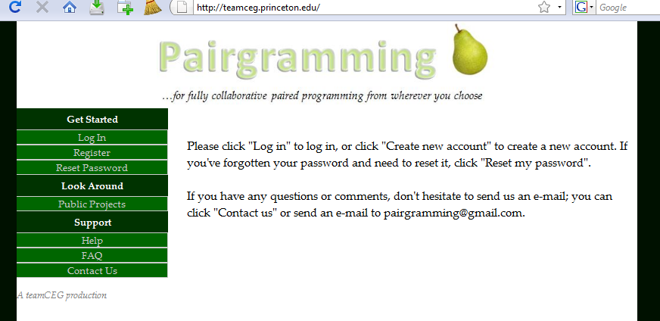
Django
Notes:
also open source

Slide 8
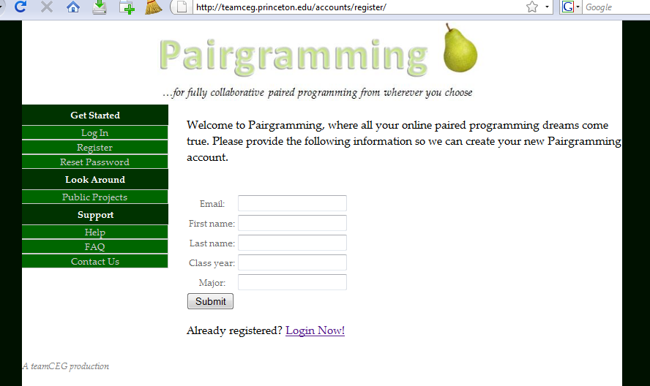
Django
Notes:
Sign up with a valid email address.

Slide 9
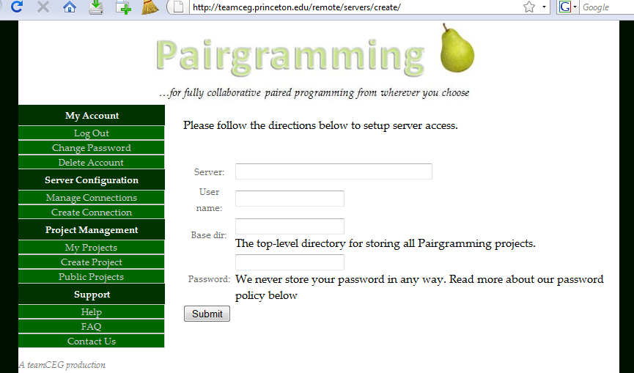
Django
Notes:
1) Setup once and never have to give us your password again. We do not store your password.
2) Using RSA public-private key pair allows us to SSH to a development server on your behalf but does not allow us to access your webmail account, etc.

Slide 10
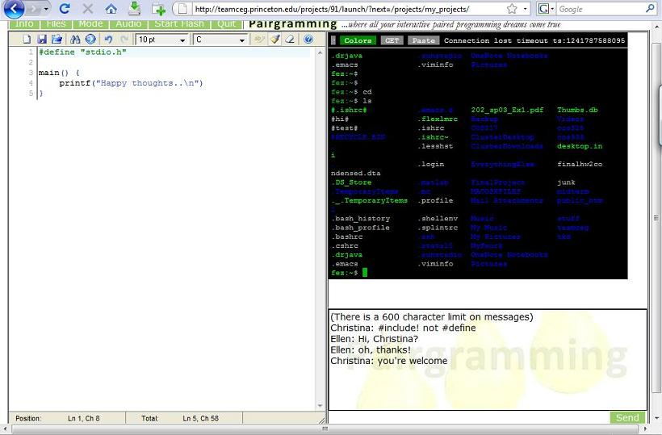
Pyjamas
Console
Text Editor
Text Chat
Notes:
PYJAMAS: open source web toolkit in Python, compiles to GWT to Javascript
AJAXTERM: open source javascript shell/console emulator. Our major changes included piping it to two users, enabling logins with keys rather than passwords.
EDITAREA: open source javascript syntax-highlighting text area. Designed for code editing. Our major changes included allowing for the passenger-side editor.
This is the driver screen: driver can interact with the console and also edit code in the syntax-highlighting editor.
Text chat allows for 2-way communications between the two users.

Slide 11
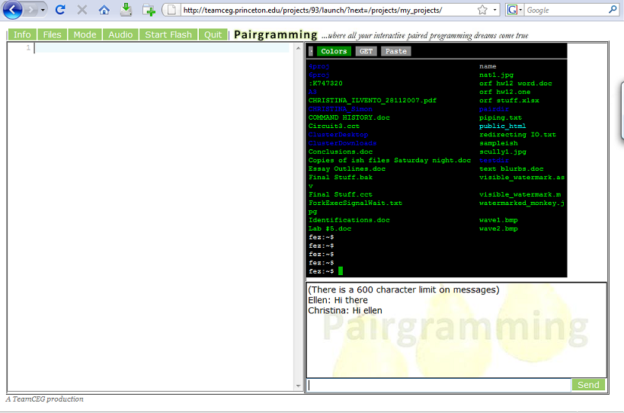
Pyjamas
Console
Text Editor
Text Chat
Notes:
The passenger screen: The editor is not enabled – it’s actually blank here because we had just started the session and hadn’t typed anything yet,
but in essence the passenger cannot interact with the console or the editor, but can view what the driver is doing in both.
the text chat interface is identical

Slide 12
Demo

Slide 13
We've come a long way...
Documentation
Be cautious using new things
Communication
SVN
Take breaks
Open source
Editor: Editarea
Console: Ajaxterm
Notes:
Documentation – it is invaluable. Motivation for us to have better documentation
Be cautious using new things (Pyjamas… not well documented, some function say “Don’t use this yet”)
Open source is open source for a reason sometimes – especially for smaller projects, the motivation for the original creator to maintain and document the code is usually not high, so you have to be very careful in deciding to take the plunge and commit a lot of time into fixing and adapting possibly irreparable or infeasible code.
Communication – know what everyone in the group is working on at all times; communicate approval (good job, x!) and disapproval (x, we’ve noticed you’ve been working on one thing for a while now, how’s progress?)
SVN – have good commit comments
Take breaks – you will feel more refreshed and your partners will probably appreciate the grasshoppers too
Open source – the best and worst thing that can happen to you (saves you a lot of work, but has a lot of bugs/quirks/often not well documented at all)
Don’t be afraid of the French – the text editor we ended up switching to kind of late in the game was French so we didn’t find it in our first 5 in-depth searches online

Slide 14
...but we've got a long way to go
Smoother switch drivers
Faster, smoother updates
Improve file tree
Protect & improve text chat
Enhance user communication
Bug hunting

Slide 15
Acknowledgements
Prof. Kernighan
Peng Jiang
Dr. Robert Dondero
Gyeong-Sik Choi & our study group
You
Notes:
Prof. Kernighan, opportunity to pursue something really cool for class credit
Peng Jiang, high expectations every week
Heineken, mini-kegs
Gyeong-Sik Choi, initial idea consultant / kick in the butt encourager
You, for coming and supporting us and not asking any tough questions---

Slide 16
Questions?

