Slide 1
Scenario 2
There are two agents: A1 and A2.
Each agent knows the locations of four parking spots.
However, each agent does not know which food truck (A, B, C, or D) is parked where until it comes within its the line of sight.
At each timestep, agents communicate their knowledge of food truck locations to each other with probability 0.15.
Each agent has its own level of desire for each food truck. Agents wish to buy from the food truck they most desire as soon as possible.
Please answer the following questions about agent A1.

Slide 2
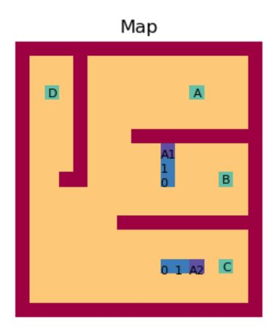
How much does A1 desire each food truck?
Please assign each truck a value 1-7, with 1 being the least, 7 being the most.
What is A1’s current goal (the location it plans to visit next)?
Please assign each location a probability such that all probabilities sum to 1.
Has A2 communicated with A1?
Please provide a probability between 0 and 1 that communication has occurred.

Slide 3
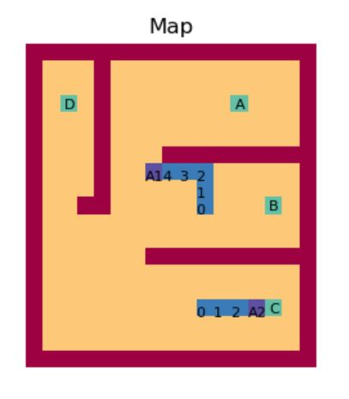
How much does A1 desire each food truck?
Please assign each truck a value 1-7, with 1 being the least, 7 being the most.
What is A1’s current goal (the location it plans to visit next)?
Please assign each location a probability such that all probabilities sum to 1.
Has A2 communicated with A1?
Please provide a probability between 0 and 1 that communication has occurred.

Slide 4
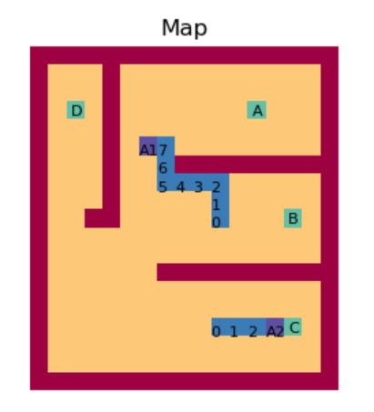
How much does A1 desire each food truck?
Please assign each truck a value 1-7, with 1 being the least, 7 being the most.
What is A1’s current goal (the location it plans to visit next)?
Please assign each location a probability such that all probabilities sum to 1.
Has A2 communicated with A1?
Please provide a probability between 0 and 1 that communication has occurred.

Slide 5
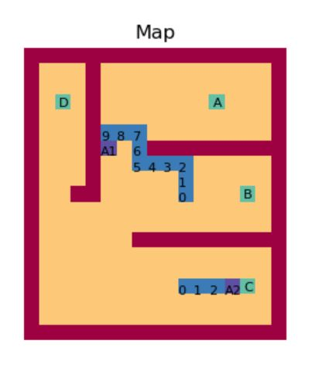
How much does A1 desire each food truck?
Please assign each truck a value 1-7, with 1 being the least, 7 being the most.
What is A1’s current goal (the location it plans to visit next)?
Please assign each location a probability such that all probabilities sum to 1.
Has A2 communicated with A1?
Please provide a probability between 0 and 1 that communication has occurred.

Slide 6
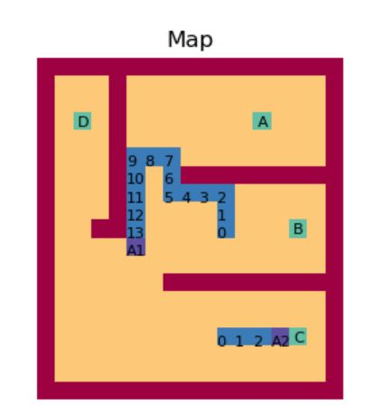
How much does A1 desire each food truck?
Please assign each truck a value 1-7, with 1 being the least, 7 being the most.
What is A1’s current goal (the location it plans to visit next)?
Please assign each location a probability such that all probabilities sum to 1.
Has A2 communicated with A1?
Please provide a probability between 0 and 1 that communication has occurred.

Slide 7
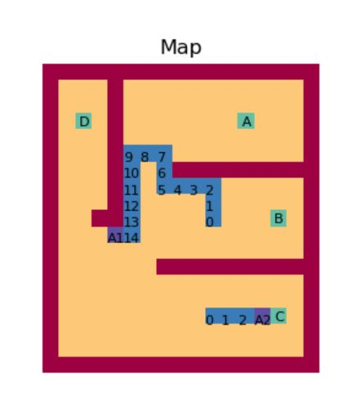
How much does A1 desire each food truck?
Please assign each truck a value 1-7, with 1 being the least, 7 being the most.
What is A1’s current goal (the location it plans to visit next)?
Please assign each location a probability such that all probabilities sum to 1.
Has A2 communicated with A1?
Please provide a probability between 0 and 1 that communication has occurred.

Slide 8
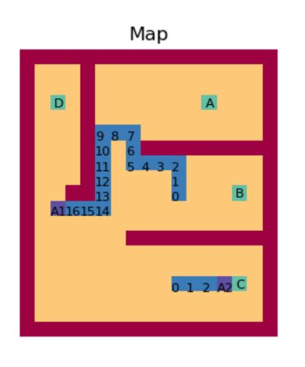
How much does A1 desire each food truck?
Please assign each truck a value 1-7, with 1 being the least, 7 being the most.
What is A1’s current goal (the location it plans to visit next)?
Please assign each location a probability such that all probabilities sum to 1.
Has A2 communicated with A1?
Please provide a probability between 0 and 1 that communication has occurred.

Slide 9
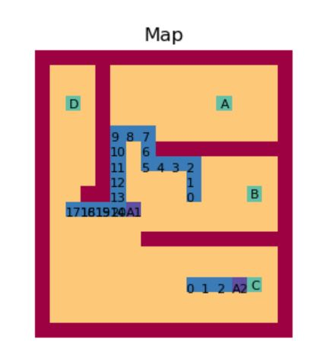
How much does A1 desire each food truck?
Please assign each truck a value 1-7, with 1 being the least, 7 being the most.
What is A1’s current goal (the location it plans to visit next)?
Please assign each location a probability such that all probabilities sum to 1.
Has A2 communicated with A1?
Please provide a probability between 0 and 1 that communication has occurred.

Slide 10
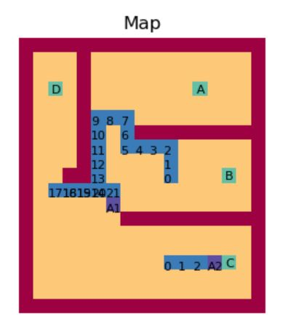
How much does A1 desire each food truck?
Please assign each truck a value 1-7, with 1 being the least, 7 being the most.
What is A1’s current goal (the location it plans to visit next)?
Please assign each location a probability such that all probabilities sum to 1.
Has A2 communicated with A1?
Please provide a probability between 0 and 1 that communication has occurred.

Slide 11
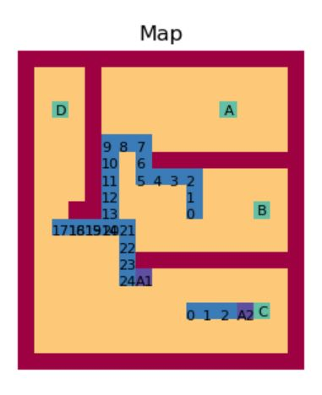
How much does A1 desire each food truck?
Please assign each truck a value 1-7, with 1 being the least, 7 being the most.
What is A1’s current goal (the location it plans to visit next)?
Please assign each location a probability such that all probabilities sum to 1.
Has A2 communicated with A1?
Please provide a probability between 0 and 1 that communication has occurred.

Slide 12
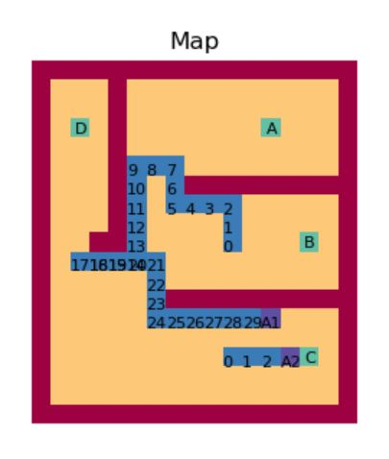
How much does A1 desire each food truck?
Please assign each truck a value 1-7, with 1 being the least, 7 being the most.
What is A1’s current goal (the location it plans to visit next)?
Please assign each location a probability such that all probabilities sum to 1.
Has A2 communicated with A1?
Please provide a probability between 0 and 1 that communication has occurred.

Slide 13
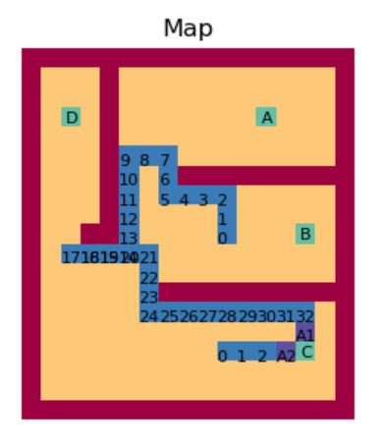
How much does A1 desire each food truck?
Please assign each truck a value 1-7, with 1 being the least, 7 being the most.
What is A1’s current goal (the location it plans to visit next)?
Please assign each location a probability such that all probabilities sum to 1.
Has A2 communicated with A1?
Please provide a probability between 0 and 1 that communication has occurred.

