Slide 1
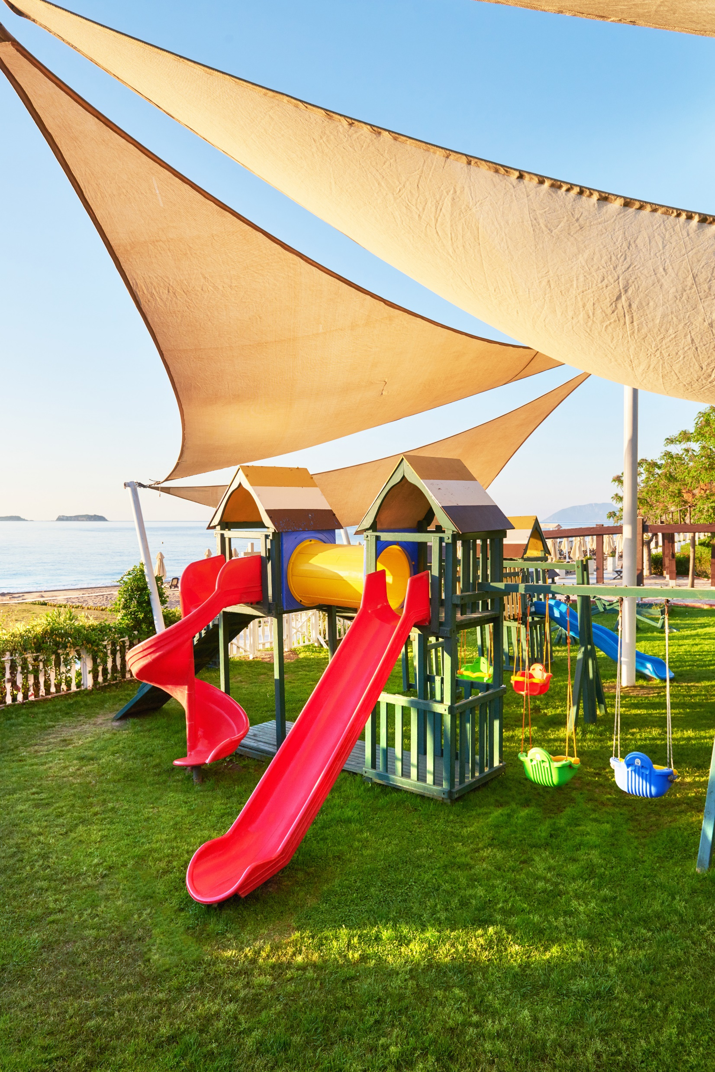
PERT ANALYIS Author Affiliation Course Instructor Due Date

Slide 2
Tasks
Research and Design Playground Equipment-Entails researching safe and age-appropriate equipment.
Purchase Playground Equipment-Involves procuring items such as swings and slides.
Backyard Preparation-Involves areas clearing, ground leveling, removal of obstacles.
Installation-Assembling and fixing procured equipment.
Safety Test-Involves conducting thorough safety checks.

Slide 3
PERT Analysis Components
Task | Optimistic Time (OT) (Days) | Most Likely Time (M) (Days) | Pessimistic Time (P) (Days) | Expected Time (E) (Days)
Research and Design Playground Equipment | 2 | 4 | 6 | (2 + 4(4) + 6) / 6 = 4 days
Purchase Playground Equipment | 1 | 2 | 3 | (1 + 4(2) + 3) / 6 = 2 days
Backyard Preparation | 3 | 5 | 7 | (3 + 4(5) + 7) / 6 = 5 days
Installation | 2 | 3 | 4 | (2 + 4(3) + 4) / 6 = 3 days
Safety Test | 1 | 2 | 3 | (1 + 4(2) + 3) / 6 = 2 days
Sum/Total | 9 | 16 | 23 | 16

Slide 4

Recommendations
One Recommendation to reduce Estimated Time (E) by 15%;
Optimization of the procurement process.
Achieved by;
Negotiating faster delivery times (Devalkar et al., 2011).
Expedited shipping

Slide 5
Recommendations
Streamline the Installation procedure: To expedite the installation procedure, enlist more assistance or have some of the equipment assembled in advance.
Concurrent Safety inspections: To find any possible problems faster, begin safety inspections when the first pieces are installed, rather than waiting for all of the equipment to be installed.

Slide 6
References
Devalkar, S. K., Anupindi, R., & Sinha, A. (2011). Integrated optimization of procurement, processing, and trade of commodities. Operations Research, 59(6), 1369-1381.

