Slide 1
ANTH 350 Final Research Project Author Affiliation Course Instructor Due Date

Slide 2
Introduction
Medical anthropology-Subfield of anthropology.
Relates culture, social, and environmental factors to health, illness, and healing practices.
The current work evaluates medical anthropological tenets in the realm of pandemics, such as COVID.
Also evaluates CDC’s intervention.
Culture, society, and environment
Health
Illness
Healing practice

Slide 3
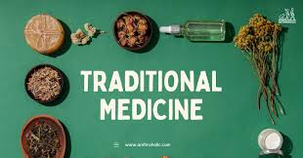
Key Concepts in Medical Anthropology
Concept 1: Cultural contraction of illness and health (Adams & Nading, 2020).
Illness and healing practices relate to culture, value, and practices.
Example: Traditional medicine such as herbs is still pursued by some communities.

Slide 4
Key Concepts in Medical Anthropology
Biocultural Approach to Health
Health outcomes=culture+ society+ environment (Ann et al., 2019).
Needs holistic input.
Sociocultural and biological health factors; equally significant (Ann et al., 2019).
Societies, for example, indigenous Luos in Kenya associate illness with spiritual imbalance.
Medical Pluralism
Many health systems, for example, biomedicine, traditional healing practices, and complementary and alternative medicine (CAM).
Many societal healing customs (Ann et al., 2019).

Slide 5
Two Problems and Their Solution
1. Stigmatization of affected communities
Manifested variedly, for example, vaccine hoarding and vaccine nationalization.
The underprivileged hardly accessed vaccines
Solution: culturally sensitive research (Gravlee & Sweet, 2008)
2. Cultural resistance to public health measures
Manifested, for example, in vaccine apathy.
Solution: Community collaborations.

Slide 6
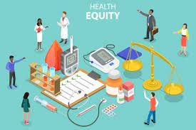
Research Plan for Future Pandemics: Healthcare Disparities
Problem 1: Healthcare disparities in future pandemics (Lasco, 2022).
Research
Ethnographic methods, including in-depth interviews and participant observations.
Theory of structural violence-Helps understand barriers.

Slide 7
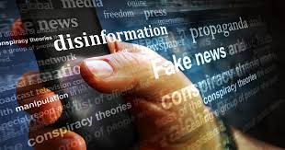
Research Plan for Future Pandemics: Information Dissemination and Misinformation
Problem 2: Information Dissemination and Misinformation.
For example, during Zika virus (Rocha, 2021).
Research
Media narrative analysis.
Surveys.
Content analysis

Slide 8

Conclusion
Medical anthropology is multifaceted.
Offers a unique perspective of addressing challenges of pandemics.
Anthropologists contribute to public health an safety by;
Understanding cultural dynamics,
Addressing stigma, cultural changes, and conducting targeted studies.
CDC’s collaboration with medical anthropologists better prepares humanity for future pandemics because of shared knowledge.

Slide 9
References
Adams, V., & Nading, A. (2020). Medical Anthropology in the Time of COVID‐19. Medical Anthropology Quarterly, 34(4), 461–466. https://doi-org.ezproxy.umgc.edu/10.1111/maq.12624
Ann H. Kelly, Frédéric Keck, & Christos Lynteris. (2019). The Anthropology of Epidemics. Routledge.
Gravlee, C. C., & Sweet, E. (2008). Race, ethnicity, and racism in medical anthropology, 1977–2002. Medical anthropology quarterly, 22(1), 27-51.
Lasco, G. (2022). Anthropological Responses to COVID-19 in the Philippines. Anthropology in Action, 29(1), 23–31. https://doi-org.ezproxy.umgc.edu/10.3167/aia.2022.290104
Rocha, I. C. N. (2021). Employing medical anthropology approach as an additional public health strategy in promoting COVID-19 vaccine acceptance in Bhutan. The International Journal of Health Planning and Management, 36(5), 1943–1946. https://doi-org.ezproxy.umgc.edu/10.1002/hpm.3191

