Slide 1
Customising RI5CY: an open-source RISC-V Core
OSHCamp 2019
Graham Markall
(SW Toolchain Engineer)
Sam Leonard
(SW/HW Intern)
Copyright © 2018 Embecosm.
Freely available under a Creative Commons license.

Slide 2







Embecosm Core Competences
Compiler Tool Chain Development
Hardware Modeling
Open Source Tool Support
Specialisms
Machine Learning Optimization
Superoptimization
Optimization for Energy Efficiency
Compilation for Security

Slide 3
Outline / goals
Talk today: groundwork
  RISC-V ISA specifics
  General concepts: C → Assembly → encoding
  RI5CY microarchitecture
Workshop tomorrow: practical
  Practical step-by-step tutorial adding new instructions
Choice: workshop tomorrow / online later

Slide 4


RISC-V is an Instruction Set Architecture (ISA)
Some other ISAs:
RISC-V: Many open-source implementations (RI5CY etc.)

Slide 5
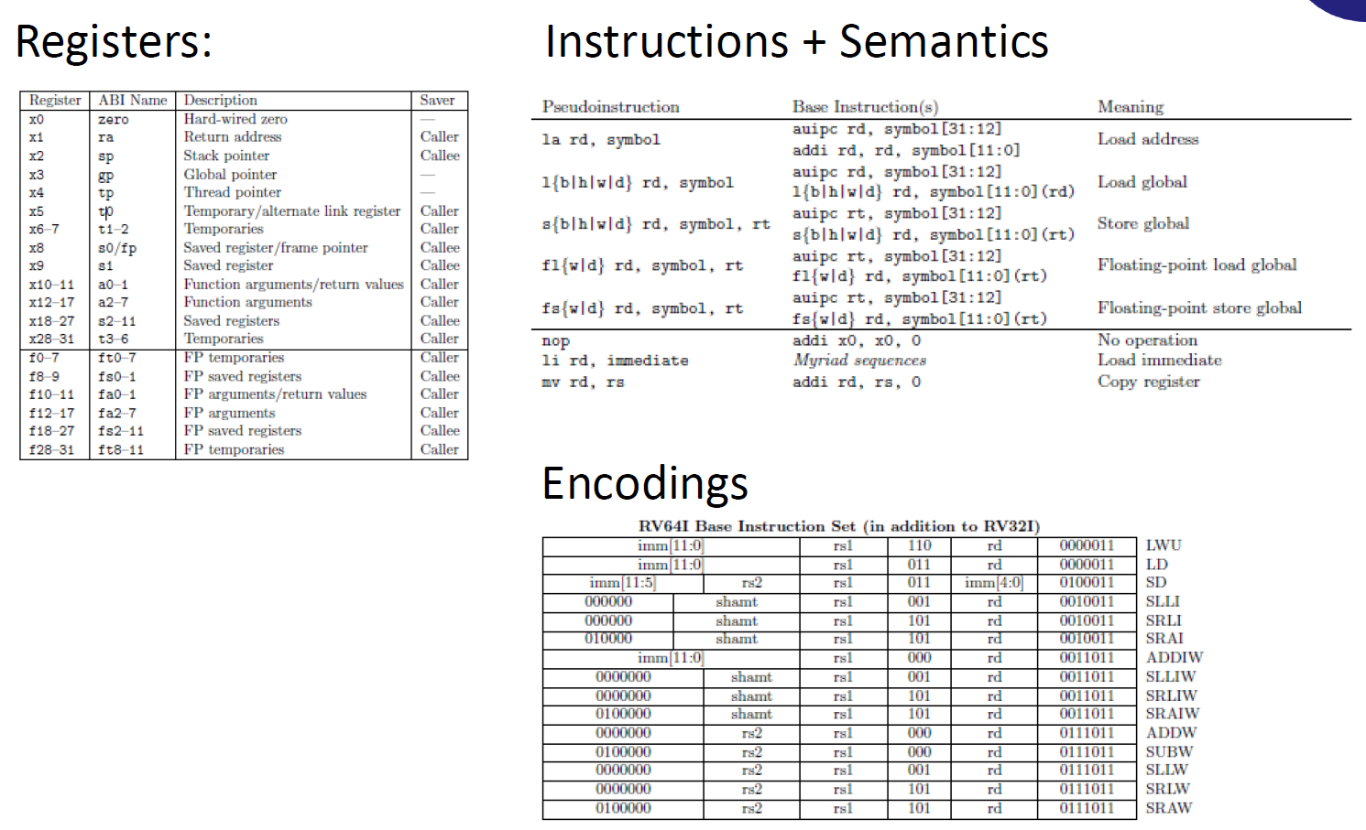
What’s in an ISA document?

Slide 6
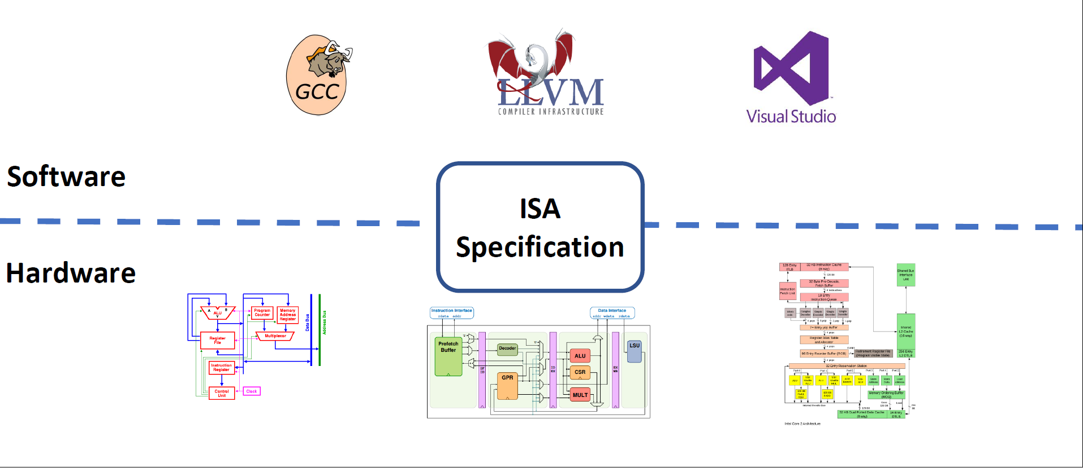
What’s implemented around an ISA?

Slide 7
(a bit of a) C program
int madd(int a, int x, int y)
{
return a * x + y;
}

Slide 8
(a bit of a) C program - compiled
int madd(int a, int x, int y)
{
return a * x + y;
}
madd:
mul a0,a0,a1
add a0,a0,a2
ret

Slide 9
Assembled
00000000 <madd>:
0: 02b50533 mul a0,a0,a1
4: 00c50533 add a0,a0,a2
8: 00008067 ret

Slide 10
Assembled
00000000 <madd>:
0: 02b50533 mul a0,a0,a1
4: 00c50533 add a0,a0,a2
8: 00008067 ret

Slide 11
Picking apart the encoding
00c50533 add a0,a0,a2

Slide 12
Picking apart the encoding
00c50533 add a0,a0,a2
0000 0000 1100 0101 0000 0101 0011 0011

Slide 13
Picking apart the encoding
00c50533 add a0,a0,a2
0000 0000 1100 0101 0000 0101 0011 0011
0000000 01100 01010 000 01010 0110011
funct7 rs2 rs1 f3 rd opcode

Slide 14
Picking apart the encoding
00c50533 add a0,a0,a2
0000 0000 1100 0101 0000 0101 0011 0011
0000000 01100 01010 000 01010 0110011
funct7 rs2 rs1 f3 rd opcode
add a0,a0,a2

Slide 15
Picking apart the encoding
00c50533 add a0,a0,a2
0000 0000 1100 0101 0000 0101 0011 0011
0000000 01100 01010 000 01010 0110011
funct7 rs2 rs1 f3 rd opcode
add a0,a0,a2

Slide 16
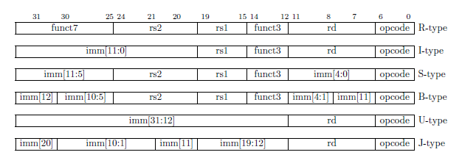
RISC-V Encoding formats
More formats → more flexibility in specifying instructions
More formats → greater decoder complexity

Slide 17
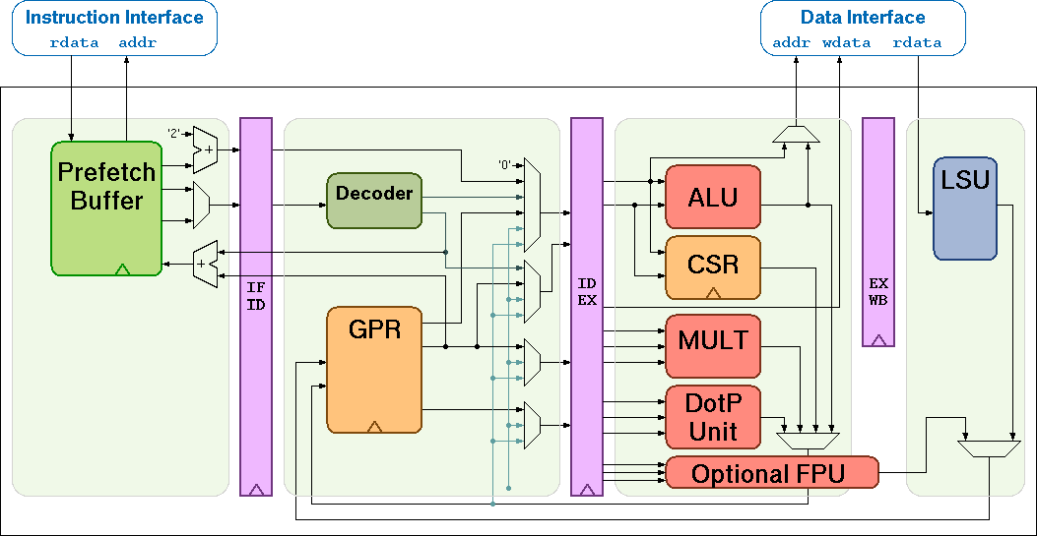
Execution – RI5CY pipeline
02b50533
00c50533
00008067
...
Fetch Decode Execute Writeback

Slide 18
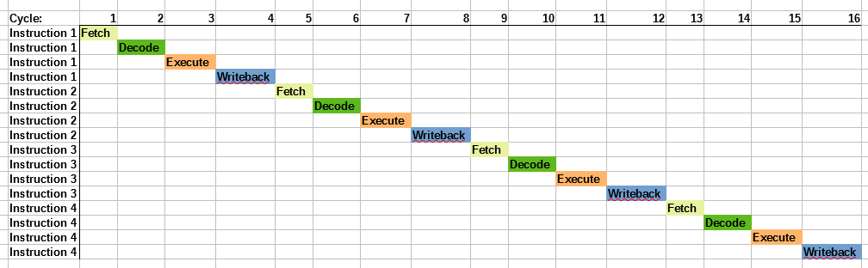
Executing 1 op per cycle
1 operation per cycle
4 cycles per instruction

Slide 19
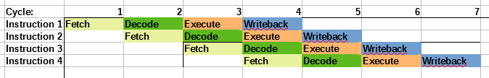
Pipelined execution
4 operations per cycle
1 cycle per instruction

Slide 20

Pipelined execution

Slide 21
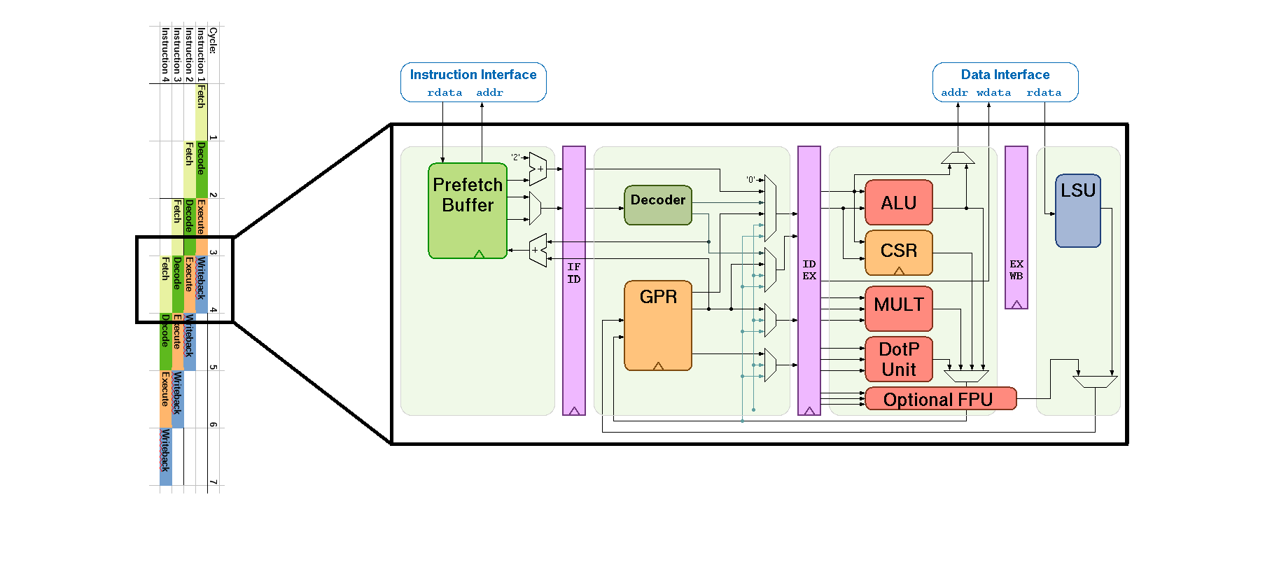
Pipelined execution
Each unit kept busy on each cycle

Slide 22
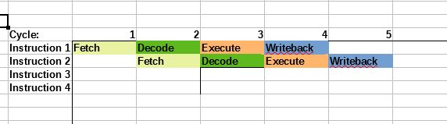
Hazards
lw a1, 0(a2) # 1. load from address in a2
add a3, a1, a0 # 2. a1 + a0

Slide 23
Hazards
lw a1, 0(a2) # 1. load from address in a2
add a3, a1, a0 # 2. a1 + a0
Instr 1: Contents of a1 loaded on cycle 4, but...

Slide 24

Hazards
lw a1, 0(a2) # 1. load from address in a2
add a3, a1, a0 # 2. a1 + a0
Instr 1: Contents of a1 loaded on cycle 4, but...
Instr 2: need contents of a1 at cycle 3!

Slide 25
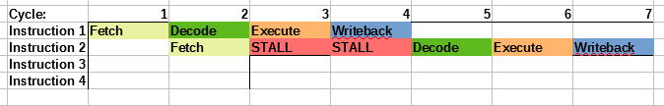
Pipeline stall on hazard
lw a1, 0(a2) # 1. load from address in a2
add a3, a1, a0 # 2. a1 + a0

Slide 26
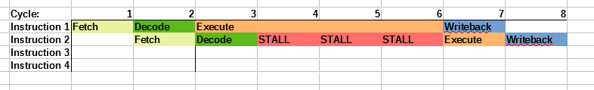
Pipeline stall on multi cycle instruction
mul a3, a1, a2
add a5, a6, a7

Slide 27
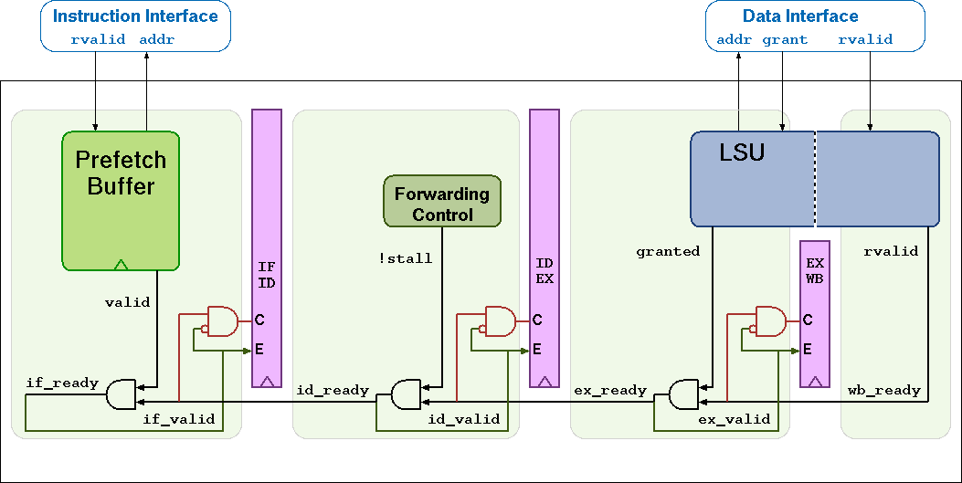
How does RI5CY stall?
Signals between each stage to indicate ready / valid

Slide 28
Adding a new instruction
Decide on syntax, semantics, and encoding
Implement decoding
Add an execution unit
Hook up decoder to execution
Hook up control signals
Worked example through all these in the workshop
  Step by step using simulation

Slide 29
Workshop options
Workshop materials:
  https://github.com/gmarkall/oshcamp-2019-workshop/
  https://oshcampri5cyworkshop.slack.com
Introduction to Verilog with Verilator:
  https://gmarkall.wordpress.com/teaching/
Chiphack (Intro to Verilog with FPGA):
  http://chiphack.org/

Slide 30
Enjoy OSHCamp! www.embecosm.com
Copyright © 2018 Embecosm.
Freely available under a Creative Commons license.
Notes:
Any questions?

