Slide 1
MF: A Conventional Radio Communication System Using Magnetic Fields To Monitor Human Body health
Maroko Gideon
gmaroko@ieee.org

Slide 2
MF: Summary
Some text

Slide 3
Target
Some text

Slide 4





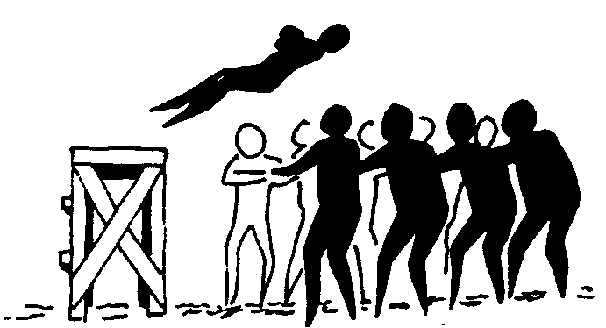




Building trust
Privacy
Scalability
Openness
Data protection
Resilience
Flexibility
Security
Cultural and age adaptation
Reliability

