Slide 1
MF: A Conventional Radio Communication System Using Magnetic Fields To Monitor Human Body health
Maroko Gideon
gmaroko@ieee.org

Slide 2
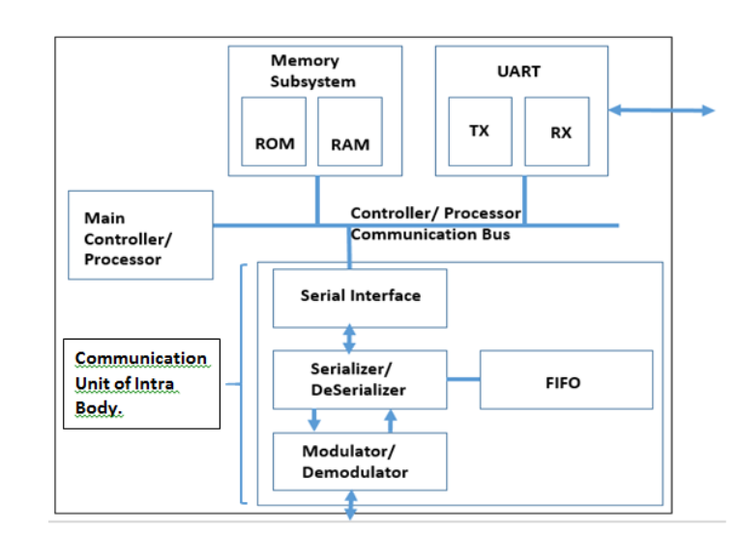
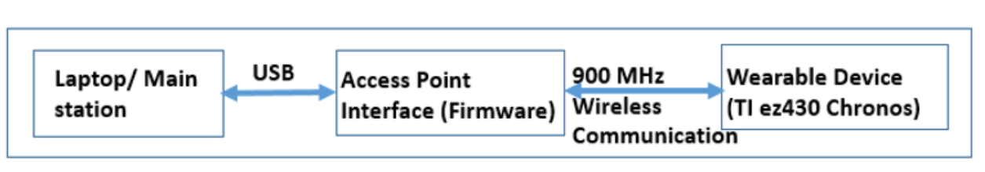
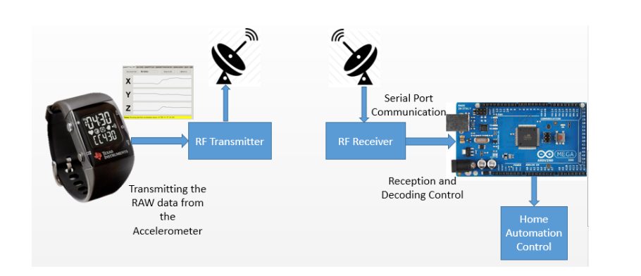
MF: Summary

Slide 3


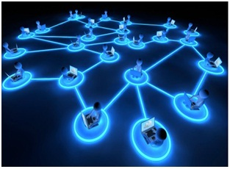


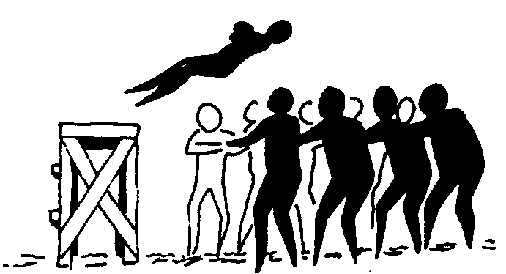




Building trust
Long Term Targets
Privacy
Scalability
Openness
Data protection
Resilience
Flexibility
Security
Cultural and age adaptation
Reliability

