Slide 1

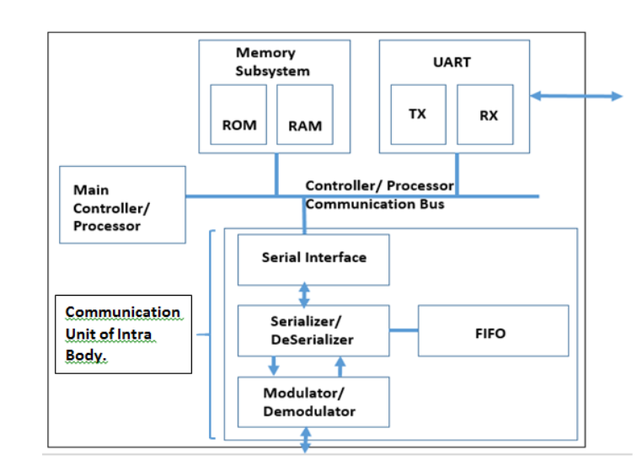
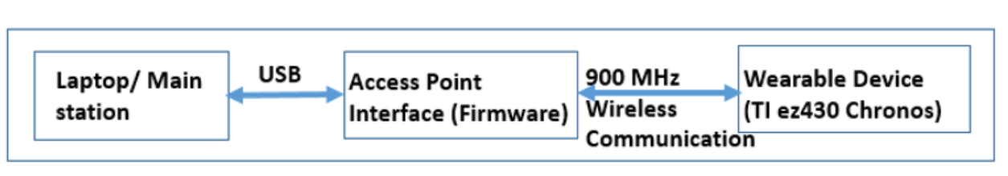
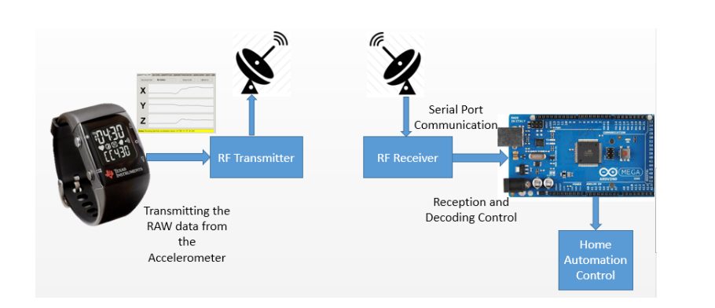
MF: Summary of Concept

Slide 2
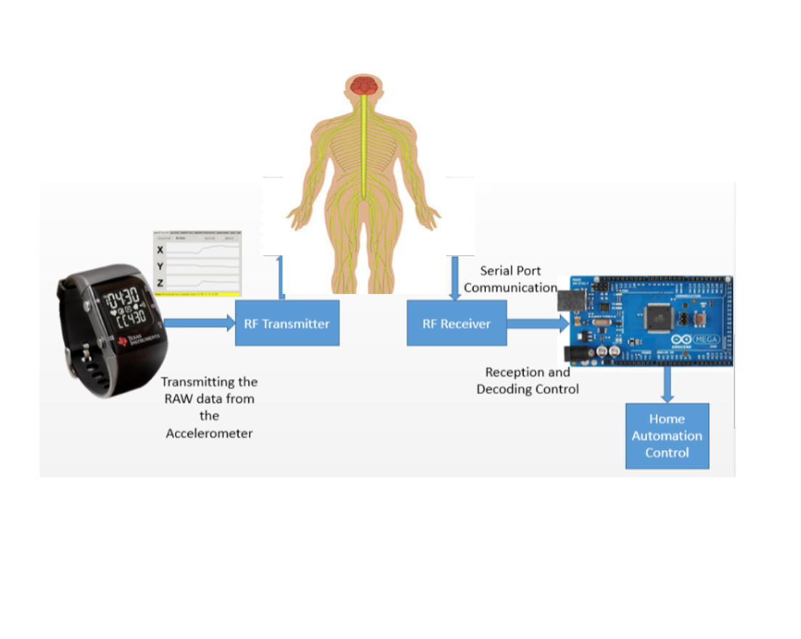
MF: Summary of Concept
Steps Coils of copper wires insulated with PVC tubing are wrapped around the left arm; these have a receiver and an analyzer (Arduino) connected at the end. Another pair of coils of copper wires is wrapped around the right arm. In this way, the coils act as inductors for the application of energy and the production of magnetic fields and allow the body itself to act as a sort of waveguide for those fields. Using this system, we're able to transmit and measure ultra-low path loss signals from the left arm to the right arm. The test can be carried out with other art of the body.

Slide 3

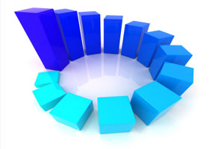
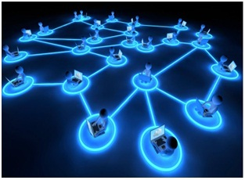


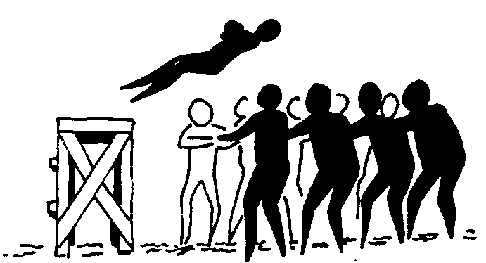
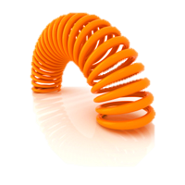



Building trust
MF: Long Term Targets
Privacy
Scalability
Openness
Data protection
Resilience
Flexibility
Security
Cultural and age adaptation
Reliability

