Slide 1
July 25, 2023
«BIRCH: An Efficient Data Clustering Method for Very Large Databases»
paper by Tian Zhang, Raghu Ramakrishnan and Miron Livny
(Univ. of Wisconsin-Maciiso)
Gaia Marsich
Gaia Marsich
Algorithmic Design
Presentation: «Merkle Hash Grids Instead of Merkle Trees»
1/17

Slide 2
Index
July 25, 2023
Introduction and purpose
Merkle trees
(Binary) Merkle tree
k-ary Merkle tree
Merkle grids
(Basic) Merkle grid
Extended Merkle grid
Conclusions
Gaia Marsich
Algorithmic Design
Presentation: «Merkle Hash Grids Instead of Merkle Trees»
2/17

Slide 3
1. Introduction and purpose
July 25, 2023
1. Introduction and purpose
Gaia Marsich
Algorithmic Design
Presentation: «Merkle Hash Grids Instead of Merkle Trees»
3/17

Slide 4
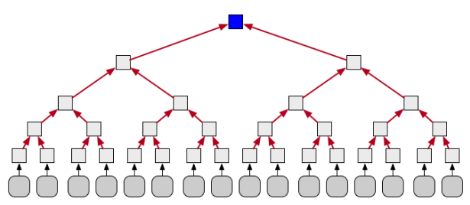
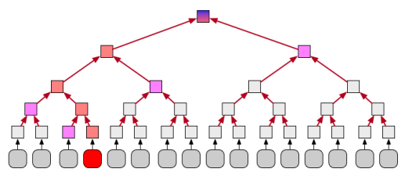


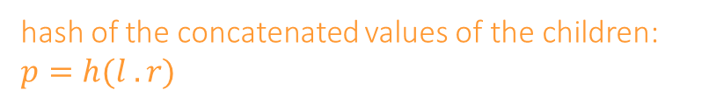
1. Introduction and purpose
July 25, 2023
root of the tree
hash of the concatenated values of the children: $p=h(l .r)$
block to be authenticated (here $n=4$, $N=16$)
A Merkle tree; ${N=2}^{n}$ blocks are arranged in a line
Aim of the paper:
introducing Merkle grids (less space needed)
comparison of performances
Use of Merkle trees: authentication
Gaia Marsich
Algorithmic Design
Presentation: «Merkle Hash Grids Instead of Merkle Trees»
4/17

Slide 5
July 25, 2023
Thank you for the attention!
Gaia Marsich
Algorithmic Design
Presentation: «Merkle Hash Grids Instead of Merkle Trees»
17/17

