Slide 1
EcoTipping Point Mini-books for Elementary Schools
Catherine Matthews
Deborah Trogdon-Stout
Water pollution (Bolivia)
Acid rain (North Carolina)
Soil erosion (Bolivia)
Fisheries (Philippines)
Water supply (India)

Slide 2
Environmental Conversations From Around the World
A Child’s view of Ecosystem Tipping Points
Acid Rain in North Carolina
By Deborah Trogdon-Stout & Catherine E. Matthews
[Photos by Deborah Trogdon-Stout]
Science Series for Grade K-5
A Teacher’s Guide to Developing Critical Thinking Skills, Respect for Cultural Diversity, and Geographical Mapping Skills through Children’s Stories

Slide 3
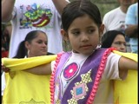
Dealing with Acid Rain in North Carolina
Hello! My name is Ahysti (eye-e’-stee). I live in the mountains of Western North Carolina in a town named Cullowhee (valley of the Lily), with my parents, two brothers, Atanto (ah-Dahn’-toe) and Katusi (gah-Dew-she) and my grandfather, Kana’te (Kah-na’-tee).

Slide 4
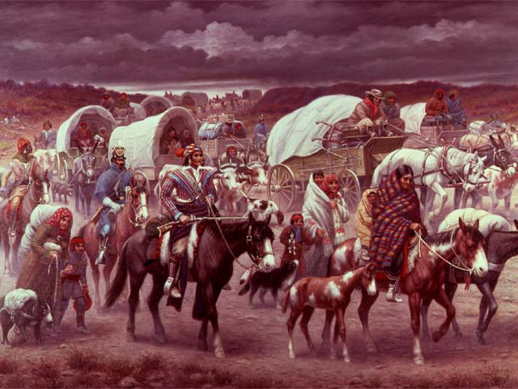
Cherokee names have meaning
We are descendents of the Cherokee tribe of Native American Indians. My Cherokee name means “to explore”. My brother, Atanto, means “spirit”, Katusi, means “mountain”, and my grandfather’s name, Kana’ means “the Lucky Hunter”. I am eight years old and I like going to school to learn about our special land.
How about you?

Slide 5
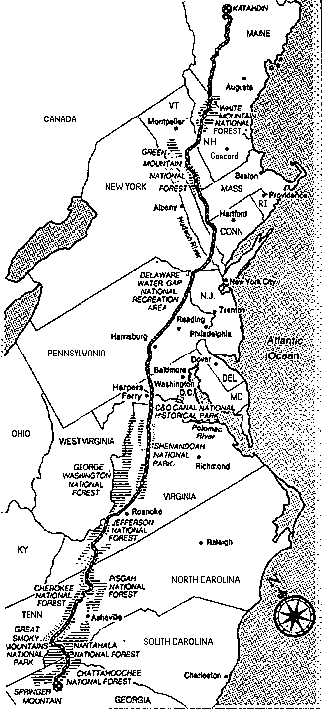

My home of Cullowhee is located high in the mountains of North Carolina. We are surrounded by evergreen forests in the mountains called the Appalachian Mountains. You can see from the map that the Appalachian Mountains stretch over 1600 miles from Quebec, Canada to Georgia.
Can you find my
home now on the map?

Slide 6


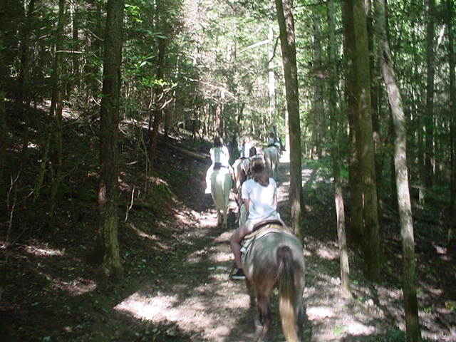
My grandfather likes to tell stories of when he was young and he walked the entire length of the Appalachian trail, exploring and hunting. He tells of the great stands of evergreen forests and the many creatures like birds, deer, black bear, beaver, and raccoons who made the forest their home.
Have you ever seen an evergreen forest?
Photos by
D. Stout

Slide 7



The Evergreen Forests have Secrets
My grandfather, Kana’te, tells stories
of how big and beautiful the mountain
forest was when he was a little boy.
He would walk for hours among the
ancient evergreen trees and listen to
the sounds of the trees as they
whispered their secrets to him. I tell
my grandfather that trees can’t talk
but he tells me that I have to listen
with my ears and my heart to hear the
trees.
Have you ever listened to the
trees in the forest?

Slide 8
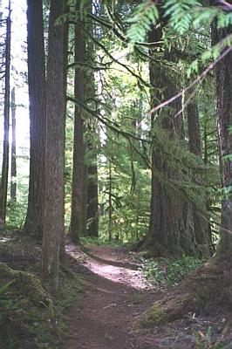
Grandfather tells us that the forest
once grew so tall that you could not
see the sky when you looked up. The
trees were powerful, strong, and
filled the mountain ridges with their
mighty numbers, just like our
Cherokee ancestors once did. The
great forest was a welcome place for
all living things. It was a place where
people went to restore their energy.
But now grandfather says the trees
tell a different, sad story of how
they are being destroyed by a poison
from the sky.
Do you know what a
poison is?

Slide 9

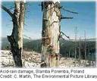

I share my grandfather’s stories with my teacher at school. My teacher tells us that the poison from the sky is called acid rain. Acid rain is a kind of pollution that comes from factory smoke, car exhaust and other places. This kind of pollution is carried by clouds and falls to the earth in the rain landing on the trees. She says grandfather is right about the poison destroying the great evergreen forests of the Appalachian Mountains.
Do you know what pollution is?

Slide 10



Acid Rain destroys the trees in the Appalachian Mountains
Acid rain pollution is a big problem
for the evergreen forests of the
mountains. The trees need fresh,
clean water to grow and be strong.
The acid rain that falls from the
clouds lands on the tree needles and
begins to destroy them. They turn
brown and eventually die.
Have your teacher show you more
pictures of how acid rain pollution
hurts the trees.

Slide 11



Cooperation within a community
Our teacher shows us how we have to balance what we do in our community to protect our forest from acid rain. She says that we have to cooperate with the businesses and learn how to safely get rid of our waste from factories and cars. It is important to protect the trees for everyone. Our teacher shows us how we can cooperate and work together in our class. We use cooperation as a solution for the acid rain pollution problem.
Maybe your teacher can show you an example of how to cooperate.

Slide 12
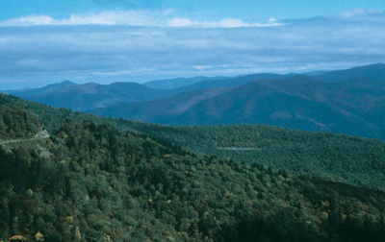
At home, I tell my grandfather how we learn to cooperate and how adults can do this too. Cooperation to save our trees is one solution for the acid rain problem. My grandfather says if all adults would respect the trees and cooperate more, then the evergreen trees would live forever and children could listen to the whisper of the trees for a long time.
I think my grandfather is very wise.
What do you think?

Slide 13
Acid Rain in North Carolina
Ecological
Balance

Slide 14
Acid Rain
in North Carolina
Ecological
Imbalance
(a tipping point)

Slide 15
Balance the Scales
of Acid Rain Pollution & Development
Science Standard: Cause/Effect Relationships:
Students list ways that acid rain pollution occurs and ways to restore the balance to the evergreen mountain forest.

Slide 16

The following is a list of science and cross curriculum vocabulary terms to review with your students after reading
“Acid Rain in North Carolina”.
Enriching Minds Through Vocabulary
  Descendents 16. Forest
  Cherokee tribe 17. Powerful
  Native American Indians 18. Strong
  Mountains 19. Mountain Ridges
  Surrounded 20. Ancestors
  Evergreen Forest 21. Restore
  Appalachian Mountains 22. Energy
  Exploring 23. Destroyed
  Hunting 24. Poison
  Stands 25. Acid Rain
  Mountain Forest 26. Pollution
  Ancient 27. Exhaust
  Whisper 28. Problem
  Balance 29. Cooperate
  Protect 30. Community

Slide 17
Environmental Conversations From Around the World
A Child’s View of Ecosystem Tipping Points
Water Pollution in Bolivia
By Deborah Trogdon-Stout & Catherine E. Matthews
[Photos by Deborah Trogdon-Stout]
Science Series for Grades K-5
A Teacher’s Guide to Developing Critical Thinking Skills, Respect for Cultural Diversity, and Geographical Mapping Skills through Children’s Stories

Slide 18
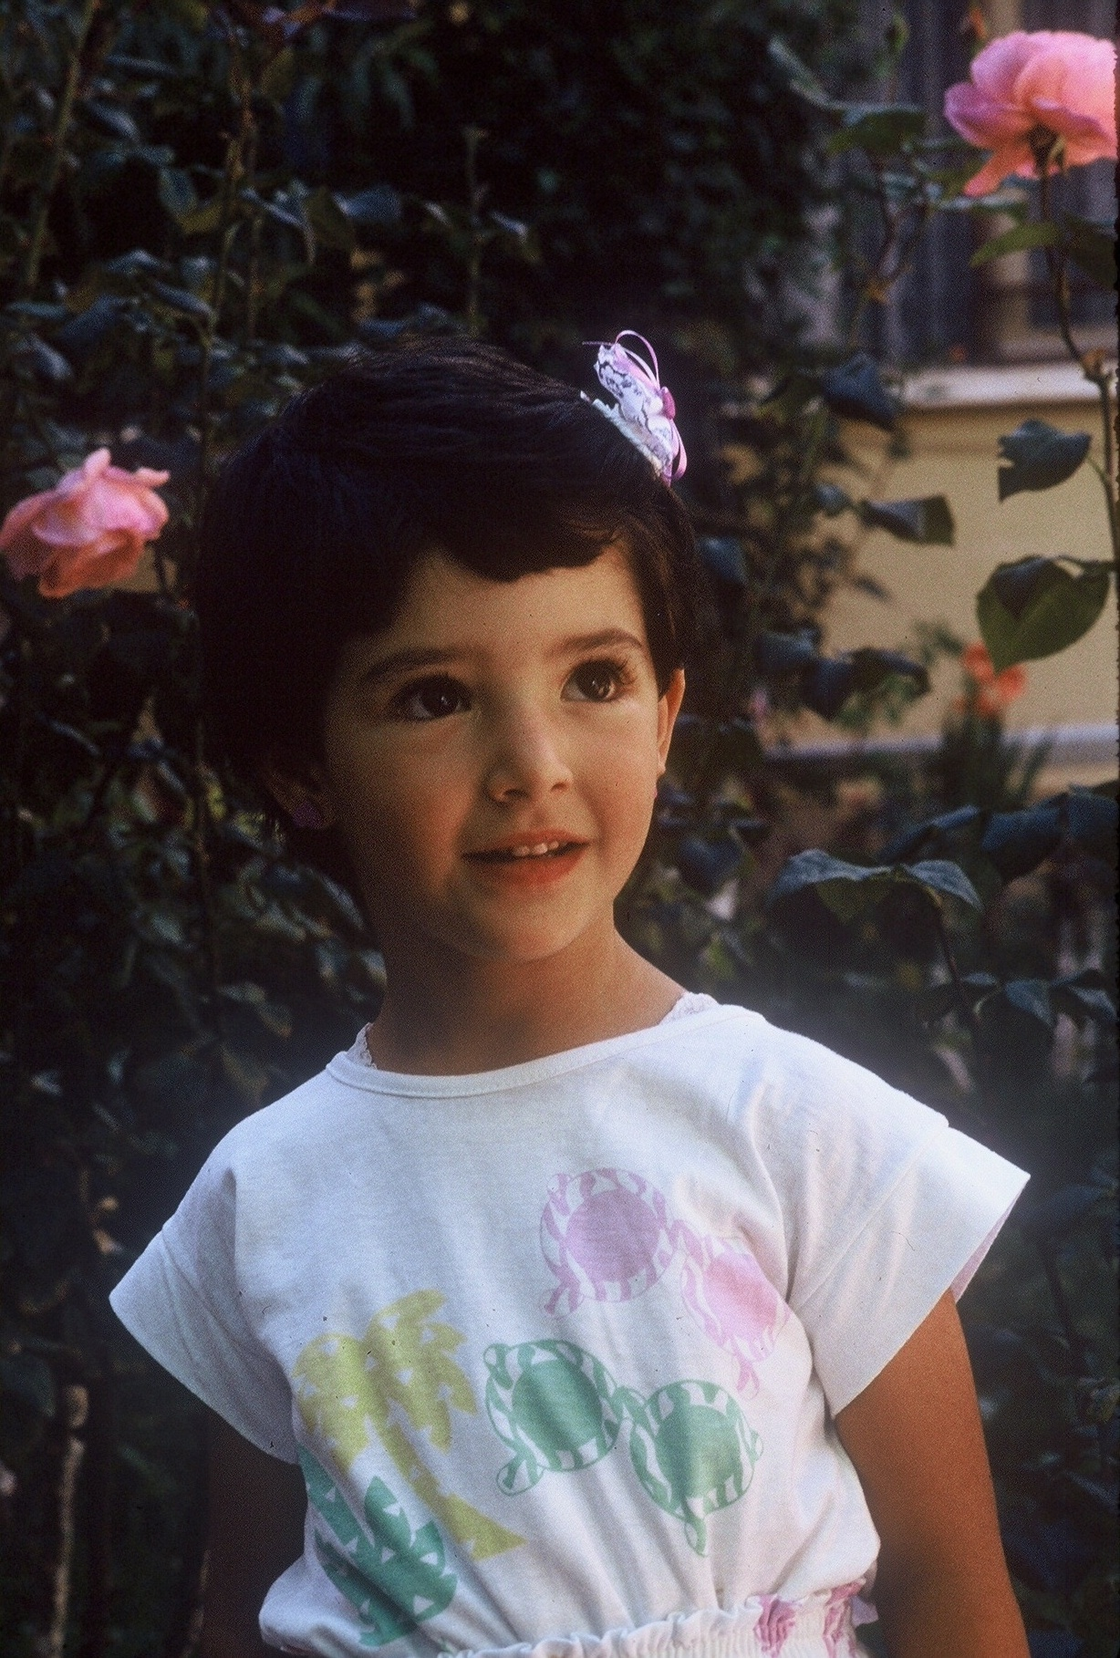
Dealing With Pollution in Bolivia
(Photo of family
By D. Stout)
Photo by
D.Stout
Hola! Hello! My name is Nathalia (Na-tal’–ya) and I live in Cochabamba, Bolivia
with my parents, my little brother, Gabriele, and my grandmother, Rosa. We are descendents of the Quechua Indians also called Incas. I am seven years old and really like going to school to learn new things.
How about you?

Slide 19
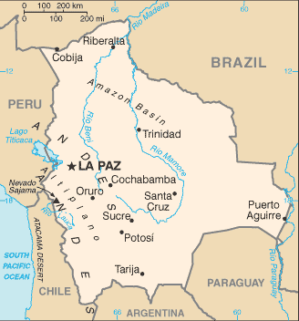
My home of Cochabamba is located high in a valley called a highland plateau that is surrounded by the Andes Mountains on every side. You can see from the map that my country is completely surrounded by land. We have no access to the ocean but we do have very large rivers that run through our land. Bolivia has a variety of land-types and climates. It is cold and desert-like high in the mountains and humid and tropical along the rivers.
N
W
E
S

Slide 20
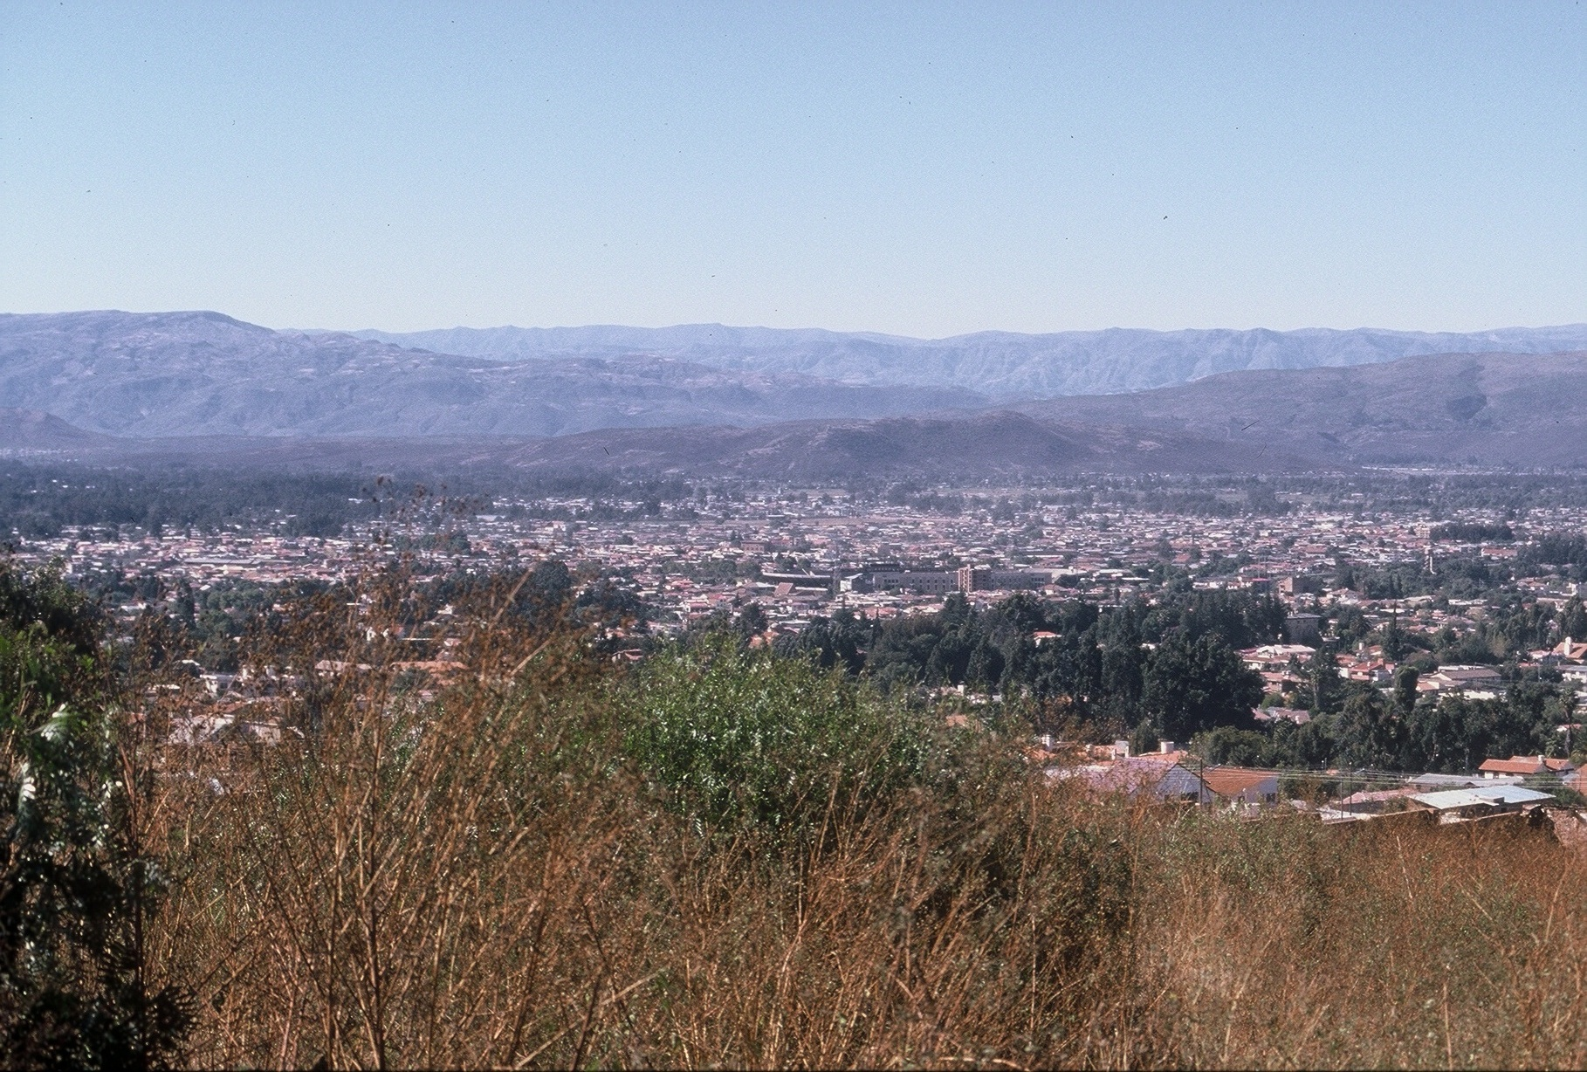
My grandmother Rosa, tells me stories of how beautiful Cochabamba was when she was a little girl. Bolivia is a beautiful country but we have some problems that our teacher talks about in class. Many of our plants and animals need our help to protect them for our future. One of the problems is water pollution.
Do you know what pollution means?
photos of Cochabamba
By D. Stout
Photo by
D. Stout

Slide 21
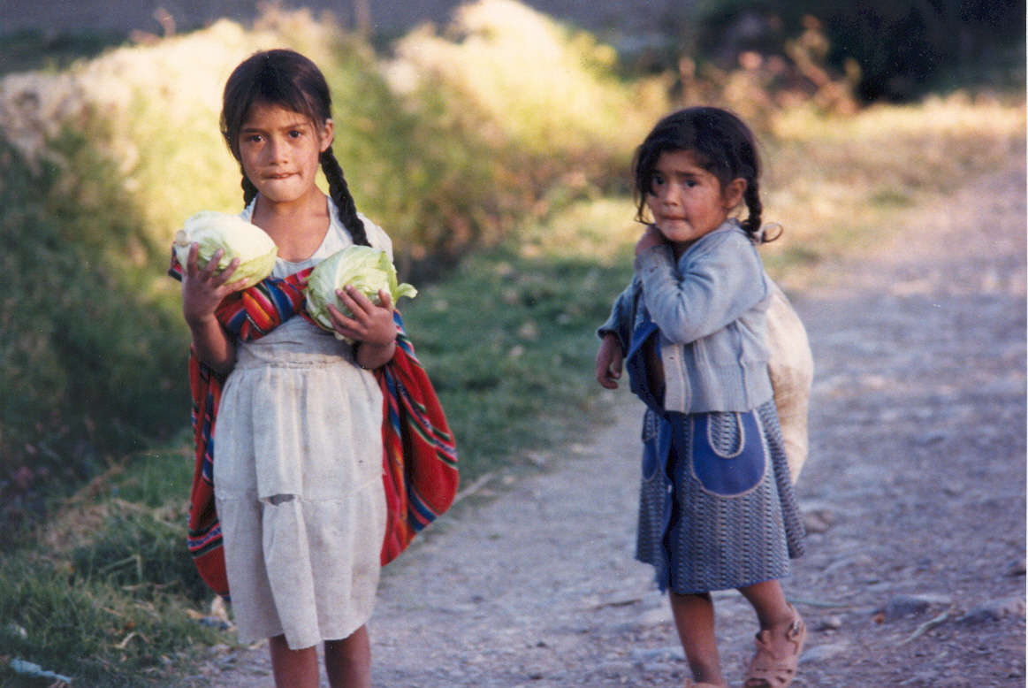
Bolivia is an agricultural area
Grandmother Rosa tells me stories of when she was a little girl and how she loved to play in the clear, clean water of the river. She says, “Nathalia, when I
was little like you, we would walk in the cool waters of the river in the early spring, when the mountain snow would melt. My mother would send me to the river to wash our cabbage before we ate
and it made the cabbage taste so
good.” But my grandmother says now the water is not as good because people do not care for the river. She says people do not respect the river water as they once did.
Photo by
D. Stout

Slide 22
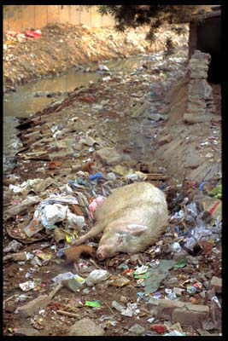
My teacher tells us that pollution is a problem that can touch our lives in many ways. She also teaches us ways that we can help prevent pollution and save our water. Grandmother tells me, “Nathalia, everything must stay in balance to work right, just like the see-saw.”
Do you know what pollution is? Can you name some ways people pollute the rivers?
Polluted stream Cochabamba, Bolivia
Photo by D. Stout

Slide 23
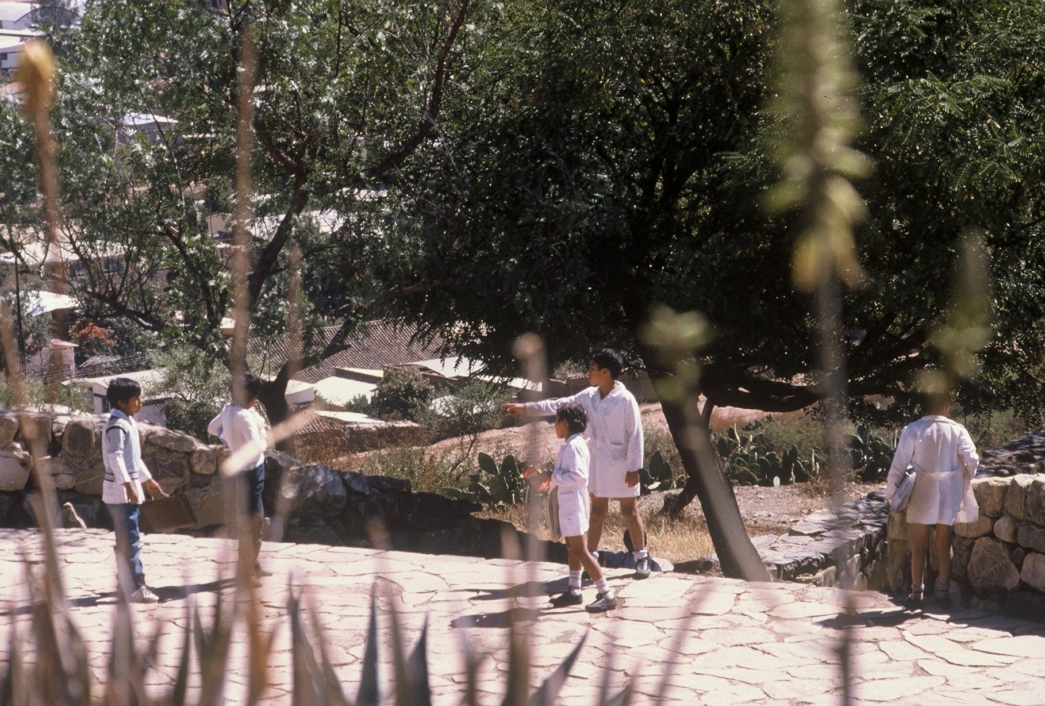
My class is doing a project to help keep our water safe and clean. We asked our parents to help us remove all of the trash in the stream that runs by our school. Next year we are going to plant native trees by the stream to help restore it to the way it looked when my grandmother Rosa was a little girl. Maybe your class can share some ideas now to help your water stay clean.
Will you write to me with your solutions to water pollution?
A community organizes to clean the streams
Photo by
D. Stout

Slide 24
Water Pollution in Bolivia
Ecological
Balance

Slide 25
Water Pollution
in Bolivia
Ecological
Imbalance
(a tipping point)

Slide 26
Balance the Scales of Water Pollution & Development
Science Standard: Cause/Effect Relationships:
Students list ways that water pollution occurs and ways to restore the balance to polluted rivers.

Slide 27
The following is a list of science and cross curriculum vocabulary terms to review with your students after reading “Water Pollution in Bolivia”.
Enriching Minds Through Vocabulary
  Hola! 16. Problems
  Cochabamba, Bolivia 17. Protect
  Descendents 18. Future
  Quechua Indians (Incas) 19. Pollution
  Valley 20. Prevent
  Highland Plateau 21. Save
  Surrounded 22. Balance
  Andes Mountains 23. Unbalanced
  Access 24. Pollute
  Variety 25. Care
  Land-types 26. Respect
  Climates 27. Solution
  Desert-like 28. Cause
14. Humid 29. Native
15. Tropical 30. Restore

Slide 28
Environmental Conversations From Around the World
A Child’s View of Ecosystem Tipping Points
Soil Erosion in Bolivia
By Deborah Trogdon-Stout & Catherine E. Matthews
[Photos by Deborah Trogdon-Stout]
Science Series for Grades K-5
A Teacher’s Guide to Developing Critical Thinking Skills, Respect for Cultural Diversity, and Geographical Mapping Skills through Children’s Stories

Slide 29
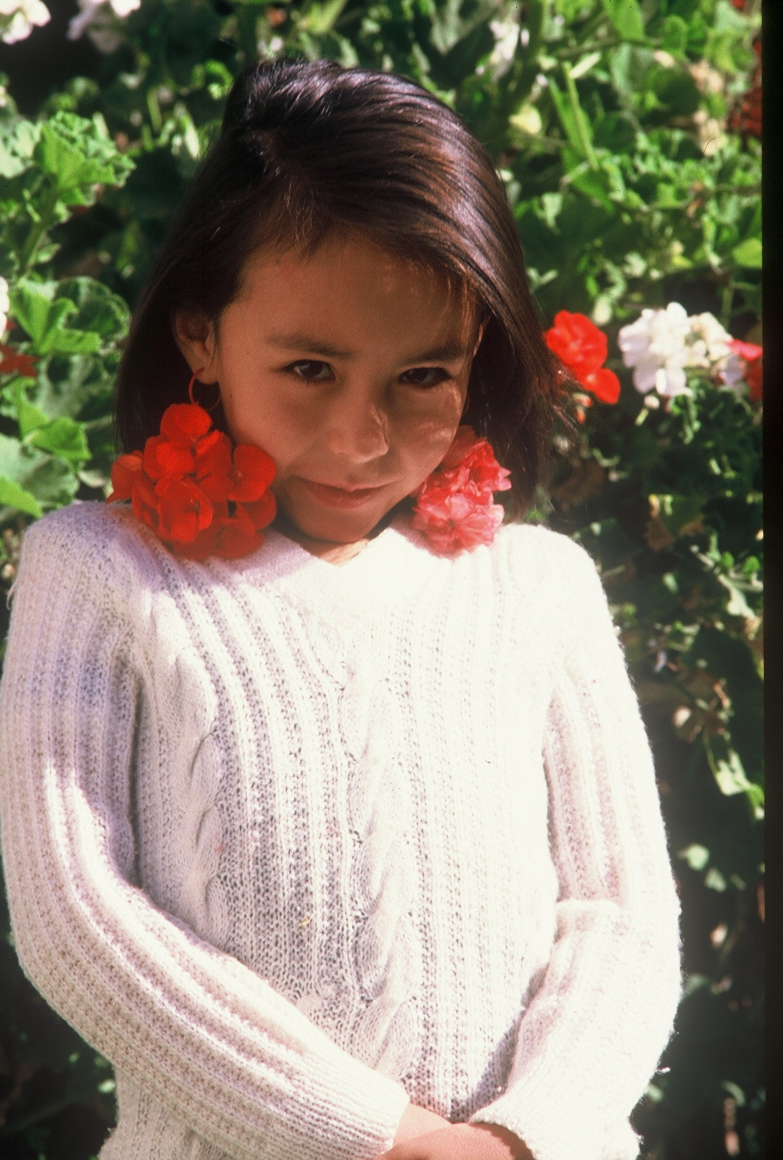
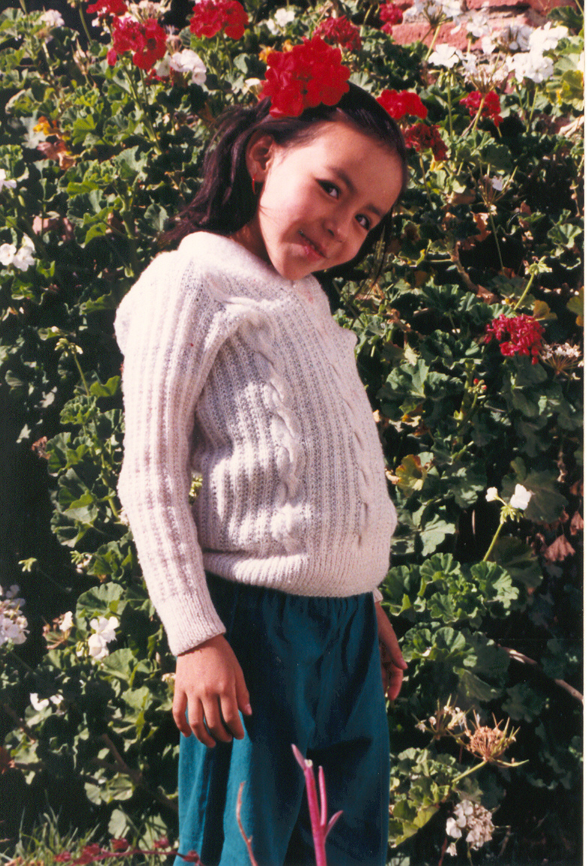
Hola! Hello! My name is Fabiano (Fab - E- ano) and I live in La Paz, Bolivia with my parents and my grandmother, Habibee. We are descendents of the original Aymara Indians who traveled over two-thousand years ago to settle in South America. My ancestors are the original, native, ethnic group of people who settled this land. I am nine years old and really like going to school to learn about science.
How about you?
Photos by
D. Stout

Slide 30
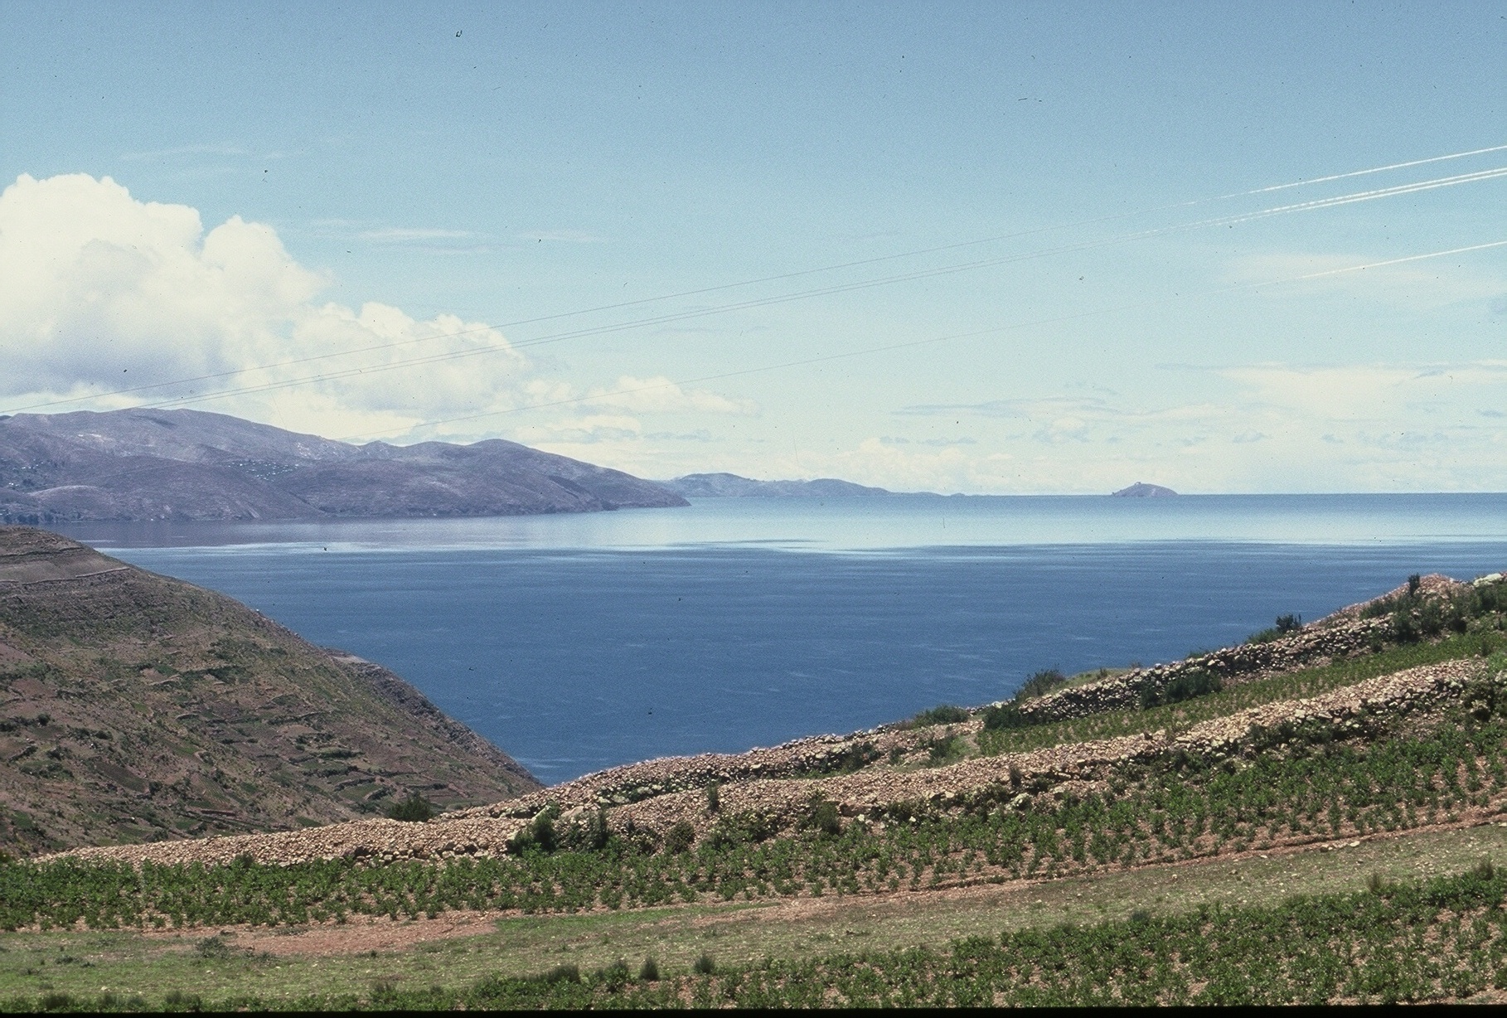
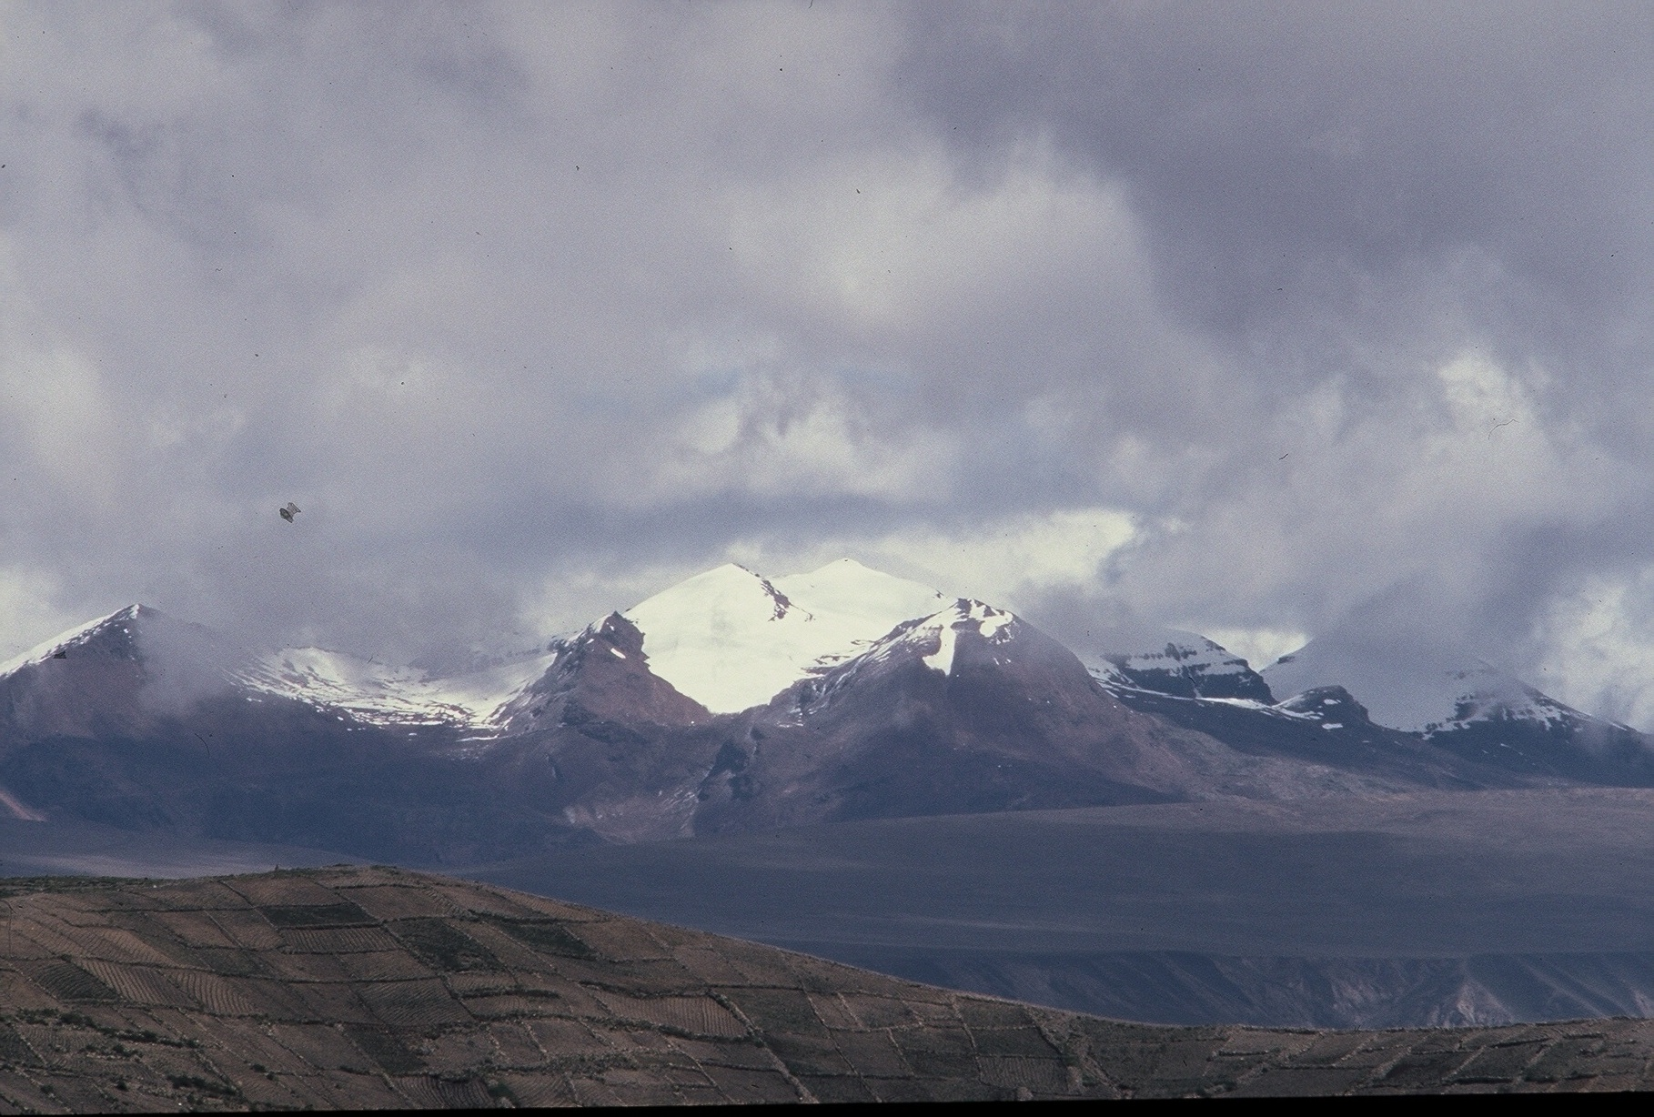
My home of La Paz is the capitol of Bolivia and is located in a canyon just below the altiplano of the Andes Mountains. I am surrounded by the tallest mountains of Bolivia that are covered with snow all year long. My home is very near the highest navigable lake in the world called Lake Titicaca. La Paz is over two miles above sea level and has very harsh weather most of the year.
Photos by
D. Stout

Slide 31
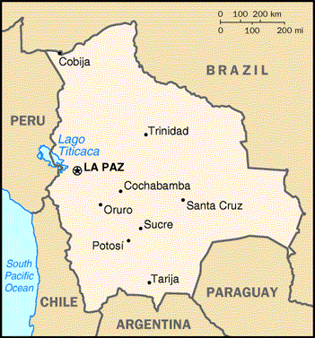
A History of Soil Erosion
My city of La Paz was founded by Spanish settlers around 1548 on the pre- existing site of Choqueyapu, an ancient Aymara village. It was started as a commercial city, lying on the main gold and silver route to the coast. The Spaniards came for the Bolivian gold found in the Choqueapu River that runs through La Paz. The Spaniards took the gold mines away from Aymara people and made them work as slaves. This was the beginning of the problem of soil erosion that my home has now.
Do you know what soil erosion means?

Slide 32
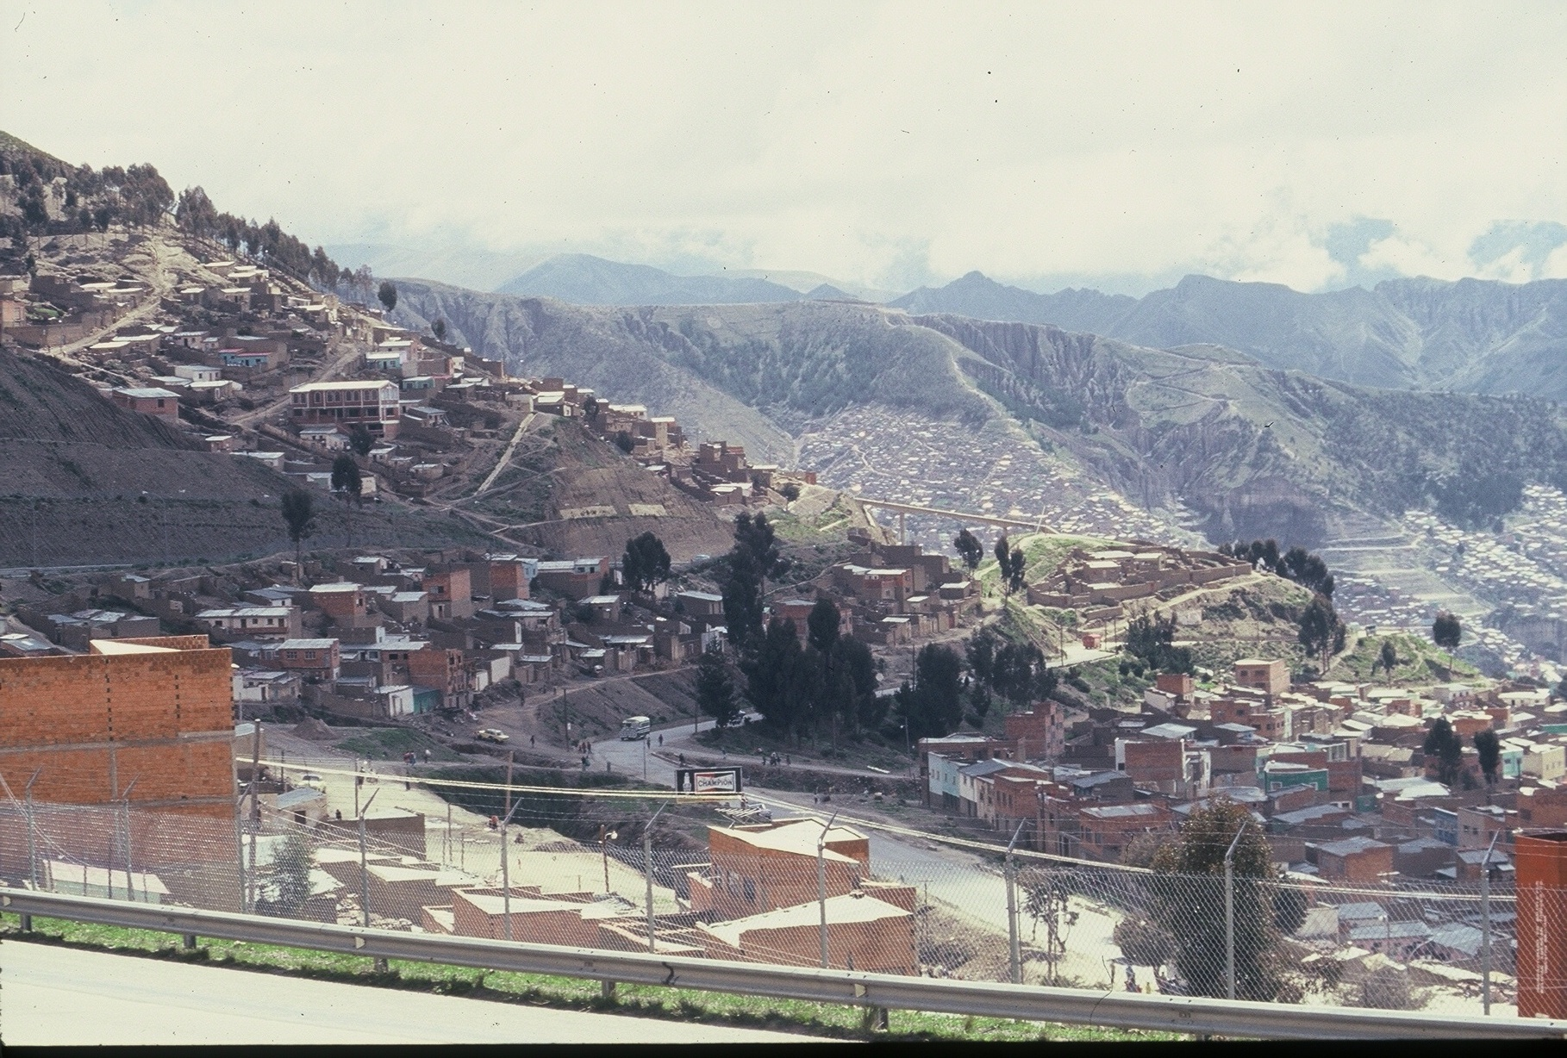
Living on a Mountain Side
My home’s location is very unusual compared to most places where people live and this will help you understand our soil erosion problem. We live on the sides of very steep mountains.
Photos by
D. Stout

Slide 33
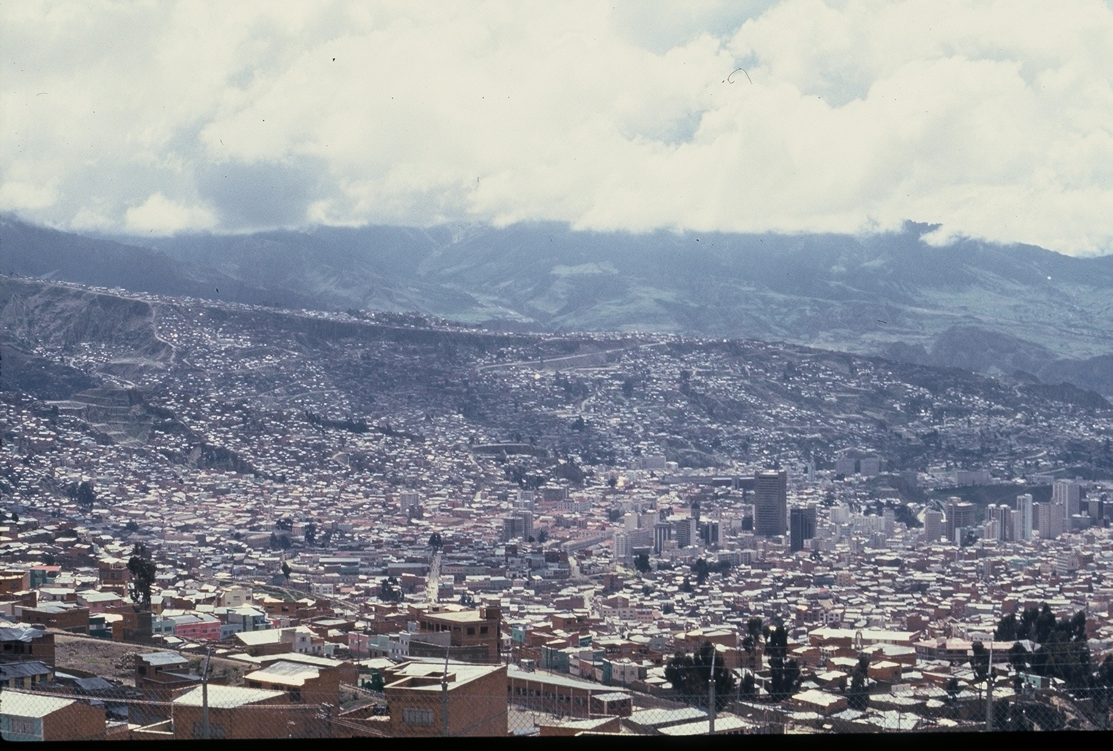
Extreme Soil Erosion
Soil erosion happens when people cut too many trees and shrubs down and do not re-plant anything in their place to hold the soil. This is what has happened in my home of La Paz, Bolivia.
Photos by
D. Stout

Slide 34
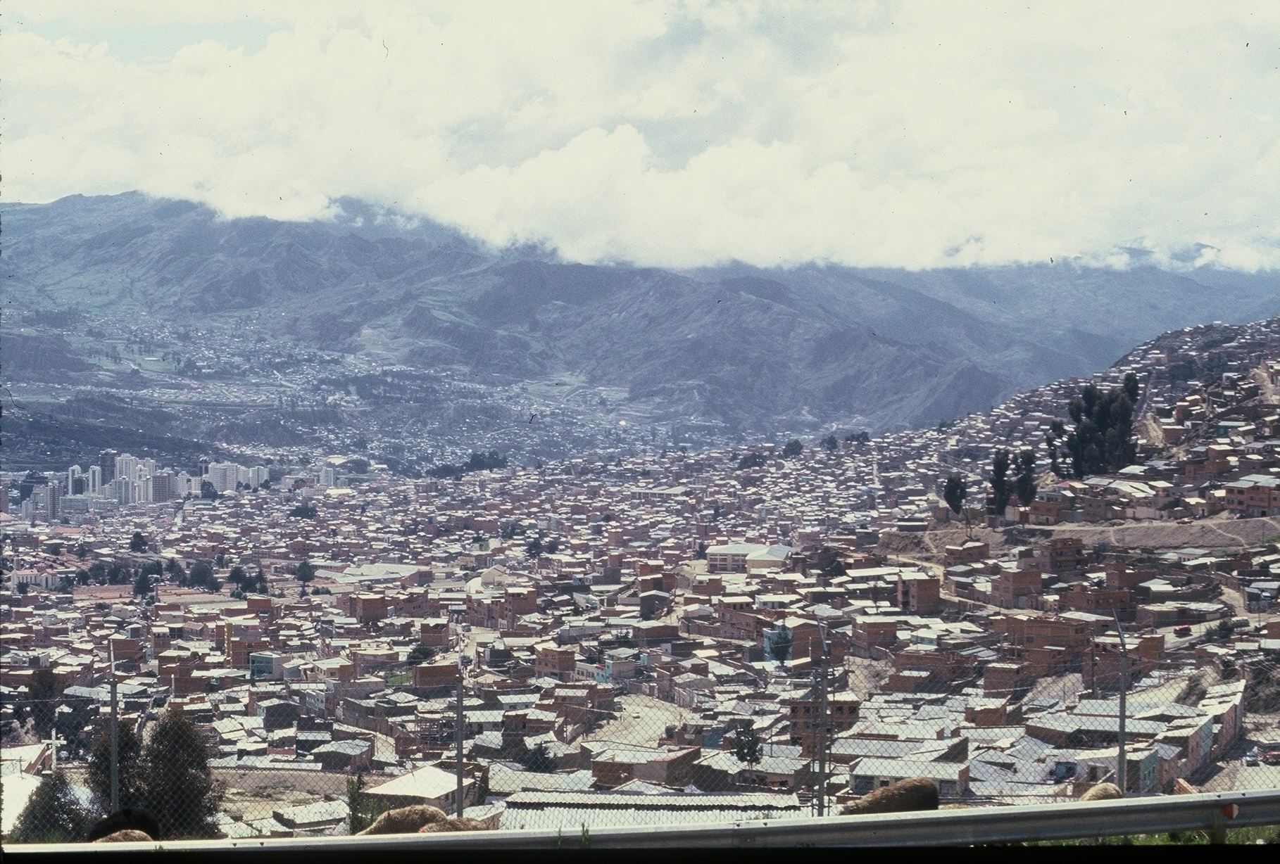
Weather Issues in La Paz, Bolivia
La Paz, Bolivia gets rain almost every day in the spring and summer. This causes the soil to be very unstable and mudslides can happen on the
mountain sides because there are not many plants to hold the soil together.
Photos by
D. Stout

Slide 35
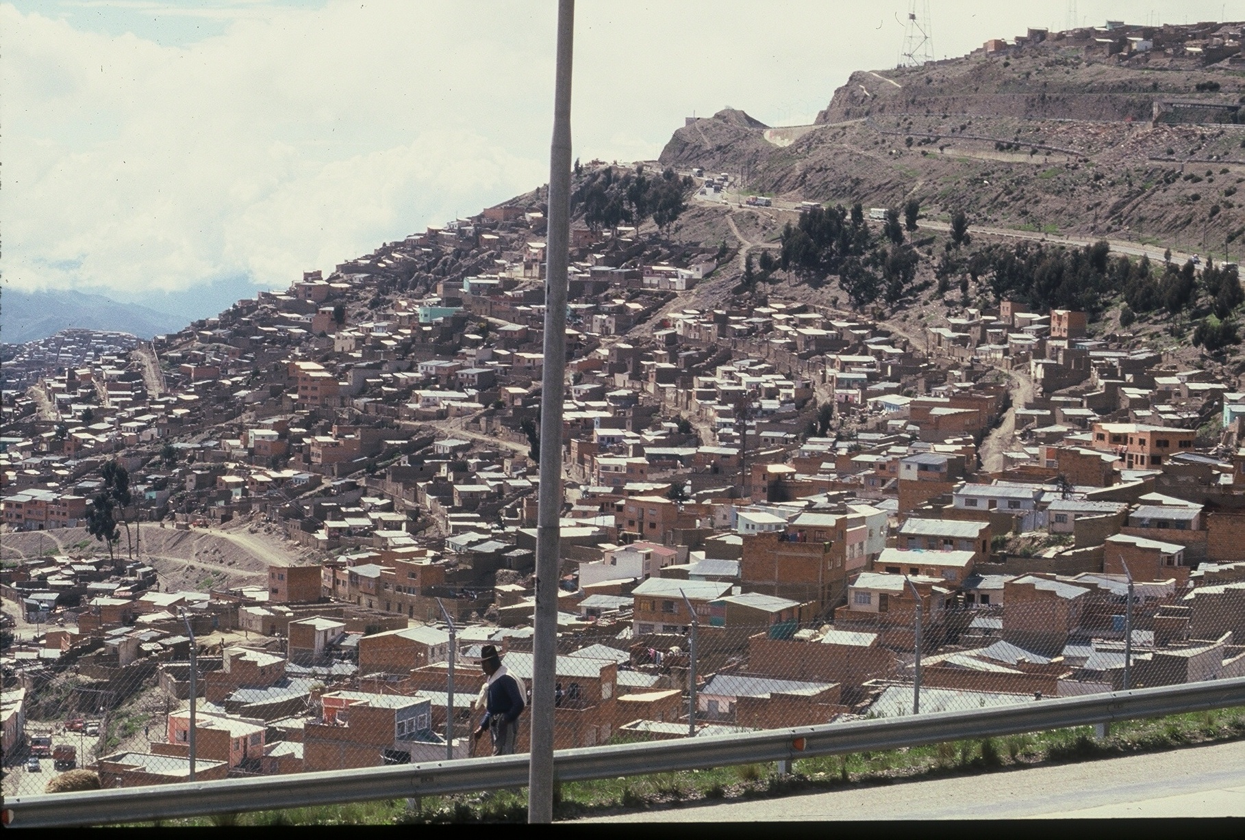
Many people have moved to the capitol, cutting down trees and shrubs to build houses. As you can see, there are many houses built on the sides of our mountains and very few trees to hold the soil in place when the rains come.
Photos by
D. Stout

Slide 36
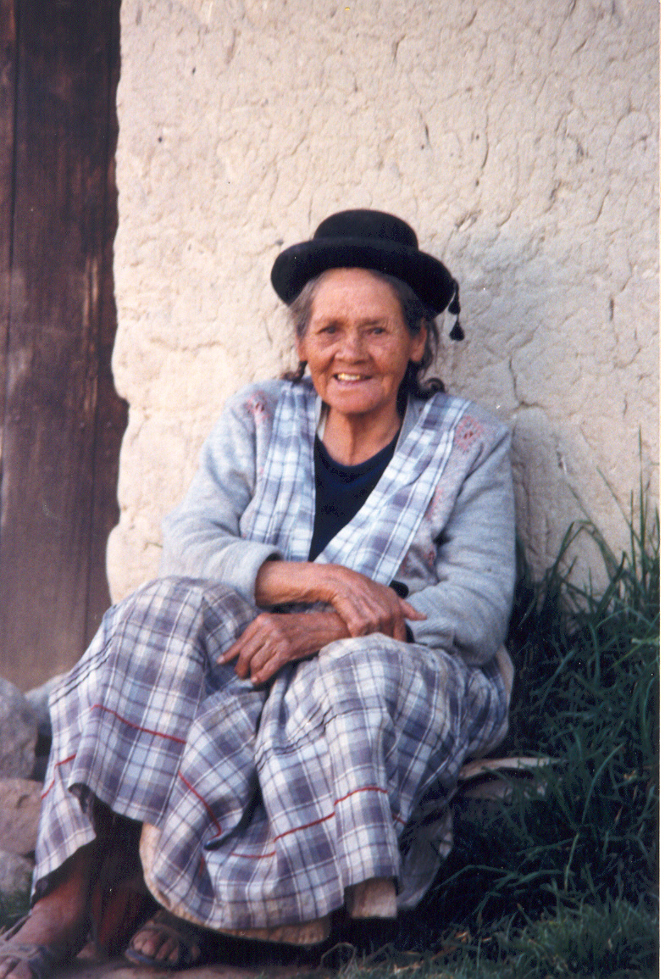
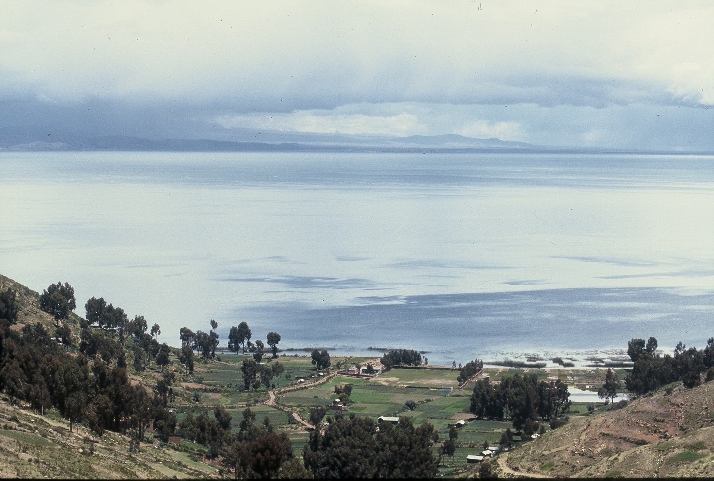
My grandmother, Habibee, tells me stories of how beautiful La Paz was when she was a little girl. Bolivia is a beautiful country but soil erosion can damage our land. My teacher tells us that many, many years ago La Paz had more trees and shrubs that helped to hold the soil together and prevent soil erosion.
Photos by
D. Stout

Slide 37
My teacher tells us that we cannot change the things that happened in the past but we can change what happens in the future for our home. My grandmother says we must learn from the mistakes people made in the past and do better for our land in the future. At school, we think of solutions to stop the soil erosion and help our land restore and find a balance.
Do you know what balance means?
A see-saw can be a balance

Slide 38
Soil Erosion in Bolivia
Ecological
Balance

Slide 39
Soil Erosion
in Bolivia
Ecological
Imbalance
(a tipping point)

Slide 40
Balance the Scales of Development & Soil Erosion
Science Standard: Cause/Effect Relationships:
Students list ways that soil erosion occurs and ways to restore the balance to the land.

Slide 41
The following is a list of science and cross curriculum vocabulary terms to review with your students after reading “Soil Erosion in Bolivia”.
Enriching Minds Through Vocabulary
  Hola! 16. Problems
  La Paz, Bolivia 17. Unusual
  Descendents 18. Future
  Aymara Indians 19. Soil Erosion
  Ancestors 20. Prevent
  Original 21. Mudslides
  Ethnic 22. Balance
  Native 23. Unbalanced
  Settled 24. Unstable
  Altiplano 25. Re-plant
  Canyon 26. Respect
  Capitol 27. Solutions
  Andes Mountains 28. Cause
14. Harsh 29. Damage
15. Lake Titicaca 30. Restore

Slide 42
Environmental Conversations From Around the World
A Child’s View of Ecosystem Tipping Points
The Fall and Rise of Fisheries in the Philippines
By Catherine E. Matthews & Deborah Trogdon-Stout
[Photos from www.ecotippingpoints.org]
Science Series for Grades K-5
A Teacher’s Guide to Developing Critical Thinking Skills, Respect for Cultural Diversity, and Geographical Mapping Skills through Children’s Stories

Slide 43

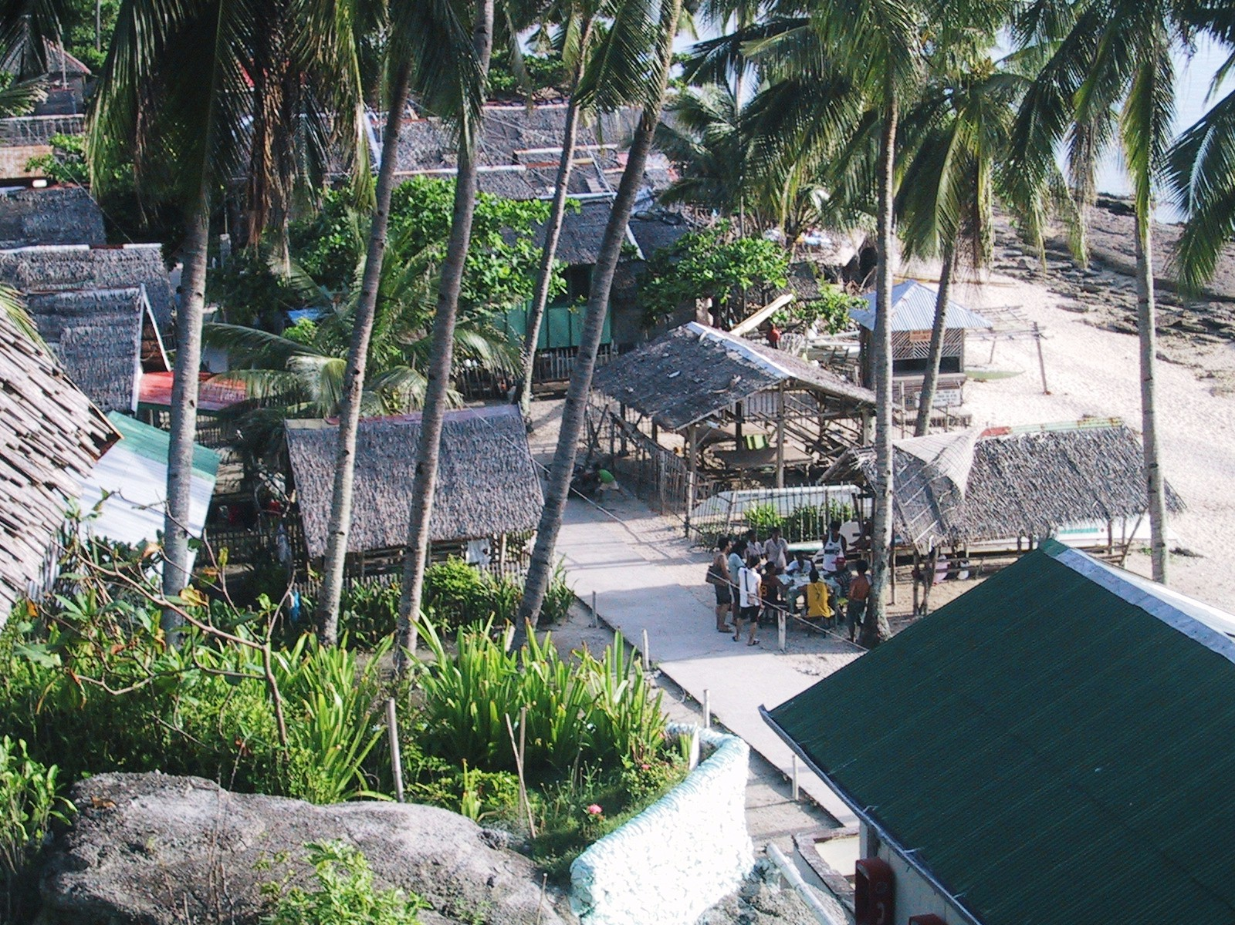
Hi. My name is Imee. I am 12 years old. My brother Benjie is 9 years old. We live on a small island called Apo Island in the Philippines. The Philippines are a collection of over 7,000 islands located in the Pacific Ocean and the China Sea. The island chain is about 1,100 miles long. My father is a fisherman as was his father before him and his father before him. When Benjie is 16 he may become a fisherman too.

Slide 44

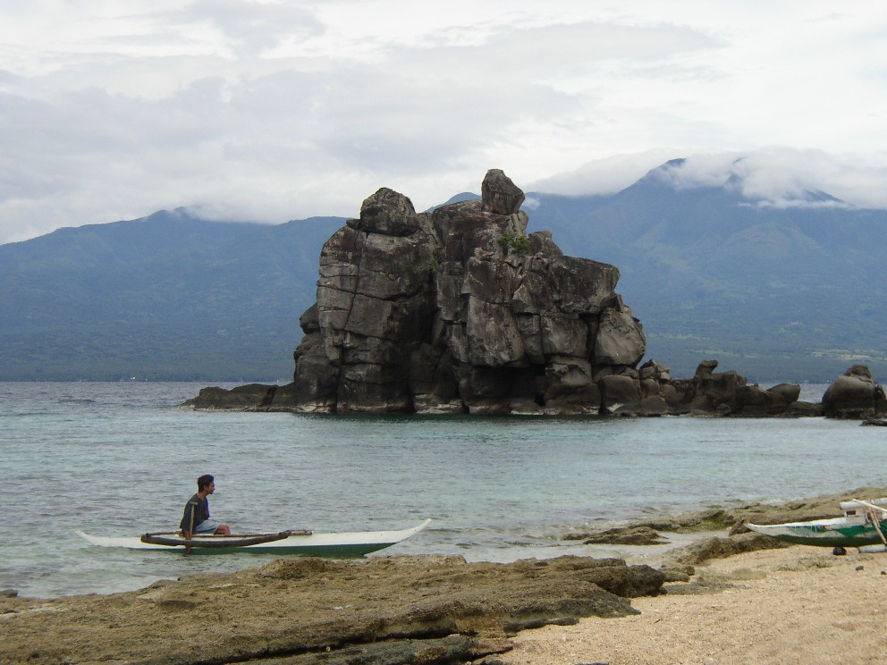
This is my country. It is called an archipelago. Do you know what an archipelago is?

Slide 45
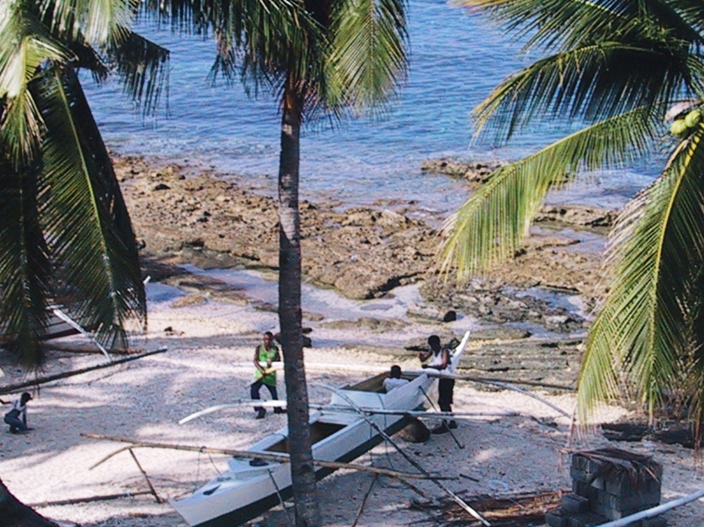
Fishing in the Philippines
When our father was a little boy he used hook and line, gill nets, and bamboo fish traps to catch fish right around Apo Island. Our Island had plenty of fish to feed everyone on the island and even some fish to sale to other people on other islands. Everyone was happy and had plenty to eat.
Do you like to go fishing? What kind of rod and reel do you use?

Slide 46

The families on Apo Island had too many children for the Island to support.
In the 1980s, when our father was a young man, the population of Apo Island was increasing and so was the pressure to catch more fish. New fishing methods included small mesh net, dynamite and cyanide fishing. My father even used Muri-amo (fish are chased into nets by pounding rocks on coral) to catch fish.
Have you seen fishing methods change where you live?

Slide 47
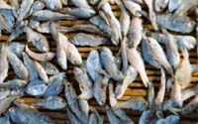
Depleting the Fishery by Over-fishing or Over-harvesting
The new fishing methods meant that the fishery was nearly fished out and fished out quite quickly.

Slide 48
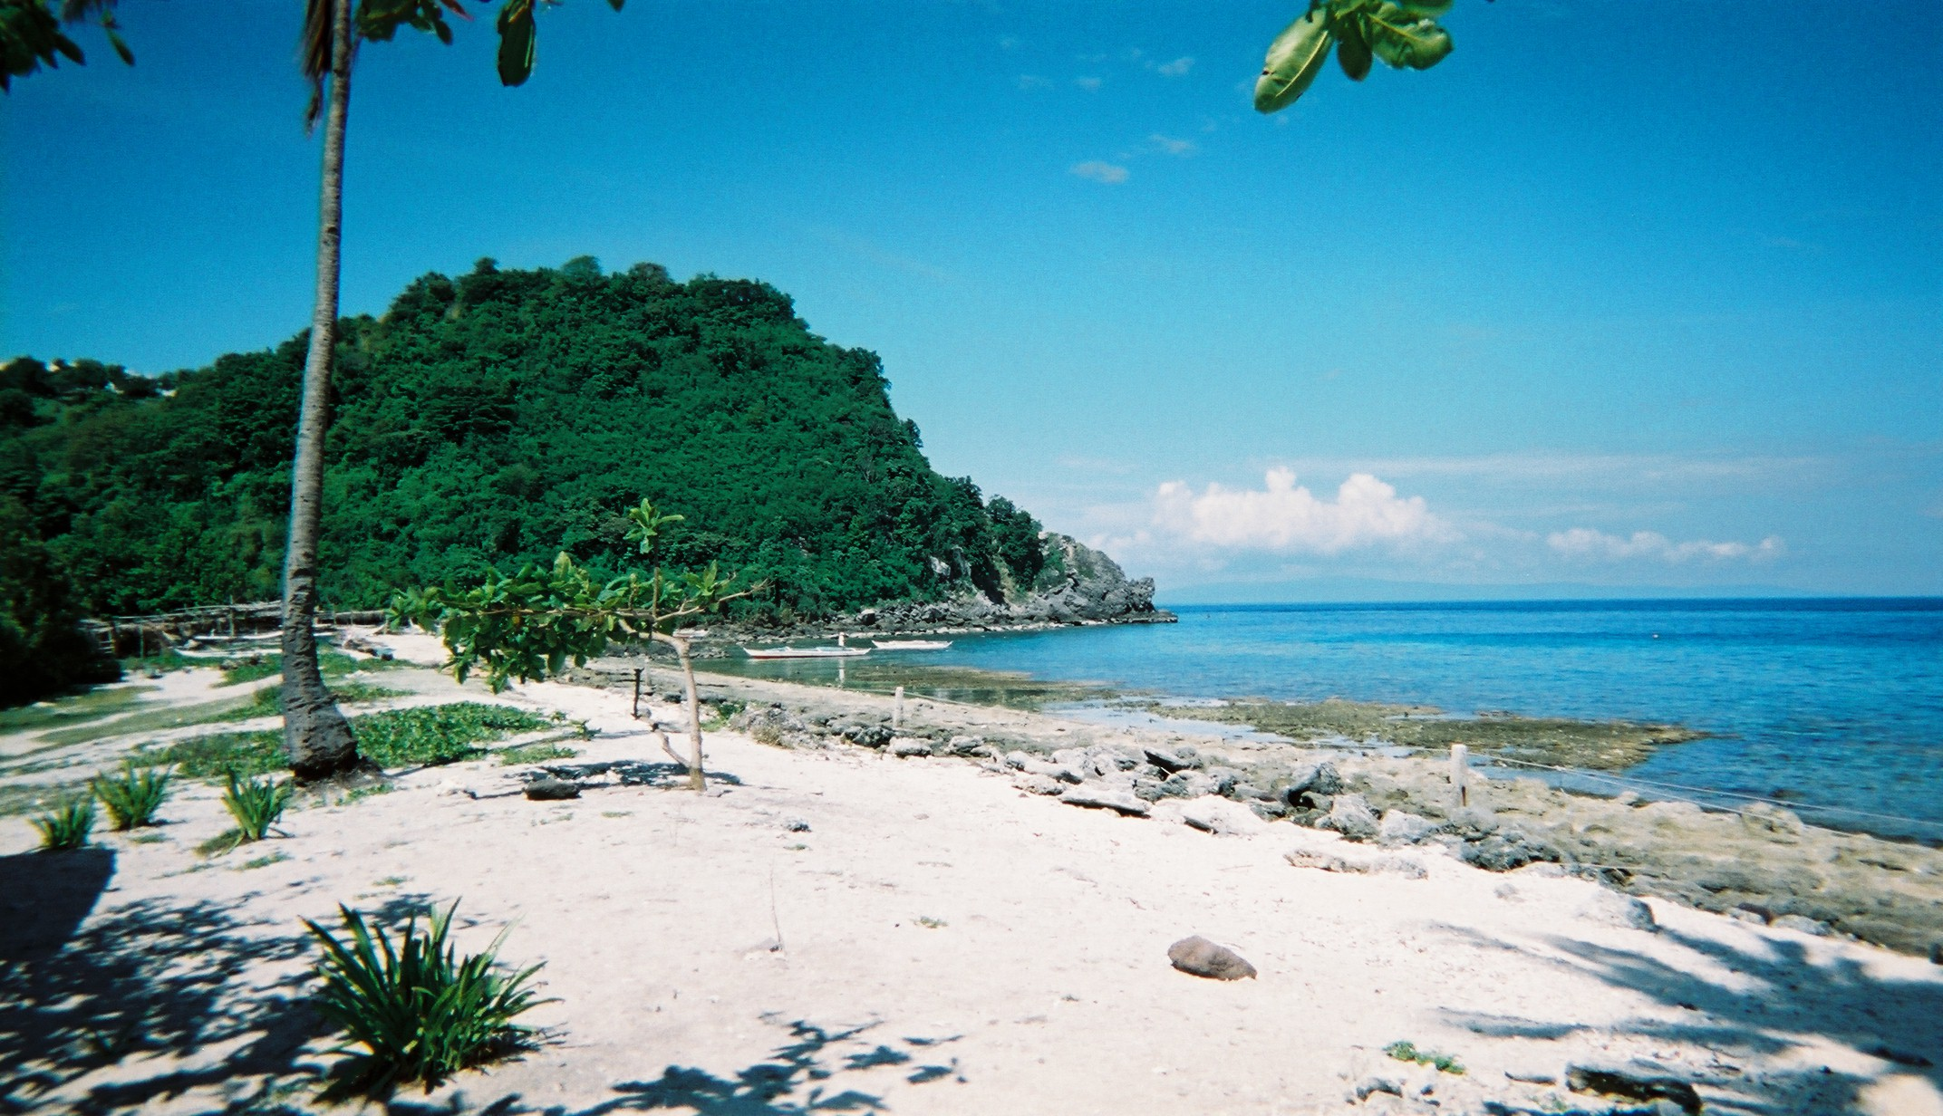
We established a marine sanctuary.
A marine biologist came to our Island in 1982 and convinced several families in our village to establish a marine sanctuary.
Do you know what a sanctuary is?

Slide 49
NEVER take it all!
The marine biologist said that it was wrong to take all of the fish. He said that if our village caught all of the fish then there would never be enough fish.
He said if we would set aside a small no fishing area like a resting area or a nursery that our fish would come back.
My Dad said that many people did not believe the marine biologist.
Do you think that it is OK to take/use/capture everything if you need it?

Slide 50

STOP: No Fishing Zone
Four families decided to try the marine biologist’s plan. Only one person had to watch from the beach to make sure that no one fished inside the sanctuary. Guard duty rotated among the participating families.

Slide 51
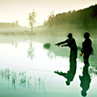
Saving a place for fish to live, grow and reproduce worked!
Fish numbers and sizes started to increase in the sanctuary, and "spillover" of fish from the sanctuary to the surrounding marine ecosystem led to higher fish catches around the periphery, eventually to a distance of several hundred meters.

Slide 52
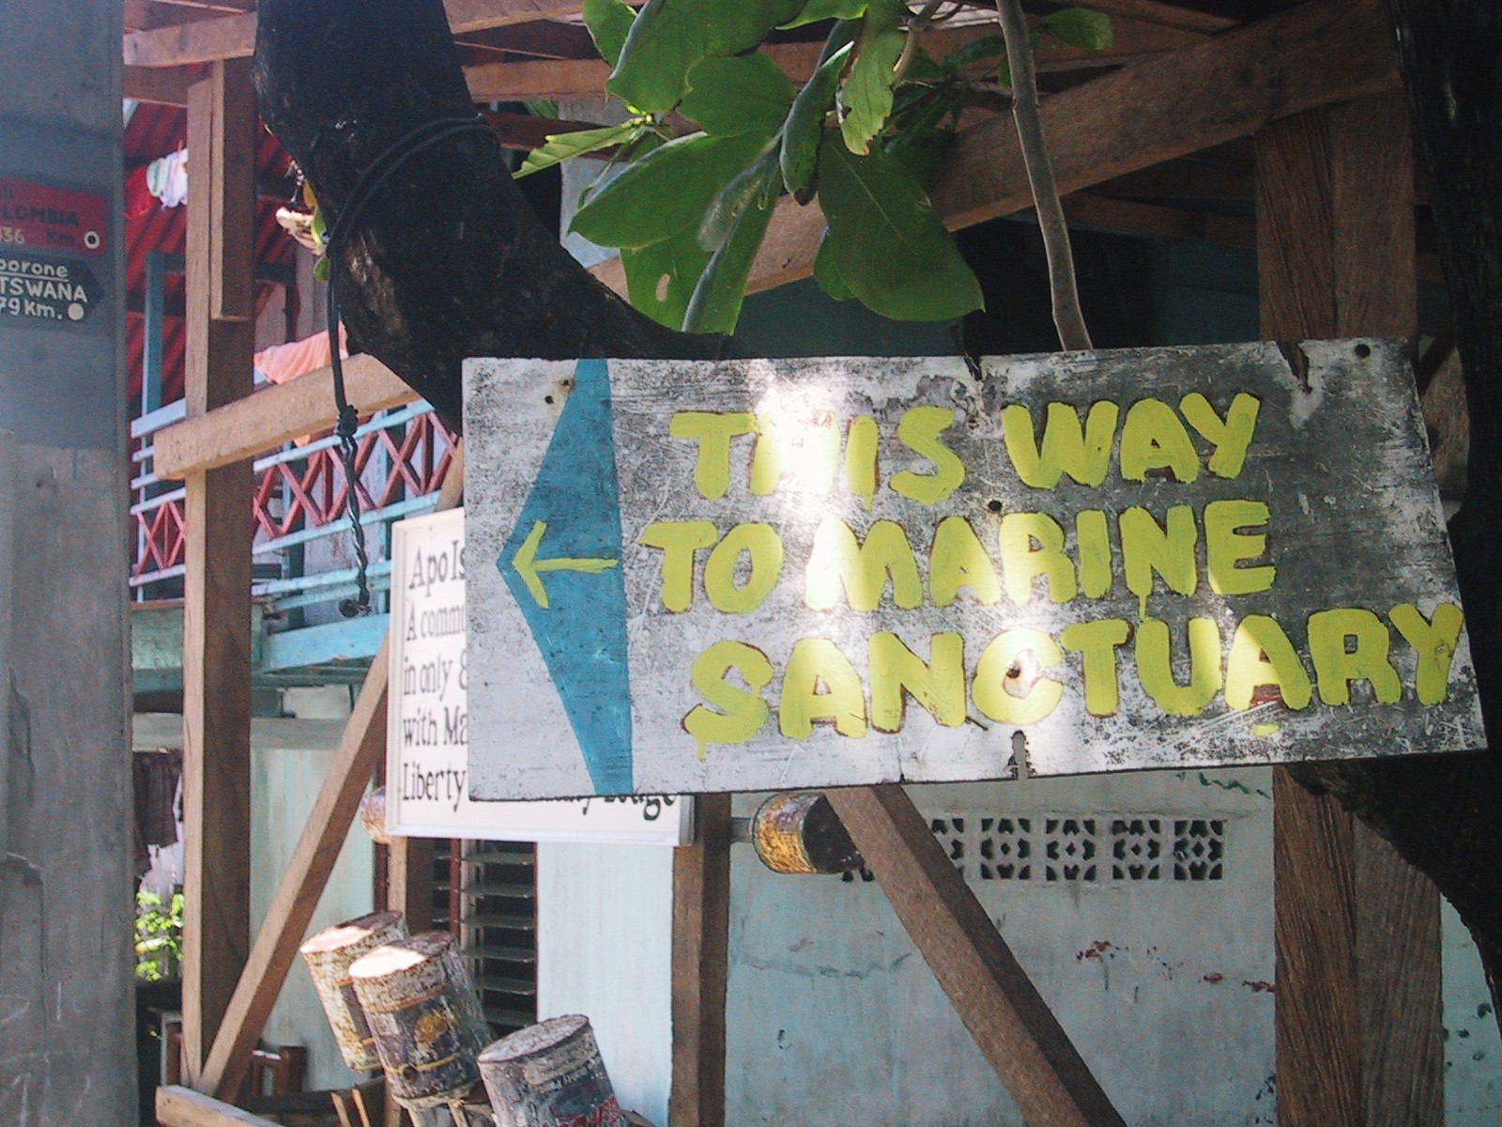
Laws can help protect natural resources.
In 1985 all island families decided to support the sanctuary and make it legally binding through the local municipal government.

Slide 53
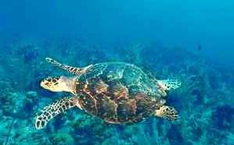
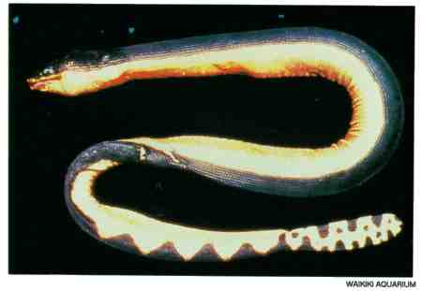
Divers and Snorkelers Visit Apo Island
The striking abundance and diversity of fish and other marine animals (e.g., turtles and sea snakes) around the island have attracted coral reef tourism (Cadiz and Calumpong (2000).

Slide 54
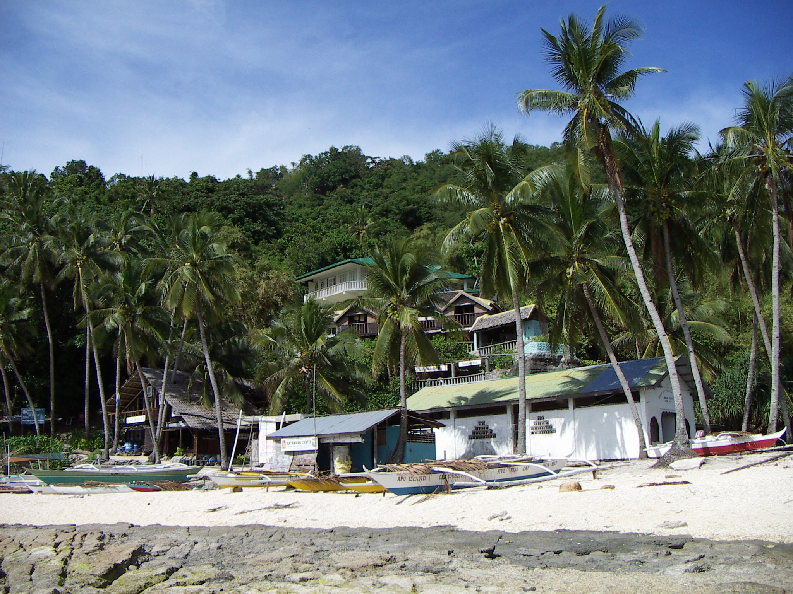
Eco-tourism has become popular on Apo Island.
The island has two small hotels and a dive shop, which employ several dozen island residents. In addition, diving tour boats come daily from the nearby mainland.
Do you like to snorkel? If so, maybe you will come to Apo Island one day.

Slide 55
Fisheries Productivity in the Philippines
Ecological
Balance

Slide 56
Fisheries Productivity in the Philippines
Ecological
Imbalance
(a tipping point)

Slide 57
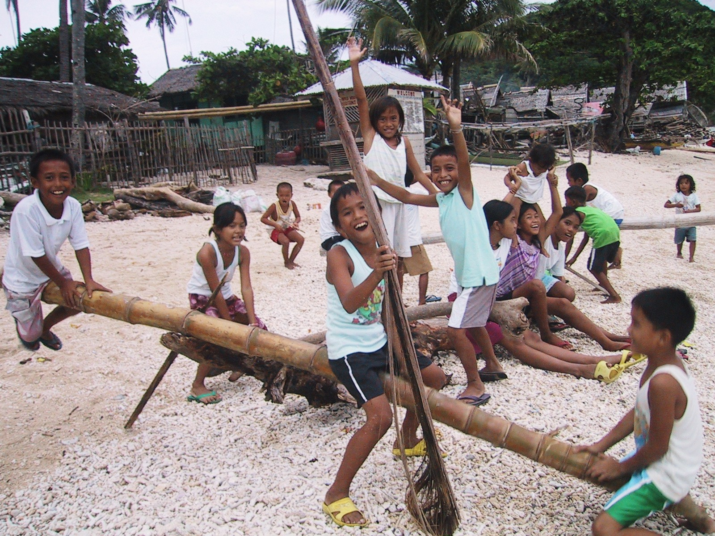
Balance the Scales
of Harvesting Fish and Sustaining Fish Populations
Science Standard: Cause/Effect Relationships
Students list reasons why fishing resources can be depleted and they list ways to restore depleted fisheries.

Slide 58
The following is a list of science and cross-curriculum vocabulary terms to review with your students after reading “The Fall and Rise of Fisheries in the Philippines”.
Enriching Minds Through Vocabulary
Marine Sanctuary 7. Harvest
Dynamite 8. Sustain
Cyanide 9. Legally binding
Muir-Amo 10. Archipelago
Fishery 11. Municipal
Periphery 12. Nursery

Slide 59
Environmental Conversations From Around the World
A Child’s View of Ecosystem Tipping Points
Dealing with Drought in India
By Catherine E. Matthews & Deborah Trogdon-Stout
[Photos from www.ecotippingpoints.org]
Science Series for Grades K-5
A Teacher’s Guide to Developing Critical Thinking Skills, Respect for Cultural Diversity, and Geographical Mapping Skills through Children’s Stories

Slide 60
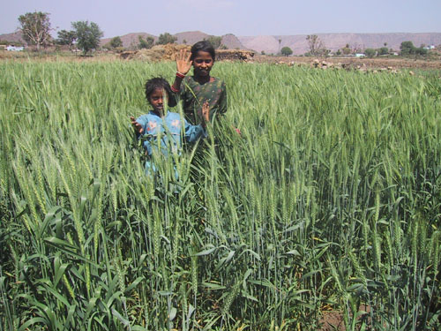
Dealing with Drought in India
Hi. My name is Pradeep. I am 12 years old. My sister Seema
is 9 years old. We were born in a village in India called Gopalpura
in the state of Rajasthan where we still live.

Slide 61
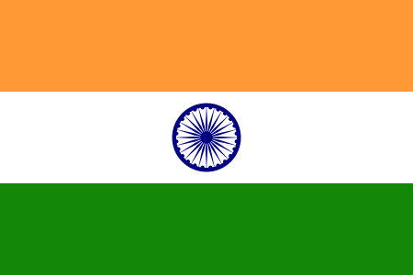
India is very different than the United States
India is one of the oldest civilizations in the world It is the largest democracy in the world. It is the world's second most populated country after China. Because it is so old and so far away, we think of it a very exotic and very mystical place.
Do you know how far India is from where you live?

Slide 62
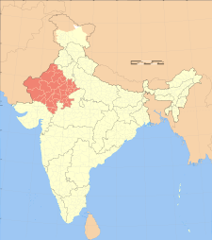
The State of Rajasthan is the largest state in India. Rajasthan includes over 10% of the land in India. Rajasthan is in western India, a semi-arid area of the country which gets about 575 mm of rainfall annually.
Do you know what semi-arid means?

Slide 63
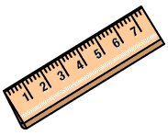

Systems of Measurement
In India we use the metric system of measurement. 575 millimeters of rain is approximately 23 inches of rain a year.
Inches is an English measurement.The top ruler is in centimeters (10 mm = 1 cm) and the bottom ruler is in inches.
Can you figure out how many centimeters are in one inch?

Slide 64
Comparing India and the U.S.
US population: 295,734,134
India population:1,027,015,247
US: 5,984,685 SQ MI
India: 1,229,737 SQ MI
India is a very large country, although not as large as the United States. However, more people live in India than live in the U.S. India is about five times smaller than the U.S. but has about 3 times as many people as the U.S.

Slide 65
India & the U.S.
•
    •
•
• • • •
• • • • •
Can you imagine what it must be like to live in such a crowded country?
• = one hundred million people

Slide 66
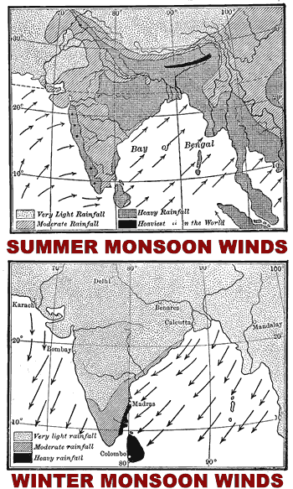
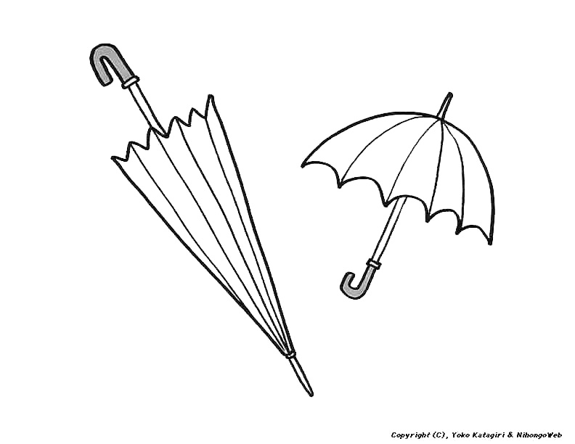
Our country usually has a rainy season (called a monsoon season) and a dry season. In the dry season we need to get water from places where it has been stored.
Do you have seasons where you live? Are they hot and cold seasons or wet and dry seasons?

Slide 67
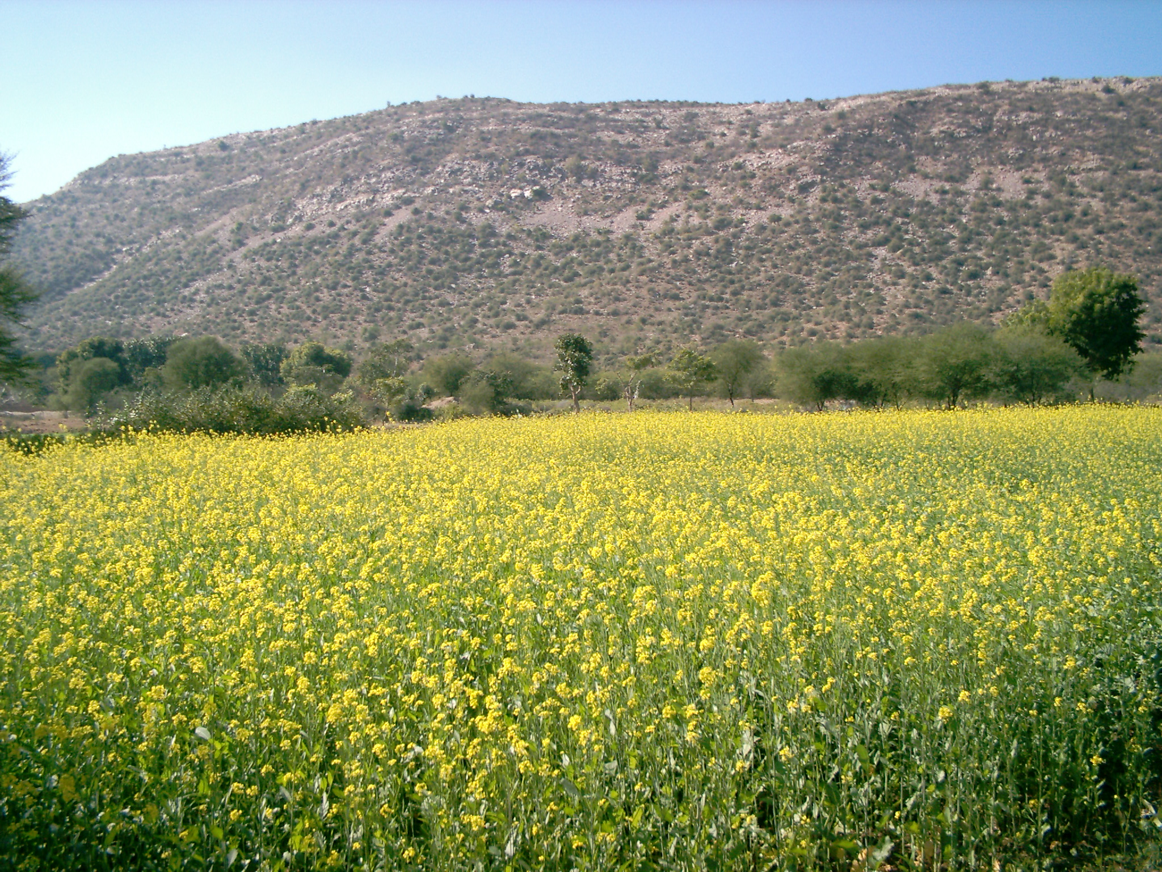
Rajasthan is an agricultural area
Our main source of livelihood in Rajasthan is agriculture.
Can you identify this crop?

Slide 68
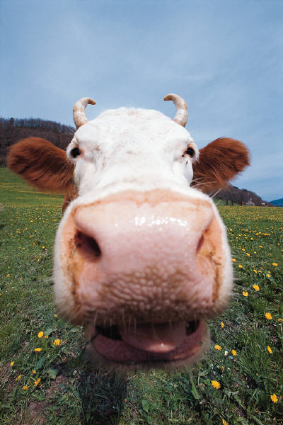
We are Hindus.
Seema and I are Hindus. Hinduism is the most popular religion in India. It is the oldest religion in the world. Most Hindus consider cows as sacred animals and therefore we do not eat beef. We are vegetarians so growing crops is critical to our survival.

Slide 69
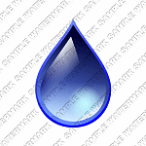
In the 1990s we had a drought. Our wells dried up and we were not able to water our crops. We did not know what to do but we could not continue to live in Rajasthan without water.
=

Slide 70
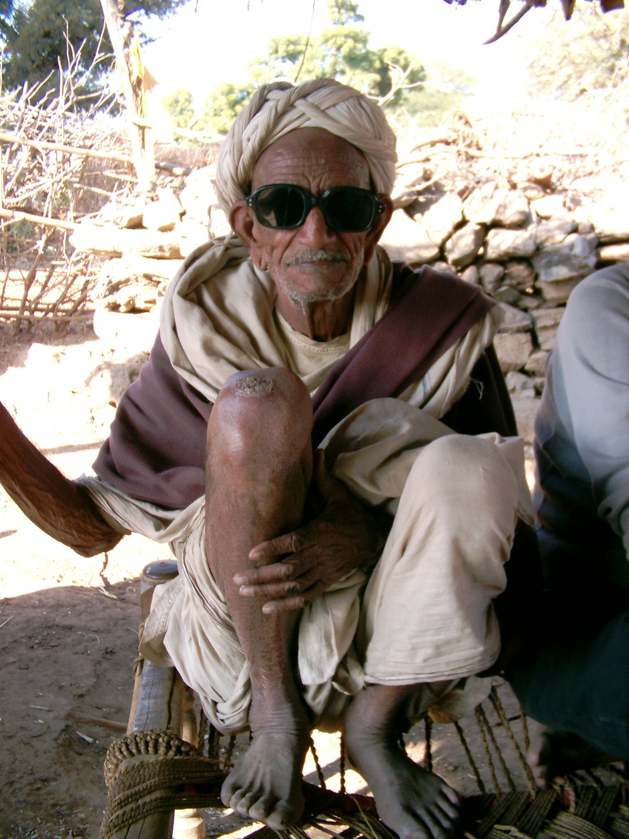
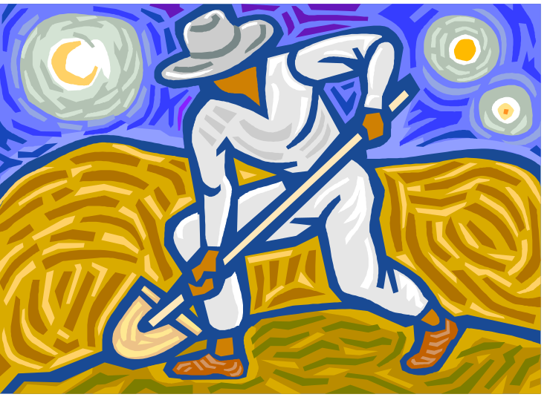
My great grandfather told me a story about the ponds that we used to have in our village. The ponds were called johads. They were dug by the people who lived in the village and provided water for the entire village all year.

Slide 71
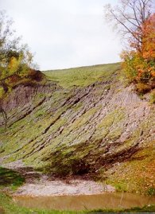
When Monsoon Rains Fall on Logged Mountains Erosion can be Severe
We live near the mountains, in the rain shadow of the mountains. Our mountains were logged, leading to soil erosion. The eroded soils filled the johads. That’s why I had never heard of johads until my great grandfather told Seema and me about them.
Do you know what soil erosion is? Do you think soil erosion fences might help solve this problem?

Slide 72
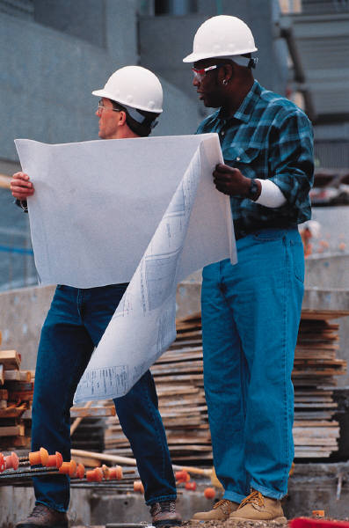
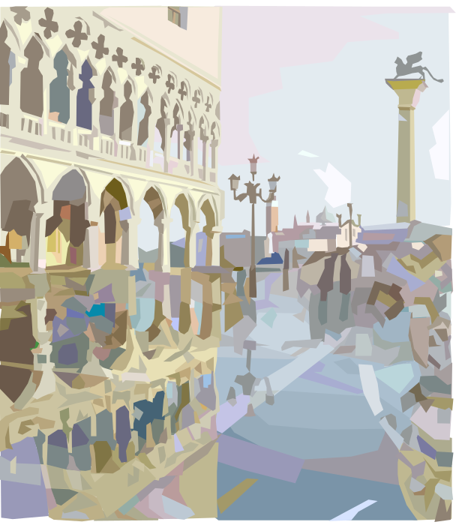
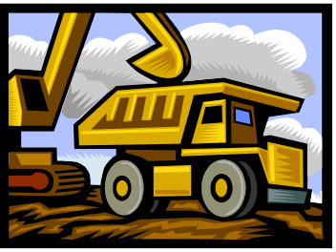
Technology doesn’t always have the answers to our ecological problems.
When the johads filled in, our centralized government began to dig wells, construct water harvesting devices and dig canals, all futile efforts that did not involve our villagers in trying to solve the issues with the drought.

Slide 73

Digging Wells

Slide 74


Our village organizes to dig johads.
My sister and I
went to the next community meeting and told the village leaders about what our great grandfather had said about the johads. The village leaders organized groups of villagers to dig johads. We had a difficult year but the following spring the rains came and filled the johads and we had enough water to drink and irrigate our crops.

Slide 75


This is a before and after picture of an area near our home.

Slide 76

Johads restore water tables to previous levels.
Johads work well. Our ground water reserves are up and we have plenty of drinking water and water for irrigation. Seema and I are two happy kids.

Slide 77
Traditional Knowledge is Important
My grandfather told Seema and me that sometimes traditional knowledge is more important than new developments. Sometimes the old ways work better than new ways. He told us that we should always weigh the costs and gains for both the old ways and the new ways and if we remembered to do that that we could help our village make the right decisions.
OLD WAYS
NEW WAYS

Slide 78
Water Reserves in India
Ecological
Balance

Slide 79
Water Reserves
in India
Ecological
Imbalance
(a tipping point)

Slide 80
Balance the Scales of Water Reserves (Groundwater) and Drought
Science Standard: Cause/Effect Relationships
Students list reasons why droughts occur and ways to restore the groundwater balance.

Slide 81

The following is a list of science and cross-curriculum vocabulary terms to review with your students after reading “Dealing with Drought in India”.
Enriching Minds Through Vocabulary
Semi-arid 14. Democracy
Metric Measurement 15. Exotic
Centimeters 16. Mystical
Millimeters 17. Sacred
Monsoon 18. Harvesting
Drought
Futile
Johad
Ground Water
Irrigation
Water Table
Rain Shadow
Canals

