Slide 1
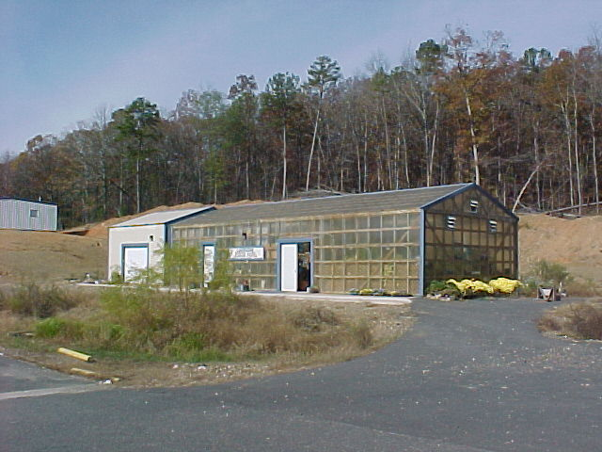
HABITAT BASED LEARNING CENTER
Lakeside Pubic Schools
2871 Malvern Avenue
Hot Springs, AR 71901
“Bringing students and their environment
closer together”

Slide 2
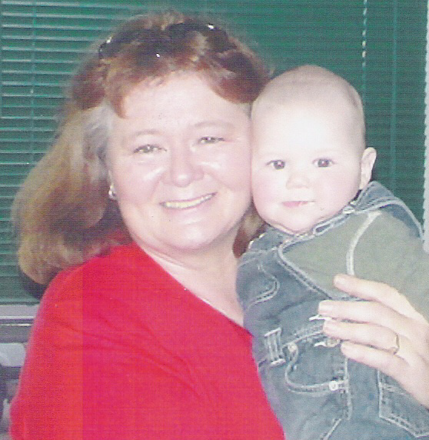


Slide 3
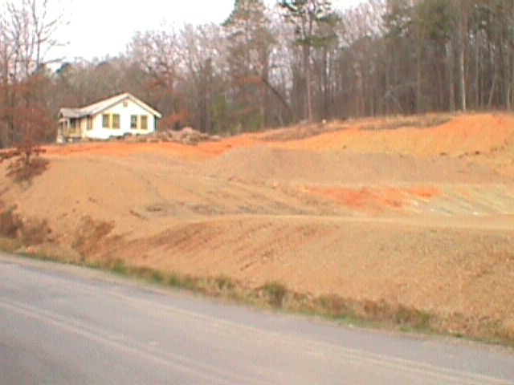
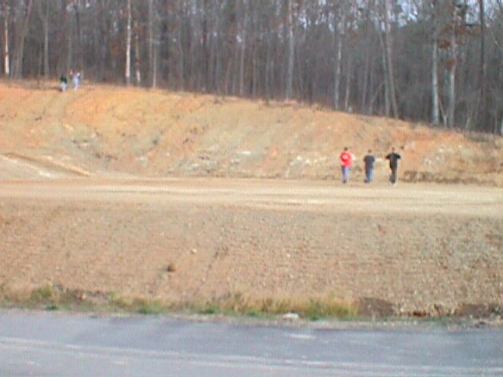
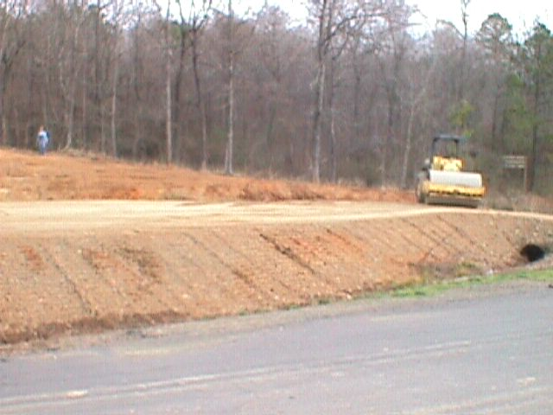
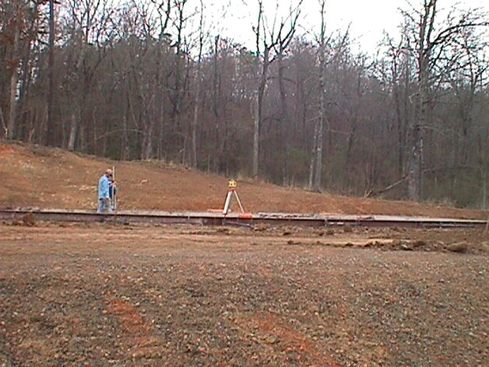
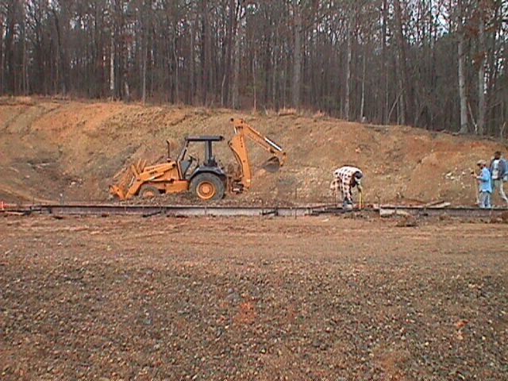
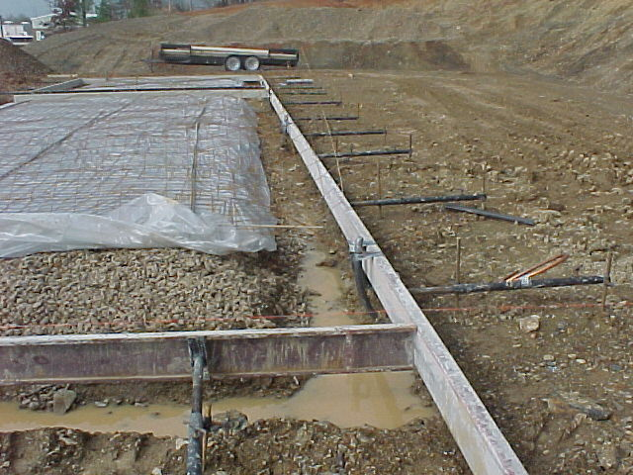
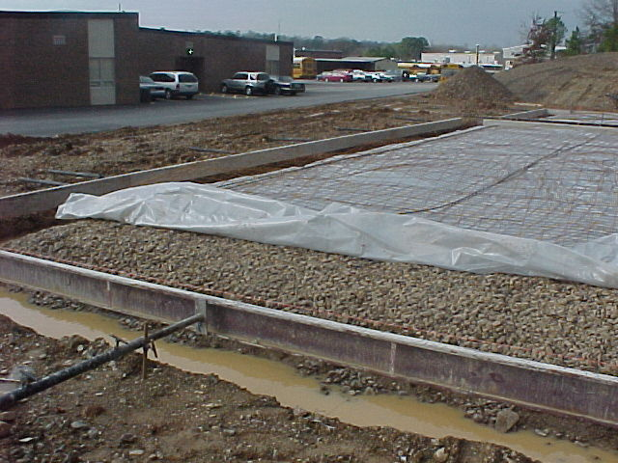
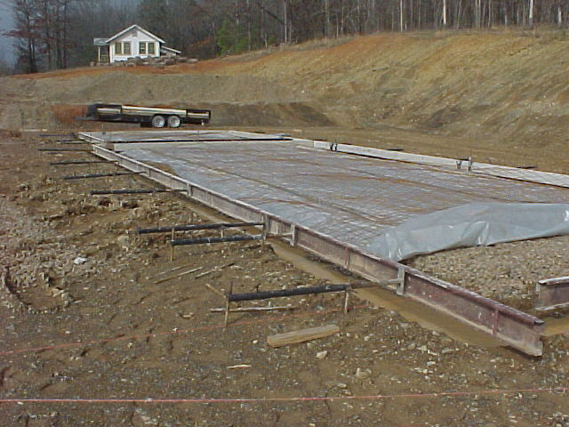
Students observe while surveyors use laser beams to make sure the surface is level before laying out the frames for the concrete foundation.

Slide 4
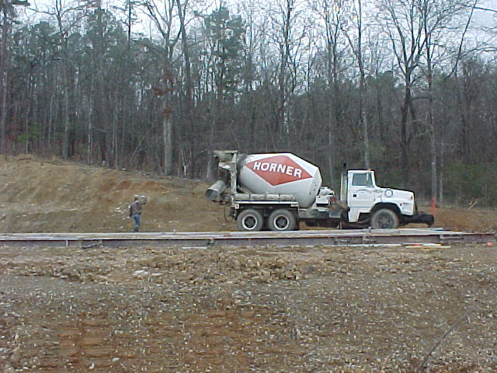
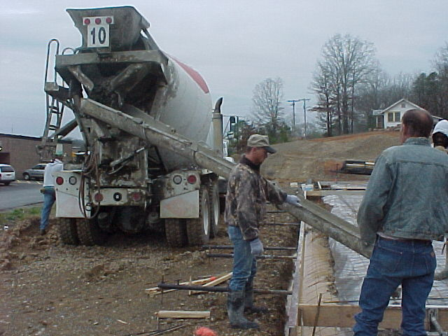
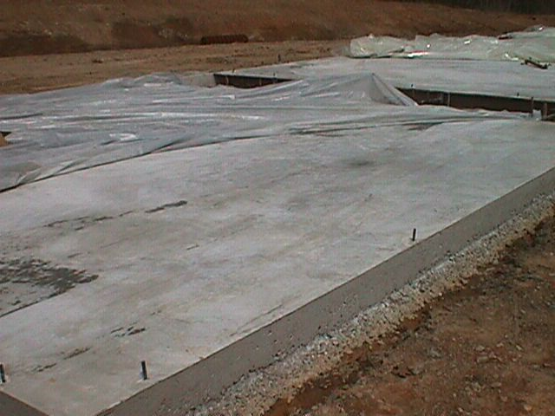
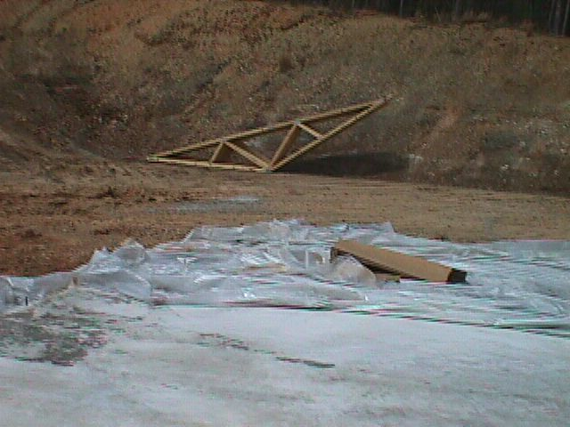
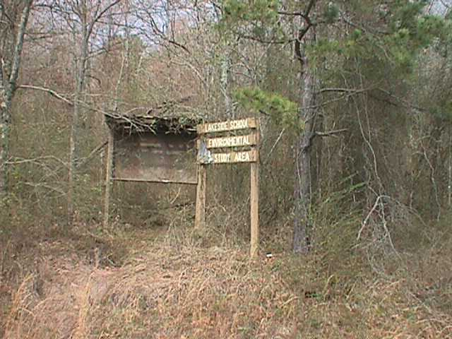
April, 2000
Pouring the slab---and the foundation takes shape.
Our environmental study area now extends into the greenhouse and aquaculture facility.

Slide 5
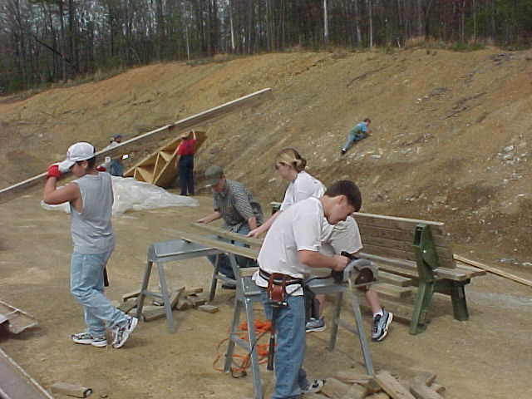
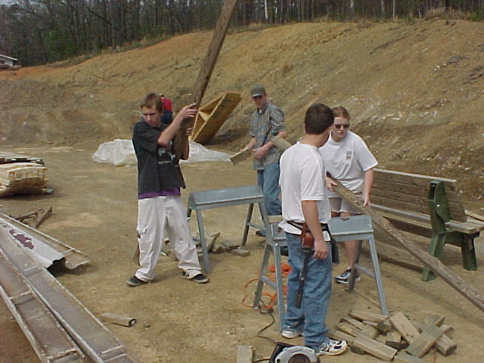
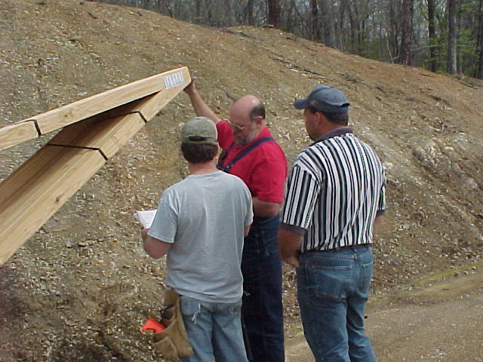
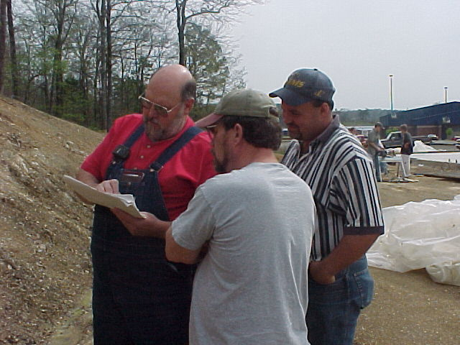
Chris Martin
Danielle Bates
Matt Cagle
Brett Sutton
We needed a few pointers on basic building construction
John Jenkins
Danny Bolding
Albert Sutton

Slide 6
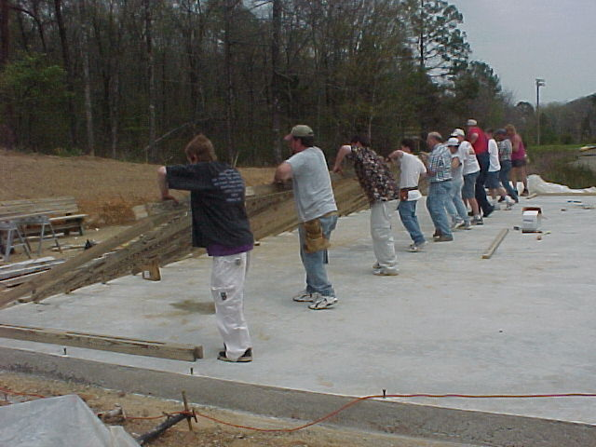
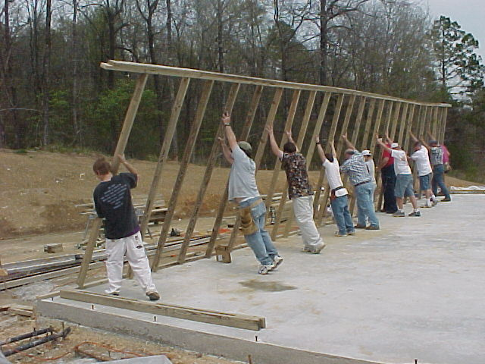
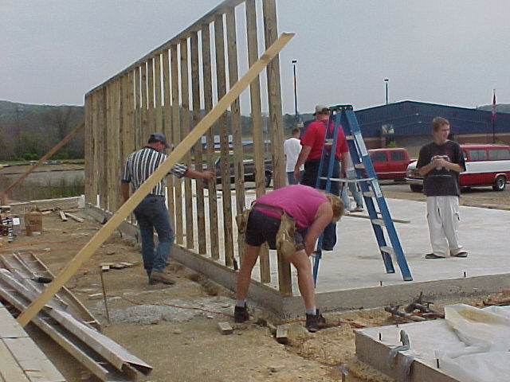
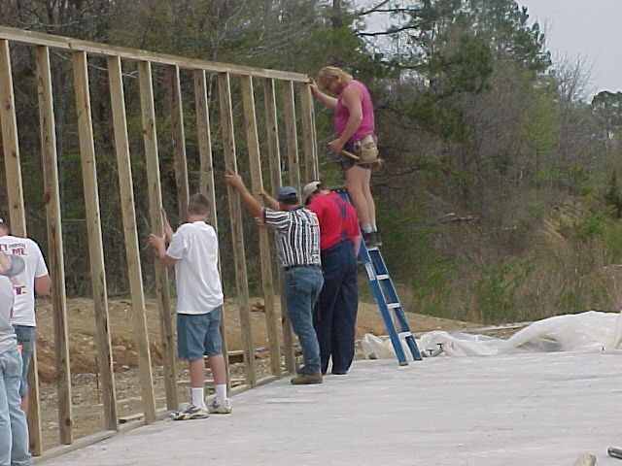
Matt Cagle
Albert T. Sutton
Chris Martin
Brett Sutton
Dean Freeman
Taylor Meeks
John Jenkins
Kathy Sutton
Danny Bolding
And the first wall goes up!
Danny Bolding
Matt Cagle
Taylor Meeks
John Jenkins
David Meeks

Slide 7
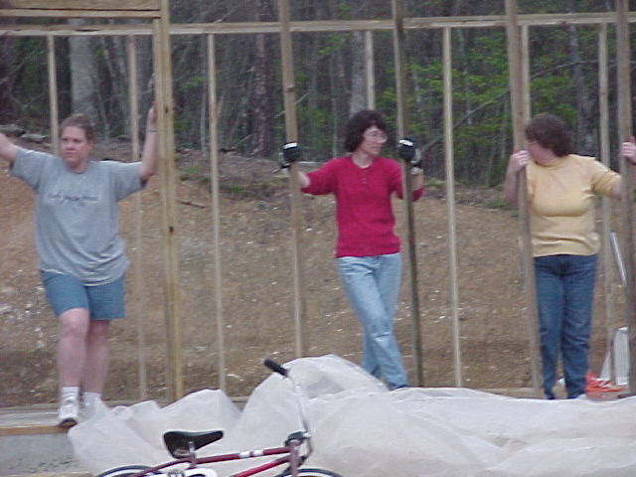
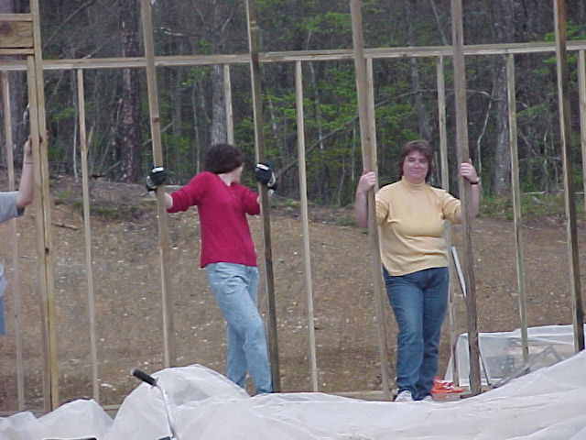
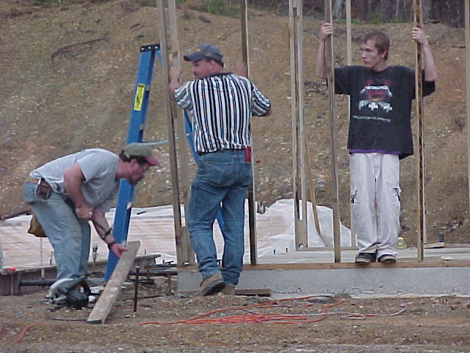
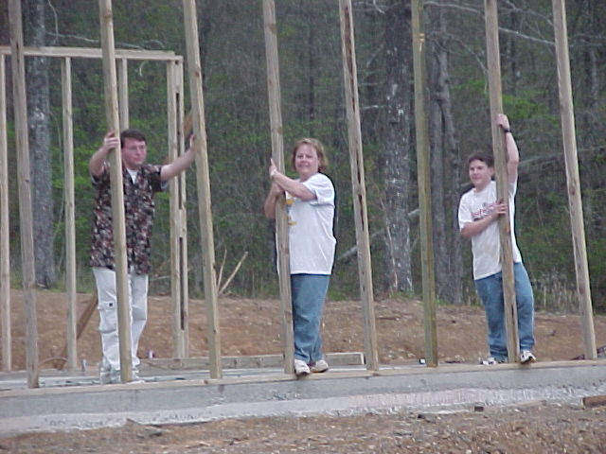
Tonja Bolding, Kaye McVey, Nikki Freeman
Are we proud or what??!?
Albert Sutton, Danny Bolding, Matt Cagle, Justin Freeman, Kathy Sutton Brett Sutton

Slide 8
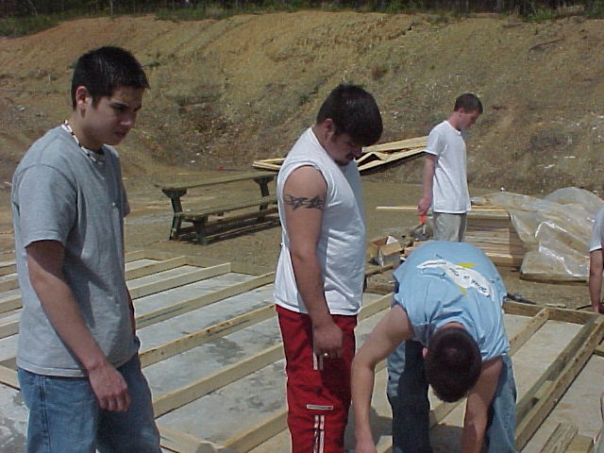
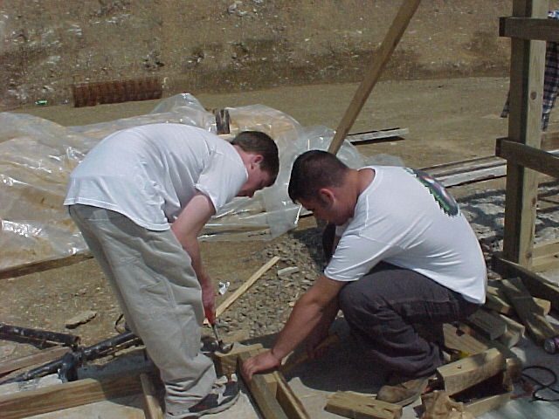
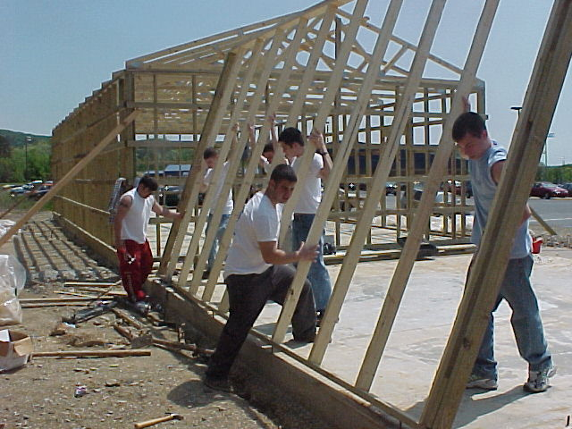
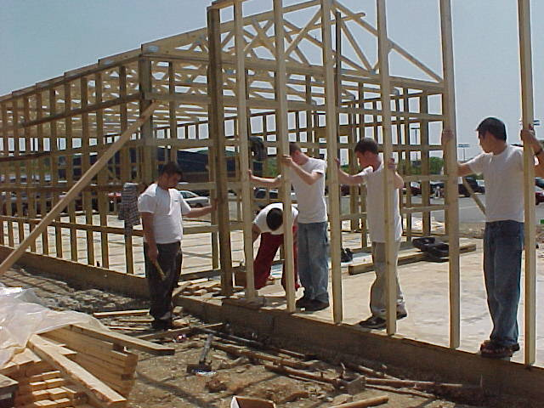
Jon Terrachi, Paul Alvarez, Clark Cherry, Brent Mingus, Chris McCrary
Real life science and math applications in action

Slide 9
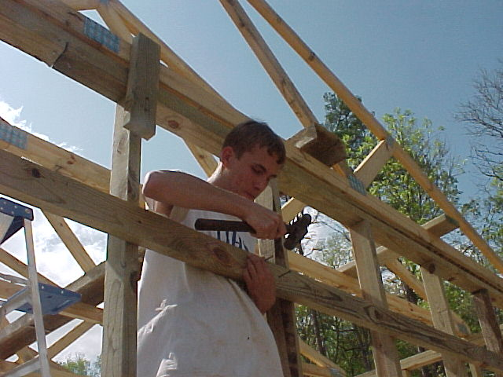
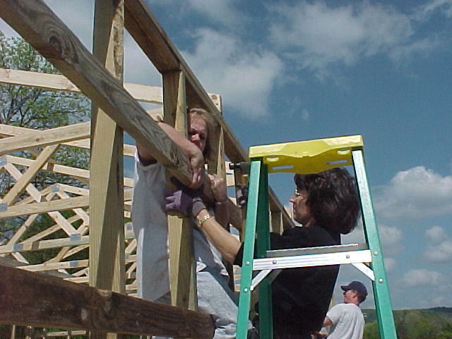
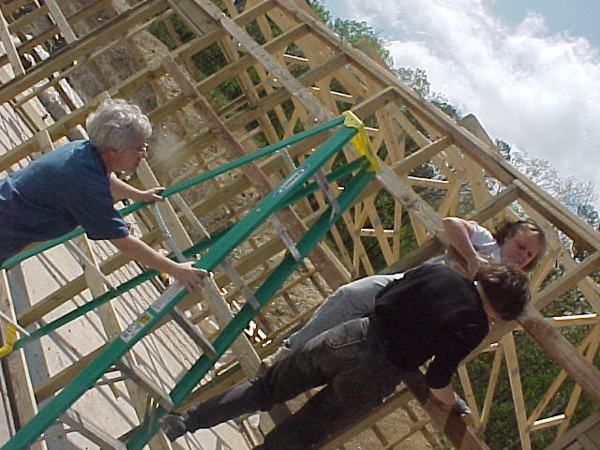
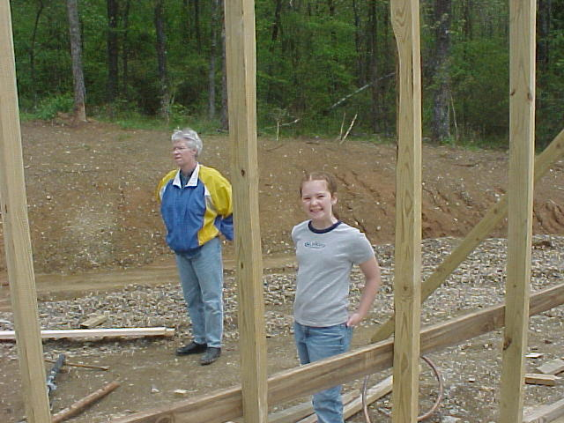
Matt Cagle adds a nailer to the outside wall
Kathy Sutton and
Kaye McVey add
one to the top row
In education, we sometimes look at learning from a different angle!
Now we are skilled labor!
What next?
Tricia and Calin Cook

Slide 10
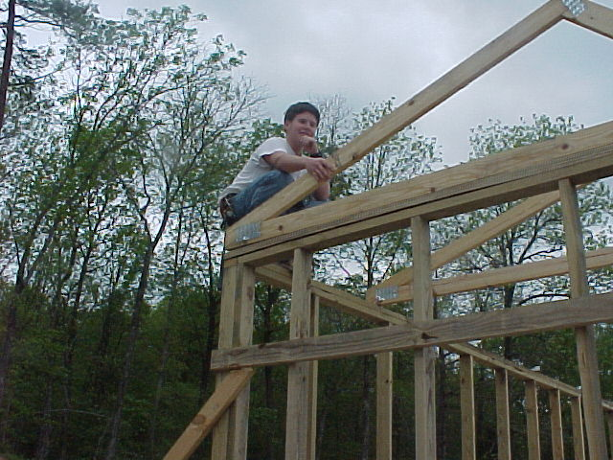
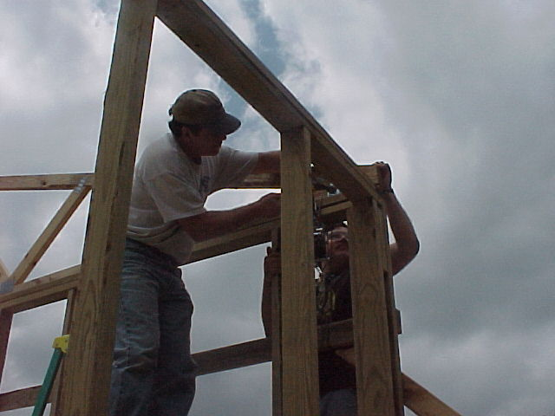
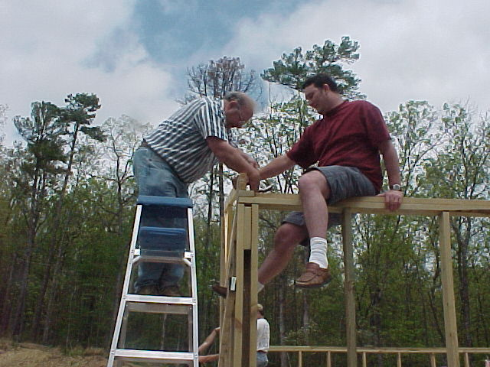
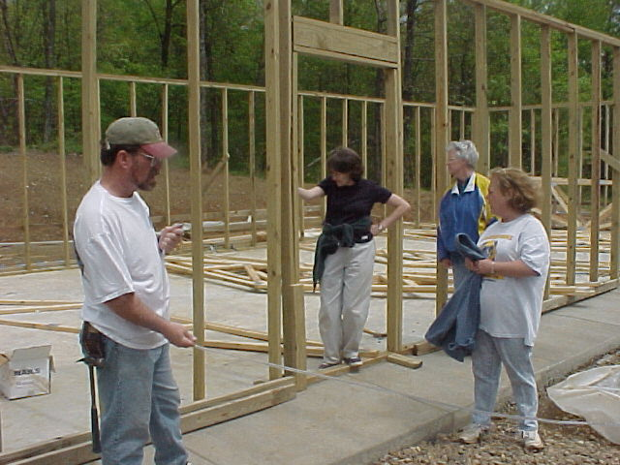
Brett Sutton waits for further instructions
Tim McVey secures the corner
Once we got “off the ground”
volunteers were scarce!!
Hey, Dean. Who really needs a ladder? (Rhett Roberts)
Ann Heirs inspects the new doorway with Tricia, Kathy, and Bert

Slide 11
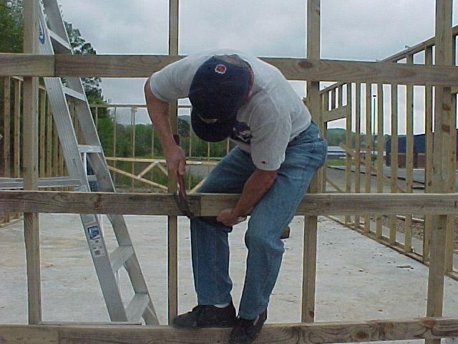
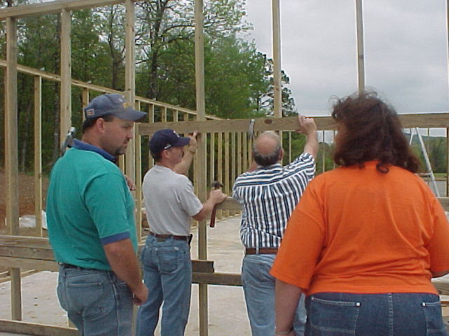
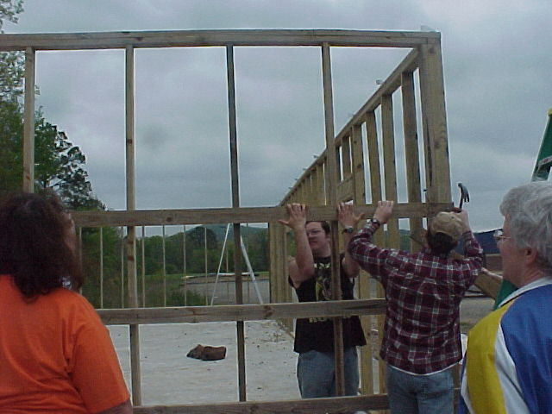
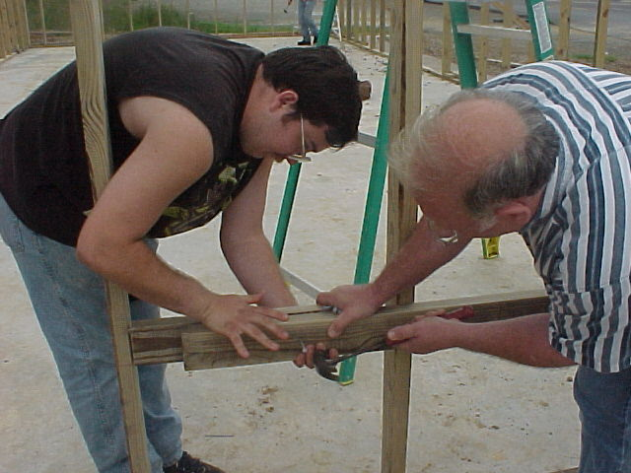
Tim McVey
Who needs a ladder anyway!
Jason and Brad Cook add a nailer to the side wall
Jason and Dean work together to finish the side

Slide 12
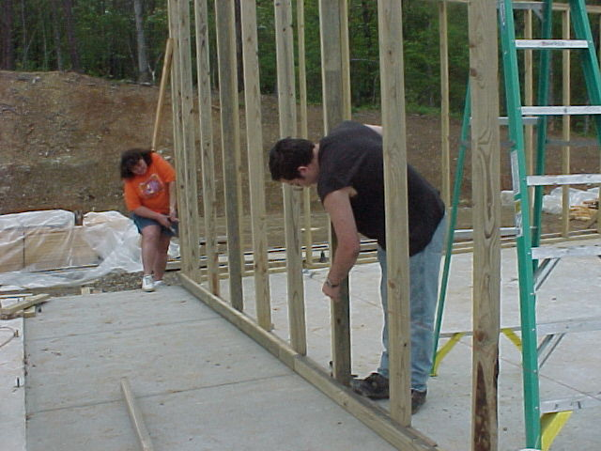
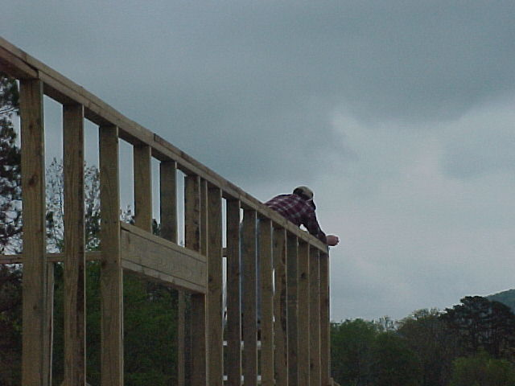
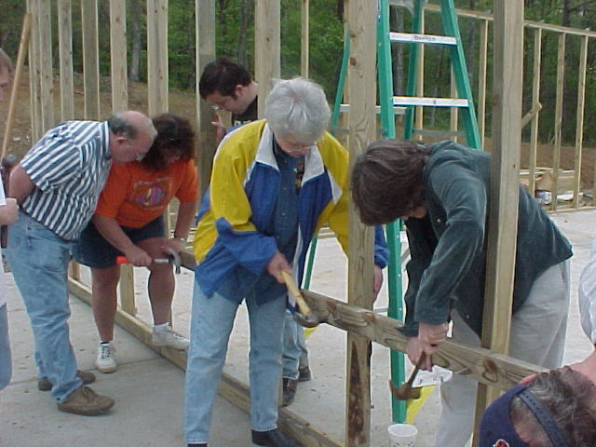
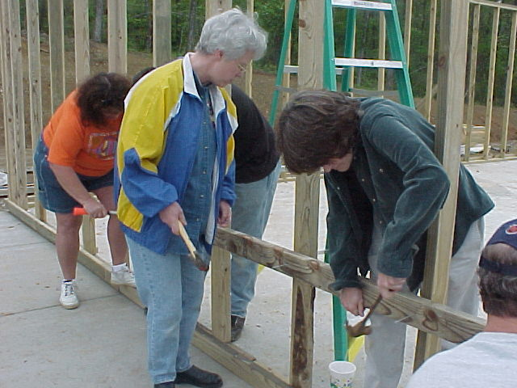
Brad Cook gets ready to set the trusses
Everybody gets into the action at ground level.
Jason and Kathey Roberts mark the wall for the nail boards
Well, Dean. Am I doing this right?
The Kindergarten teachers are showing their hidden talents! Tricia Cook and Ann Heirs

Slide 13
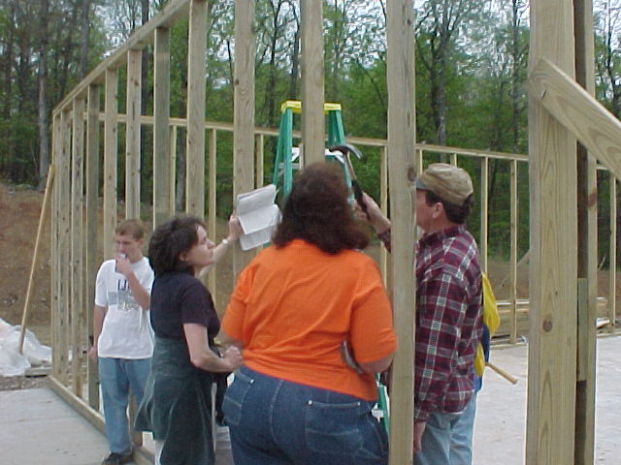
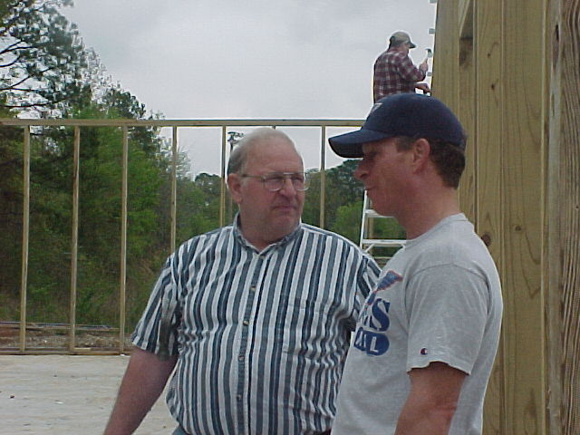
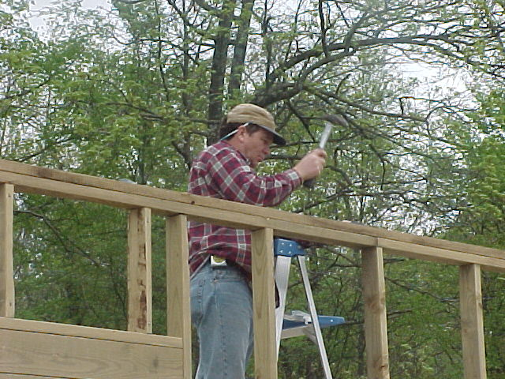

Ann and Brad discuss the next step
Dean Freeman and Tim McVey talk it over
The trusses go where? And how do you get them up there!!!
Brad Cook places the supports for the trusses while the guys lay the bottom nail boards

Slide 14







Students were involved in the construction of study area, aquaponics units, and design and construction of butterfly aviary and misting system..

Slide 15


Brett Sutton and Matt Doss assemble automated misting system

Slide 16





ABOVE: Students measure and construct aquaponics systems
BELOW: Advanced students use graphing calculators and trig functions to figure angles in construction of the butterfly aviary.

Slide 17




ABOVE: Tropical area with waterfall; enclosed butterfly aviary designed
and constructed by students, funded by Hot Springs Downtown Rotary.
Plant propagation on left and a garden area for very special kids on the right.

Slide 18


Habitat Based Learning Center
Due to the work of volunteers, the habitat-based learning center nears completion. To the left is the aquaculture area where fish and plants will be grown. To the right is the greenhouse facility which also contains space for class activities. The project was funded through a grant from the Regional EPA Office and Lakeside Public Schools.

Slide 19



Existing facility top right; garden area above; small drainage stream below
Water feature to be constructed in corner at left of aquaponics structure

Slide 20


Tropical
Biome

Slide 21







Desert
Biome

Slide 22







Teacher inservice training and student summer environmental science camp

Slide 23








TOP: Mrs. Sears 3rd graders;
MIDDLE: Mrs. Sutton’s 4th graders;
BOTTOM: Biology and Environmental Science students, 10-12

Slide 24




Mrs. Sutton shows her students how some plants are propagated.

Slide 25








Environmental Science students prepare area near atmospheric study site for soil analysis

Slide 26

Environmental Science students accept a grant for $15,000 from Pat Knighten, Education Director for the Arkansas Game and Fish Commission to continue development of the schoolyard habitat area.

Slide 27





Constructing an outdoor habitat
Spring, 2003

Slide 28










Slide 29










Slide 30





The Crew: Elizabeth Tillery, Corey Medlock,
Holly Millard, Mary Baker

Slide 31



Steven Runyon, Tony Torres, Lakeside High School and Takatoma Fujii from Higashi High School, Hanamaki, Japan, gather weather data after collecting the ozone readings from the ozone station at the right.

Slide 32




Entry bridge to herb gardens and planter boxes.

Slide 33



Herb gardens are surrounded by natural gravel walkways and split rail fencing separating a small stream. Composting area at bottom right.

Slide 34




Blocks were
used in wet
areas; student
artwork used
to represent biomes; ceramic
tile designed by LHS and Japanese students.

Slide 35



Three natural springs provide a constant supply of water for our wetland area except during high summer months. This area provides a breeding zone for 4 species of frogs and salamanders.

Slide 36



Raised planter boxes for student experiments are barrier free as is the rest of the outdoor area. The large compost tumbler is used to recycle organic matter.

Slide 37



Hardwood forest area above the habitat has pathways marked with fallen limbs and natural gravel. And, of course, the guys had to have make a faster way down!

Slide 38



Flowing water in front of the habitat provides native plant life for monarchs, tadpoles, crayfish, birds, small mammals and even a snake of two!

Slide 39




Monarchs are caught, sexed, tagged, recorded, and released to continue their journey prior to construction damage in 1998.
Monarch Migration
Lakeside High School October 1-5, 1999
Monarchs are caught, sexed, tagged, recorded, and released to continue their journey

Slide 40

Monarchs are now returning to the area and ten were tagged in the fall of 2005, this one by Josh Hopkins.

Slide 41



The final major project is completing the pond with water feature. A small garden pond has grown into a 21’ x 28’ pond with sampling platform.

Slide 42


A small pergola was constructed near the pond area. Construction has begun on the observation platform and walkway to be placed in the pond.
The barren area in the northwest corner will have numerous types of bird feeders as well as a privacy wall for viewing birds.

Slide 43



A variety of flowering plants can be found in the greenhouse throughout the year. Pond plants are also placed here through the winter months.

Slide 44






Slide 45





Slide 46





Slide 47





Slide 48






Slide 49
“. . . . .in the wilderness is the preservation of the world.”
Henry David Thoreau
Lakeside Habitat Based Learning Center
School Yard Habitat Program
“Bringing students and their environment closer together”

Slide 50
Kathey A. Roberts
Lakeside High School
2871 Malvern Avenue
Hot Springs National Park, Arkansas 71901
Kathey_Roberts@LS1.DSC.K12.AR.US

