Slide 1
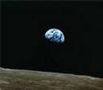
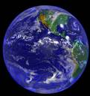

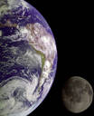
As seen from a view in Space, Earth is but a small, blue-green orb, surrounded by a sea of darkness.

Slide 2


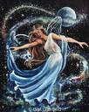

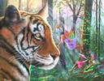
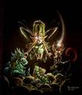


As seen from the view of a Child, Earth is a place of enchantment and wonder.

Slide 3







As seen from the view of a River, Earth is a maze of canyons yet to be traveled.

Slide 4

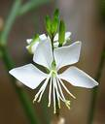













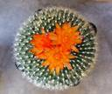

As seen from the view of a Flower, Earth is a kaleidoscope of vibrant color.

Slide 5


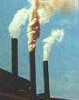

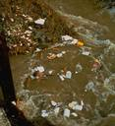
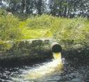


As seen from the view of Pollution, Earth is suffocating, strangling, battered, and dying.

Slide 6

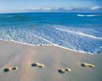


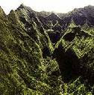

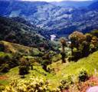
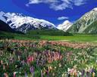

Open Your Eyes
You Can Change the VIEW

Slide 7
Leave the Earth A Better Place,
EVERYDAY!
It doesn’t cost a thing to be the caretaker of our home.

Slide 8
Welcome to a Whole New World of Science
where:
You will succeed
All your senses will be challenged
You will face the impossible dream with a solution
You will become more than you are now
You will grow in respect of the world around you
You will make a difference today, tomorrow, and in the years to come
You will become a conscious consumer
You will experience environmental science personally and your life will change

Slide 9
CROSSING BOUNDARIES:
THE ENVIRONMENT AND CONFLICT
Overview:
Physical and political boundaries play an important role in the world. They are conventions that have been created, adapted, and/or devised by nature and humans. So too, are a wide variety of other boundaries. These boundaries can act as national and/or international assets, but they can also act as impediments that restrict or prohibit the flow of resources, commerce, or intellectual property, or barriers that isolate people and divide nations. Finally, they can be the source of international compromise, cooperation, or conflict. Many boundaries play an important role in issues pertaining to environmentalism, epidemiology, and discord that might range from trade wars to military confrontations to the extinction of an eco-system. In this course, you will learn about boundaries as they apply to matters of pollution, disease, and conflict within the continent of countries and community members of the greater environmental international community that binds us all to the planet earth.

Slide 10
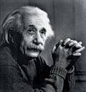
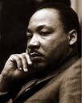
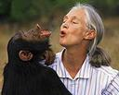
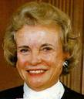

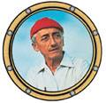
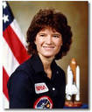

You Have The Power To
Albert Einstein/
Science Thinking
Jane Goodall/
Animal Behavior
Martin Luther King/
Civil Rights
Be The Face
Of Change
Sandra Day O’Conner/
1st Female Justice
Mother Teresa/
Unconditional Compassion
Jacque Cousteau/
Ocean Exploration
Mohandas K. Gandhi/
Social Equality
Sally Ride/
1st Female Astronaut

Slide 11

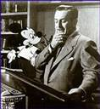

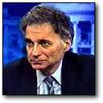
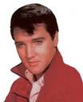


Insert your photo, your name, and your gift to the world
Kelly Clarkson/
1st American Idol
Walt Disney/
Animated Movies
Florence Nightingale/
Nursing
Ralph Nader/
Consumer Conscious
Elvis Presley/
Rock and Roll
Christiaan Barnard/
1st Heart Transplant
The Beatles: John, Paul, George and Ringo/
British Music to America

Slide 12

Be a Face of Change
For A World That
We Can All Share

Slide 13
“Earth is our only suitable habitat. Earth/Environmental Science’s task is to discover and capture its horizons in order to understand how people live and work and utilize resources. This understanding is more urgently required than ever for all students because of new global realities—the interconnected, integrated, and interdependent character of our lives.”

Slide 14
Objectives:
Students will
Ascertain (think about) the origins, nature, and current status of contemporary issues that fall within the topics of environment, disease, and conflict in a variety of eco-system models and the members of the international community;
Research and analyze the various types of boundaries and the impact that they have on the environment, disease, and conflict;
Express informed opinions about the degree to which boundaries act to create, prolong, and potentially solve or act as impediments to solving issues related to the environment, disease and conflict;
Write a series of two or three commentaries that educate you and your family about an issue involving the environment, disease, or conflict, explain how a boundary or boundaries have created, prolonged, solved, or impeded the solution of the issue, and offer a potential solution to the issue if it has not already been resolved.
Design models, create illustrated graphic multi-media presentations, explore solutions, demonstrate your knowledge and understanding of eco-systems through the mediums of art, literature, graphics, mathematics, language and physical interaction.

Slide 15



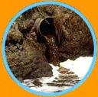

Open Your Eyes
Before it is too late to
change the view

Slide 16
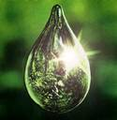
Change takes place with one drop at a time, one step at a time, one heartbeat at a time, one idea at a time, and with one person at a time.

Slide 17
Welcome to Earth/Environmental Science
Welcome to a year of CHANGE for your mind, your soul, your body, your consciousness, your interaction with the earth you live on and the way you behave from this day forth with all living things around you.
Welcome to my world and an adventure in learning that will CHANGE you if you will free yourself of the past and look into the future.

Slide 18
Environmental Science Requires
Critical Thinking Skills

Slide 19

How Do I Develop Critical Thinking Skills?
Understand the question or problem before you: Who, What, When, Where, and How
Understand the context of the language of the problem: 1st, 2nd 3rd person, past, present, future tense
Examine a question or problem from more than one angle, more than one view, more than one perspective: examine from 6 dimensions
Try more than one solution: have options
Open your mind to endless possibilities; even those that push the envelope of thinking: there’s more than one way to skin a cat!

Slide 20
Question #1:
If you knew a woman who was pregnant, who had eight kids already, three who were deaf, two who were blind, one who was mentally retarded, and she had syphilis, would you recommend that she have an abortion?

Slide 21
Question #2:
It is time to elect a new world leader, and only your vote counts. Here are the facts about the three leading candidates
Candidate A:
Associates with crooked politicians, and consults with astrologists. He has had two mistresses. He is a chain smoker and drinks 8-10 martinis a day.
Candidate B:
He was kicked out of office twice, sleeps until noon, used opium in college and drinks a quart of whiskey every morning.
Candidate C:
He was a decorated war hero. He is a vegetarian, does not smoke, drinks an occasional beer and never cheated on his wife.
Which of the candidates would be your choice? And why?

Slide 22
Candidate A: is
Franklin D. Roosevelt
Candidate B: is
Winston Churchill
Candidate C: is
Adolph Hitler

Slide 23
And by the way, the answer to the abortion question: If you said yes the woman should abort the pregnancy, you just killed
Ludwig Von Beethoven.

Slide 24
Just as you have learned today from these two critical thinking problems, things are not always what they seem to be. Successful Problem Solving requires us to investigate, to explore, to analyze, to evaluate, to hypothesize, to observe, to record details, to discover, to uncover, to relate, and to use careful scientific methods when solving for the unknown; applying not only knowledge but also common sense.
This is your challenge in Earth/Environmental Science
each and every day – think critically about
the earth and yourself. Use your
knowledge, skills, and resources (common sense) to be SUCCESSFUL!

Slide 25
Classroom Guidelines to Success
(REACH)
R- RESPECT:
The time we share to learn
The teacher’s job to educate you
Your classmate’s rights to be successful
E- ENERGY:
Bring this to class each day
Share this with your family as you learn
Carry this with you into your adult life to make changes
A- ATTITUDE:
Curiosity and discovery are the only attitudes allowed in Science Class
Leave the bad attitude outside the doors and forget to pick it up as you leave
C- CHANGE:
Change begins within each of us
A better world begins when you look in the mirror each day and ask “ Can I make
a difference today for myself, for someone else, or for the environment that will
benefit the world tomorrow?”
Every change no matter how big or how small is significant and makes a
difference
H- HOPE:
Hope for the best and strive for the good of all – survival of our species after all is
worth the effort

Slide 26

3 D’s To Succeed
Desire: TO BE A FORCE OF CHANGE
Determination: TO NOT QUIT
Dedication: TO A WORTHY GOAL

Slide 27



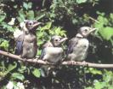




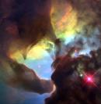
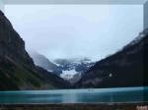
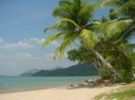

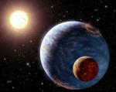
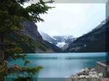
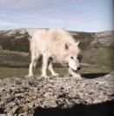
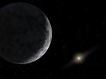
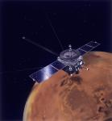

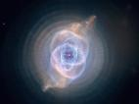
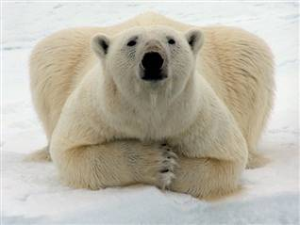
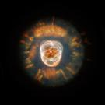
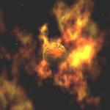


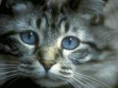



Environmental Science will STRETCH your mind and open your thinking to:
What IF?

