Slide 1
Eco
Tipping Points
A New Paradigm for
Strategic Environmentalism
Gerry Marten
East-West Center

Slide 2
The problem with environmental problems
Overwhelmingly complex (hard to know what to do)
Overwhelming in scale
Overwhelming social and ecological forces
Attempts to solve the problems: “swimming against the current”

Slide 3
The problem with environmental problems
Lots of “doom and gloom”
Not much about what we can do to really make a difference

Slide 4
“Tipping point”
In 1950s, used by a few sociologists to indicate thresholds for social change
In 2002, popularized by Malcolm Gladwell’s book to refer to an idea “taking off”
Recently used to refer to a “point of no return” in global warming and climate change

Slide 5
I use “Eco Tipping Points” to refer to a part of the human environment system that can set in motion a cascade of changes that transform the system from sustainable to unsustainable -- or vice versa

Slide 6
“Eco Tipping Points” reflect the switching behavior of human/environment systems
Introduction of Nile Perch to Lake Victoria
Introduction of urban agricultural markets to highlands in the Philippines
Urban decay and sprawl

Slide 7
Eco Tipping Points provide a lens for
Understanding “how the world works” (Book: Human Ecology: Basic Concepts for Sustainable Development)
Identifying doable actions to turn environmental change from unsustainable to sustainable
Mobilizing powerful social/ecological forces to work for us instead of against us

Slide 8
Philippine Fisheries
Peak catch (1990): 2 million tons/yr
(compared to 12 thousand tons/yr for Hawaii)
One-half of catch from near-shore fishery (coral reef)
Traditional fishing methods:
  Hook-and-line
  Bamboo fish traps
  Gill nets

Slide 9
Fishery in trouble
Increase in fishing effort (200X in past 50 years)
Destructive fishing methods
  Dynamite
  Muro-ami
  Cyanide
  Small-mesh nets

Slide 10
Vicious Cycle
MORE
DESTRUCTIVE
FISHING
HABITAT DESTRUCTION AND FEWER FISH

Slide 11
Severe decline in the fisheries
Government regulations in early 1980s banning destructive fishing.
Regulations haven’t worked.
Fish stocks in many places now < 5% of 50 years ago
Average catch per unit effort now 3% of 50 years ago

Slide 12
The Philippine fishery didn’t collapse everywhere:
Apo Island
75 hectares
140 families
Near shore fishery
Coral reef ecosystem

Slide 13
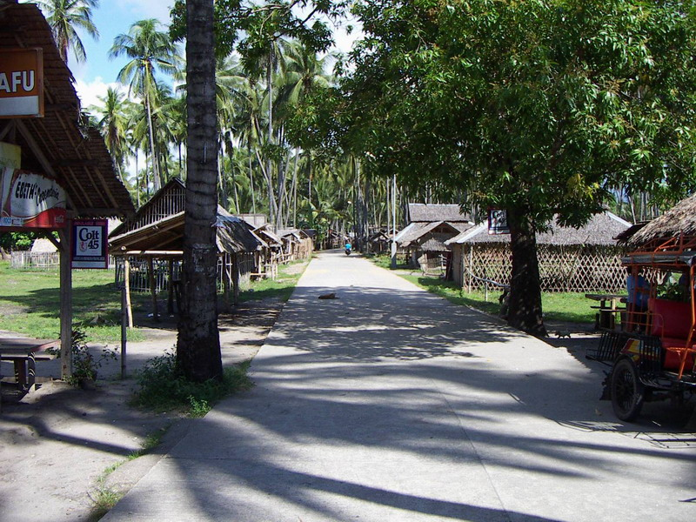

Slide 14
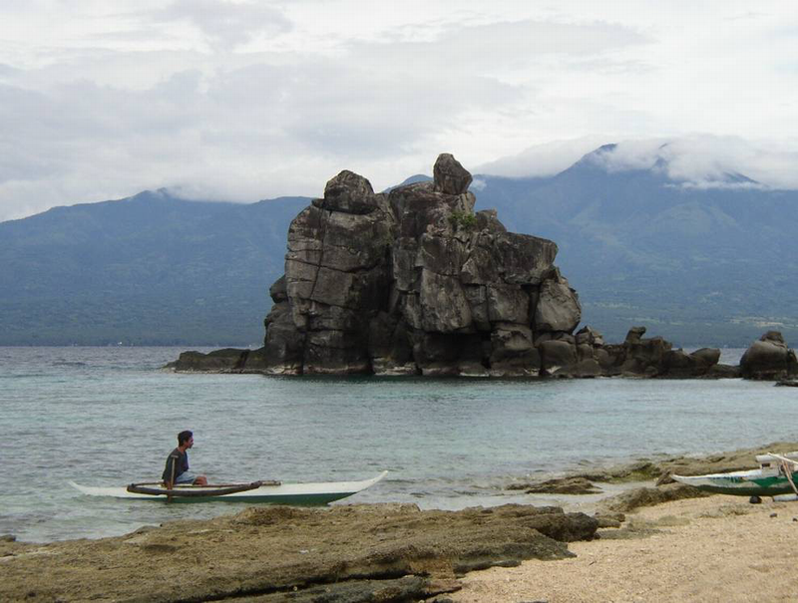

Slide 15
1980: The fishery was headed for collapse
Apo Island fishing grounds seriously depleted
Fishermen traveled long distances to find fish

Slide 16
Apo Island
Negative Tip
ETP:
Introduction of
destructive fishing
Use of destructive fishing methods around the island
Less concern for quality of the island’s marine ecosystem
Degradation of island coral reef habitat and fish stocks
More fishing away
from the island

Slide 17
Apo Island
In 1979, Angel Alcala (Silliman University, Dumaguete) proposed a no-fishing sanctuary on 10% of the fishing grounds.
Sanctuary would serve as source of fish for Island’s fishing grounds.
Fourteen families began a sanctuary in 1982 (450 meters of shoreline).
Lots of fish in the sanctuary by 1985.

Slide 18
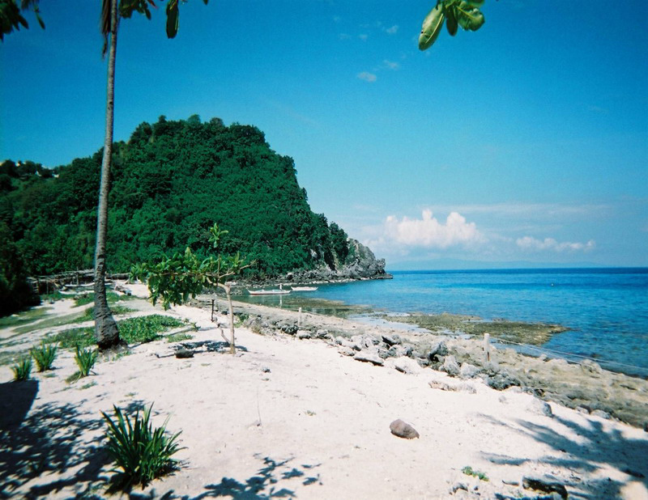

Slide 19
In 1985:
All families supported sanctuary.
Local government made sanctuary legal.
Decided to regulate the fishing grounds
  No destructive fishing methods
  Only Apo Island fishermen allowed to use fishing grounds
Created a volunteer “marine guard” to enforce the regulations

Slide 20
Consequences of marine sanctuary and regulation of fishing grounds
Large increase in fish stocks on fishing grounds within 10 years
Fishermen could fish almost entirely at home (less work)

Slide 21
Virtuous cycle:
“Success breeds success”
Improvement of coral reef habitat and fish
stocks → Management experience,
commitment, pride → Better management
→ Improvement of coral reef habitat and
fish stocks

Slide 22
Spin-offs
Tourism (diving, snorkeling) → Money → Improvements to village infrastructure and education
Village organization
  Fisheries management
  Women’s groups

Slide 23
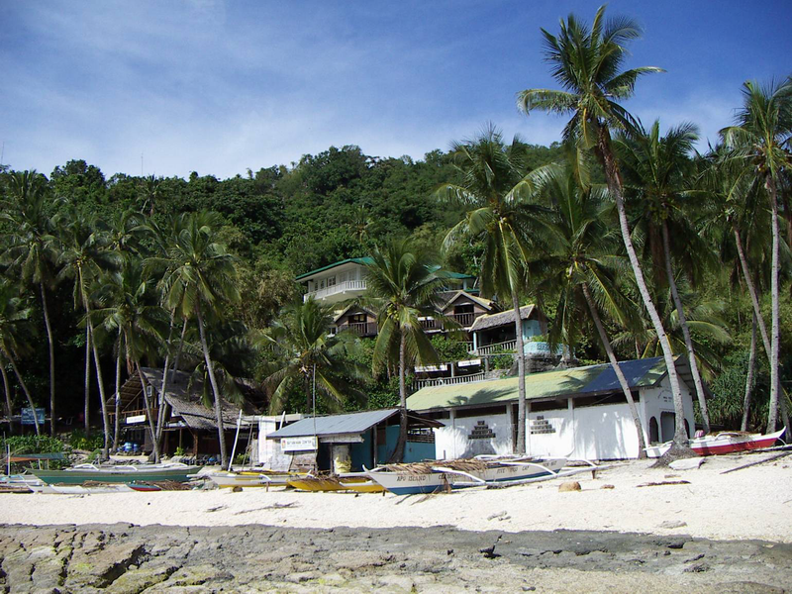

Slide 24
“Lock-in”
Ecological consciousness
Tourism regulated to prevent damage to fishery and marine ecosystem
Family planning so they don’t overrun fisheries in future
Education of new generation
  Cherish Island’s marine ecosystem
  Ability to cope with challenges from outside world

Slide 25
Apo Island
Positive Tip
ETP:
Marine sanctuary
Management of entire island’s fishing grounds
More concern for quality of island ecosystem
Awareness of management impact
Less use of destructive methods
Experience, pride, commitment
Less fishing away from the island
Recovery of habitat and fish stocks
Village infrastructure
Tourism
Cash
Education
Island population
Awareness & professional capacity
Family planning

Slide 26


Slide 27
Replication
People have come from other villages to see what is happening at Apo Island.
400 villages now have marine sanctuaries.

Slide 28
What can we learn from this story?
There were switches from one “stability domain” to another
There were levers (catalytic actions): “Eco Tipping Points” (Small changes that set in motion a new direction for change in the larger eco-social system).

Slide 29
Three act play
Act 1: Sustainable.
Act 2: Negative tip – Change from sustainable to unsustainable.
Negative tipping point: Introduction of destructive fishing methods
Act 3: Positive tip – Change from unsustainable to sustainable.
Positive tipping point: Creation of marine sanctuary

Slide 30
Central role of feedback loops
Catalytic action: cascade of effects through the system
Vicious cycles transformed
to virtuous cycles
Additional virtuous cycles
“Lock in” – Resilience

Slide 31
A story from the U.S.
New York City (Bowery)
Negative tip: Reduction in city services
Result: Acceleration of urban decay

Slide 32
Vicious cycle
Out-migration → abandonment of properties → less taxes to city → less infrastructure maintenance, fewer city services, fewer people on streets → more crime → further decay and out-migration

Slide 33
New York City Bowery
Negative Tip
More vacant properties
Less maintenance
Fewer residents
More crime
Less income, tax revenue
Fewer people on streets
ETP:
Fewer services

Slide 34
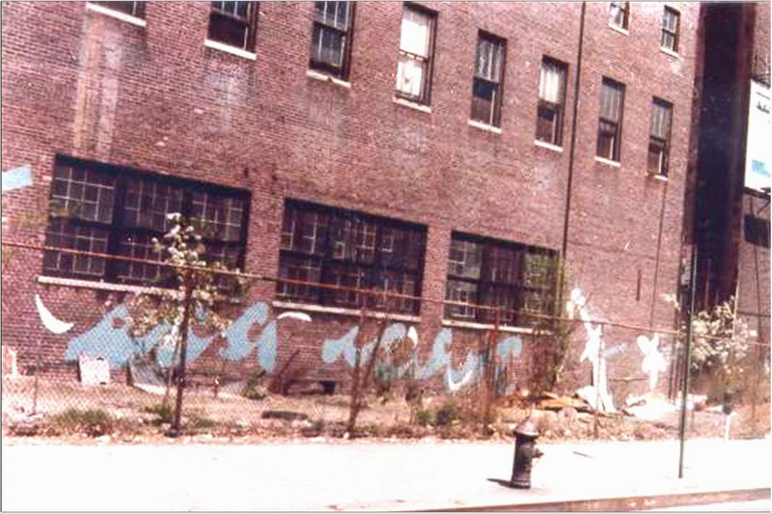
Bowery & Houston, ca. 1973
Notes:
Finally, as we move on to the 1970s, the neighborhood was becoming undercrowded.
First, the urban riots of the 1960s had destroyed a lot of buildings.
City Fiscal Crisis, teetering on the edge of bankruptcy. Around the Lower East Side, the city closed fire stations, which meant a lot of abandoned buildings burned down and became vacant lots.
The city repossessed thousands of the vacant lots. Police stations were closing, too, so many of the lots turned into trash dumps and drug markets.

Slide 35
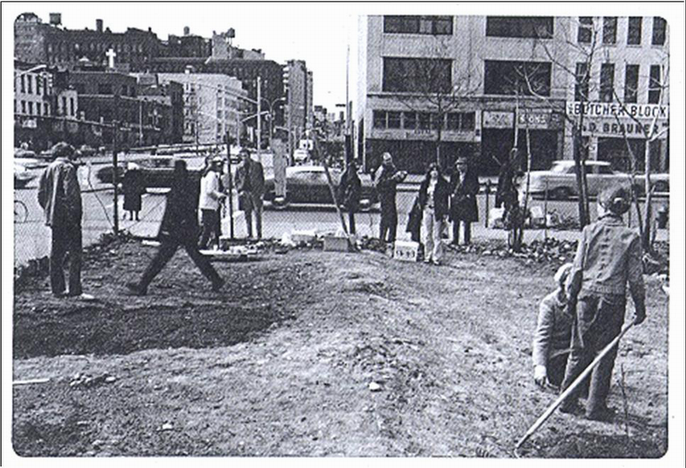
Positive Tipping point (1973):
Transformation of a vacant lot to a community garden
Notes:
Here is that same vacant lot a few months later. And thereby hangs a tale.
Liz Christy. (Local Pioneer)
Corner of Bowery & Houston.
Encounter with mother.
Cleaning out vacant lot.
Collect soil, manure, seedlings. (Creating a Commons)

Slide 36
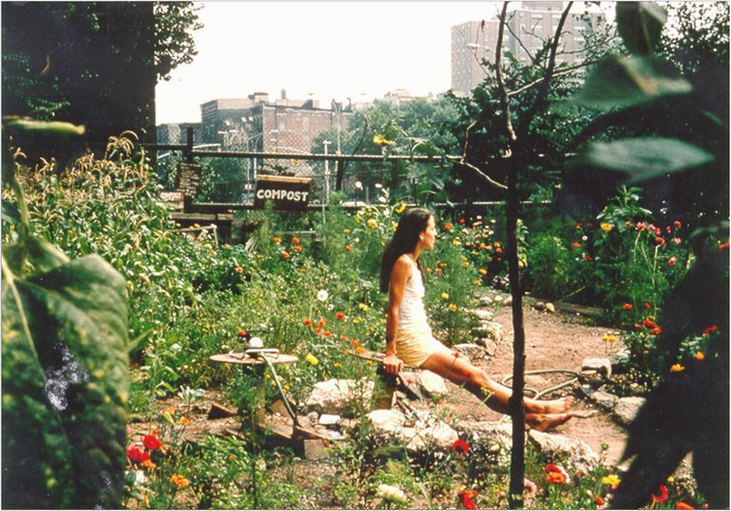
Notes:
First harvest (Short-term paybacks)
Papers pick up the story. (Channels of communication)
City grants a lease. (Institutions)

Slide 37
Benefits
Environmental goods and services
Fresh food
Green/public space
Social interaction (“Community centers without walls”)
Recycling

Slide 38
Positive tipping point:
Community gardens in vacant lots
More and better gardens → more neighborhood pride, awareness, experience, commitment → more resources and knowledge to care for them → more and better gardens

Slide 39
Positive tip
More attractive and safe neighborhood → In-migration → More resources for renovating buildings, more people on streets, more city services → More attractive and safe neighborhood

Slide 40
New York City Bowery
Positive Tip
Fewer vacant properties
More maintenance
More income, tax revenue
Less crime
More residents
ETP: Gardens
More people on streets
More services
More experience, commitment
More attractive & safe neighborhood
More neighborhood awareness, pride

Slide 41
Lock-in
City government tried to sell garden lots for development after neighborhood property values increased.
Neighborhood commitment to gardens, and organizational experience managing them, gave citizens the ability to fight back.

Slide 42
Lock-in and replication
Garden supporters took legal action against the city.
The legal tenure of the gardens was consolidated.
People visit from around the world to see how to set up community gardens in their own cities.

Slide 43
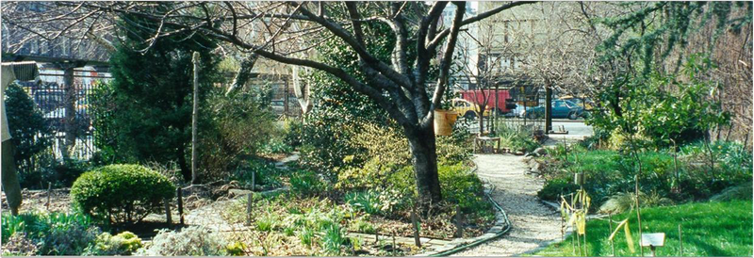
600 gardens today
Liz Christy Memorial Garden

Slide 44
Tipping point at regional level reversing urban decay/sprawl
Structured citizen participation for regional planning:
Portland
Salt Lake City
Minneapolis-St. Paul
Austin

Slide 45
Stories on the website: www.ecotippingpoints.org
In-depth stories
Capsule tales
Publications
  Journal of Policy Studies
  WorldWatch magazine

Slide 46
The stories have the same structure
Three act play
  Originally sustainable
  Negative tip: Sustainable→Unsustainable
  Positive tip: Unsustainable→Sustainable
Catalytic action: cascade of effects through the system

Slide 47
Central role of feedback loops
Reversal of vicious cycles to form virtuous cycles
Formation of new virtuous cycles
Lock-in

Slide 48
Applying Eco Tipping Points to practical problems
We can recognize environmental tipping points by hindsight.
How can we create them by foresight?
The key: Converting vicious cycles to virtuous cycles

Slide 49
Some Eco Tipping Point ingredients:
Central role of local community and persistent local leader
Outside stimulation and facilitation
Quick payback to stimulate commitment
Strong symbol to mobilize community support

Slide 50
Ingredients
Social institutions for common property resources
Social/ecological memory
Social/ecological diversity

Slide 51
Two Eco Tipping Point success stories from India
Rainwater harvest in Rajasthan
Escaping the pesticide trap
in Andhra Pradesh

Slide 52
Rainwater harvest in Rajasthan
Act 1:
Village water/forest management
Earthen dams (johad) catch rainwater runoff to percolate into ground
  Water stored in the aquifer
  No water loss to evaporation
  Underground delivery to wells

Slide 53
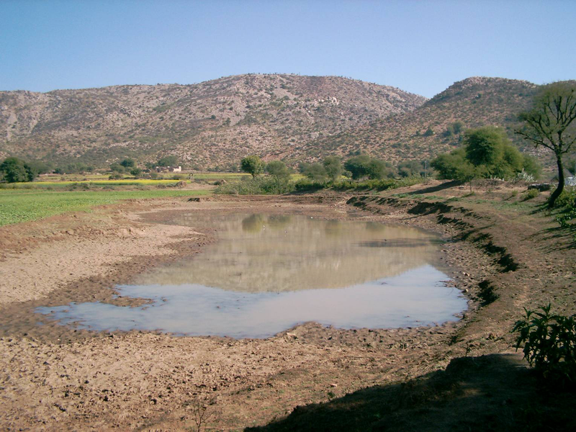

Slide 54
Act 2: The “negative tip”
Commercial logging
  Erosion
  Siltation of johads
Borewell/pump technology
Government control of water and forests

Slide 55
Vicious cycles
Less (or deteriorating) johad → Water table lower →Trees die → More erosion/siltation →Less johad
Less johad → Lower water table → Less water in wells → Decline in motivation, social institutions, technology → Less johad

Slide 56
Vicious cycles
Water table lower → Deeper wells →
Water table even lower
Less irrigation water → Agriculture declines → Men move to cities →Less labor to maintain johad → Less johad → Lower water table → Less water

Slide 57
TIPPING POINT:
LOGGING
Deeper wells
Less vegetation
Lower
water table
Less water
in wells
More
erosion &
sediment
Less
johad
capacity
Less motivation, social institutions, technology

Slide 58
Rajasthan Rainwater Harvest
Negative Tip
ETP:
Logging
Deeper wells
Less vegetation
Lower water table
Less water in wells
More erosion
& sediment
Less johad capacity
Less motivation, social institutions, technology
Less labor to maintain johad
Less irrigation water
Men move to cities
Agriculture declines

Slide 59
Spin-offs
Wells and rivers dried up.
No water for dry season crops.
Village forests gone.
Women/children worked harder and longer to fetch water and fuelwood.
  Women had little time for household and money-earning activities.
  Children couldn’t go to school.

Slide 60
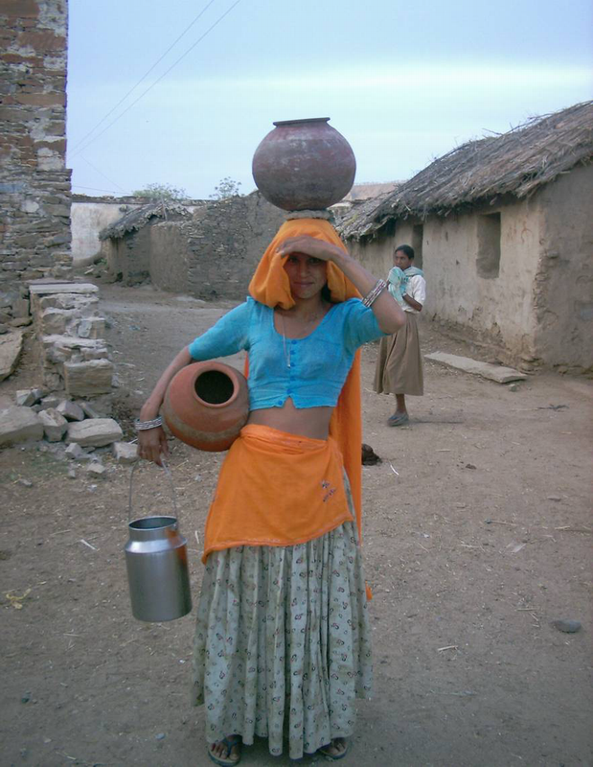

Slide 61
Solutions not working
Indian government constructed irrigation canals to carry water from distant rivers to villages.
They could only do it for a few villages.

Slide 62
Act 3: The “positive tip”
Golpapura village (1985)
Rajendra Singh of TBS (Tarun Bharat Sangh: Young India Organization) tried to set up clinic and school but told “We need water!”

Slide 63
Golpapura village
Tipping point: A single johad restored by digging out the pond area behind the dam
Water filled nearby well
Set up Gram Sabah (traditional village council) to manage restoration of more johad

Slide 64
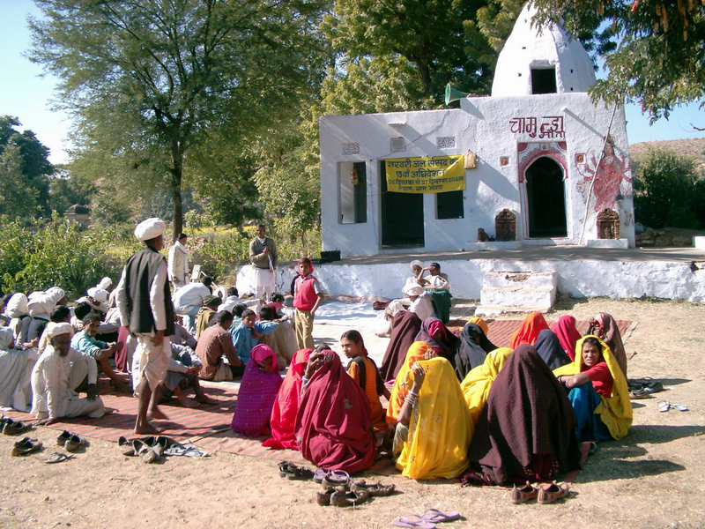

Slide 65
Consequences
The community made more johad the next year
All wells had water within a few years
Planted trees and made rules about fuelwood collection

Slide 66
Vicious cycles reversed
More success, motivation, experience, social institutions, technology
Higher water table, tree survival, less erosion/siltation
More irrigation water → More agricultural work → Men move back to village → More labor to build/maintain johad → More and better johad → More irrigation water

Slide 67
More
vegetation
Higher
water table
More water
in wells
Less
erosion &
sediment
More
johad
capacity
More
motivation, experience
TIPPING POINT:
RESTORING JOHAD AND TRADITIONAL VILLAGE COUNCIL

Slide 68
Rajasthan Rainwater Harvest
Positive Tip
More vegetation
Higher water table
More water in wells
More motivation, experience
More johad capacity
Less erosion & sediment
ETP:
Restoring johad
& traditional
village council
More labor to maintain johad
More irrigation water
Men return to village
More agricultural work in village

Slide 69
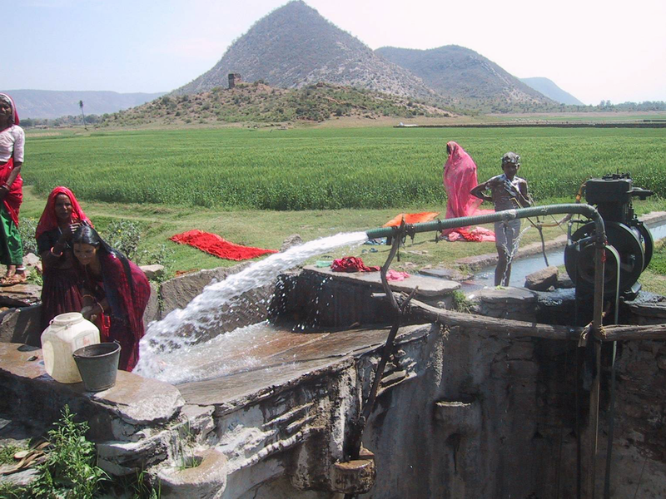

Slide 70
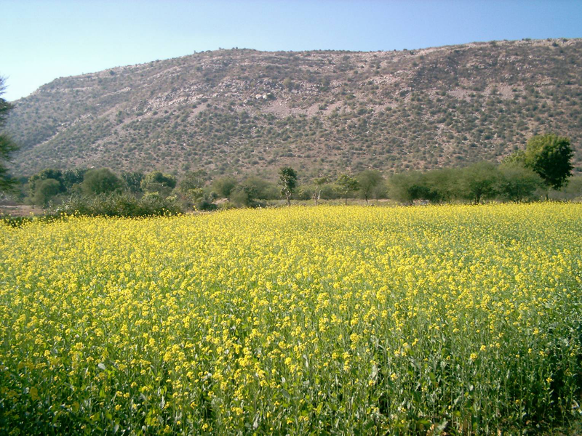

Slide 71
Lock-in:
They overcame response of the system to nullify their gains
Government claimed jurisdiction over underground water and forest land
Government concession for fishing in revived river

Slide 72
Replication
People came from many villages to see what was happening.
Johad now in 850 villages.

Slide 73
Escaping the pesticide trap in Andhra Pradesh
Negative tipping point: Introduction of cotton production 20 years ago
Production inputs provided by middlemen (“traders”): seed, fertilizer, insecticides
Inputs on credit, guaranteed market
High yields and incomes during early years

Slide 74
…Things started to unravel
Insecticide resistance and loss of natural control (birds and predatory insects)
Vicious cycles of higher insecticide applications, more resistance, and less natural control

Slide 75
Vicious cycles
  Higher input costs
  Chronic and acute pesticide poisoning
  Higher medical costs
  Increasing debt
  Dependence on middlemen
Mental disorders, despair, and suicides
“Lock in” (pesticide trap)

Slide 76
Andhra Pradesh
Negative Tip
ETP:
Introduction of cotton
Technical support from traders
More child bondage
More debt
Higher costs
More chemical pesticides
Dependence on traders
More suicides
Less education
Medical costs
Less natural control
More pesticide poisoning
More pesticide resistance

Slide 77
Positive tip
Positive tipping point: Introduction of Non-Pesticide Management (NPM)
NGO: Socio-Economic and Cultural Upliftment in Rural Environment (SECURE)
Neem, chili-garlic, cow dung/urine, trap plants, sticky boards, bonfires, bird perches, insect virus, deep plowing, pheromone

Slide 78
Positive tip
One farmer in Punukula village tried NPM in 1996
Cotton harvest as good as with chemical insecticides
Input costs much less
By 1998, entire village using NPM for cotton and other crops

Slide 79
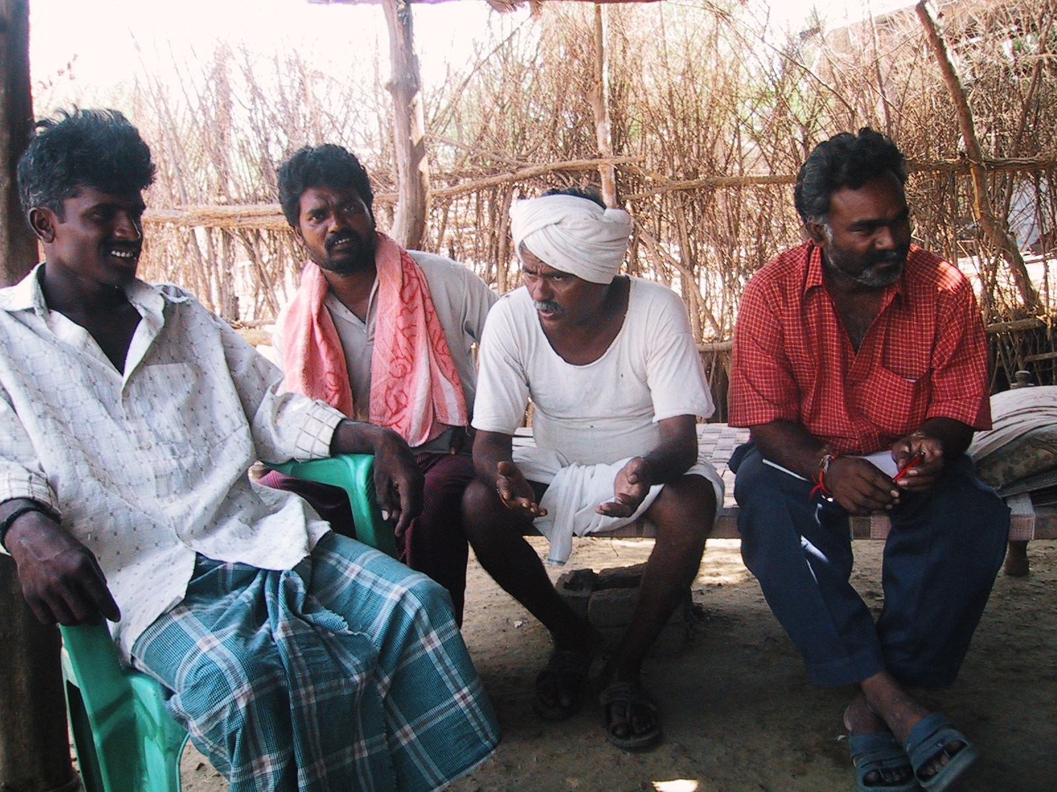

Slide 80
Cascade of effects
Vicious cycles reversed
Natural control returned
Virtuous cycles of success, confidence, and experience
Replaced chemical fertilizer with compost
Told middleman they no longer needed him

Slide 81
Spin-offs
Women have business selling neem to other villages
More money to lease land for farming and initiate entrepreneurial projects
Rescue of indentured children and school dropouts
Village is more assertive with government

Slide 82
Andhra Pradesh
Positive Tip
ETP:
Introduction
of NPM
less chemical pesticides
Less child bondage
Less debt
Lower costs
Less pesticide resistance
More education
Fewer suicides
Less pesticide poisoning
More natural control
Entrepreneurial activities & community projects
More income
Less time applying botanical pesticides
More time
Lease land
Farm more land
Farm wages increase
Labor demand

Slide 83
Lock-in and Replication
Pesticide companies tried to use influence with government to suppress Non-Pesticide Management, but not successful.
State government has asked SECURE to train agricultural extension agents in NPM.
NPM now in about 200 villages.

