Slide 1
STAKEHOLDER PRESENTATION
A reliable schedule
when the clinic
cannot pause.
Calendar Keeper turns clinic scheduling into a resource-aware service that stays useful when infrastructure does not.
Product strategy · Experience design · AI-assisted process

Slide 2
CALENDAR KEEPER / 02
02
A clinic appointment
is more than a time slot.
Practitioner
Room
Generic calendars treat every booking alike. In a clinic, the practitioner, room, equipment, and preparation have to work together.
Equipment
Prep time
One coordinated appointment
The opportunity: scheduling that respects real clinical dependencies.
The problem

Slide 3
CALENDAR KEEPER / 03
03
One product, three layers,
two entrances.
Configure by practice shape—not by nationality.
Why this structure?
RETURNING PATIENT
Fast self-service for routine changes
The shared core protects the booking logic across both experiences.
CALENDAR KEEPER
Operational visibility and recovery
Resource awareness cannot be added safely after the fact.
SHARED CORE
Resource-aware appointments
The strategy

Slide 4
CALENDAR KEEPER / 04
04
Start where the work
compounds.
THE CALENDAR KEEPER
Keep the day moving.
Staff need visibility into exceptions, dependencies, and the next safe action.
We prioritized two users whose friction is immediate, frequent, and solvable without network effects.
RETURNING PATIENT
Avoid the routine phone call.
Patients need a focused path to rebook, cancel, and check appointment status.
We did not lead with backfill or a broad marketplace: neither creates value at the first clinic without history or waitlist liquidity.
Where we start

Slide 5
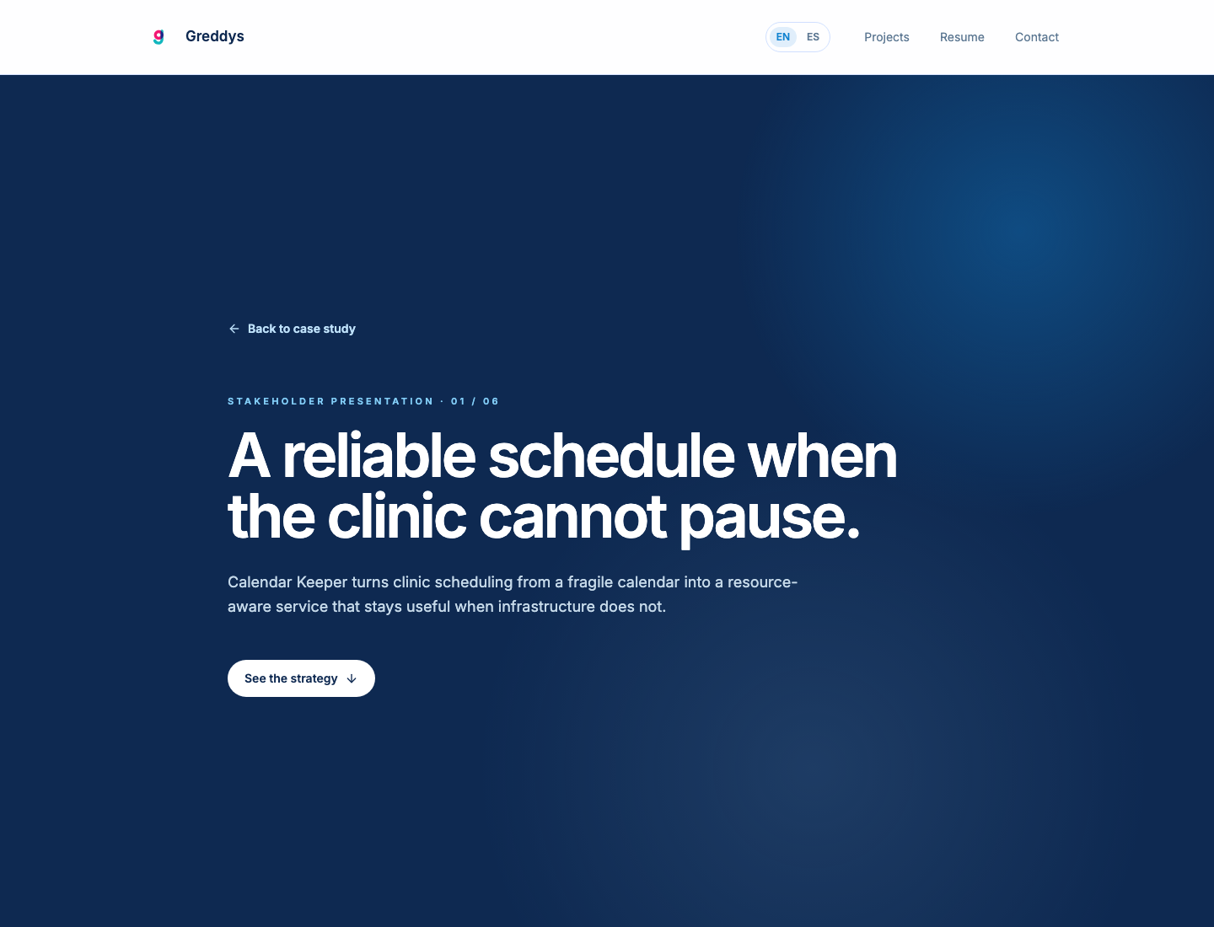
CALENDAR KEEPER / 05
05
Make both paths
legible.
The same service coordinates resources. Each user sees the part that helps them act.
Visible degraded mode
A named status and reconciliation queue replace silent desynchronization.
Prototype capture from the local Calendar Keeper concept
The service and experience

Slide 6
CALENDAR KEEPER / 06
06
AI accelerated the work.
It did not make the
product choices.
01
02
Synthesize
Expand
Clustered competitor signals, reviews, and research notes.
Generated alternative HMW directions and edge cases.
I used AI as a research, synthesis, writing, and prototyping partner. Its output was treated as material to interrogate—not evidence to accept uncritically.
03
Accelerate
Supported copy exploration and prototype iteration.
Designer decision
Priorities, safety boundaries, and the shared-core architecture remained human calls.
AI-assisted, human-directed

Slide 7
CALENDAR KEEPER / 07
07
A calm schedule is the outcome—
not just a polished calendar.
✓
Can staff resolve a sync exception without training?
✓
Do resource rules prevent rework before a booking is created?
✓
Can returning patients complete routine changes without calling?
✓
Does the experience scale from a team practice to a solo practitioner?
Calendar Keeper · Stakeholder presentation
What we validate next

