Slide 1

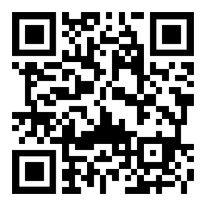
Services
Flower Orders
We’ll help you choose and arrange a bouquet — just ask the receptionist.
Housekeeping
Daily before 18:00.
Linen change — on the 3th day.
Excursions
Book excursions at reception.
Item Rental
Vases, various pillows, baby items
— available on request at reception.
Transfers
Order a transfer to the railway station or airport — details at reception.
Courier Deliveries
Couriers are not allowed on guest floors.
Orders can be collected in the lobby.
Restaurant MemET & Pir
Continental breakfast is served from 9:30 AM to 11:30 AM, starting from 950 RUB. Lunch and dinner are also available à la carte.
Luggage Storage
You can store your luggage for 24 hours on the 1st floor.
Laundry & Amenities
1 laundry powder sachet — 150 ₽ each.
Electronic
Guest Book
More than just a stay
DIP SPA ROOM
Bookings at reception.
Full list of services and useful information
— in the electronic guest book
(scan the QR code below)
Breakfasts, flowers, excursions —
live like at home, relax like in a hotel.
All services — within reach. Just ask at reception!

Slide 2

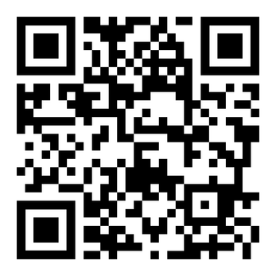
A space where art, the city, and people meet.
You are not just guests of the aparthotel — you are co-creators of the atmosphere, witnesses to cultural events, and part of the visual story of ARTSTUDIO.
We truly appreciate it when you share your photos
and tag us on social media!
wi-fi
network : ARTSTUDIO NEVSKY
ARTSTUDIO Nevsky
— a space of comfort and inspiration.
A unique aparthotel for living, working and leisure.
{{PASSWORD}}
password:
The code is secure and unique
— valid only for your room.
merch
{{QR_WIFI}}
Signature pajamas, candles, and souvenirs —
all available at reception.
Stay connected with ARTSTUDIO
Contacts, social media, and assistance
— all available via QR

