Slide 1
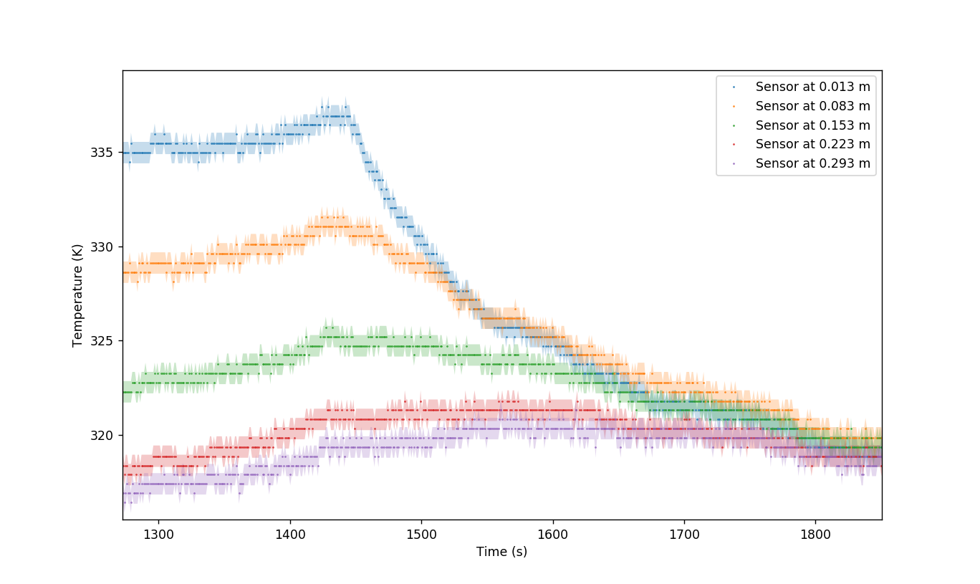
Cooling
Heating

