Slide 1


Bobbie Berkowitz, PhD, RN, FAAN
Dean and Mary O. Mundinger Professor
Sr. Vice President, Columbia University Medical Center

Slide 2

Our Discussion this Morning
Setting a framework for policy and advanced practice.
Review the health “environment” and it’s determination on how healthy we are as a nation.
Examine how regulation impacts health and advanced practice.
Analyze the policy barriers to advanced practice.
Explore the options available to support advanced practice and scope of practice.
Your thoughts.

Slide 3
How Healthy Are We?
What determines health?
  Socioeconomic status
  Education
  Physical environment
  Occupation
  Social support
  Health behavior
  Genetics
  Geographic location
  Health services

Slide 4
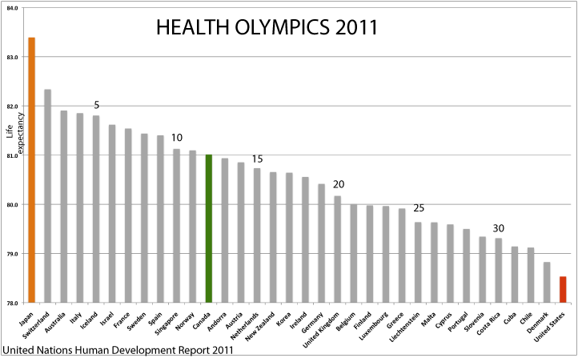

Slide 5
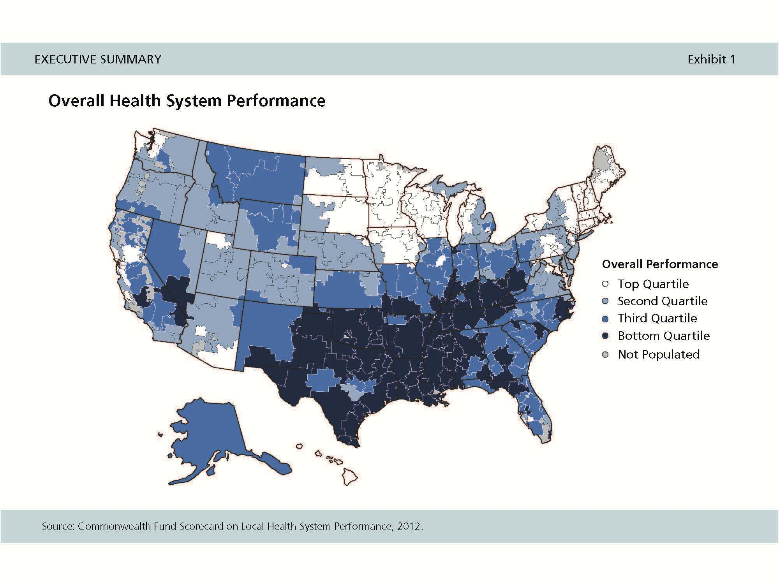

Slide 6
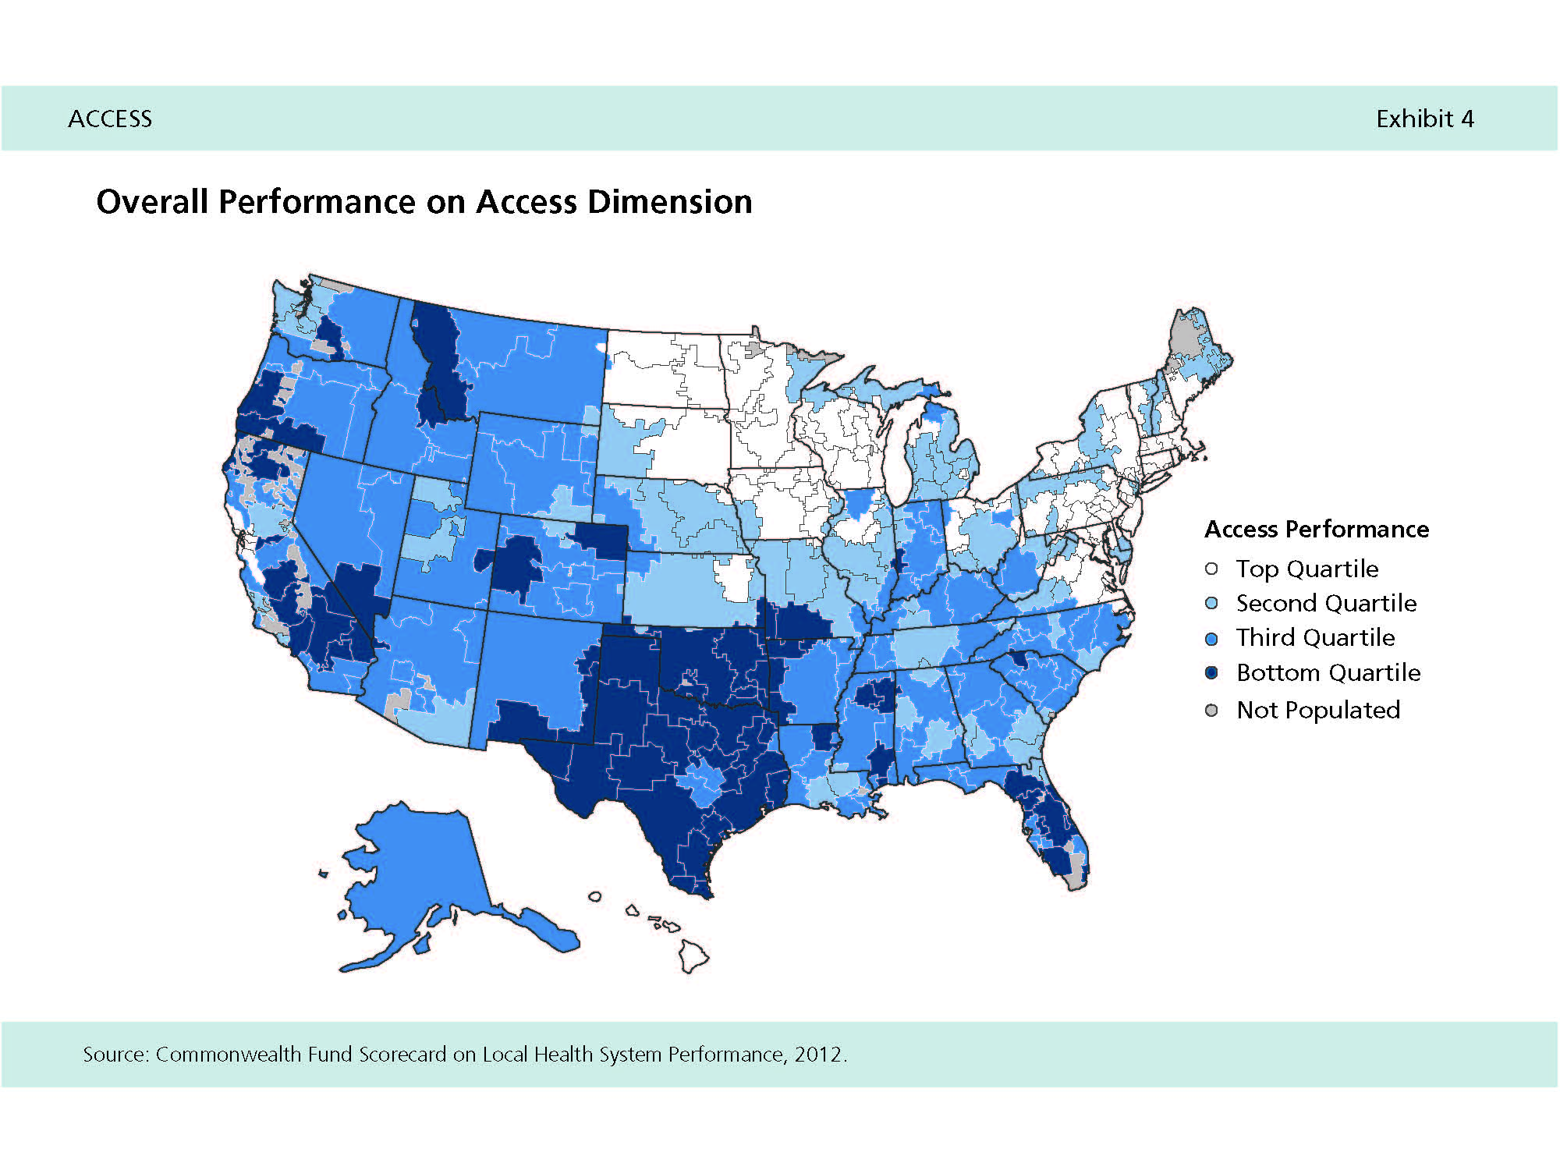

Slide 7
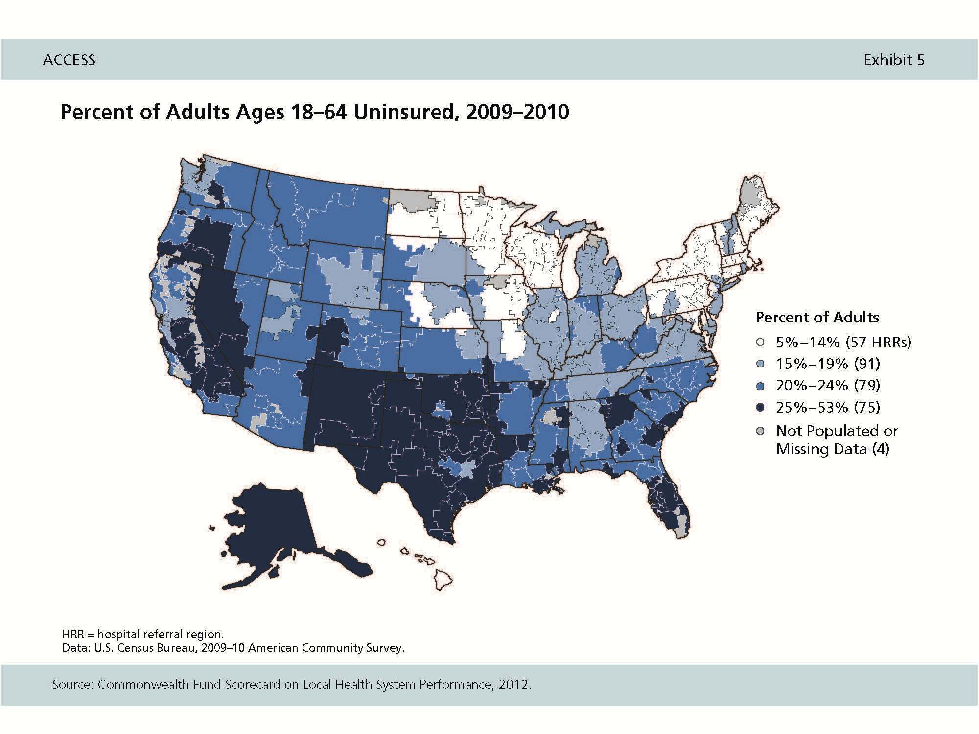

Slide 8
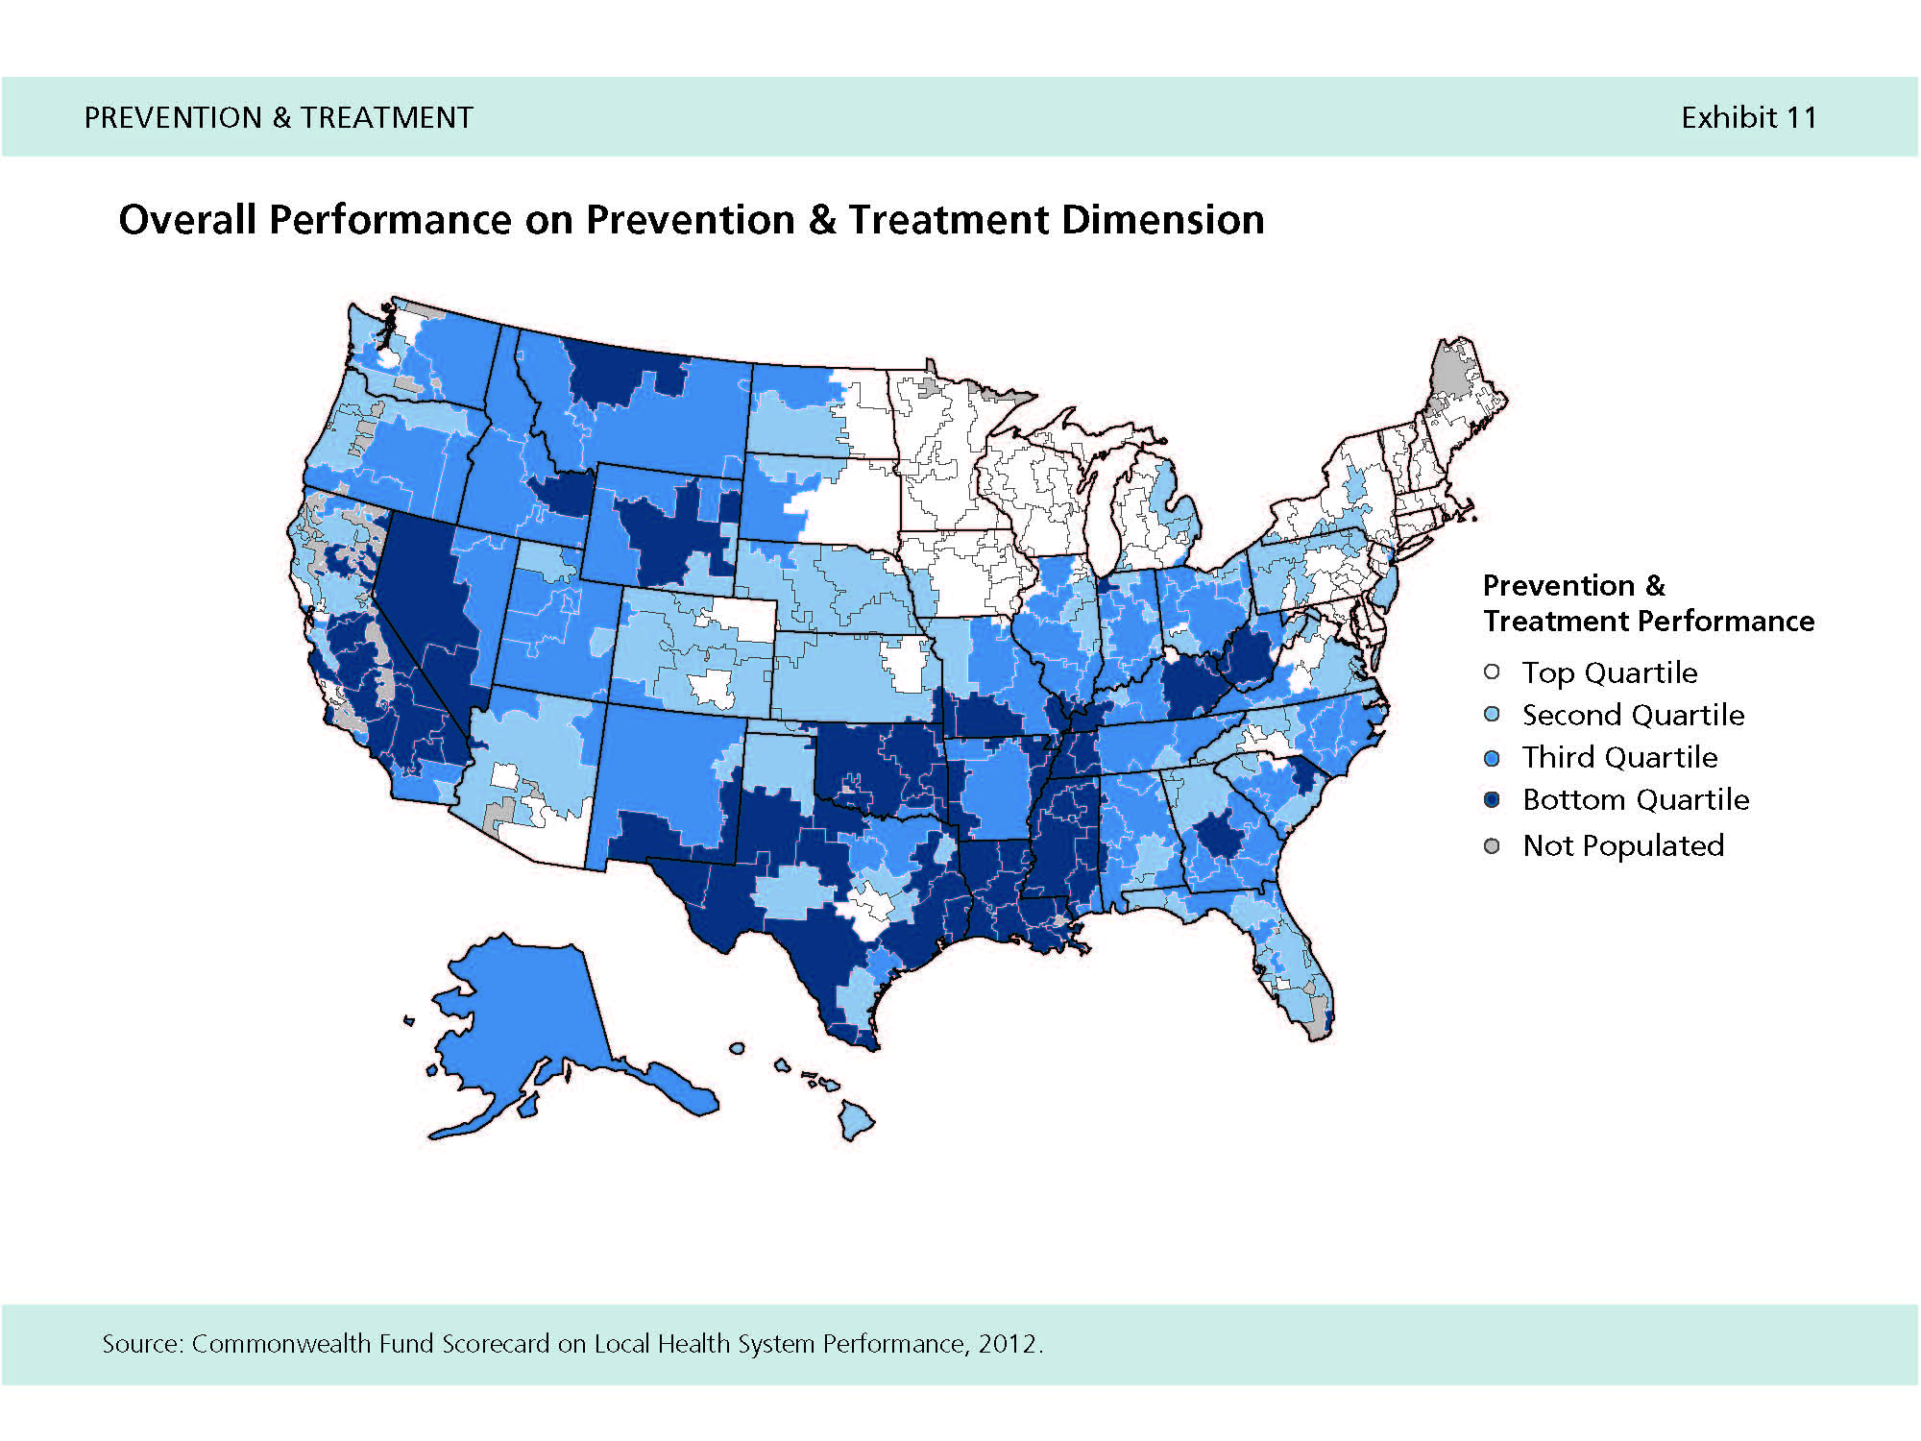

Slide 9
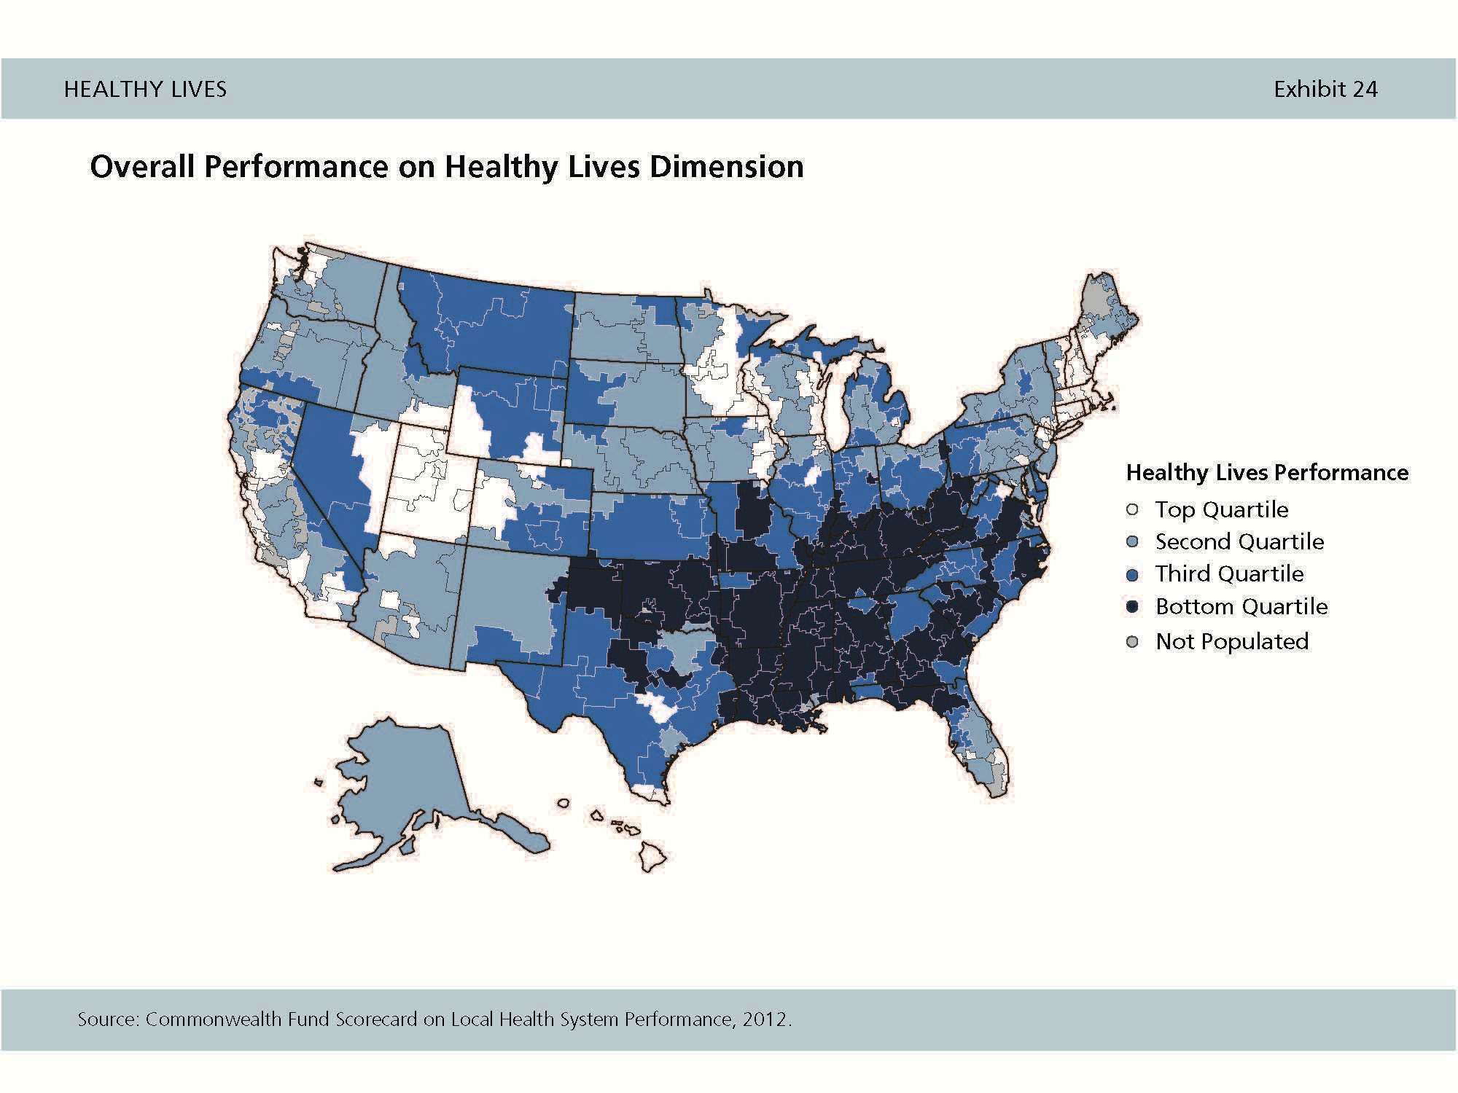

Slide 10
Policy Can Influence Health
Regulating behavior
  Tobacco control
  Vehicle speed restrictions
  Motorcycle helmets
  Seat belts
Regulating the environment
  Clean air and water standards
  Food safety standards
  Road and highway standards
  School lunch standards
Regulating industry including healthcare
  Occupational Safety standards
  Affordable Care Act (ACA)
  Measures for health system performance
Regulating health professions’ practice

Slide 11
ACA: Major Insurance Provisions
Guaranteed issue of insurance without regard to pre-existing conditions
Individual mandate
Medicaid eligibility expanded for individuals and families up to 133% of poverty
Health insurance exchanges
Minimum standards for health insurance policies (annual and lifetime caps will be banned).
Firms employing 50 or more people but not offering health insurance will help subsidize of employees health care
Businesses will receive subsidies if they purchase insurance through an exchange
Co-payments, co-insurance, and deductibles are eliminated for select benefits considered to be “essential benefit”
Additional support for medical research

Slide 12
ACA: Major Population
Health Provisions
Patient Centered Outcomes Research Institute
Preventive Services and Community Preventive Services task forces
Indian Health Care Improvement Act
Caloric content of foods
National Prevention, Health Promotion and Public Health Council
Center for Medicare and Medicaid Innovation

Slide 13
Advanced Practice and Accountable Care
Care and resource coordination
Transitional care
Symptom management
Technology assistance
Coaching and behavior modification
Analysis of and strategies for population health
Ongoing oversight of populations with chronic disease

Slide 14
Regulation and Practice Barriers
Collaborative agreement requirements
Payment restrictions by insurers including Medicare and Medicaid
Restrictions on admitting privileges
Restrictions on referrals

Slide 15
Policy Options to Support Full Scope of Practice
Establish standard and broadened scope of practice for all states
Payment reform
  Parity
  Bundling of payments
Models that encourage team-based, patient centered care and shared leadership

Slide 16
Politics Aside: Influencing Care
Knowledge
Advocacy
Leadership
Collective Voice and the Power in Numbers
Quality Initiatives
Practice Based Research

