Slide 1
Large-Scale Data Architectures project plan
Gábor András Mátay-Csepeli

Slide 2

Business Case
Betting site: offers for Formula 1 fans
Managers: increase live-time bets (during races)
Understand race data more efficiently
Analyse historical data → change odds closer to real probabilities

Slide 3



Data pipeline
FastF1:
Telemetry data of cars
Laps times
Tyre status
OpenWeather:
Live weather data
  Temperature
  Rain
  Humidity
Reddit: social media activities during the race

Slide 4
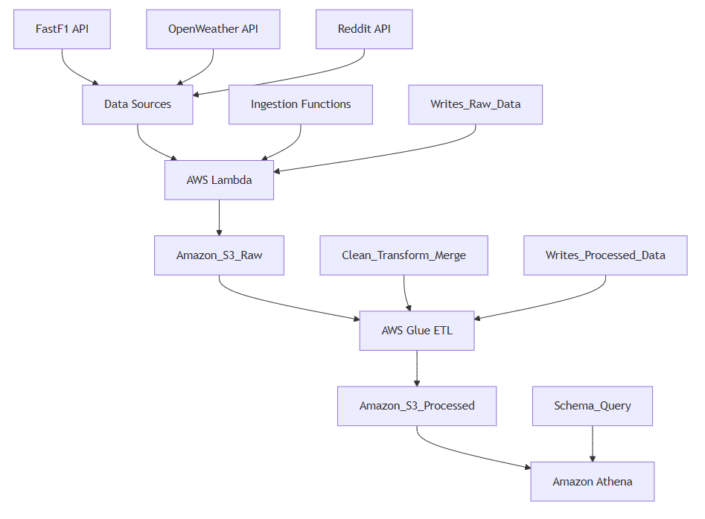
Data pipeline

Slide 5
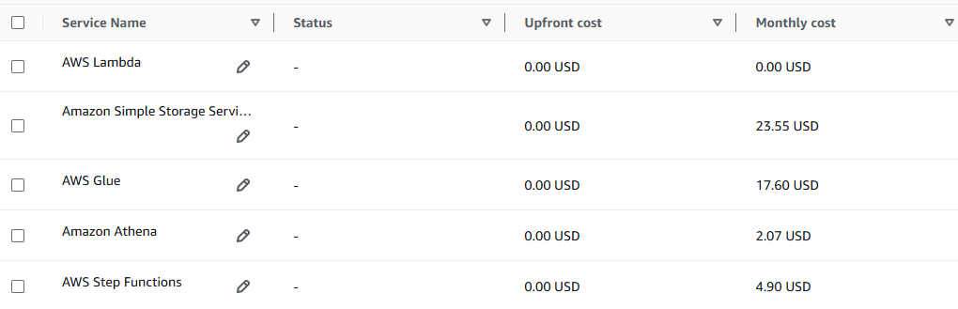
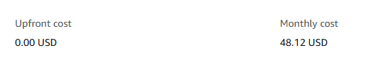
Cost estimation

