Slide 1
Digital Portfolio
STUDENT NAME: MATHISHREE G
REGISTER NO :2428c0484
NMID: 7301DE72607F72AA84A43EDA9E4336FC
DEPARTMENT: BSc. AIML
COLLEGE: KPR College Of Arts Science and Research

Slide 2
PROJECT TITLE
Physiotherapist Portfolio

Slide 3


AGENDA
Problem Statement
Project Overview
End Users
Tools and Technologies
Portfolio design and Layout
Features and Functionality
Results and Screenshots
Conclusion
Github Link
3/21/2024 Annual Review

Slide 4

PROBLEM STATEMENT
Lack of awareness about physiotherapy’s role in recovery and wellness.
Need for showcasing practical skills, projects, and achievements of physiotherapy students/professionals.
Importance of a portfolio to highlight clinical experience, research, and patient care contributions.

Slide 5

PROJECT OVERVIEW
Brief Summary: Digital portfolio showcasing academic, clinical, and professional achievements in physiotherapy.
Contents: About Me, Education, Clinical Postings, Research/Case Studies, Skills, Certificates, Contact.
Main Idea: Present a professional profile that highlights skills in patient care, rehabilitation techniques, and physiotherapy research.

Slide 6

WHO ARE THE END USERS?
Students – for academic evaluation and internships.
Job Seekers – to present qualifications and clinical skills to recruiters.
Healthcare Institutions – to assess potential physiotherapists for hiring.
Patients/Community – to build trust and credibility.

Slide 7

TOOLS AND TECHNIQUES
HTML: Page structure—sections, headings, and content layout.
CSS: Custom styling—organization, responsiveness, and visual appeal.
JavaScript: Simple interactive features—navigation enhancements or animations.
Platforms (if applicable): Hosted via GitHub Pages for easy access/sharing.

Slide 8
POTFOLIO DESIGN AND LAYOUT
Clean and intuitive navigation between sections.
Visually structured for ease of reading and engagement.
Designed to be responsive across devices—mobile and desktop compatibility.
8

Slide 9
FEATURES AND FUNCTIONALITY
Smooth navigation across portfolio sections.
Professional aesthetic aligned with healthcare credibility.
Inclusion of interactive elements—animations, links, or contact forms.
(Optional) Quick loading and easy access to key content (e.g., case studies, certifications).

Slide 10
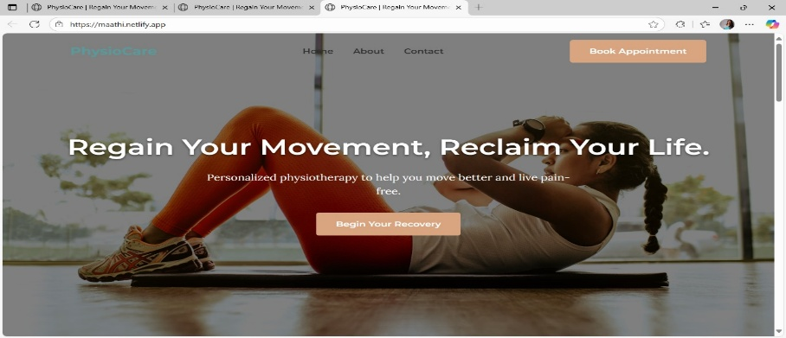
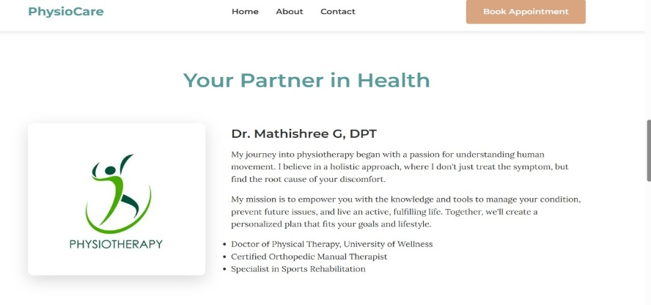

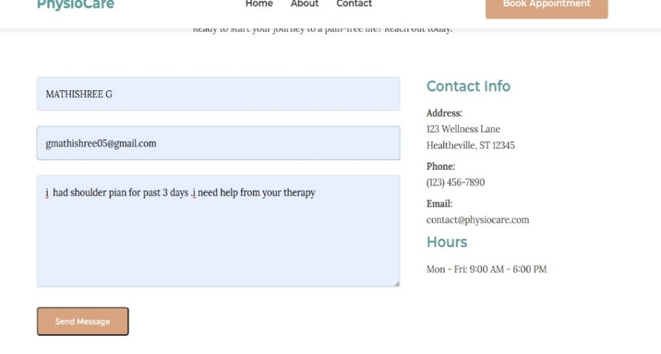
RESULTS AND SCREENSHOTS
Screenshots of portfolio pages (About Me, Case Studies, Research, Skills).
Highlighted achievements: e.g., patient recovery cases, workshops, or certifications.
3/21/2024 Annual Review
10

Slide 11
CONCLUSION
A well-designed web portfolio highlights your physiotherapy skills, experience, and digital proficiency.
Encourages better engagement—easy to share, visually appealing, and informative.
11

Slide 12
GitHub Link
https://github.com/gmathishree/Physiotherapist-portfolio

