Slide 1
Content Management Systems
Part 1

Slide 2
What is a Content Management System?
A tool to separate content from presentation
What’s the difference??
  http://www.csszengarden.com/

Slide 3

How does a CMS work ?
Basic information flow
  Template is designed
  Content is entered as plain-text or HTML into database
  Content is placed in a template for display to the end user
Page Content
Page
Template

Slide 4
Why is this a good thing?
Pages can be created or changed without knowing or using HTML
Large-scale changes can be made to the site much easier
Increased functionality, including blogs and RSS feeds/readers
Structured Content = Content re-use

Slide 5
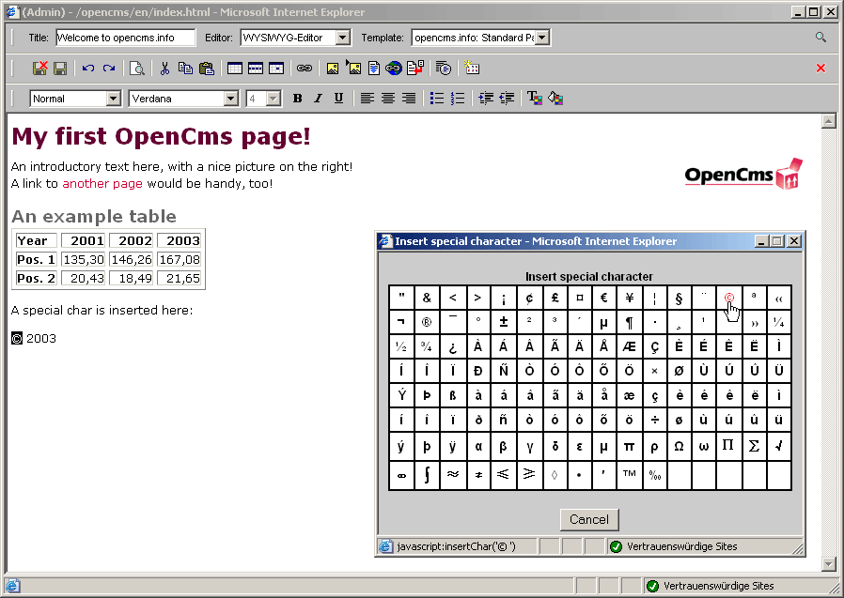
How is content created?

Slide 6
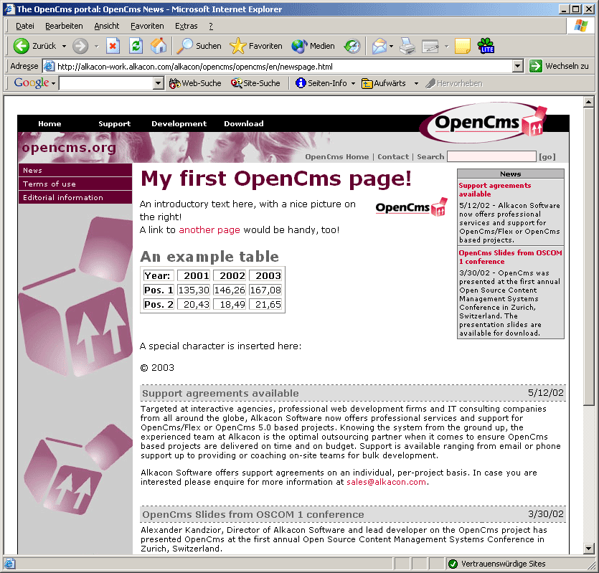
How is content created? (cont.)

Slide 7
Who needs one?
Anyone with a website that…
  Is large
  Gets updated often
  Requires multiple contributors
  Includes dynamic content or functionality

Slide 8
Who’s using CMSs?
Businesses & non-profits – almost all large sites use them.
  3M (http://www.3m.com/US/index.jhtml)
  Amazon.com
Libraries
  Calvin College (http://www.calvin.edu/library/) built their own
  Baylor University Library (http://www3.baylor.edu/Library/) shares the University’s
  Many others have converted or are looking into it

Slide 9
How much is a CMS?
$500,000 plus tech support and add-ons
OR
They’re FREE!! Open source is a viable option, but…
  By techies, for techies
  Limited support = more work for Systems
  No guarantee

Slide 10
Where are we now?
“Content Management Systems are where the Internet was 5 years ago.”-Tony Byrne, CMS Watch
We are 2+ years away from beginning to implement a CMS

Slide 11
Content Management Systems
Part 2

Slide 12
Distributed authorship
Some kinds of content updated directly by content providers
Content goes live instantly, or once an editorial check is complete
No need for a page editor
No knowledge of HTML or other technology required
Would require training in use of CMS authoring interface

Slide 13
Efficiency
Some content created directly by CPs
Page appearance controlled from a collection of central templates
Navigation aids (such as current breadcrumbs) generated automatically
All translates to: less staff time needed to maintain site.

Slide 14
Global updating
Add links sitewide
Change text sitewide
Add or change navigation features sitewide
All from a central interface or template.

Slide 15
Timing
Content can be set to a timer
Displays only during a specified period
Erased/hidden after that period
Hours, classes, front page news

Slide 16
Integration of blogs/RSS
Many systems supply own blogging software
Many can interoperate with popular blogging software such as moveable type
Many include software for parsing RSS feeds, or syndicating our own content

Slide 17
Challenges of implementing a CMS
Distributed versus centralized authorship
Often, programming knowledge/technical expertice required
Training on the system
Migration is a huge project-as big as a catalog migration

Slide 18
To move to a CMS…
Inventory all content present on current site
Port it all to some non-HTML format (word, text)
Input into CMS
Set up linking and site structure
Set up user accounts
Training!

Slide 19
What would change?
Web development team would shrink, possibly vanish
Some parts of site updated directly by CPs.
Look and feel would have to be more consistent
More staff time focused on special projects rather than day-to-day updating

Slide 20
So what now?
WDS is watching CMS markets/products
Assembling lists of technical requirements
Looking for good open source system to experiment with in test environment
Probably years before actual selection or migration

Slide 21
Additional Resources
Content Management System article at Wikipedia- http://en.wikipedia.org/wiki/Content_management_system
University of Sidney- http://www.mpg.usyd.edu.au/osd/Projects/cms/index.shtml
Baylor University Libraries- http://www3.baylor.edu/Library/
“CMSs: Who Needs Them”- http://www.ariadne.ac.uk/issue30/techwatch/
“CMS in Higher Education”(pdf)- http://www.educause.edu/ir/library/pdf/eqm0325.pdf
CMS Watch.com- http://www.cmswatch.com/

