Slide 1
Content Management Systems and ContentDM
Or: How to Bake a Cake

Slide 2
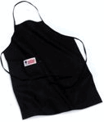

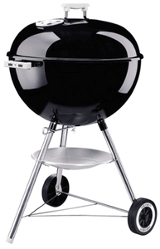
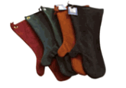
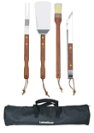

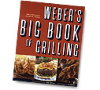

Early days of the web

Slide 3
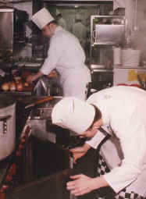
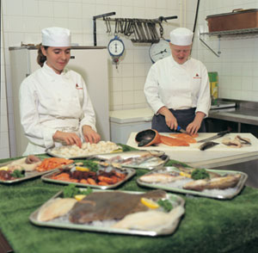
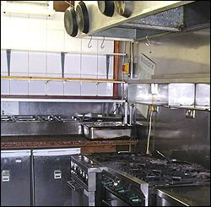
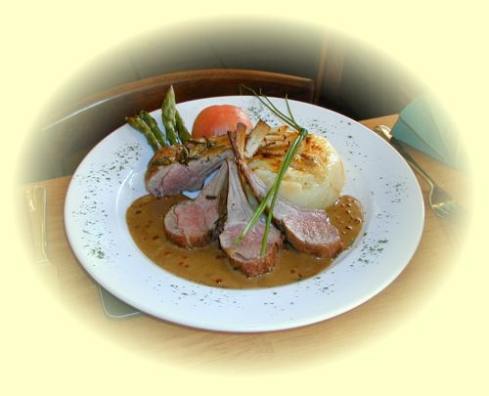
The web today

Slide 4
What will we discuss?
Brief discussion of a CMS
Analogy: Baking a cake
ContentDM in relation to a CMS

Slide 5
What is a CMS?
Content Management System
A system for updating, maintaining, and searching web content, usually discrete pieces of text, but can also include images and other kinds of files.

Slide 6
How it works
Text and other files reside in a database
Each piece or pieces of content associated with a template
Template specifies layout and positioning (similar to form letter)
CMS combines content with template, presents to user as a web page

Slide 7
How it works
Template (layout, colors, navigation)
Content (usually text)
CMS System
Complete web page

Slide 8
Advantages
Direct editing of content
Global updating
Timed content
Versioning and rollback
Searching (some)
Content Re-use
All adds up to greater efficiency, less work, less duplication of effort, more speed and ease in making changes.

Slide 9
Disadvantages
Can be expensive to purchase/implement
Great deal of work/planning
Requires overhaul of existing web operation

Slide 10
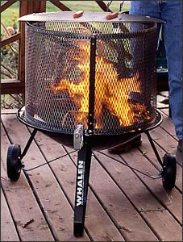
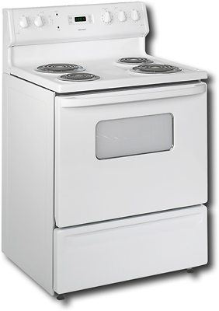
ContentDM and CMS:
Let’s bake a cake.
The stove versus the outdoor grill

Slide 11
The stove
Essential to basic cooking
Performs a variety of tasks
Can make most simple dishes

Slide 12
The Grill
Performs one task: outdoor grilling
Does this much better than the stove
Is only good for this task

Slide 13
Likenesses/Differences
Both cook food
Cook different types of food
Cook foods differently

Slide 14
CMS = Stove
Intended to manage a large, general purpose website, mostly made of text with some images.

Slide 15
ContentDM = Outdoor Grill
ContentDM is designed for a very specific task, which it does extremely well. It is not, however, any good for anything other than that task.

Slide 16
ContentDM
ContentDM is a system for managing “digital objects” such as scanned images, PDF files, word documents, etc, as well as their associated metadata, which allows user to search for a particular object or type of object.
(We have another system for managing metadata in the Libraries already…anyone? Anyone?)

Slide 17
How it works (OPAC)
Metadata
About
object
Web
Searching
Interface
OPAC
MARC
Records

Slide 18
How it works (ContentDM)
Could be:
PDF file
Image file
Word document
Sound file
Digital object
Metadata
About
object
Web
Searching
Interface
ContentDM
Dublin Core
Could be:
File size
Subject
Title
Author/creator

Slide 19
How it works (CMS)
Template (layout, colors, navigation)
Content (usually text)
CMS System
Complete web page
User

Slide 20
Both contentDM and CMS manage content
Radically different kinds of content
Radically different ways

Slide 21
What does ContentDM look like?
http://banyan.library.unlv.edu

Slide 22
Fin
Questions?

