Slide 1

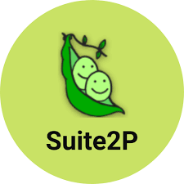

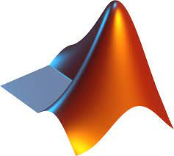
Semi-Automatic Workflow
To ensure each cell has comparable response
Data for future offline analysis
Data for future offline analysis
2p Imaging ~20 min
Quick analysis
2p Imaging + Single cell stimulation ~20 min
Quick analysis
Identify the SLM parameters for each single cell
2P imaging + Holographic photo-stimulation
Data for future offline analysis
Bruker_PrairieLink
Bruker_PVLinkExcuteFolder
Bruker_PVLinkExcuteFolder
Identify ROI of each cell, and their behavioral dependency

Slide 2
Semi-Automatic Workflow
To ensure each cell has comparable response
Data for future offline analysis
Data for future offline analysis
2p Imaging ~20 min
Quick analysis
2p Imaging + Single cell stimulation ~20 min
Quick analysis
Identify the SLM parameters for each single cell
2P imaging + Holographic photo-stimulation
Data for future offline analysis
Bruker_PrairieLink
Bruker_PVLinkExcuteFolder
Bruker_PVLinkExcuteFolder
Identify ROI of each cell, and their behavioral dependency
Imaging for 15 min -spontaneous movement + sensory stim (60 stim, 1 file)
Imaging: 3-4 planes (>50 um apart) spanning from130 up to 300um (7-10Hz)/ 512x512 pixel/ ~600x600um/ under these imaging conditions, almost no imaging (<50mW) artifact for ChroME2f
During the recording, 0-Power SLM stimuli is applied randomly to make sure animal get used to the sound of shutter on-off switch. And provide supplementary data to prove cells do not just respond to the sound.

Slide 3
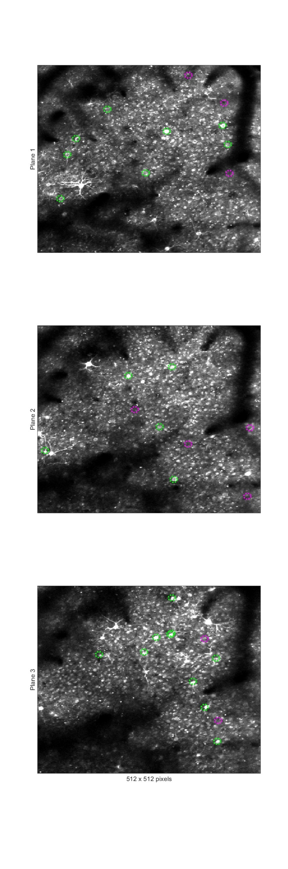
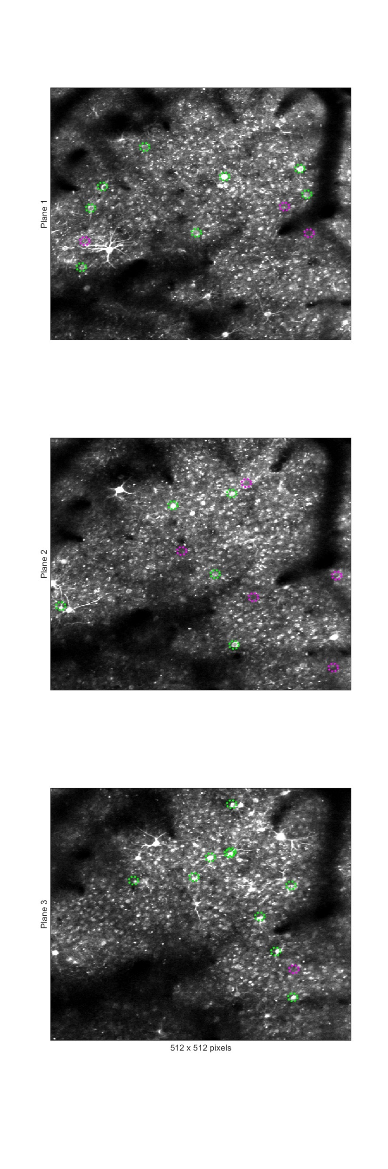
Semi-Automatic Workflow
To ensure each cell has comparable response
Data for future offline analysis
Data for future offline analysis
2p Imaging ~20 min
Quick analysis
2p Imaging + Single cell stimulation ~20 min
Quick analysis
Identify the SLM parameters for each single cell
2P imaging + Holographic photo-stimulation
Data for future offline analysis
Bruker_PrairieLink
Bruker_PVLinkExcuteFolder
Bruker_PVLinkExcuteFolder
Round 1 Round 2
Identify ROI of each cell, and their behavioral dependency
Plane 1
Plane 2
Plane 3
Automatic-generate 30 Non-cell targets mostly locate at blood vessel regions (Noted that in right figure, blood vessel region is avoided, need to being updated.), loaded them in PV, and manually delete some of non-cell targets. Use the rest of non-cells and randomly generate 5 groups (9 non-cell targets) as Round 1, Round 2, … Round 5 trials for future 1 cell + 9 non-cell targeting.

