Slide 1
SLM-Project Progress
Lu Zhang
8/12/2024
Lab meeting

Slide 2
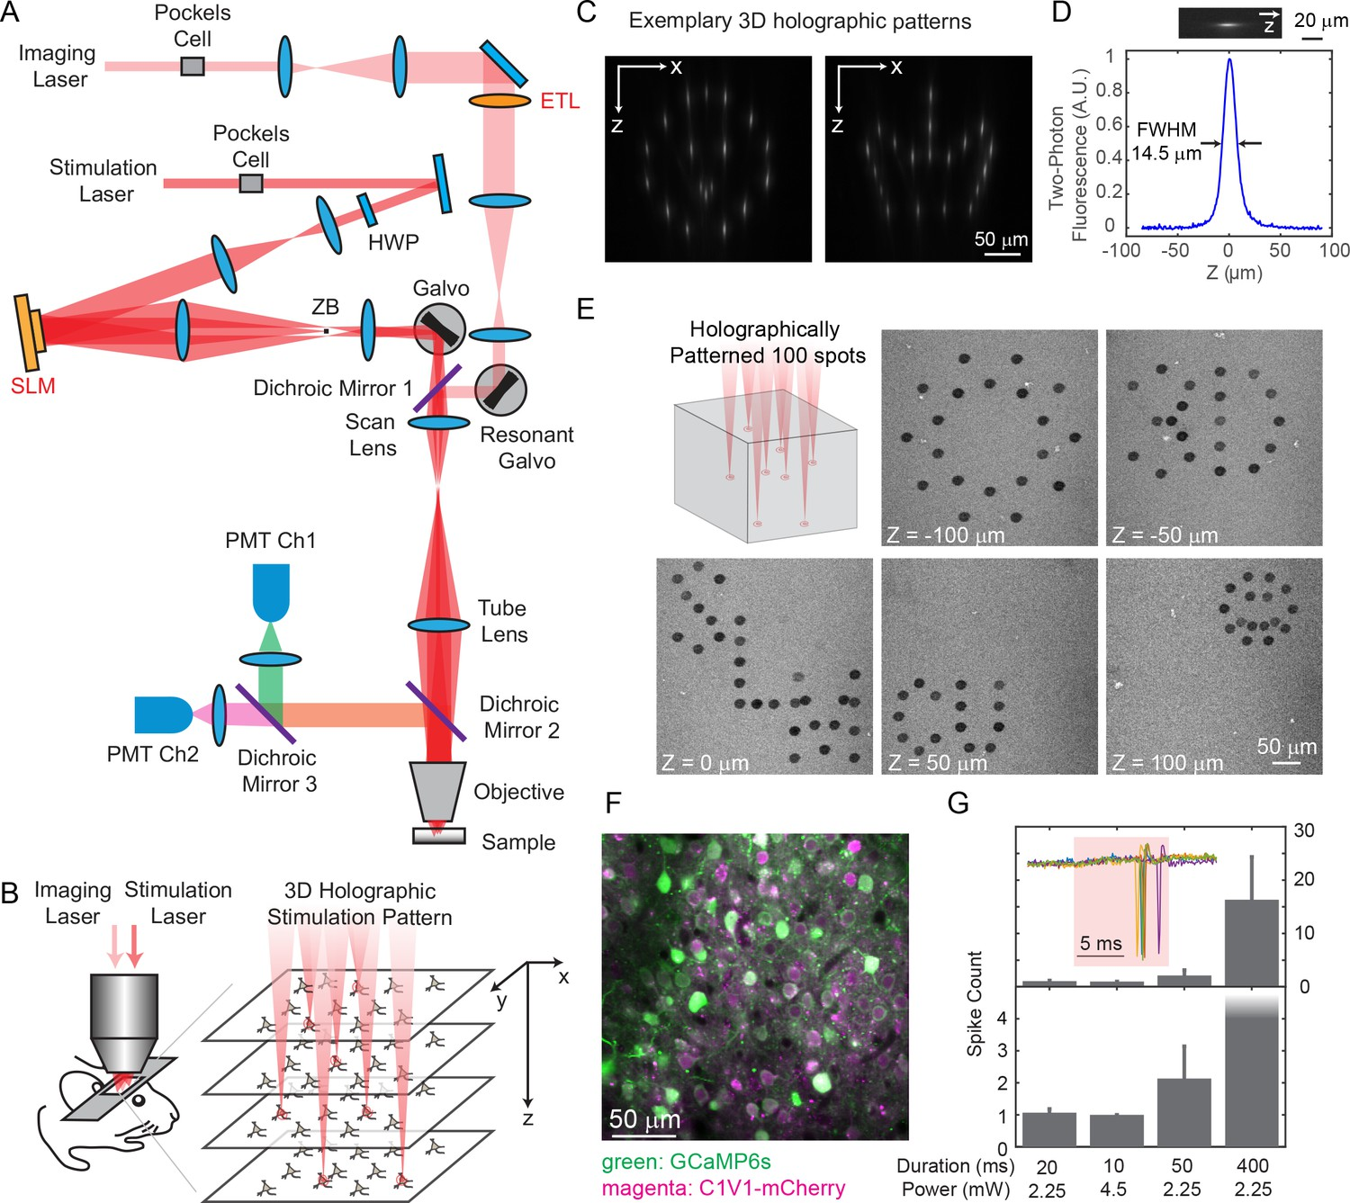
Holographic Imaging and Photo-Stimulation
Spatial Light Modulation (SLM)
Source: https://doi.org/10.7554/eLife.32671

Slide 3

Two Parts of SLM
Using Bruker 2PPlus, establish a workflow to image and stimulate functionally distinct neuronal assemblies
(functional, or network properties)
Engineering
Spatial Light Modulation (SLM)
Find the most suitable optogenetic strategy (cell type interested, transgenic mice, viral strategy, et al)
Biology

Slide 4




Update in Engineering
10-15 mins, Suite2p processing + simple manual correction
To ensure each cell (~10 cells/group) has comparable response
Data for analysis
Data for analysis
2p Imaging ~20 min
Quick analysis
2p Imaging + Single cell stimulation ~20 min
Quick analysis
Identify the SLM parameters for each single cell
2P imaging + Holographic photo-stimulation
Data for future offline analysis
Bruker_PrairieLink
Bruker_PVLinkExcuteFolder
Bruker_PVLinkExcuteFolder
Identify ROI of each cell, and their behavioral dependency
Make future single target as 1 target + 9 non-targets
Non-targets: Randomly chosen from regions with blood vessels across 3 recording planes, 30 µm away from all detected cells, 50 µm away between each non-targets.

Slide 5
Two Parts of SLM
Using 2PPlus from Bruker, establish a workflow to stimulate cells assemblies with specific characteristics (functional, or network properties)
Engineering
Spatial Light Modulation (SLM)
Find the most suitable opto-genetics strategy (cell type interested, animal model, virus, et al)
Biology

Slide 6
Main Aims in Biology Part of SLM
Cell Targets: Excitatory Cells in Primary Somatosensory Cortex (L2/3)
SLM
High signal quality (Calcium signals)
Large population of cells (Calcium signals)
Aims :
Considerable population of SLM target cells (Optogenetics)
Low and controllable ‘cross-talk’ issue.
Affordability (Animal, surgery, delay-time)

Slide 7
Evaluation of Three Animal Strategies
 | vGluT1-Ai203 | GCamp6s-CamkII | Emx1.Cre-Ai96
?
Signal quality
Imaging population
Aims :
?
SLM populations
?
‘Cross-talk’
?
Affordability

Slide 8
SLM: vGluT1-Ai203

Slide 9
SLM: vGluT1-Ai203

Slide 10
SLM: vGluT1-Ai203

Slide 11
SLM: GCamp6s-CamkII

Slide 12
SLM: GCamp6s-CamkII

Slide 13
SLM: GCamp6s-CamkII

Slide 14
SLM: Emx1.Cre-Ai96

Slide 15
SLM: Emx1.Cre-Ai96

Slide 16
SLM: Emx1.Cre-Ai96

Slide 17
Thoughts?
 | vGluT1-Ai203 | GCamp6s-CamkII | Emx1.Cre-Ai96
?
Signal quality
Imaging population
Aims :
?
×
SLM populations
?
‘Cross-talk’
Affordability
√
×
Using Ai203 at this moment, while testing more Emx1Cre-Ai96 mice
Push forward with vGluT1-Ai203 , while testing more Emx1Cre-Ai96 mice

