Slide 1
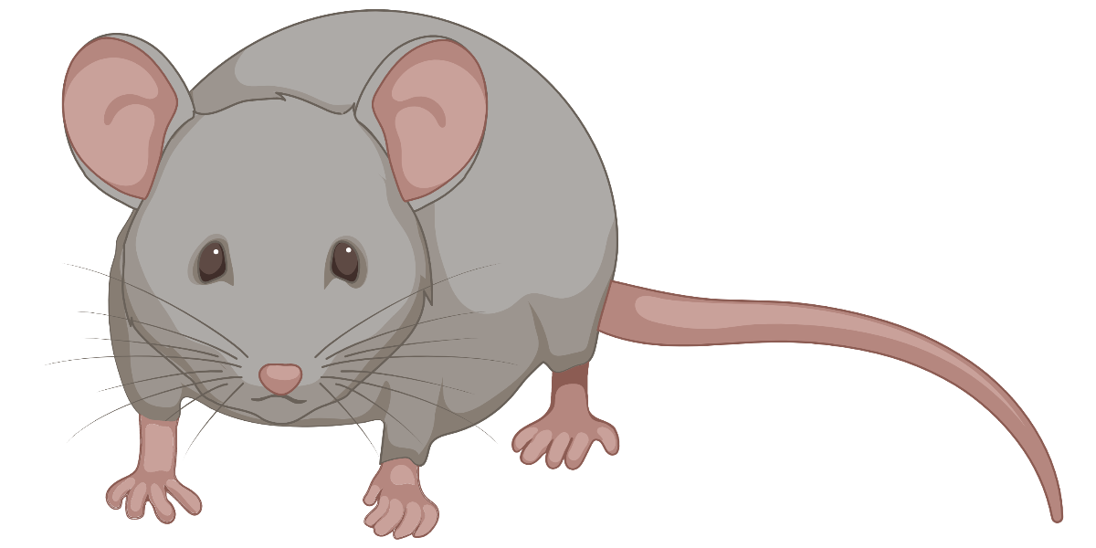
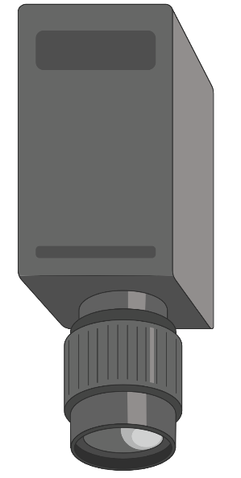
2-PT Ca²⁺
imaging
IR imaging
Whisker motion (WM)
Motion encoder
Locomotion (L) speed
Whisker
stimulation

