Slide 1
Pairs Trading with a Kalman Filter
by Glen Cahilly

Slide 2
Criteria for Identifying Pairs
Same Industry
Similar market drivers and risks
Makes spurious correlations much less likely
Lower Volume Stocks
E.g., not Coke & Pepsi
Idea: less efficient market --< more potential for mispricing
Cointegration
Better than correlation tests at identifying pairs of series linked by long-term equilibrium relationships (Granger 1987)

Slide 3
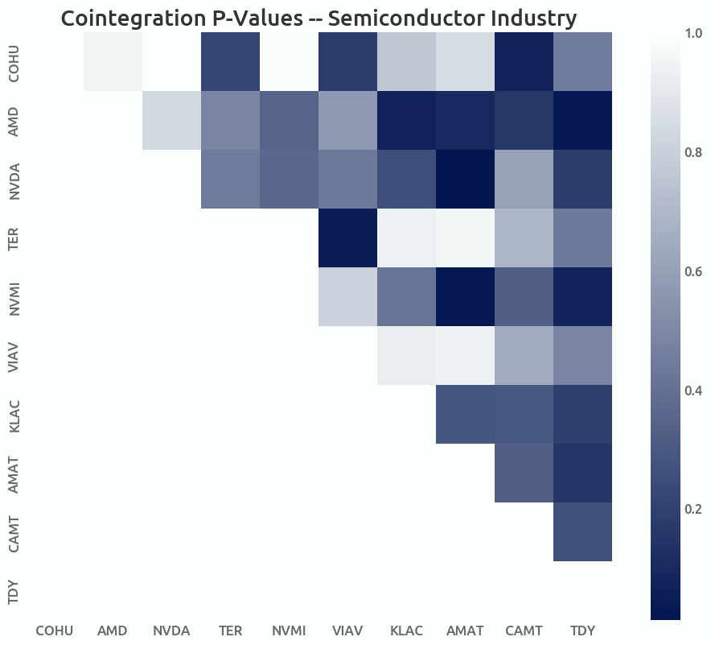
Identifying Pairs
Created cointegration matrices for 3 industries
Took most cointegrated pairs from each industry
<0.05 pvalue
75% training data, 25% saved for testing

Slide 4
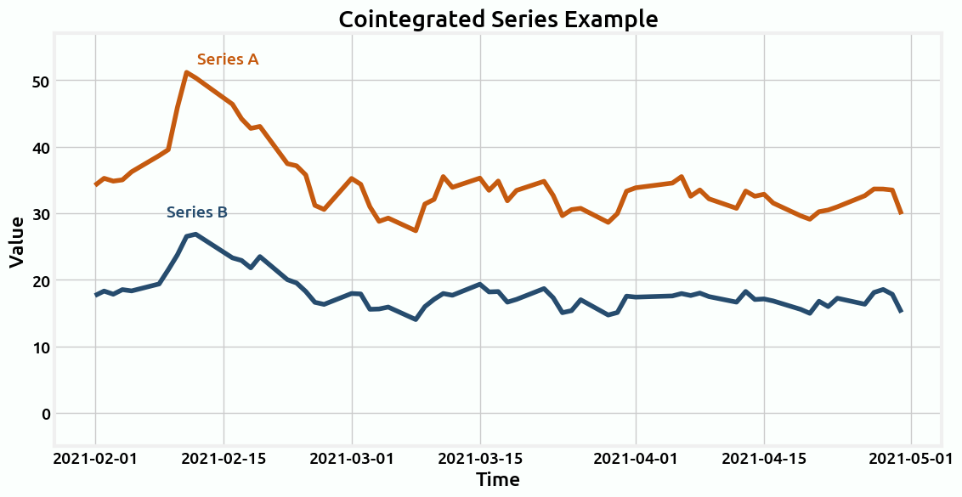
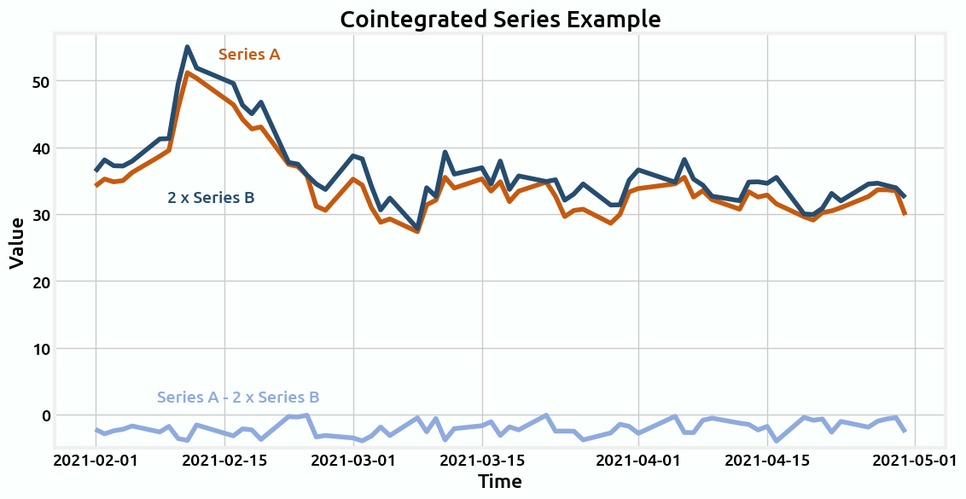
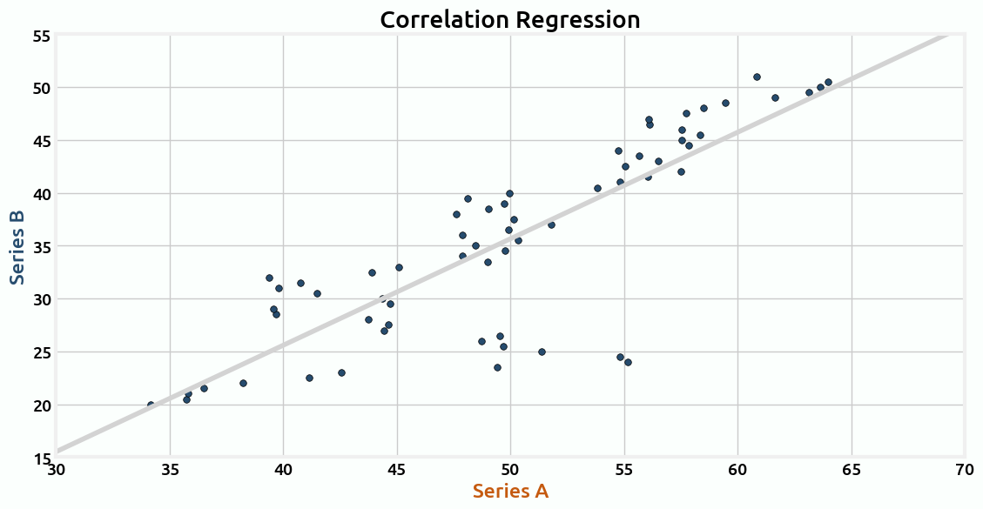
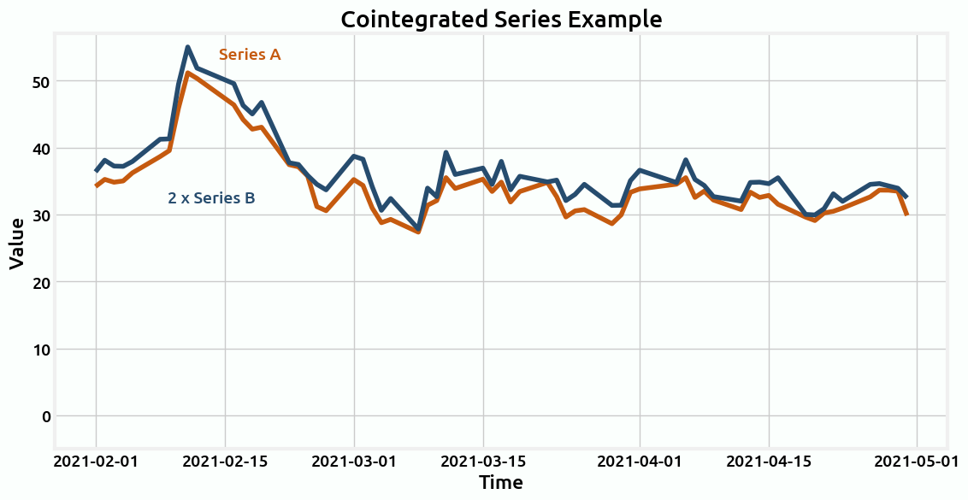
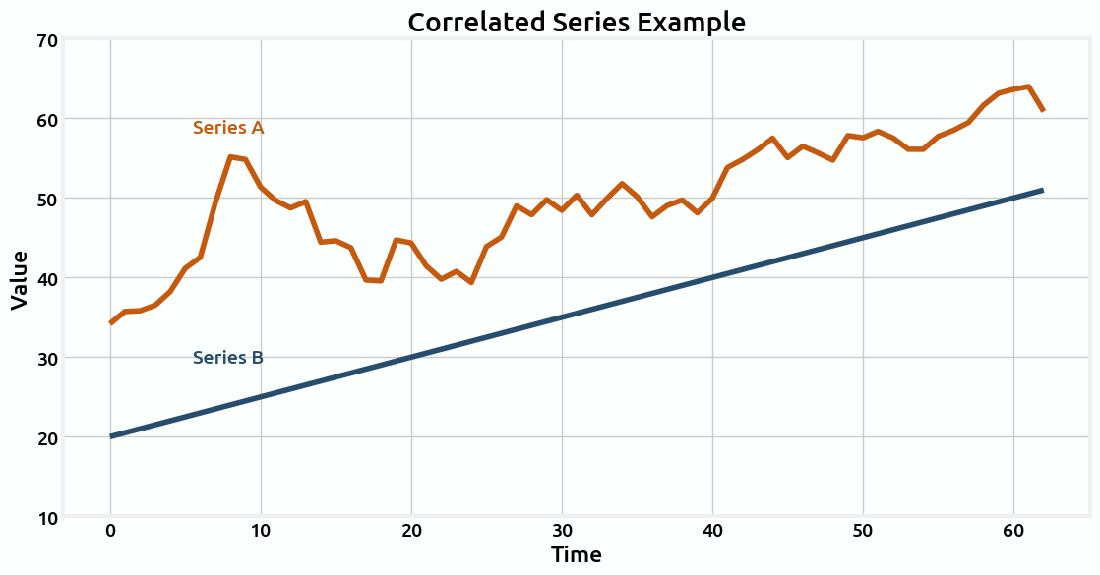
Correlation vs. Cointegration
Correlation
Cointegration
Often leads to spurious correlations
Checks for stationarity – “is there a linear combination of the series that results in a roughly constant value?”
Think about a person walking their dog; they don't move in a predictable manner, but their distance returns to same

Slide 5
Risks of Many Traditional Pairs Trading Strategies
Have to choose arbitrary lookback window to calculate hedge ratio
Ignores changing market conditions
May not effectively distinguish between genuine market signals and noise, leading to poor trading decisions
Our solution: Kalman Filter!

Slide 6
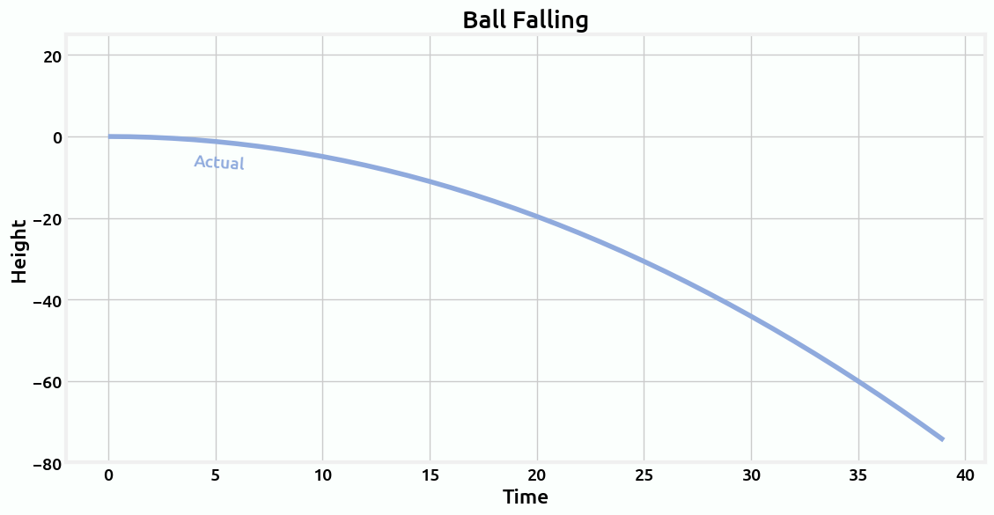
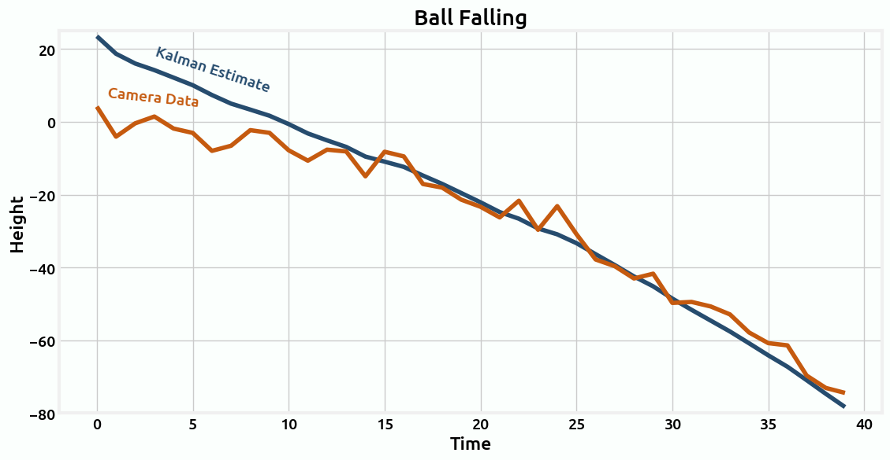
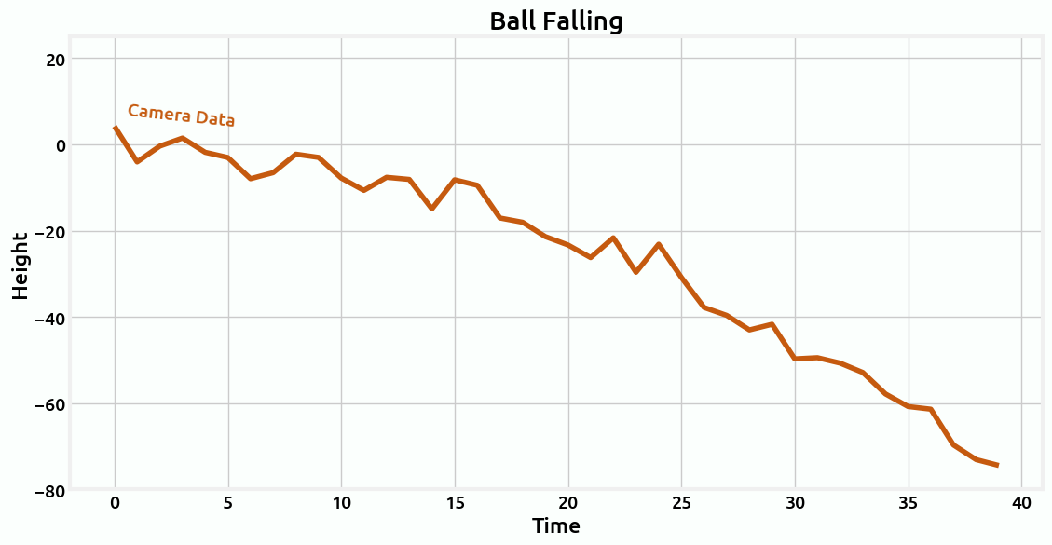
What is a Kalman Filter?
Mathematical tool used to estimate values given noisy data
Assumes some knowledge of underlying process
Dynamically updates predictions with new data

Slide 7
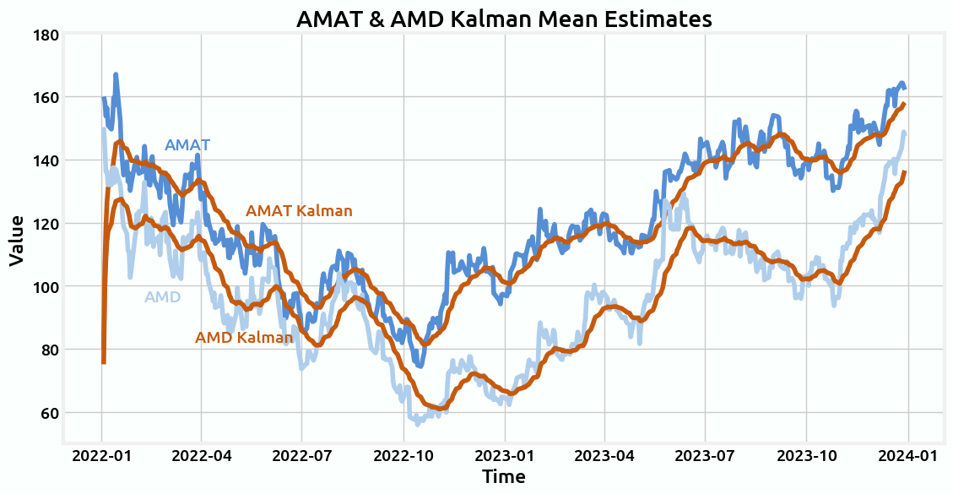
Kalman Filter for Price Estimation
Same idea as ball example
Filters out noise
Assumes stock prices are random walks

Slide 8
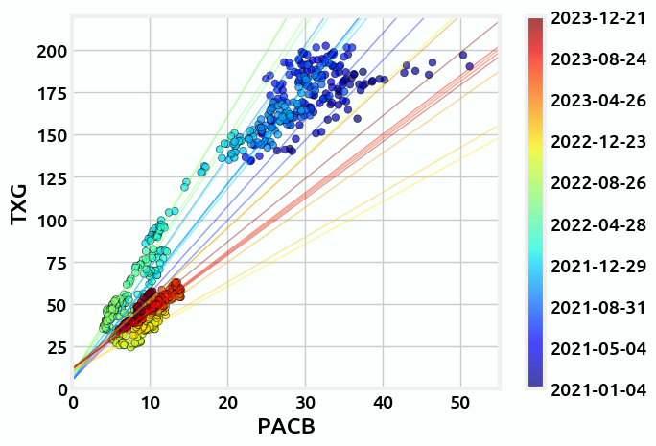
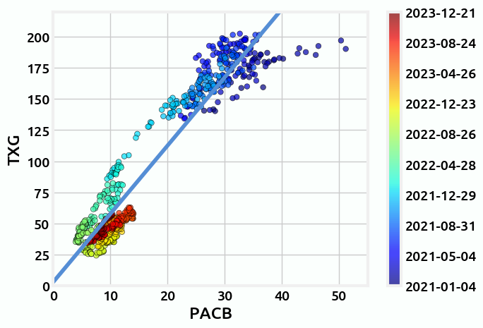
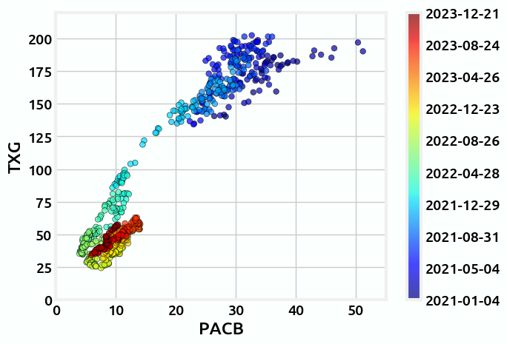
Kalman Filter for Hedge Ratio Estimation
Runs regression of prior price estimates
Dynamically adjusts hedge ratio given new data

Slide 9
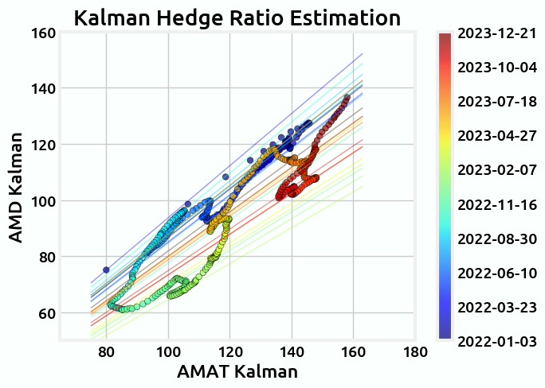
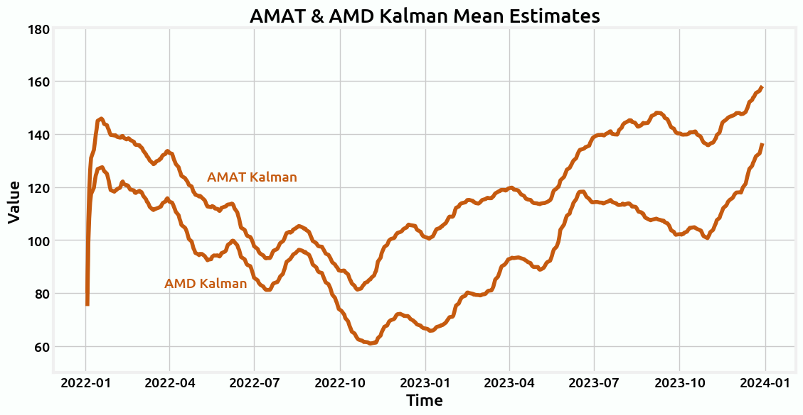
Putting it together
Use Kalman mean estimates to estimate hedge ratio (using second Kalman filter)

Slide 10
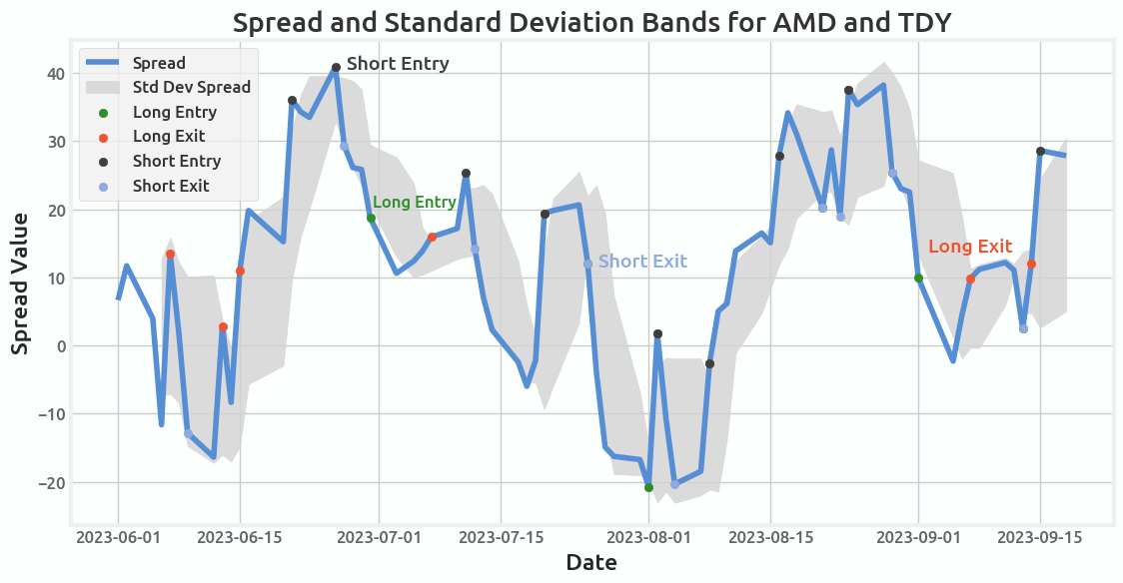
Trading Logic
Using hedge ratio, calculate spread
How many units of A are equivalent to 1 unit of B
When spread >__ std away from norm, long or short spread accordingly
Always 2 simultaneous trades
When <___ std from mean, exit positions
Grid search used to optimize z-scores for Sharpe ratio, on training data

Slide 11
Portfolio allocation
13 pairs, same amount of $ allocated to each pair strategy

Slide 12
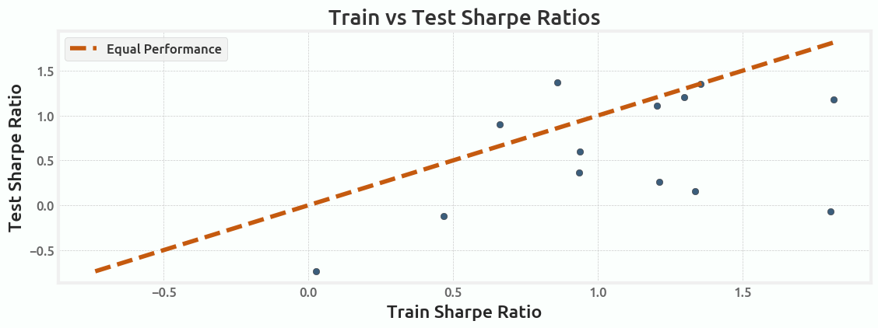
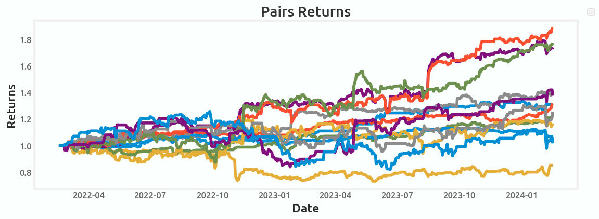
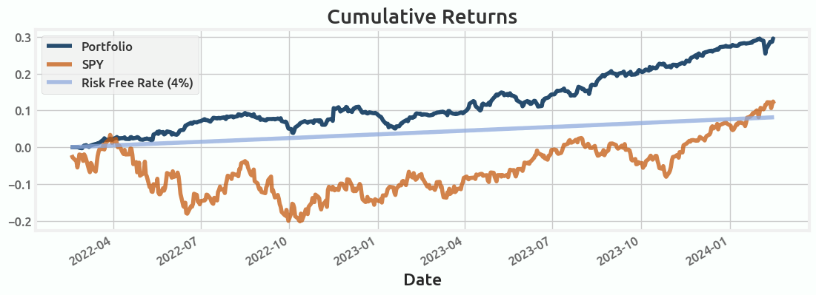
Results
Train vs. Test
Results of Pairs
Results vs. Benchmarks
Statistics
Sharpe ratio: 2.08
CAGR: 14.44%
Max drawdown: -5.42%
Trade frequency: ~1 trade per 5 days per pair

Slide 13
Risks and Rewards of Strategy
Risk: Spread Divergence
Cointegration tests might hold for past data but break in future
Would lead to sustained losses as we would enter new trades but never exit
Risk: Overfit Parameters
Z-score grid search might overfit to in-sample data and perform poorly on out-of-sample data
Reward: Management of Risk
By continuously adjusting using Kalman filter, the strategy offers (in theory) better risk management
Helps minimize losses during periods of market volatility
Reward: Asset Diversification
Diversification across industries helps lower variance
Protects against larger swings

Slide 14
Future Improvements
Portfolio Allocation
Optimize allocation of portfolio to maximize Sharpe ratio
Online Estimation of Z-Scores
Use model to dynamically estimate optimal z-scores given market conditions
Other Data
Incorporating volume, order book depth, or similar data could improve performance

Slide 15
Pairs Traded
13 total pairs:
Semiconductor:
AMD & TER, NVMI & KLAC, VIAV & TDY
Electronics/energy:
ARW & EMR, JBL & PLXS, TEL & COHR, TEL & EMR, PLXS & COHR
Healthcare:
BAX & BKD, BKD & ADUS, SNDA & CHE, ADUS & SNDA, BAX & SNDA

Slide 16
External References
https://goldinlocks.github.io/PAIRS-TRADING-WITH-A-KALMAN-FILTER/
https://www.bzarg.com/p/how-a-kalman-filter-works-in-pictures/
Link to our code:
https://colab.research.google.com/drive/1p6yqRybTecWzfd9ytN4tMqe3NksE_p3p?usp=sharing

